Slide 1

Azure Cosmos DB
45389618

Slide 2
Basic Characteristics
Microsoft: „A globally distributed, massively scalable, multi-model database service“
Multi-model: NoSQL (SQL) API, MongoDB API, PostgreSQL API, Cassandra API, Gremlin (Graph) API, Azure Table API
How? JSON! And RESTful API
Different data models (layers) are just specific JSON Schema within JSON SQL
Globally distributed: Multi-Region -> many datacenters, Ultra-fast data replication, Regional failover
Massively scalable: Partitioning using chosen Partition Key
All Items in a partition are co-located for speed
CosmosDB automatically scales out partitions

Slide 3
Installation & Setup
Requirements:
Microsoft (Azure) personal account
Free Trial: https://cosmos.azure.com/try/
Choose „Azure Cosmos DB for Apache Gremlin“ Graph API
Check out tutorial: https://learn.microsoft.com/en-us/azure/cosmos-db/gremlin/quickstart-console
Database ID: ndbi040-project
Graph ID: Webcrawler
Partition Key: /recordId
Optional: Download G.V() – Gremlin IDE & Visualisation tool for Cosmos DB

Slide 4
Data Models – API Layers
NoSQL API - Database of Collections of Documents
Native SQL queries over JSON documents
New features priority
Recommended way to use Cosmos DB for new projects
MongoDB API
BSON Document format
Simple migration to Cosmos DB by just changing a connection string
PostgreSQL API
Single-Node or Multi-Node using Citus open source
Apache Cassandra API – Column-oriented schema
Apache Gremlin API – Graph API (showcased in this presentation)
Table (Key-Value) API - Database of Tables, with Rows
https://learn.microsoft.com/en-US/azure/cosmos-db/choose-api

Slide 5
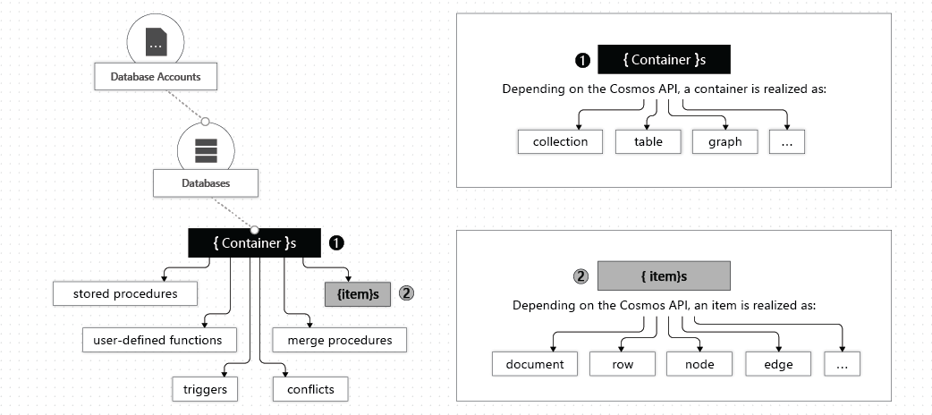
Cosmos DB Entities
https://learn.microsoft.com/en-us/azure/cosmos-db/resource-model

Slide 6
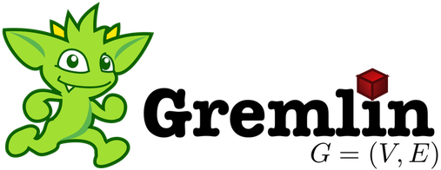
Apache Gremlin
Apache TinkerPop Standard
Vertices „G.V()“ & Edges „G.E()“
g.V('id').out('rel').has('attr')

Slide 7
Labeled Property Graphs
Vertices (Nodes) & Edges (Relationships)
Nodes & Relationships can contain Properties = Mutable Key/Value pairs
Property | Data Type | Details
ID | String | Unique identifier. Auto-generated if not provided
Label | String | Entity type identifier. Query filtering clause.
Partition Key | Integer, String | Horizontal data distribution key. Query filtering clause.
vertex
id: Luis
label: Person
properties:
age: 27
edge
id: edgeId
label: WORKS_AT
properties:
distance: 10miles
Luis

Slide 8
Cosmos DB Gremlin API
Only fully-managed horizontally-scalable PaaS graph database service.
Graph engine based on Apache Tinkerpop standard
Adapted to a horizontally-scalable distributed storage system
Extended with Cosmos DB specific features: resource throttling, retry logic, and distributed runtime diagnostics.
Wire-protocol compatibility with OSS connectors and libraries.
Flat data, modelled within SQL API
Can use SQL API to add additional data to graph collection (e.g. _graph_icon_)
Not all Apache Tinkerpop Gremlin functionalities are supported: https://docs.microsoft.com/en-us/azure/cosmos-db/gremlin-support

Slide 9
Apache TinkerPop Compatibility
Platform | Source | Getting Started | Version
.NET | Gremlin.NET on GitHub | Create Graph using .NET | 3.4.0-RC2
Java | Gremlin JavaDoc | Create Graph using Java | 3.2.0+
Node.js | Gremlin-JavaScript on GitHub | Create Graph using Node.js | 3.3.4+
Python | Gremlin-Python on GitHub | Create Graph using Python | 3.2.7
PHP | Gremlin-PHP on GitHub | Create Graph using PHP | 3.1.0
Gremlin console | TinkerPop docs | Create Graph using Gremlin Console | 3.2.0 +

Slide 10
Cosmos DB supported Gremlin steps
CRUD
Aggregation
Computation
Projection
Cosmos DB specific steps
Partitioning Strategy
Execution Profile

Slide 11
DML Operations
Create vertices and add properties
Create edges with to() or from()
Add/modify properties for vertices or edges
g.addV(<label>).property([...])
g.V(<id>).addE(<label>).to(g.V(<id>))
g.V(<id>).property(<key>, <value>)

Slide 12
Point-Lookups
Vertex point-lookup by ID
Edges point-lookup by ID
Vertex point-lookup by ID and partition key
g.V(<id>)
g.E(<id>)
g.V([<pk>,<id>])

Slide 13
Filtering
Property filtering using .has()
Traversal condition filtering using .where()
Comparison parameters
g.V().has('name', 'Luis')
g.V(<id>).outE(<id>).
where(inV().has('distance', '3'))
g.V().has('distance', gt(300))

Slide 14
Filtering
Result set filtering using .range() or .limit()
g.V().limit(100)
g.V().range(1, 100)

Slide 15
Traversal
Adjacency exploration .out()
The .repeat() function with .until() predicate.
The .repeat() function with .times() predicate.
g.V(<id>).out().has('name', 'Luis')
g.V(<id>).repeat(out()).
until(has('name', 'Luis'))
g.V(<id>).repeat(out()).times(8))

Slide 16
Aggregation
Terminal step used for aggregation: .sum(), .avg(), .mean(), .count(), .min(), .max(), ...
g.V(<id>).sum() | .avg() | group().by() ...

Slide 17
Demo: Webcrawler
Webcrawler Data Domain using Cosmos DB for Apache Gremlin API
Demo Repository: https://github.com/corovcam/NDBI040-CosmosDB-Presentation

Slide 18
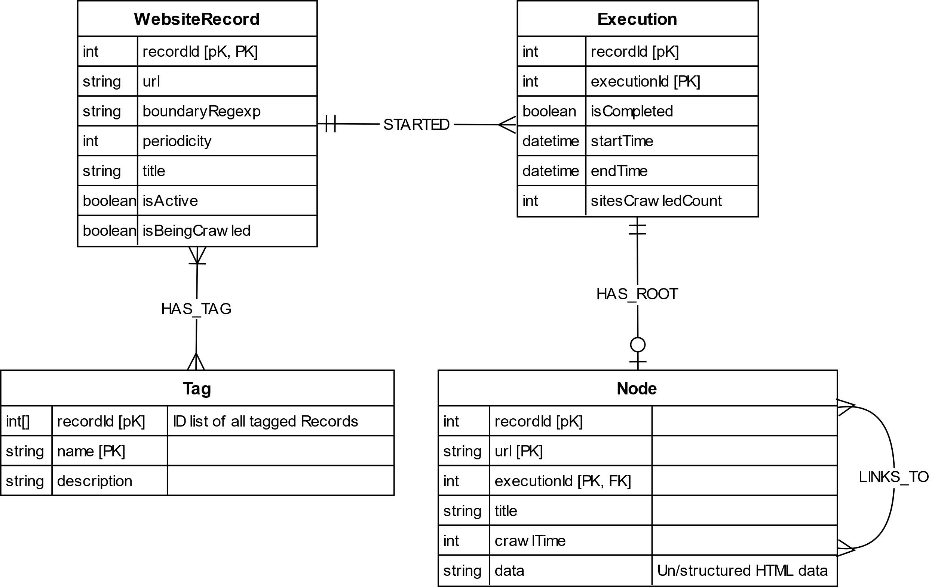
ER Schema
pK = partitionKey
Also a FK
PK = Primary Key
Unique
Composite (Node)
FK = Foreign Key

Slide 19
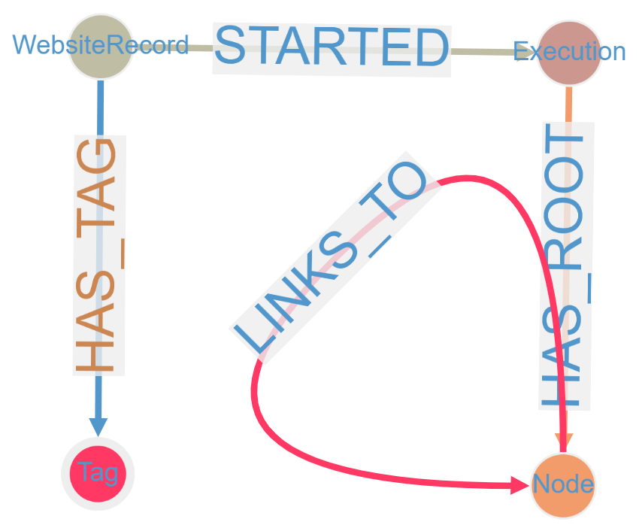
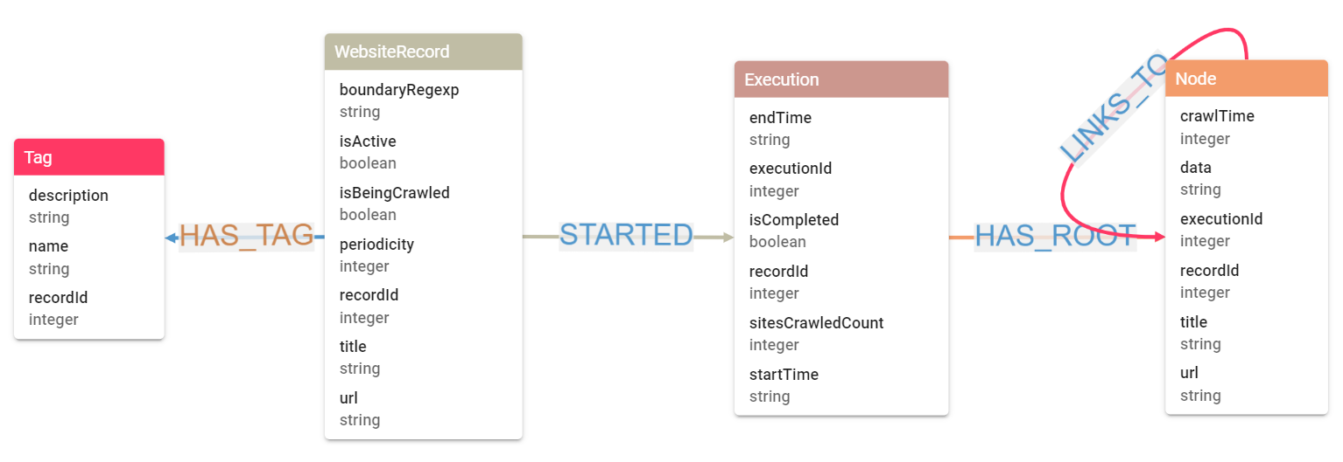
Logical (Database) Schema

Slide 20
Indexing & Primary/Secondary Keys
https://learn.microsoft.com/en-us/azure/cosmos-db/index-overview
„By default, Azure Cosmos DB automatically indexes every property for all items in your container without having to define any schema or configure secondary indexes.“
For our Webcrawler demo only 1 Composite Secondary Key is defined:
Node: [url, executionId]
Most of Node retrieval operations will use combination of [url, executionId] because that uniquely identifies each Node

Slide 21
Indexing Policy
Simple JSON configuration using: Azure Web Interface -> Graph -> Settings
{
"indexingMode": "consistent",
"automatic": true,
"includedPaths": [
{
"path": "/*"
}
],
"compositeIndexes": [
[
{
"path": "/url",
"order": "ascending"
},
{
"path": "/executionId",
"order": "ascending"
}
],
[
{
"path": "/url",
"order": "descending"
},
{
"path": "/executionId",
"order": "descending"
}
]
]
}

Slide 22
Sample Data
Check out scripts/data.groovy: https://github.com/corovcam/NDBI040-CosmosDB-Presentation
Sample data is partially generated by ChatGPT and transformed into Gremlin operations

Slide 23
1. Query: Shortest Path
Find the shortest path between "https://amazon.com/prime" and "https://amazon.com/prime/video/63d895bb-dac9-4d32-8e80-37783fe220c9/season/1/episode/7"
g.V().
has("Node", "url", "https://amazon.com/prime").
repeat(both().simplePath()).
until(
has(
"url",
"https://amazon.com/prime/video/63d895bb-dac9-4d32-8e80-37783fe220c9/season/1/episode/7")).
path().by(project('title', 'url').by('title').by('url')).
limit(1)

Slide 24
1. Query Result (JSON)
...[
{
"title": "Amazon Prime",
"url": "https://amazon.com/prime"
},
{
"title": "Amazon Prime Video",
"url": "https://amazon.com/prime/video"
},
{
"title": "Penguins of Madagascar - Season 1",
"url": "https://amazon.com/prime/video/63d895bb-dac9-4d32-8e80-37783fe220c9/season/1"
},
{
"title": "Penguins of Madagascar - Season 1 - Episode 7",
"url": "https://amazon.com/prime/video/63d895bb-dac9-4d32-8e80-37783fe220c9/season/1/episode/7"
}
]...

Slide 25
2. Query: Degree Centrality
Determine Degree Centrality (In/Out Edge Count) for each Node in the graph and order by degree value descending
g.V().
hasLabel("Node").
project("title", "url", "degree").by("title").by("url").by(bothE().count()).
order().by(select("degree"), decr)

Slide 26
2. Query Result (JSON)
[
{
"title": "Amazon Prime",
"url": "https://amazon.com/prime",
"degree": 18
},
{
"title": "Penguins of Madagascar - Season 1",
"url": "https://amazon.com/prime/video/63d895bb-dac9-4d32-8e80-37783fe220c9/season/1",
"degree": 11
},
...,
{
"title": "Penguins of Madagascar - Season 2 - Episode 3",
"url": "https://amazon.com/prime/video/63d895bb-dac9-4d32-8e80-37783fe220c9/season/2/episode/3",
"degree": 1
}
]

Slide 27
3. Query: Cycle Detection
Detect the presence of a cycle in the graph (i.e. a loop)
g.V().as("cycle").
repeat(out().simplePath()).times(2).
where(out().as("cycle")).
path().
dedup().by(unfold().order().by(id).dedup().fold())

Slide 28
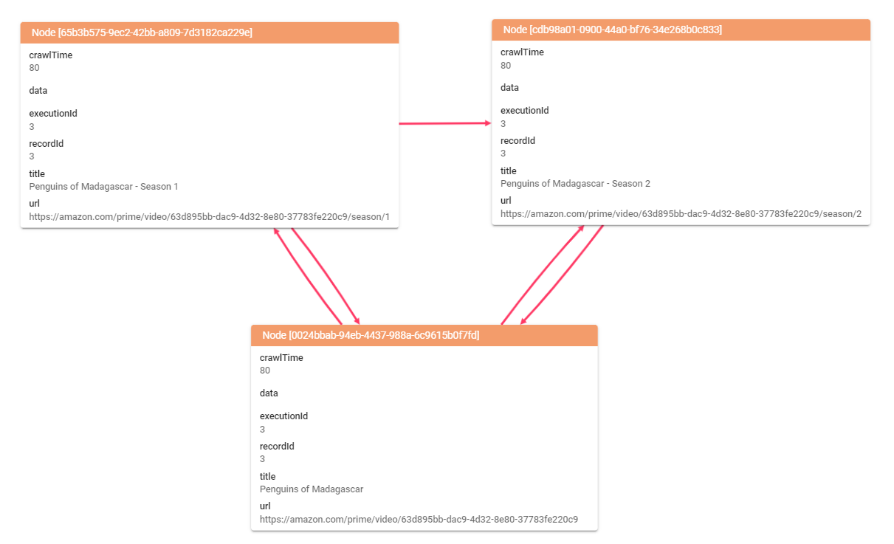
3. Query Result (G.V() visualisation)

Slide 29
Query Execution Profile
Simple measure of Execution Time and other information by appending .executionPlan() at the end of a Gremlin Query
https://learn.microsoft.com/en-us/azure/cosmos-db/gremlin/execution-profile
[
{
// The Gremlin statement that was executed.
"gremlin": "g.V('mary').out().executionProfile()",
// Amount of time in milliseconds that the entire operation took.
"totalTime": 28,
// An array containing metrics for each of the steps that were executed.
// Each Gremlin step will translate to one or more of these steps.
// This list is sorted in order of execution.
"metrics": [
{
...
}
]
}
[

Slide 30
Query Results – Execution Times
Query/time | Execution #1 | Execution #2 | Execution #3 | Execution #4
Query 1 | 169ms | 71ms | 34ms | 35ms
Query 2 | 150ms | 145ms | 148ms | 142ms
Query 3 | 64ms | 20ms | 20ms | 20ms
The results show an interesting correlation between 1st and subsequent executions
Based on Cosmos DB documentation, the 1st execution is expensive but is cached afterwards to produce faster retrievals on next attempts
Based on results it takes at least 3 executions to stabilize
2nd execution (edge counts) is always Full Scan, so it cannot go any faster
Full Execution Plans: https://github.com/corovcam/NDBI040-CosmosDB-Presentation

Slide 31
Useful Tools & Platforms
Azure Cosmos DB Web Interface
Data Explorer to execute Gremlin queries
Weak visualising tool to show only subset of queried data
Gremlin Console
For automated script execution
Playground & Debug tool alongside other Programming SDKs (.NET, Java, Python,...)
G.V()
Feature-rich and robust ecosystem for debugging Gremlin queries, visualising Cosmos DB Gremlin API, Amazon Neptune, JanusGraph,...
30-day Free Trial for new installations only

Slide 32
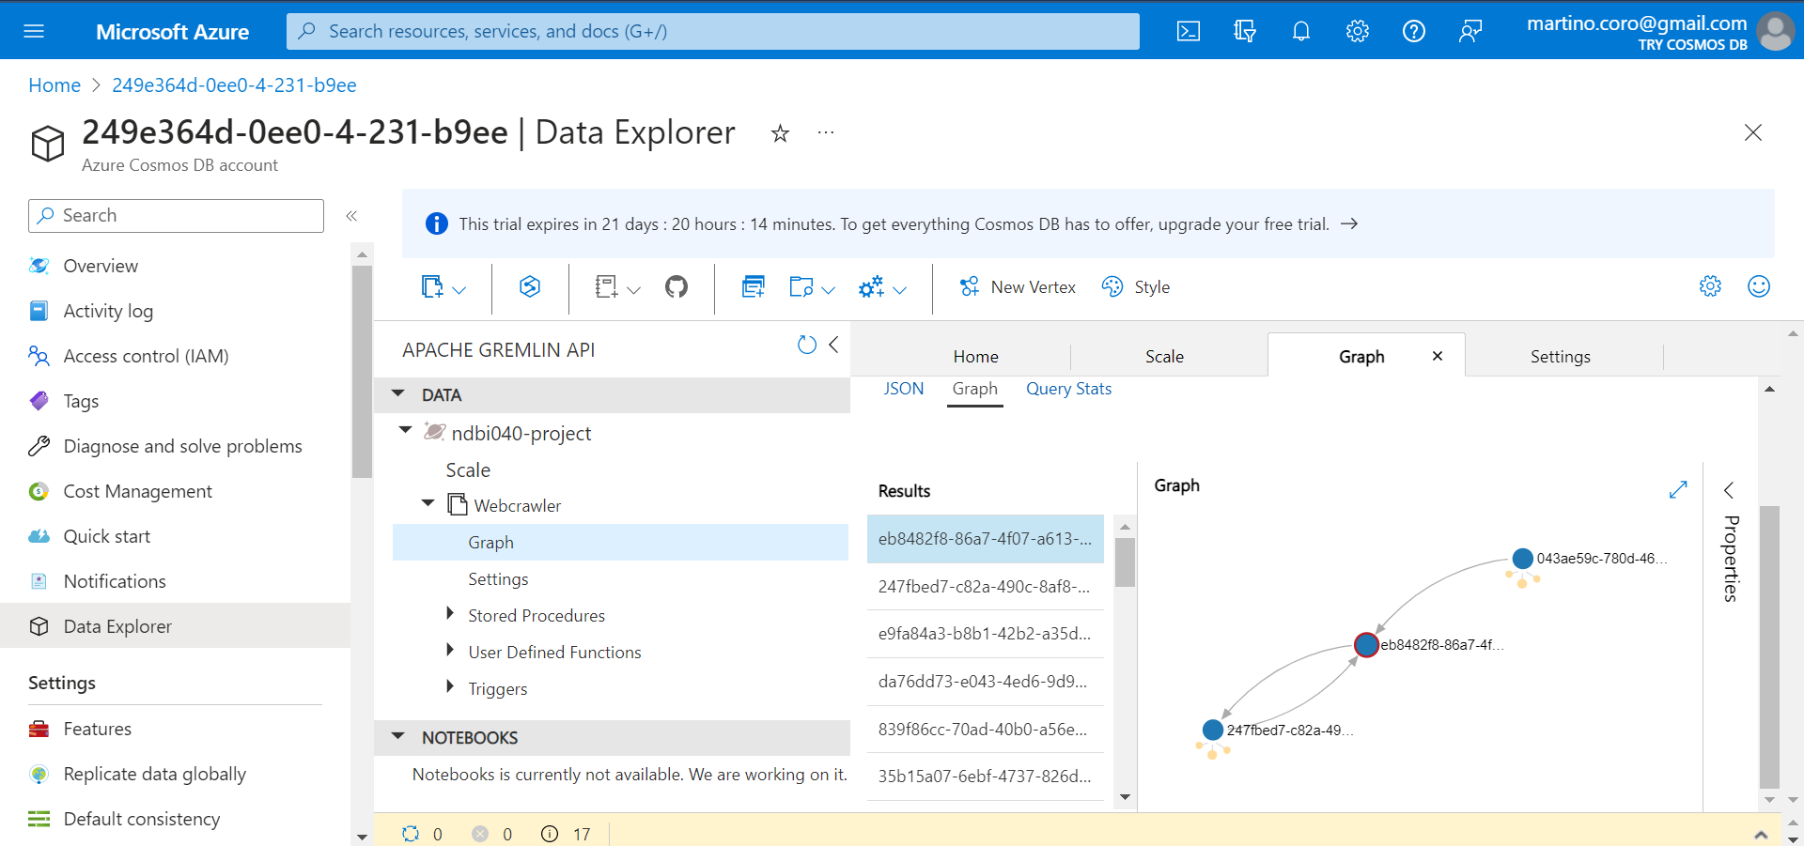
Azure Web Interface

Slide 33
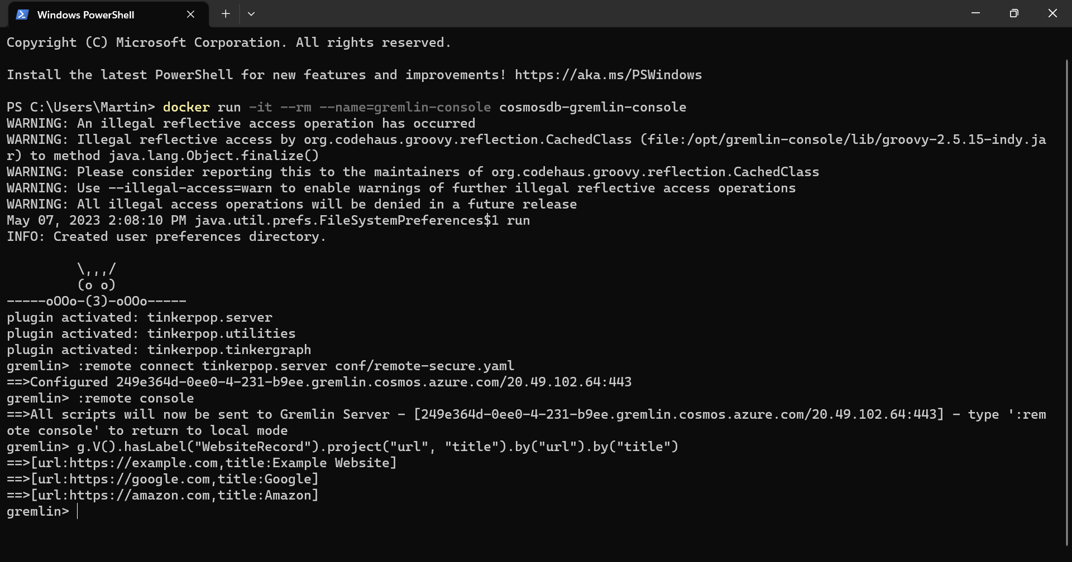
Gremlin Console

Slide 34
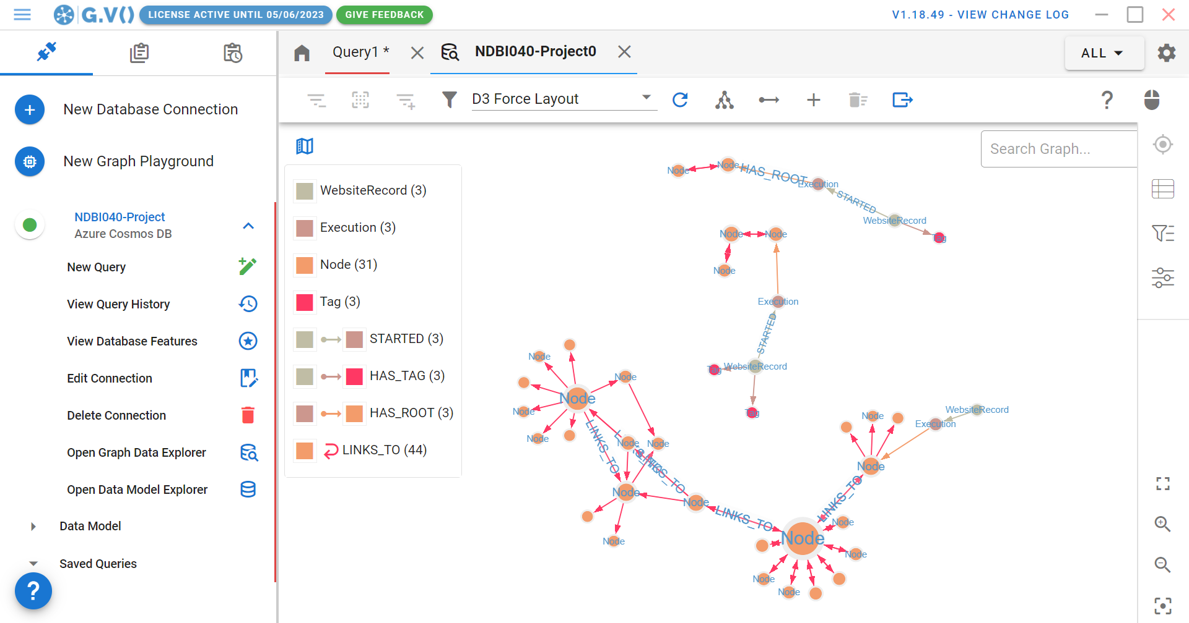
G.V() – Gremlin IDE & Visualisation Tool

Slide 35
Re/sources
https://learn.microsoft.com/en-us/azure/cosmos-db/
https://gdotv.com/
https://azurecosmosdb.github.io/labs/
https://en.wikipedia.org/wiki/Gremlin_%28query_language%29
https://kepty.cz/wp-content/uploads/2021/11/AzureCosmosDB.png

Slide 36
List of Additional Files
„cosmos-db-recording.mp4“ – video recording of the presentation
Repository:
„/scripts/data.groovy“ – data generation script
„/scripts/queries.groovy“ – Gremlin queries script
„/conf/remote-secure.yaml“ – Gremlin Console config
„/conf/indexing-policy.json“ – Azure Web Interface -> Webcrawler -> Settings -> Indexing Policy configuration

Slide 37
The End of Cosmos

