Slide 1
Lab 2
Software Design 2022

Slide 2
Today
Git classroom
Clean code, lesson #1
Class/Package design principles
Database modelling

Slide 3
OOP
L1_Revision.pdf
Relationship between classes
Dependency
Association
Aggregation
Composition
Generalization
Realization

Slide 4
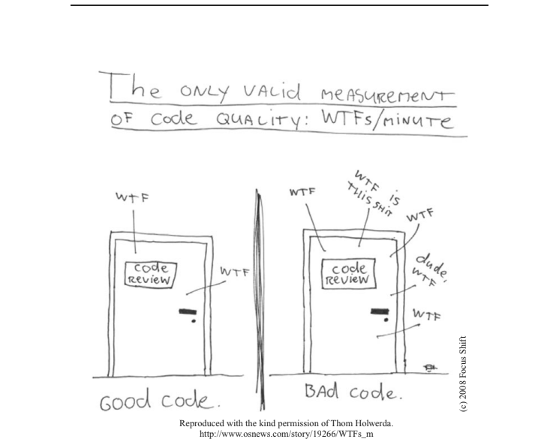
Clean code

Slide 5
Lesson #1: Namings
Use Intention-Revealing Names
NO: int d; // elapsed time in days
YES
int elapsedTimeInDays;
int daysSinceCreation;
int daysSinceModification;
int fileAgeInDays;

Slide 6
Namings cnt
What does this code do?
YES
public List<Cell> getFlaggedCells() {
List<Cell> flaggedCells = new ArrayList<Cell>();
for (Cell cell : gameBoard)
if (cell.isFlagged())
flaggedCells.add(cell);
return flaggedCells;
}
What does this code do?
NO
public List<int[]> getThem() {
List<int[]> list1 = new ArrayList<int[]>();
for (int[] x : theList)
if (x[0] == 4)
list1.add(x);
return list1;
}

Slide 7
Namings
Use simple names
Use meaningful names
Use searchable names
Use camelCase or pascalCase
Avoid snake_case (Exception Constants)
Use nouns for class and attribute names
Use Verbs for actions

Slide 8
Class design
public class Student
{
private int yearOfBirth;
public int Age { get; set; }
public Student (string name, int age) {…}
public void IsStudentReady() {}
public string GetAverage() {}
protected void … () {}
private string CalculateAverage() {}
}

Slide 9
Comments
Unless there is an exception, a hack or something really complicated to understand, do not comment out your code.
Code should be self descriptive
Documentation needs to be maintained and it tends to lack behind

Slide 10
NO COPY PASTE
Duplicate code is bad
Why?
How to avoid it

Slide 11
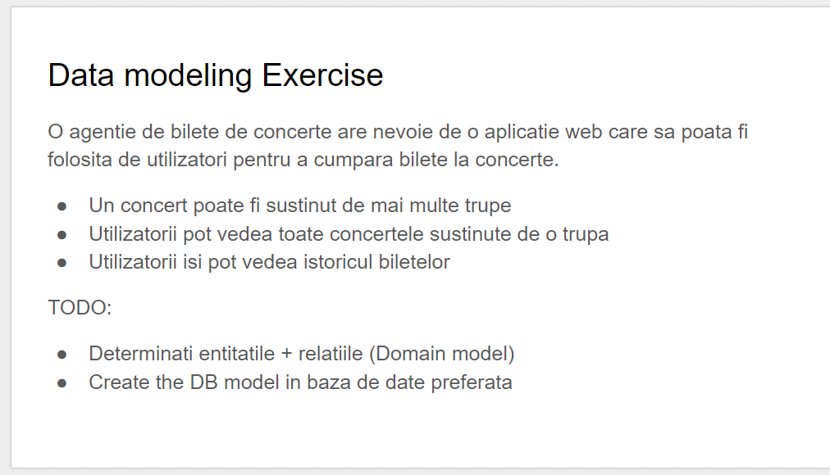

Slide 12
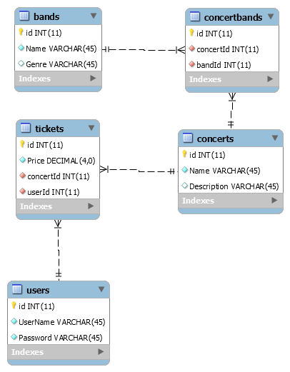
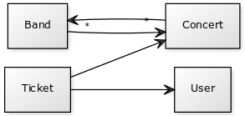
Data modeling Exercise
Notes:
Yuml.me
[Ticket]->[User]
[Ticket]->[Concert]
[Concert]-*>[Band]
[Band]-*>[Concert]

Slide 13
Data modeling Exercise #2
A bookstore needs to sell books to people. A user can buy multiple books.
We need to track the price for a book. How can we do that?
TODO:
Determine relations + build database model (mysql / sql server)
Connect from .net/ java to this database

