Slide 1
Lab 2
Software Design 2021

Slide 2
Today
Git classroom
OOP - part 2
Class/Package design principles
Database modelling

Slide 3
OOP - part 2
L1_Revision.pdf
Relationship between classes
Dependency
Association
Aggregation
Composition
Generalization
Realization

Slide 4
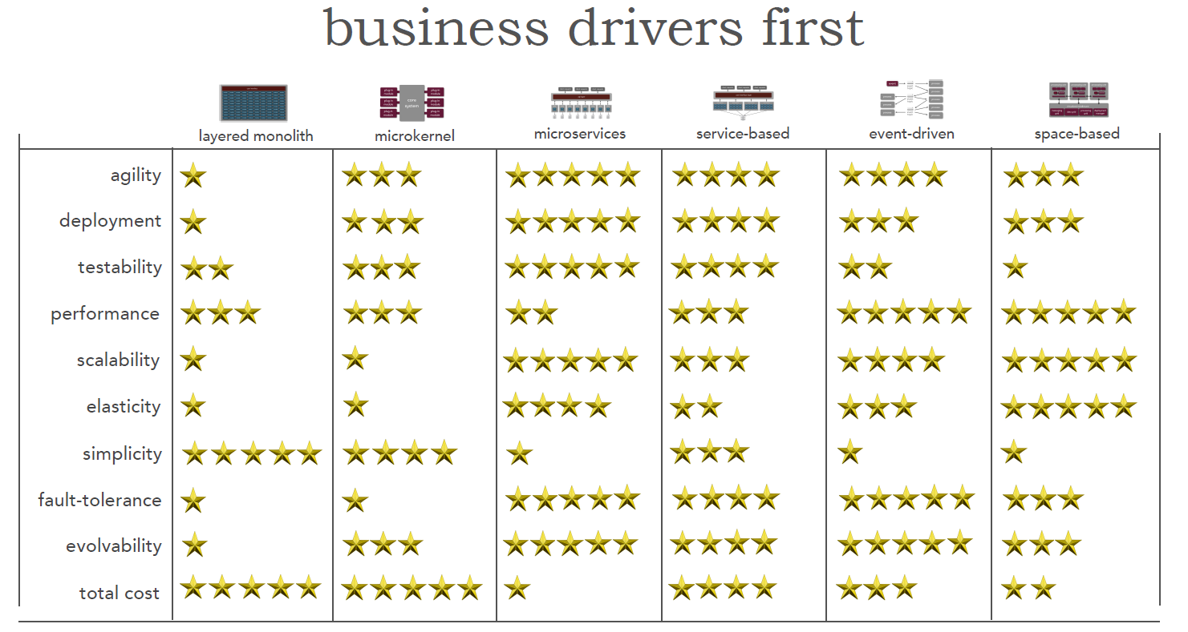
Architecture Patterns

Slide 5
SOLID Design Principles
Why do you need a good design?

Slide 6
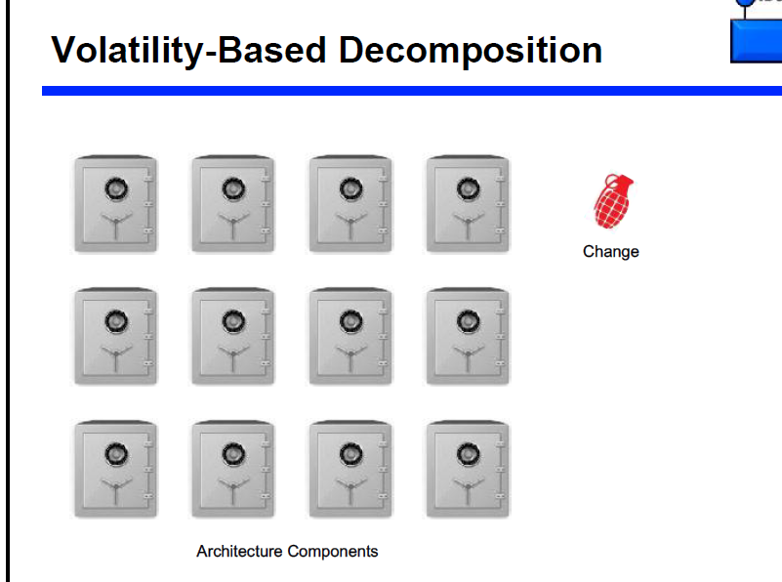
Change

Slide 7
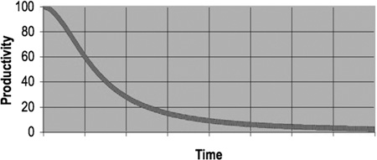
SOLID Design Principles - Why?
Changes are inevitable. The only constant is change.
A change in code will take more and more

Slide 8
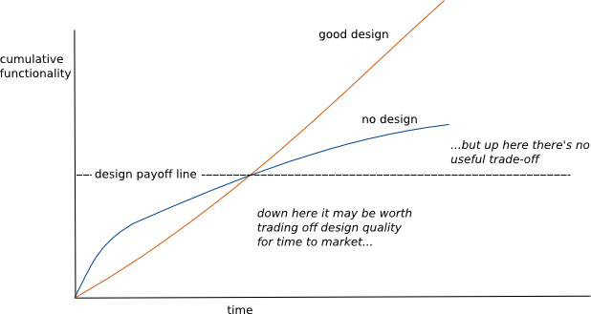
SOLID Design Principles - Why?
Roughly speaking, design phase should take ~1 week.

Slide 9
SOLID Design Principles
Single Responsibility
Open/Closed
Liskov Substitution
Interface Segregation
Dependency inversion

Slide 10
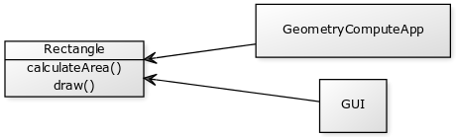
SOLID - Single Responsibility Principle
A class should only have one reason to change
Notes:
yuml.me
[Rectangle|calculateArea();draw()]<-[GUI]
[Rectangle]<-[GeometryComputeApp]

Slide 11
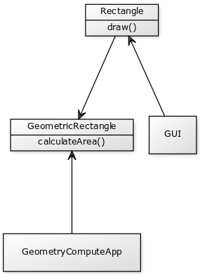
SOLID - Single Responsibility Principle
Separation of responsibilities
Notes:
Yuml.me
[Rectangle|draw()]
[Rectangle]<-[GUI]
[GeometricRectangle|calculateArea()]
[Rectangle]->[GeometricRectangle]
[GeometricRectangle]<-[GeometryComputeApp]

Slide 12
SOLID - Open Closed Principle
Open for extension
Closed for modification

Slide 13
SOLID - Liskov Substitution Principle
A class should not alter the behavior of the superclass
Example

Slide 14
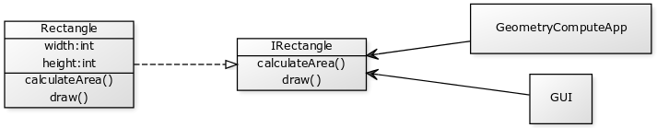
SOLID - Interface Segregation Principle
Clients of interfaces should only use the methods that they use i.e. do not create very big interfaces; and think about the interfaces from the consumer perspective
Notes:
[IRectangle|calculateArea();draw()]
[Rectangle|width:int;height:int|calculateArea();draw()]-.-^[IRectangle]
[IRectangle]<-[GUI]
[IRectangle]<-[GeometryComputeApp]

Slide 15
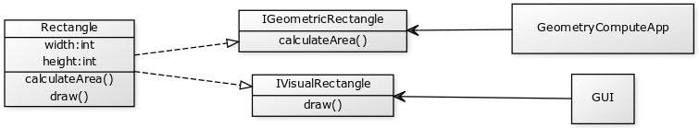
SOLID - Interface Segregation Principle
Notes:
[IGeometricRectangle|calculateArea()]
[IVisualRectangle|draw()]
[Rectangle|width:int;height:int|calculateArea();draw()]-.-^[IVisualRectangle]
[Rectangle]-.-^[IGeometricRectangle]
[IVisualRectangle]<-[GUI]
[IGeometricRectangle]<-[GeometryComputeApp]

Slide 16
SOLID - Dependency Inversion Principle
Based on this idea, Robert C. Martin’s definition of the Dependency Inversion Principle consists of two parts:
High-level modules should not depend on low-level modules. Both should depend on abstractions.
Abstractions should not depend on details. Details should depend on abstractions.

Slide 17
Favor composition over inheritance
Depth (Death) of inheritance

Slide 18
Data modelling Exercise
A ticketing agency needs to build a model to sell tickets
A concert can be held with many bands
Users can buy tickets to a concert
TODO:
Determine entities + relations

Slide 19
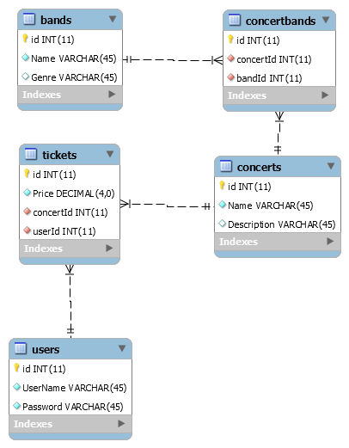
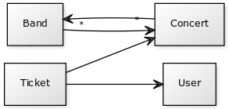
Data modeling Exercise
Notes:
Yuml.me
[Ticket]->[User]
[Ticket]->[Concert]
[Concert]-*>[Band]
[Band]-*>[Concert]

Slide 20
Data modeling Exercise #2
A bookstore needs to sell books to people. A user can buy multiple books.
We need to track the price for a book. How can we do that?
TODO:
Determine relations + build database model (mysql / sql server)
Connect from .net/ java to this database

