Slide 1
Software design
Lab 1

Slide 2

Hello! Instructor Introduction
Instructor: Andrei Corovei
MCT, Developer Associate, Azure Architect Cloud Technologies
Qubiz
andreicorovei.com
Twitter @andreicorovei
Mail: Andrei.Corovei@gmail.com
Notes:
Working with Azure background
Started working with VMs in our own Data center
Then worked on Cloud Services
Then worked with AppServices

Slide 3

Hello! Student Introductions
Let’s get acquainted:
Your name
Your expectations for the lab
Notes:
Rand de masa

Slide 4

Why do we need Software design?

Slide 5
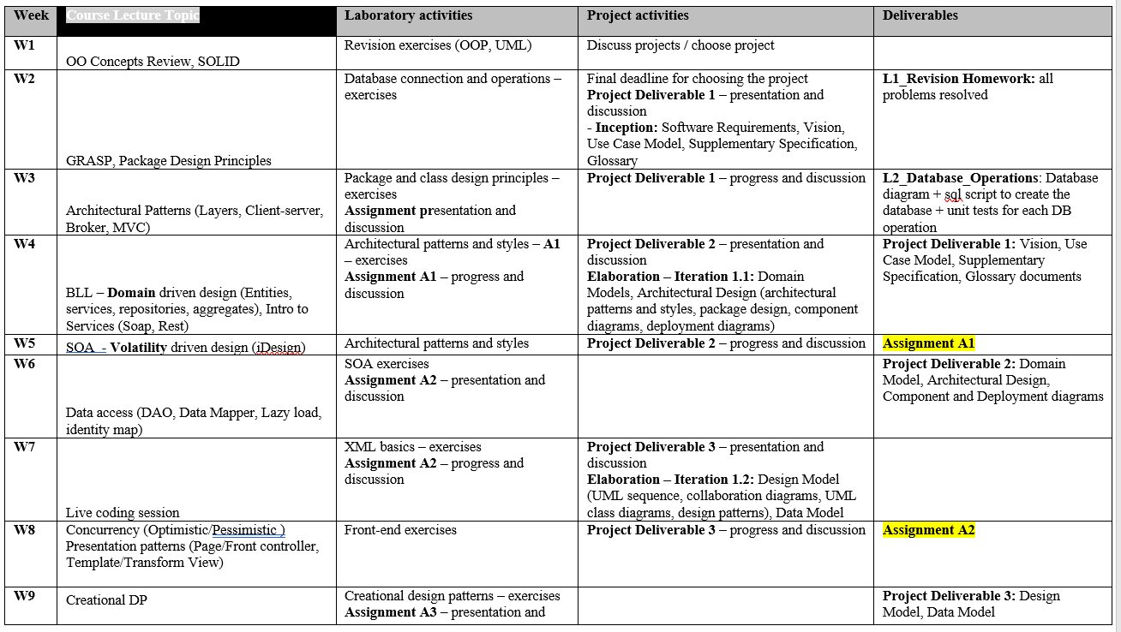
Schedule

Slide 6
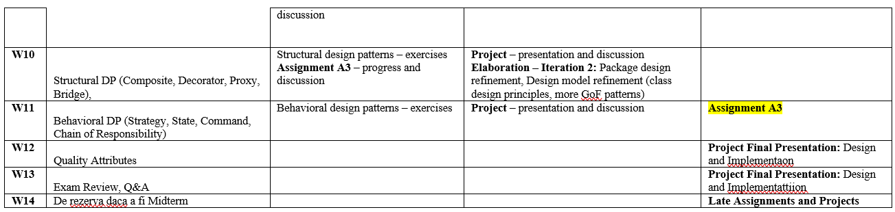

Slide 7
Rules and grading
Laboratory policy
Laboratory sessions are compulsory – no more than 3 absences are allowed.
Assignments and project deliverables must be presented when established. One delay/semester is accepted, while the other delays are penalized as following:
You have a delay of 1 week then you lose one point of the assignment final grade. (Not applied if it is the first delay in the semester.)
You have a delay of 2 weeks then you lose two points of the assignment final grade.
You have a delay of 3 weeks then you lose four points of the assignment final grade.
You have a delay of > 3 weeks then you do not pass the assignment.
A single assignment can be presented during a laboratory session.
No migration between groups is allowed

Slide 8
Grading
Assignment grading = 0.4 * Documentation_grade + 0.6 * Implementation_grade
Project grading = 0.1*Deliverable1 + 0.1*Deliverable2 + 0.1*Deliverable3 + 0.3*Final Design + 0.4*Implementation
Extra points/ penalties can be given each lab

Slide 9
Some extra rules
I appreciate and understand personal effort and honesty – it might be the case that I will accept homework that is just 60-70% complete over one that is 100% complete but was copied. Therefore I encourage you to do the homework by yourselves.
I encourage you to discuss with me and within yourselves and ask when things are not clear. The right software design is not a single solution, thus there might be multiple solutions for one problem. Take the time to ask as many questions as possible during the labs and send me emails whenever something is not clear.
When submitting the homework I will also ask some basic theoretical questions and some practical questions about the assignment. The purpose of these questions is to make sure that you understand the concepts and not learn them by hard. It is also a good time for you to ask for feedback and ideas for improvements.
Mistakes are totally allowed, allow yourself to do them. No one is perfect and the best way to get better is to recognize and learn from our mistakes. And as I said, there is no one-only solution to software design.

Slide 10
Some extra rules (cnt.)
Creating a repository and putting everything under source control is mandatory.
Don’t write fluff in the documentations. Focus on the diagrams and just a few lines to explain them should be enough.

Slide 11
Repos
https://github.com/coroveiandrei/UTCNSoftwareDesignLab

