Slide 1
CHINJU MERIN RAJU
Mail: 213410@ust-global.com

Slide 2
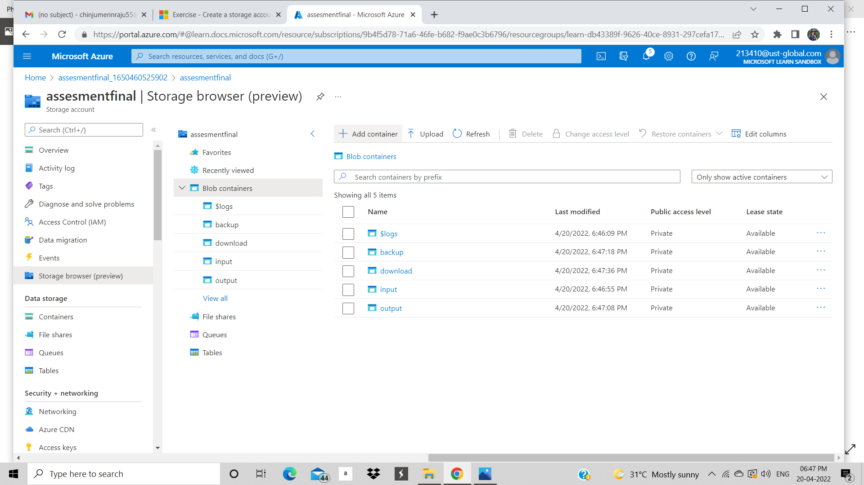
STORAGE ACCOUNT IN AZURE

Slide 3
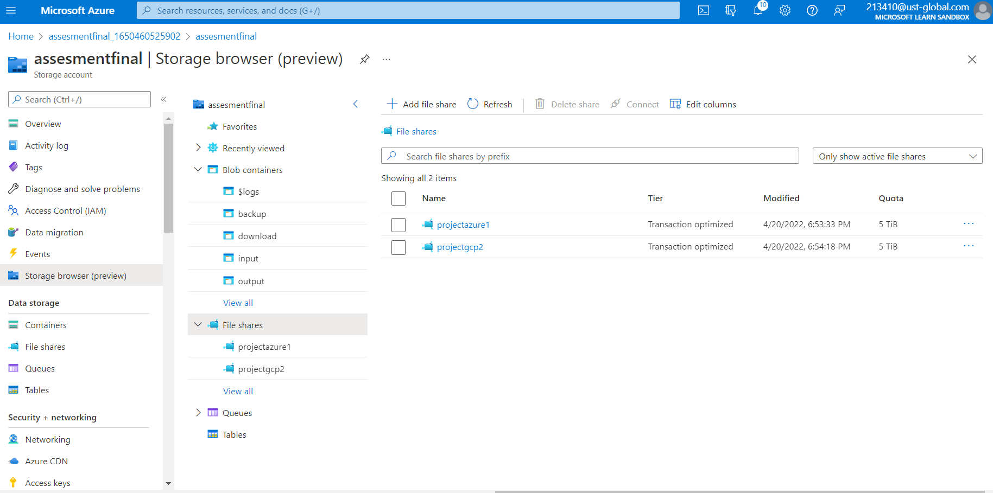
FILESHARE

Slide 4
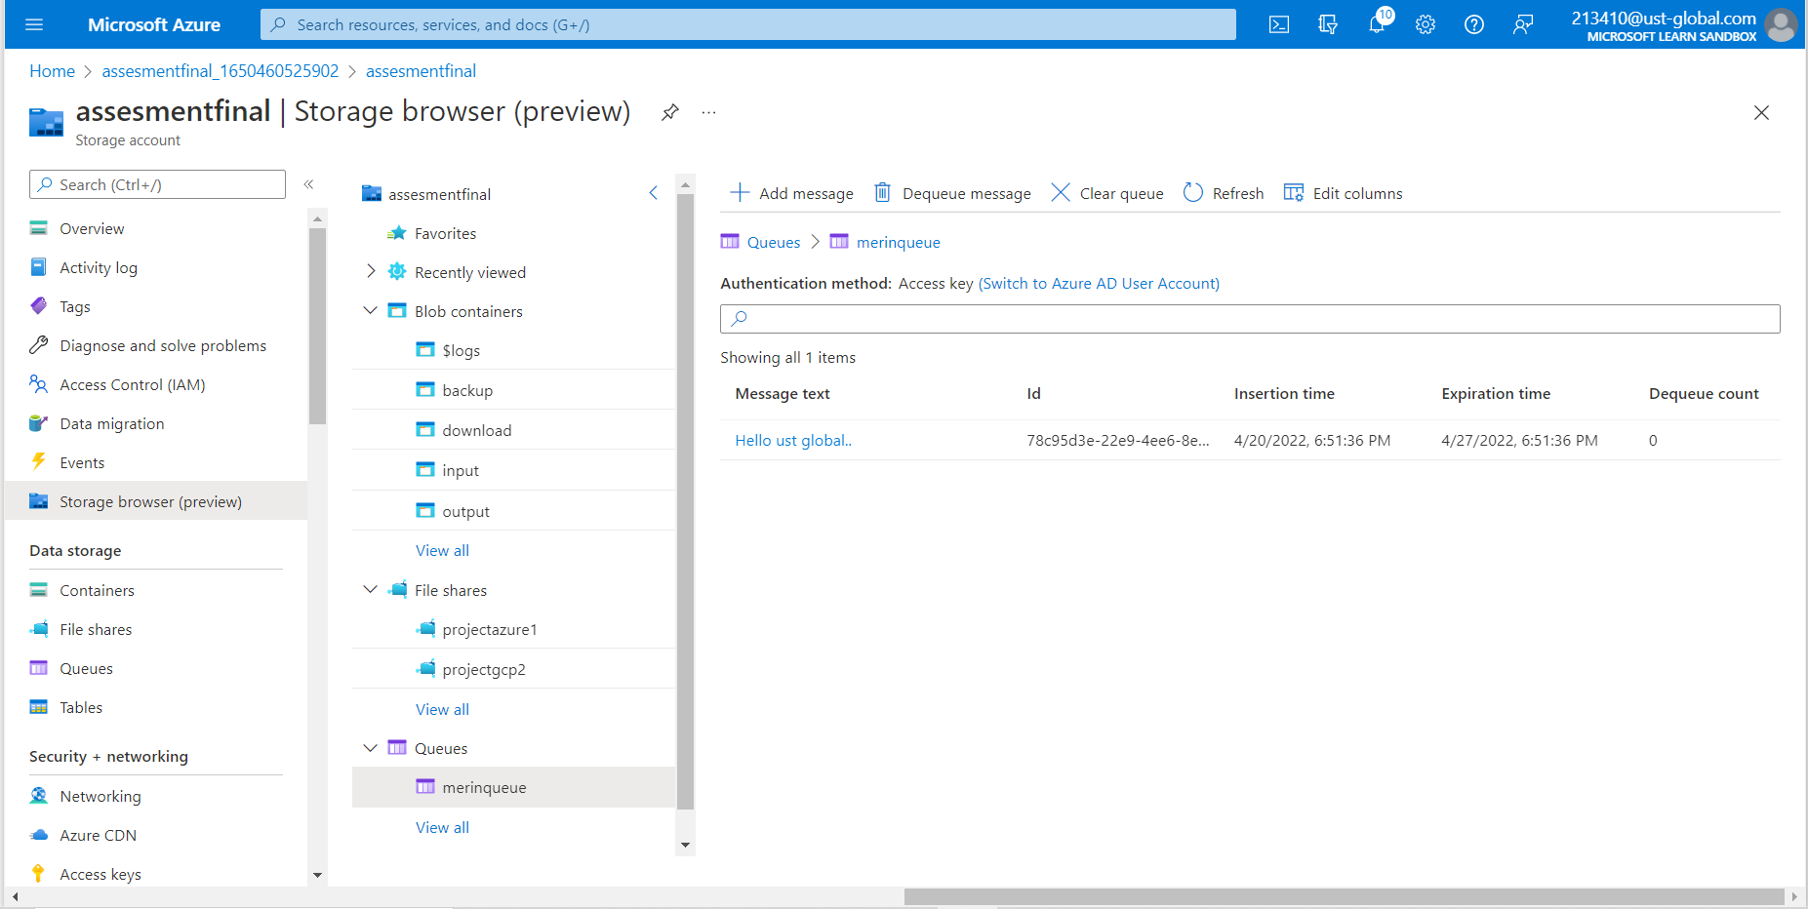
QUEUE MESSAGE

Slide 5
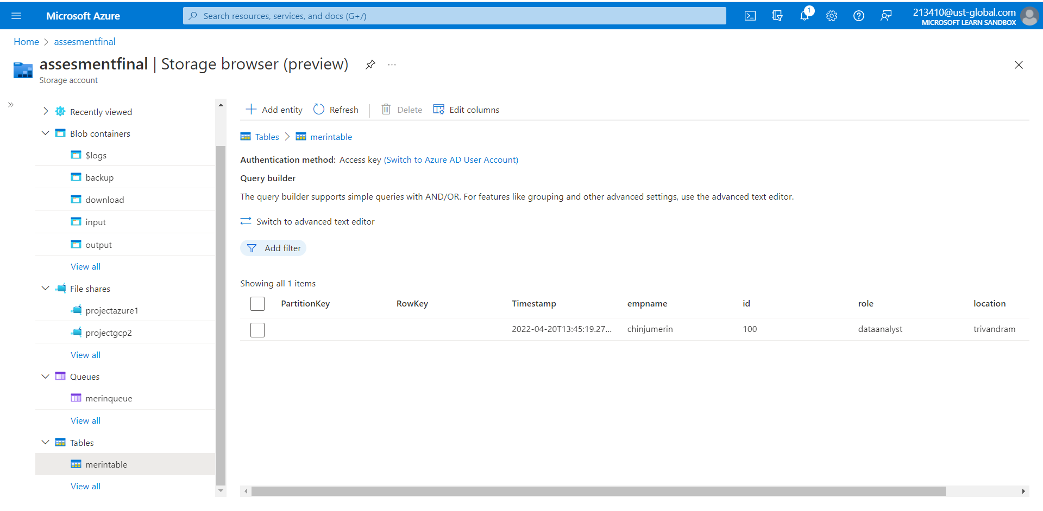
TABLE

Slide 6
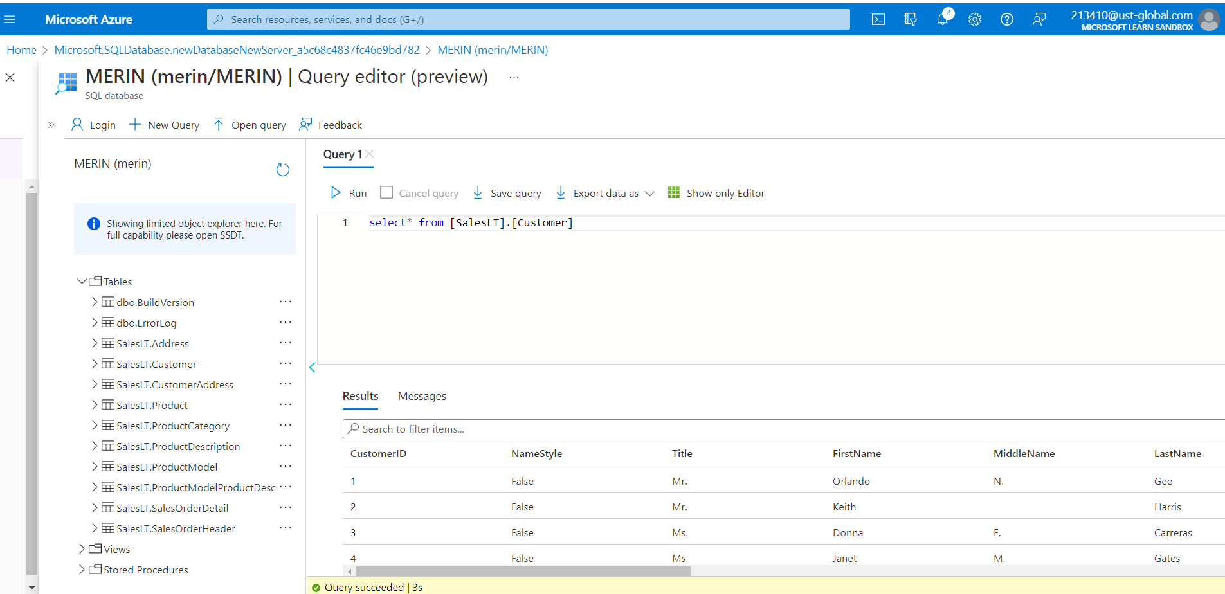
SAMPLE DATABASE WITH QUERY

Slide 7
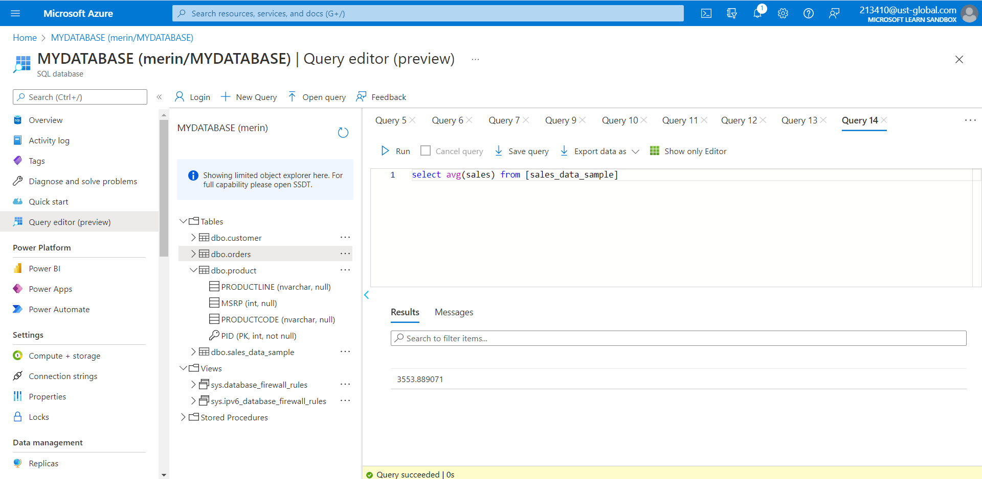
TO ESTIMATE THE UNIT SALES OF RETAIL GOODS

Slide 8
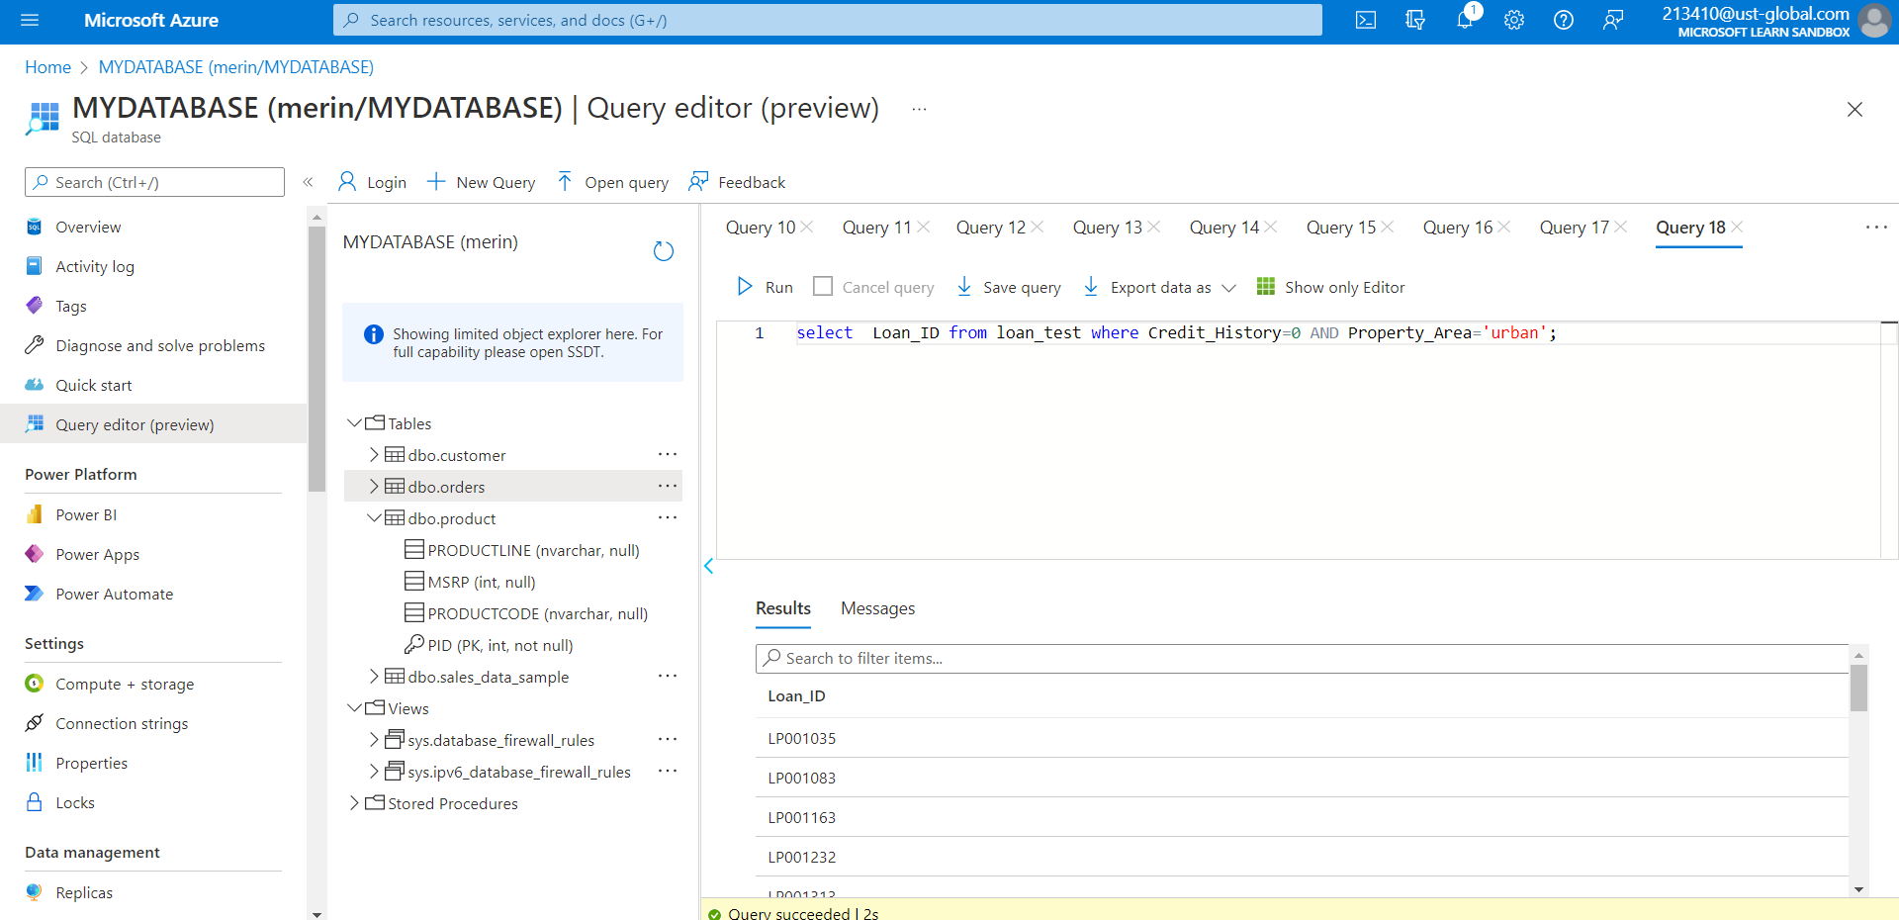
FINANCIAL NEED PROGRAMS FOR CONSUMER LOAN PRODUCTS

