Slide 1
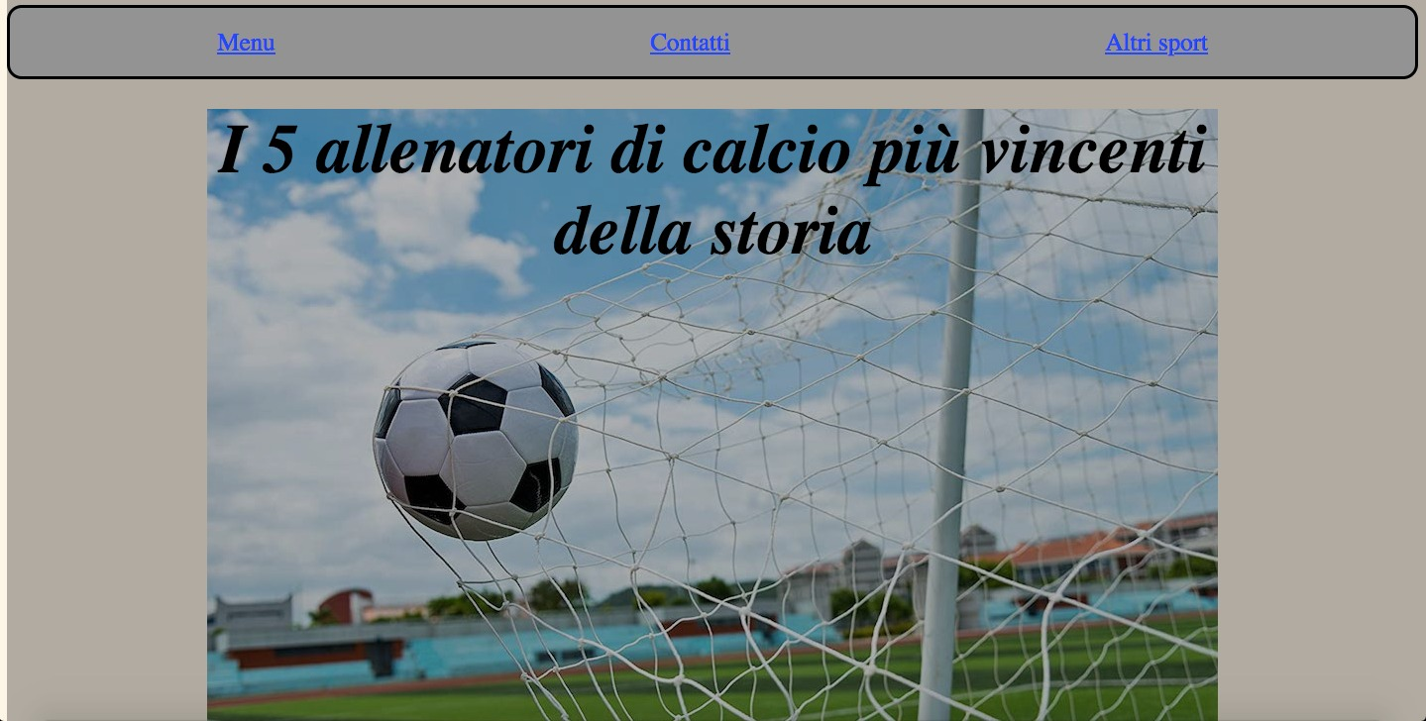
3px

Slide 2
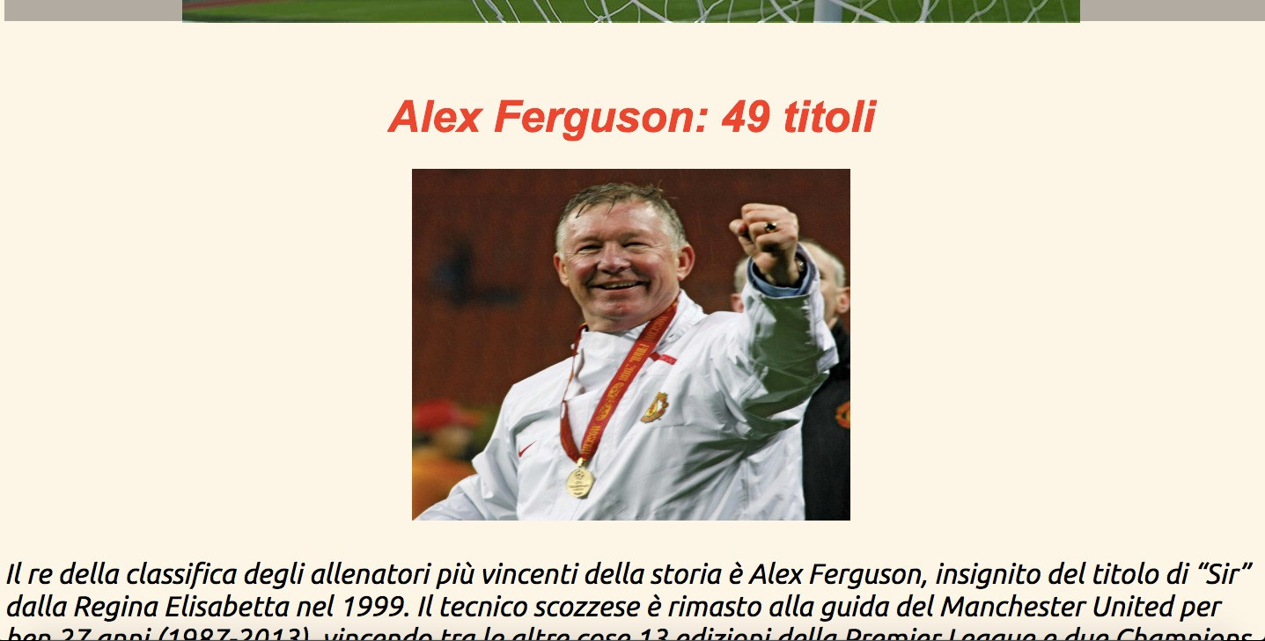
20px
Space Around
10px
10px

Slide 3
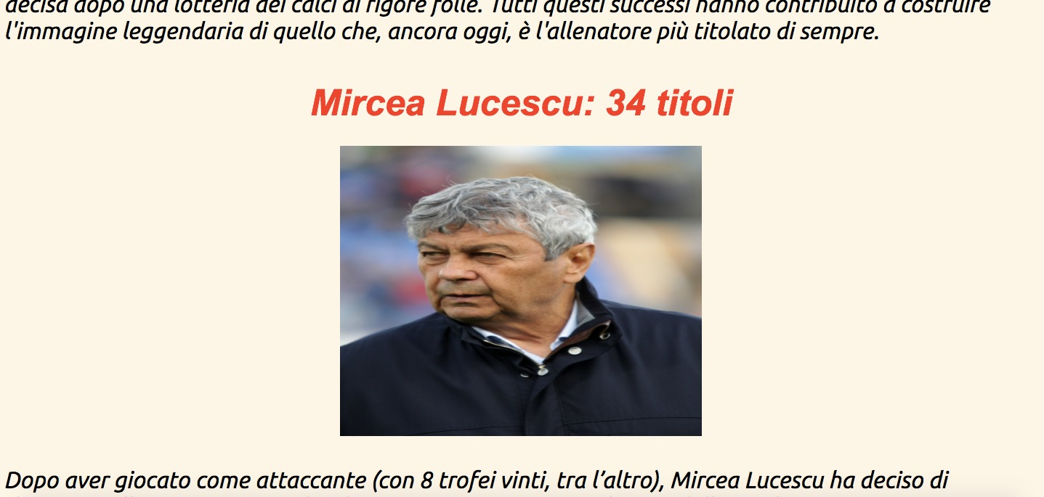
20px
Space Around
10px
10px

Slide 4
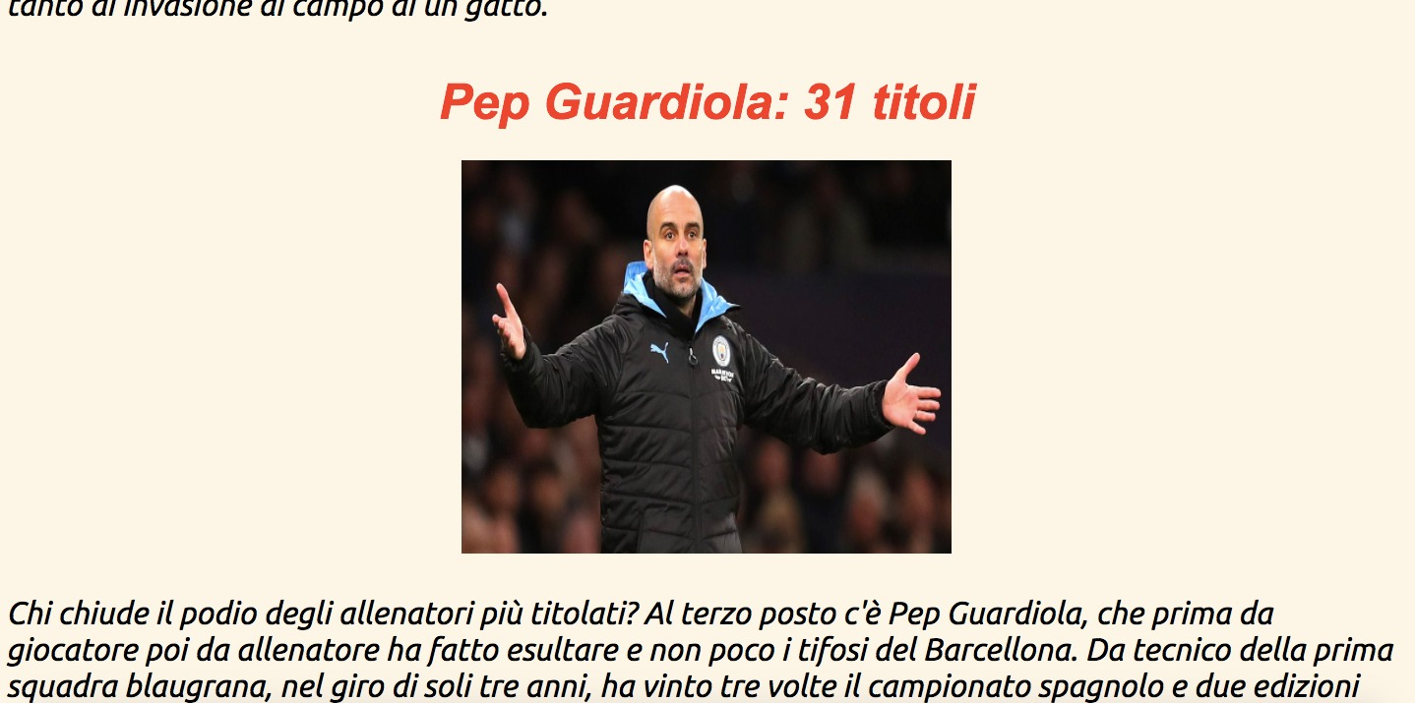
20px
Space around
10px

Slide 5
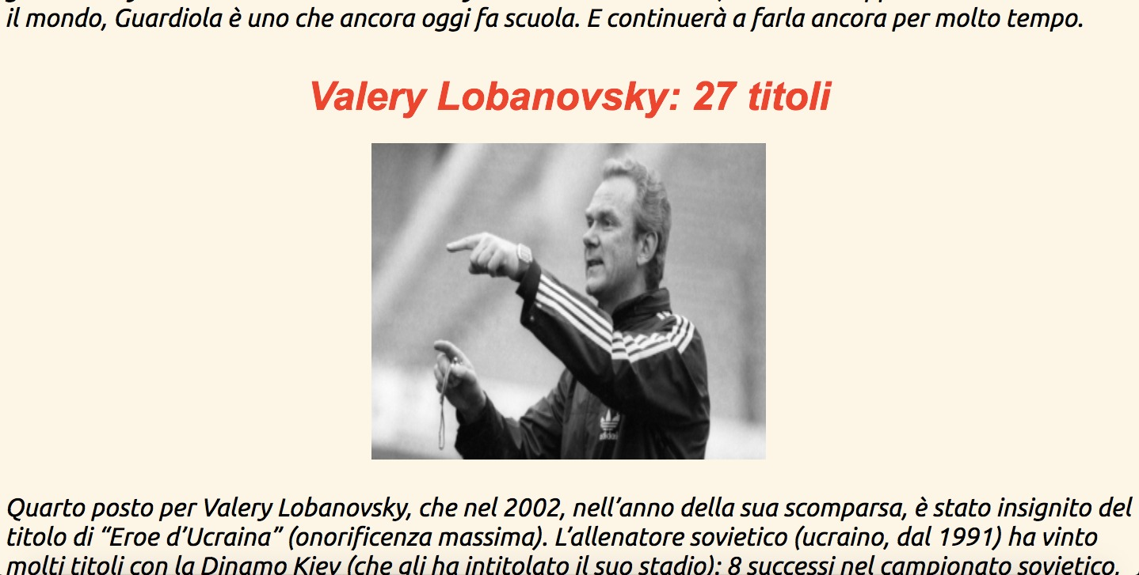
20px
10px
Space Around
10px

Slide 6
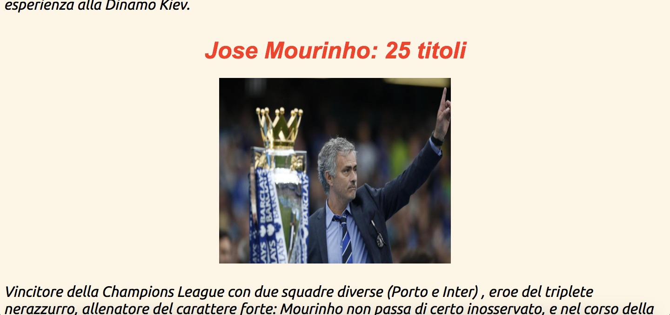
20px
Space Around
10px
10px

Slide 7
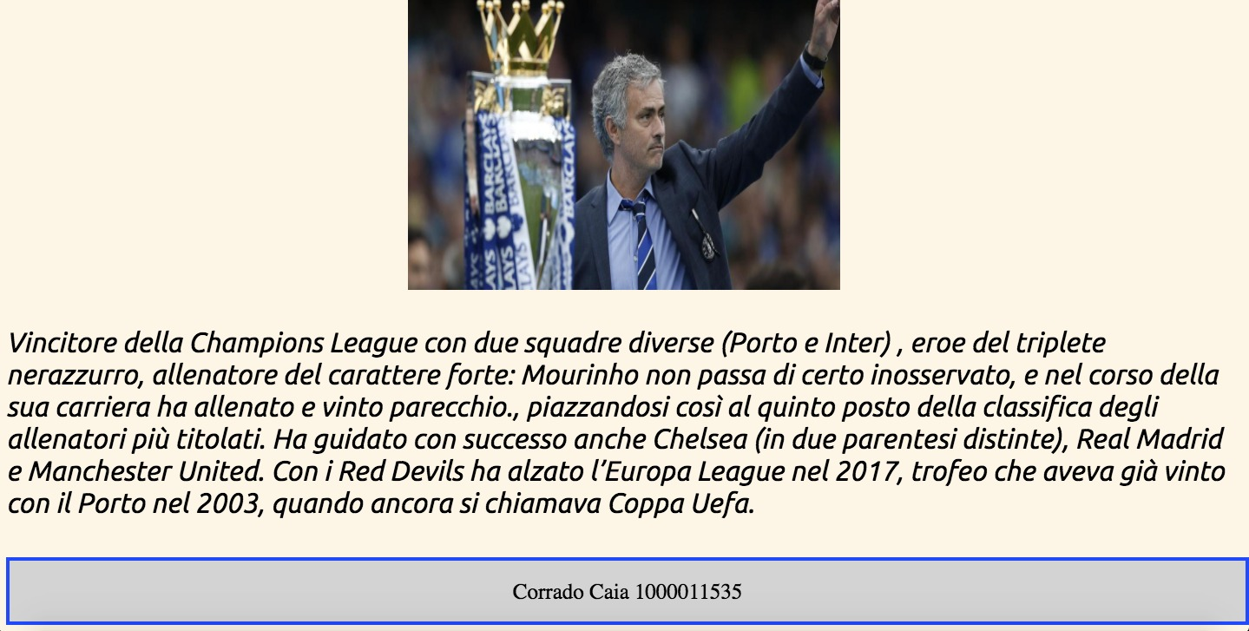
10px
10px

