Slide 1
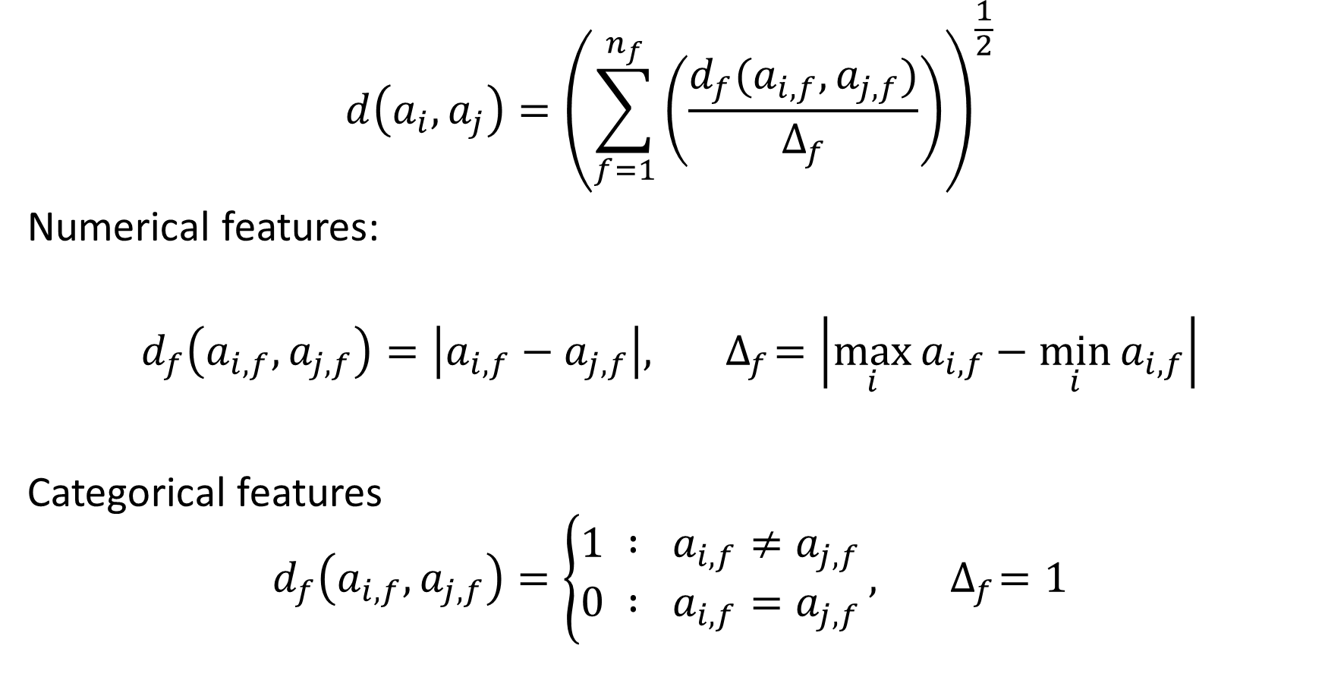
$$d\left(a_{i}, a_{j}\right)={\left(\sum_{f=1}^{n_{f}}{\left(\frac{d_{f}(a_{i,f}, a_{j,f})}{∆_{f}}\right)}\right)}^{\frac{1}{2}}$$
Numerical features:
$$d_{f}\left(a_{i,f},a_{j,f}\right)=\left|a_{i,f}−a_{j,f}\right|,{ ∆}_{f}=\left|\max_{i}{a_{i,f}}−\min_{i}{a_{i,f}}\right|$$
Categorical features
$$d_{f}\left(a_{i,f},a_{j,f}\right)=\left\{\begin{matrix}1 : a_{i,f}≠a_{j,f} \\ 0 : a_{i,f}=a_{j,f}\end{matrix}\right.,{ ∆}_{f}=1$$

