Slide 1

Yilin Shen
02/18/2009

Slide 2

Definition:
Given a network (Graph G=(V,E)), A COMMUNITY is a subgraph of a network whose nodes are more tightly connected with each other than with nodes outside the subgraph.
Applications:
  Social Networks
  Biochemical networks
  Internet
  Food webs

Slide 3

Definition:
A quantitative measure to essentially compare the number of links inside a given module with the expected value for a randomized graph of the same size and degree sequence.
Objective:
Maximize the Modularity:
The number of links inside a given module
-
The expected value for a randomized graph of the same size and degree sequence

Slide 4

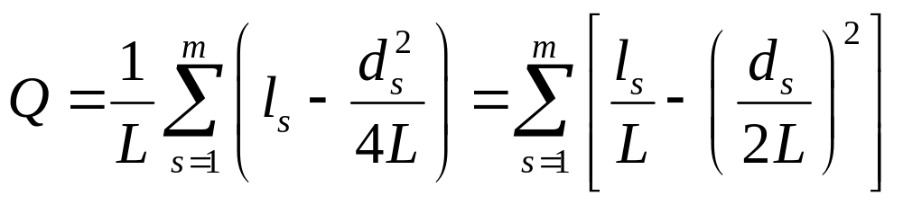
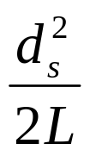
l_{s} : # links inside module s
L : # links in the network
d_{s} : The total degree of the nodes in module s
: Expected # of links in module s

Slide 5

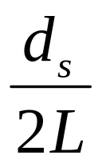
Probability that a stub, randomly selected, ends in module s
=

Slide 6

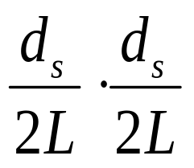
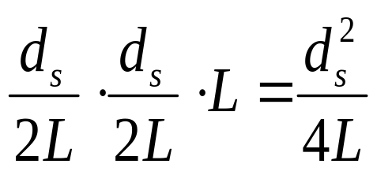
Probability that the link is internal to module s
=
Expected number of links in module s
=

Slide 7

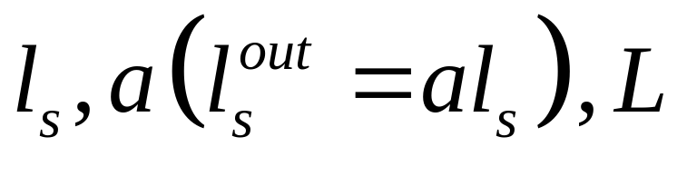
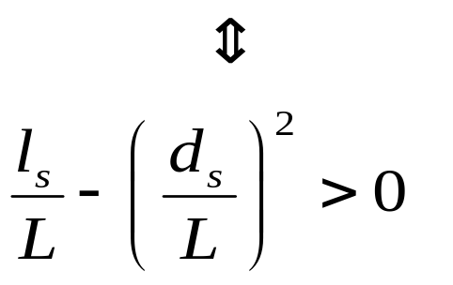
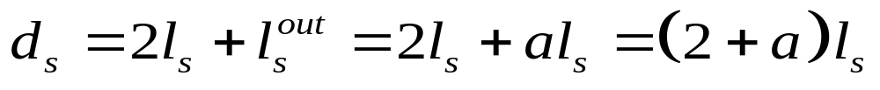
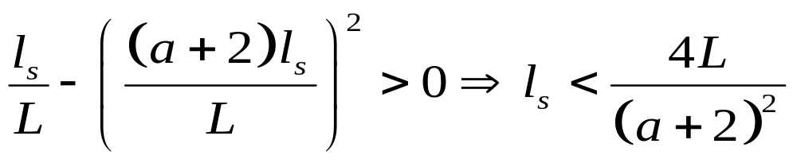
Subgraph S is a module
Since

Slide 8

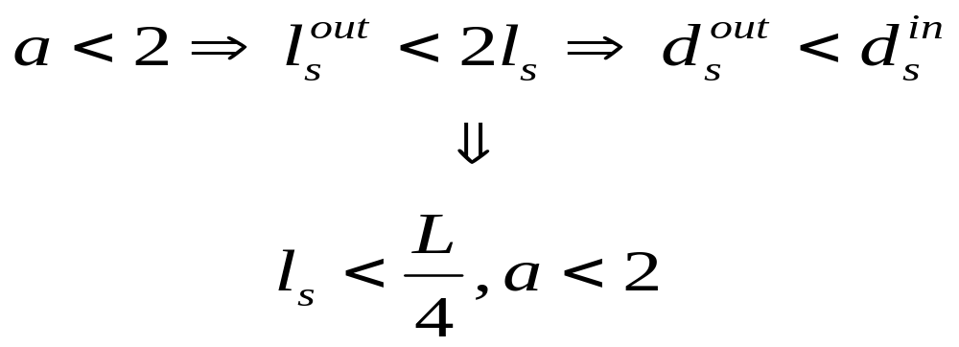
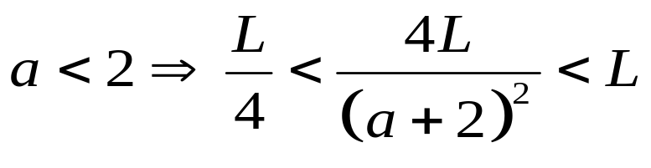
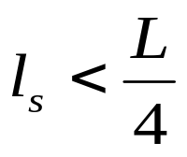
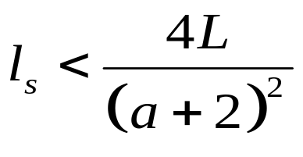
Consider “weak” definition for a community
Since ,
Therefore for each , holds.

Slide 9

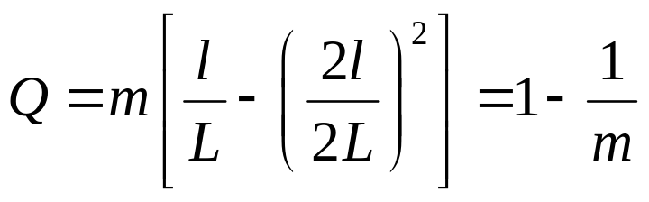
A network made of m identical complete graphs (or ‘cliques’) (actually the m connected components are not necessarily cliques), disjoint from each other.
which converges to 1 when the number of cliques goes to infinity.

Slide 10

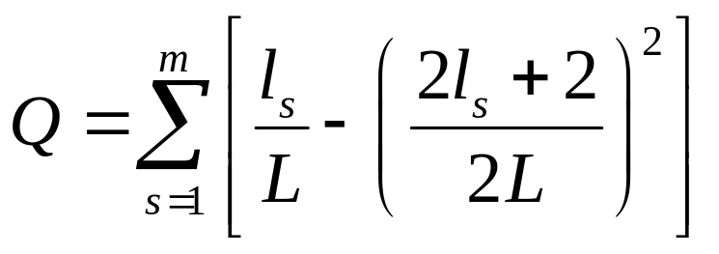
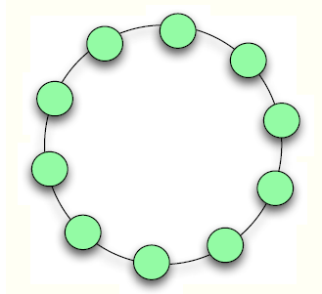
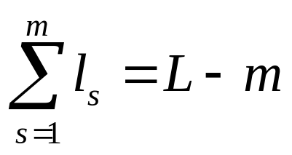
A connected network with N nodes and L links which maximizes modularity.
where

Slide 11

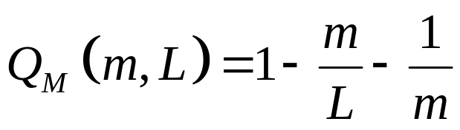
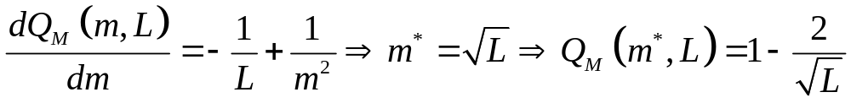

For fixed m, we easily know that Q reaches maximum when
For variable m,
The corresponding number of links in each module is .

Slide 12


The crucial point here is that modularity seems to have some intrinsic scale of order
, which constrains the number and the size of the modules. For a given total number of nodes and links we could build many more than modules, but the corresponding network would be less “modular”, namely with a value of the modularity lower than the maximum

Slide 13

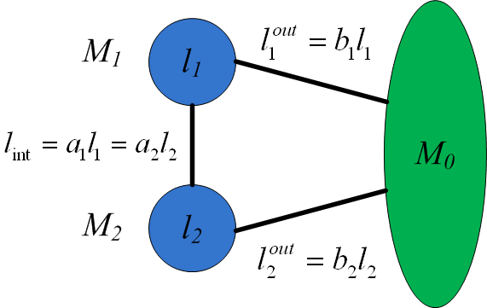
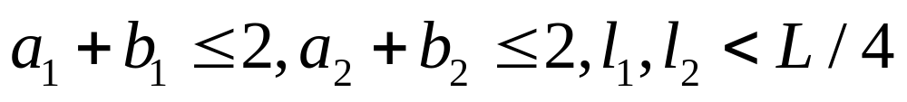
Since M₁ and M₂ are constructed modules, we have

Slide 14

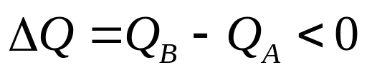
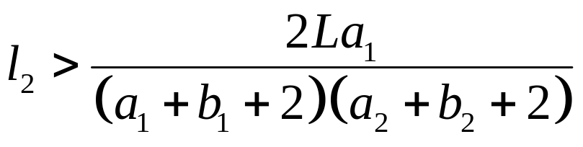
Let’s consider the following case
Q_{A} : M₁ and M₂ are separate modules
Q_{B} : M₁ and M₂ is a single module
Since both M₁ and M₂ are modules by construction, we need
That is,

Slide 15

Now let’s see how it contradicts
the constructed modules M₁ and M₂
We consider the following two scenarios: ( )
The two modules have a perfect balance between internal and external degree (a₁+b₁=2, a₂+b₂=2), so they are on the edge between being or not being communities, in the weak sense.
The two modules have the smallest possible external degree, which means that there is a single link connecting them to the rest of the network and only one link connecting each other (a₁=a₂=b₁=b₂=1/l).

Slide 16



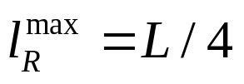
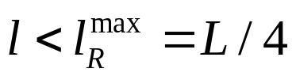
When and , the right side of
can reach the maximum value
In this case, may happen.

Slide 17

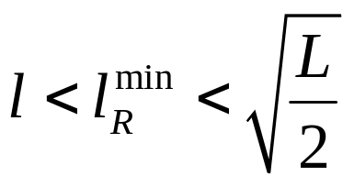
a₁=a₂=b₁=b₂=1/l

Slide 18

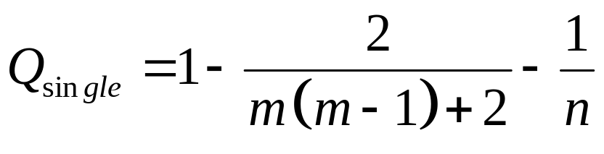
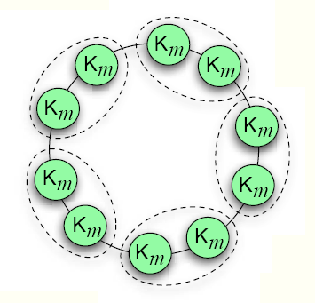
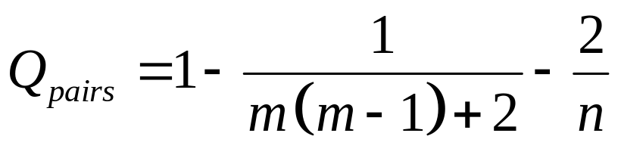
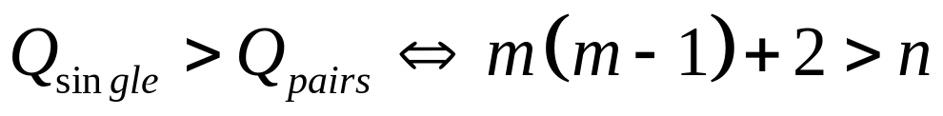

Slide 19

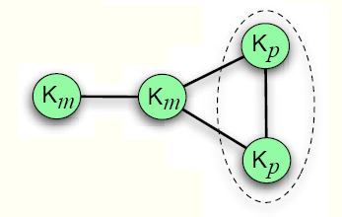
For example, p=5, m=20
The maximal modularity of the network corresponds to the partition in which the two smaller cliques are merged

Slide 20


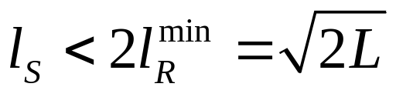
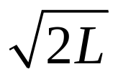
Any two interconnected modules, fuzzy or not, are merged if the number of links inside each of them does not exceed .
If modularity optimization finds a module S with l_{S} internal links, it may be that the latter is a combination of two or more smaller communities.
The upper limit of l_{S} can be much larger than , if the substructures are on average more interconnected with each other.

Slide 21

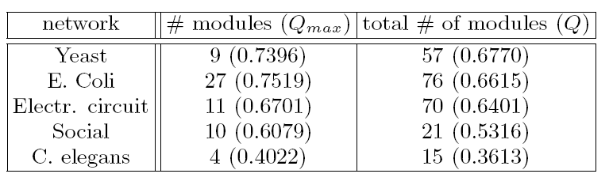

Slide 22

Modularity is actually not consistent with its optimization which may favor network partitions with groups of modules combined into larger communities.
The resolution limit of modularity does not rely on particular network structures, but only on the comparison between the sizes of interconnected communities and that of the whole network, where the sizes are measured by the number of links.
An increase of the number of modules does not necessarily correspond to an increase in modularity because the modules would be smaller and so would be each term of the sum.
Quality functions are still helpful, but their role should be probably limited to the comparison of partitions with the same number of modules.

