Slide 1
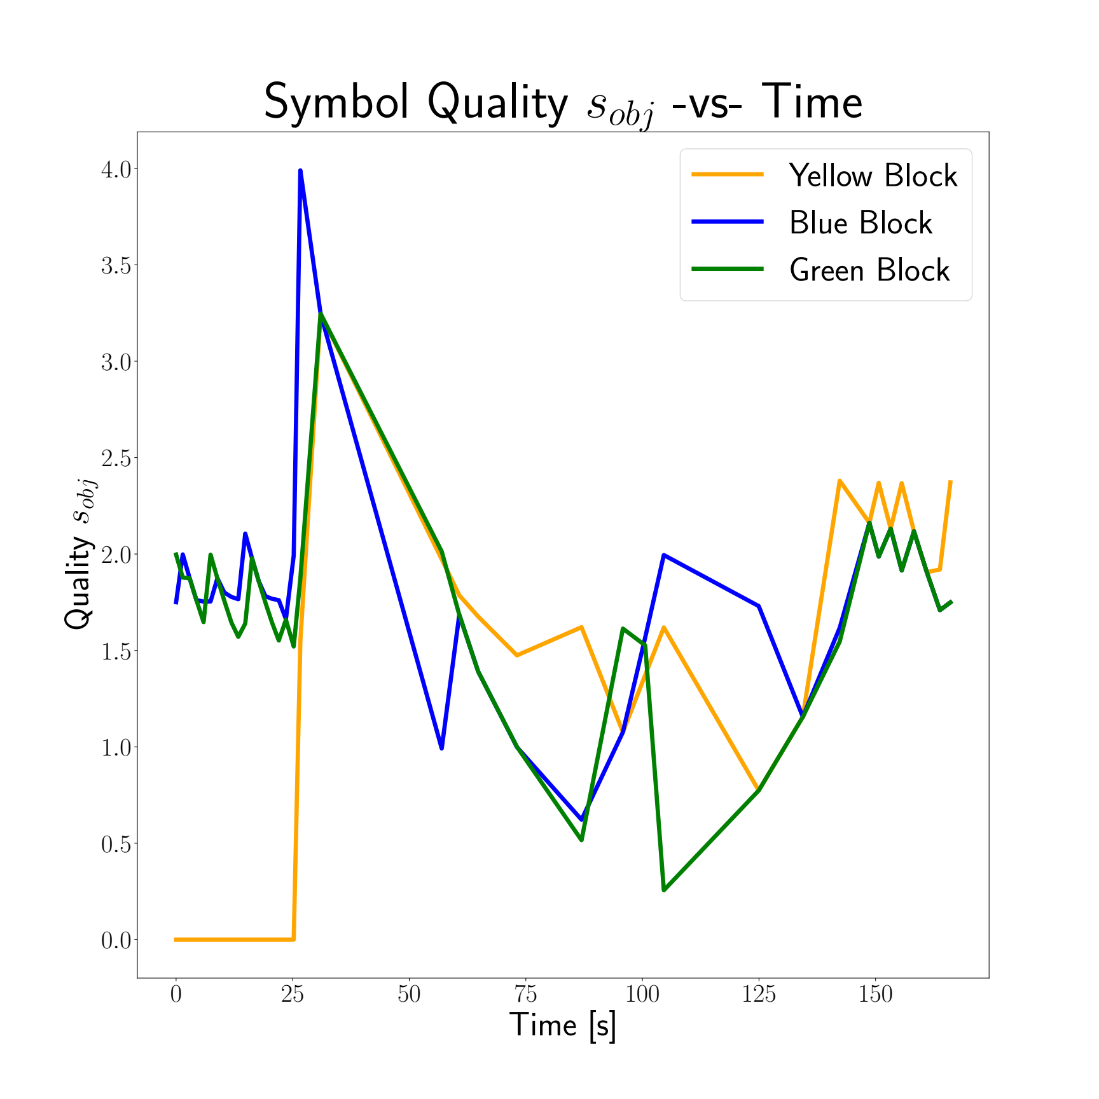
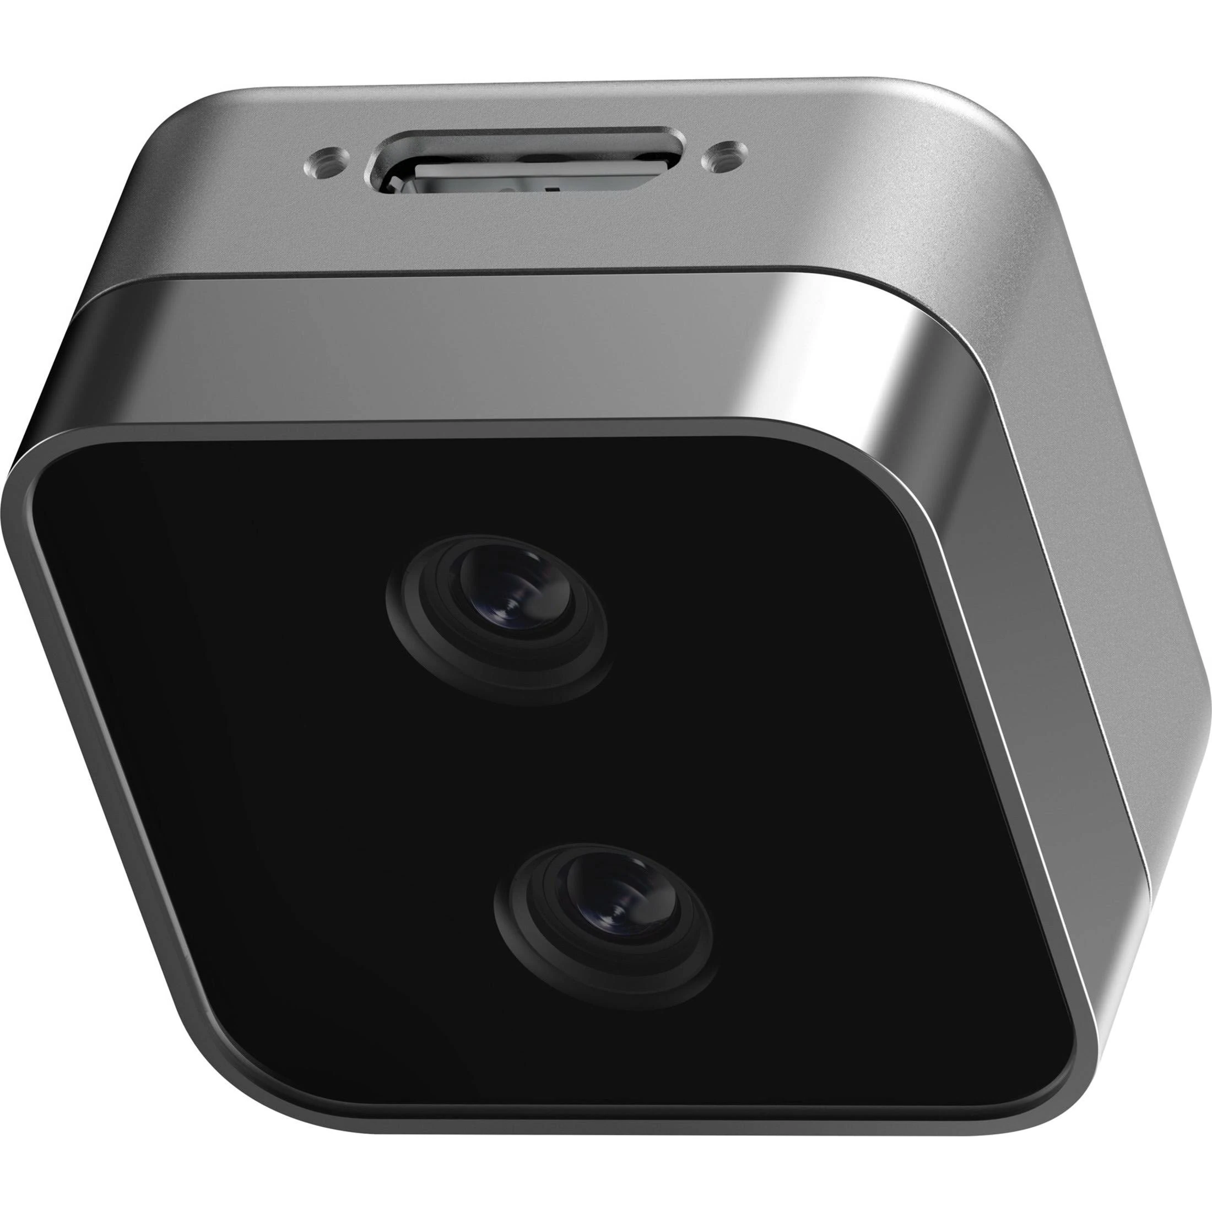
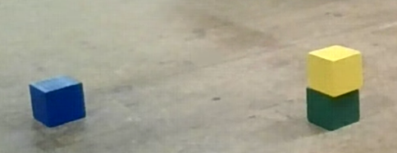
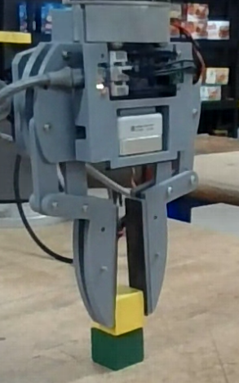
OWL
ViT
q3
OWL
ViT
q3
B
[ …,
{ Prob: {q1: 0.50, q2: 0.25, q3: 0.25},
Pose: [pX, pY, pZ, rW, rX, rY, rZ],
Count: 4,
Time: 14.5 },
… ]
B
[ …,
{ Prob: {q1: 0.50, q2: 0.25, q3: 0.25},
Pose: [pX, pY, pZ, rW, rX, rY, rZ],
Count: 4,
Time: 14.5 },
… ]
OWL
ViT
OWL
ViT
q2
q2
OWL
ViT
OWL
ViT
q1
q1
Entropy
Ranked
Object
Memory
Entropy
Ranked
Object
Memory
s_{obj}
s_{obj}
A
A
Beliefs:
Bayesian
Update
Beliefs:
Bayesian
Update
Ranked Memory:
Reconcile Collisions
Filter by Score
Update action results
Ranked Memory:
Reconcile Collisions
Filter by Score
Update action results
BT
BT
s’_{obj}
s’_{obj}
PDDL
Stream
PDDL
Stream
Symbol Grounding:
Reconcile Collisions
Compute Joint P
Filter by score
Rank by score
Symbol Grounding:
Reconcile Collisions
Compute Joint P
Filter by score
Rank by score

