Slide 1
JAG
This deck is grounded in the supplied evidence pack.
This deck is grounded in the supplied evidence pack.
- JAG: Joint Attribute Graphs for Filtered Nearest Neighbor Search
Notes:
Source Trace:
Source: JAG.pdf p.1 55be30fe29f54eef-section-0001 - JAG: Joint Attribute Graphs for Filtered Nearest Neighbor Search

Slide 2
Problem / Motivation
1. Introduction
- 1. Introduction - JAG: Joint Attribute Graphs for Filtered Nearest Neighbor Search
01
02
03
1. Introduction
Notes:
Source Trace:
Source: JAG.pdf p.1 55be30fe29f54eef-section-0005 - 1. Introduction

Slide 3
Method / Summary
Abstract
- Abstract - JAG: Joint Attribute Graphs for Filtered Nearest Neighbor Search
01
02
03
Abstract
Notes:
Source Trace:
Source: JAG.pdf p.1 55be30fe29f54eef-section-0004 - Abstract

Slide 4
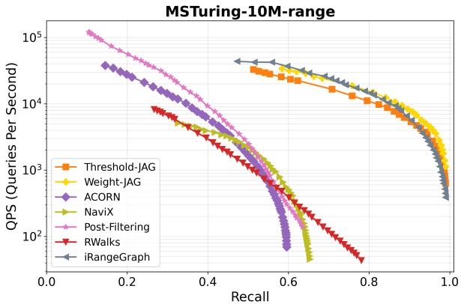
Figure Evidence
Figure 1. QPS vs. recall plot for range filters on the MSTuring-10M dataset. Please refer to Section 4 for experimental details.
- Figure 1. QPS vs. recall plot for range filters on the MSTuring-10M dataset. Please refer to Section 4 for experimental details.
Figure 1. QPS vs. recall plot for range filters on the MSTuring-10M dataset. Please refer to Section 4 for experimental details. | Source: JAG.pdf, p. 1
Notes:
Source Trace:
Source: JAG.pdf p.1 fig_001 - Figure 1. QPS vs. recall plot for range filters on the MSTuring-10M dataset. Please refer to Section 4 for experimental

Slide 5
Takeaways
However, a significant challenge arises in the wide selectivity range between these two extremes. In this transition zone, the valid subset is too small for post-filtering to be ef
01 However, a significant challenge arises in the wide selectivity range between these two extremes. In this transition zone, the valid subset is too small for post-filtering to be ef
02 Abstract
03 1. Introduction
Notes:
Source Trace:
Source: JAG.pdf p.2 55be30fe29f54eef-section-0015 - However, a significant challenge arises in the wide selectivity range between these two extremes. In this transition zon

