Slide 1
Session 1 of 2 Learning Goals
Introduction
Manage identity and access
Administer Azure AD security
Configure Azure AD PIM
Implement platform protection
Configure network, container, host security
Manage security operations
Configure Azure Security Center
Configure Azure DevOps

Slide 2
Session 2 of 2 Learning Goals
Manage security operations, continued
Configure security policies
Configure security alerts
Secure data and applications
Configure data classification
Protect data infrastructure
Configure application security and Key Vault

Slide 3
Level set
The job role in play is the Azure Security Administrator
Identify which security controls are available for different Azure products and know their configuration basics
This is a "crash course"
Plan to review these materials more than once
Five-minute break at midpoint
Please ask/answer questions and provide feedback in the Q/A panel, not the group chat

Slide 4
Exam/Certification Updates
Microsoft Worldwide Learning updates the exams every 2 months
They update certifications every year
This summer marks the anniversary of AZ-500
Be on the lookout for changes

Slide 5
Tim's Certification Study Pyramid
Interdependence
Content knowledge
Practical application
Test-taking skills

Slide 6
Manage Identity and Access

Slide 7

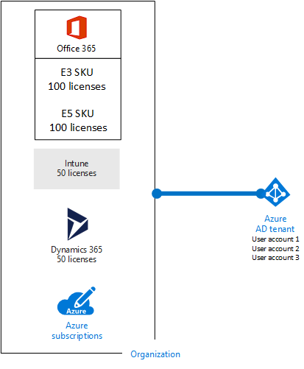
Azure AD and Subscriptions

Slide 8
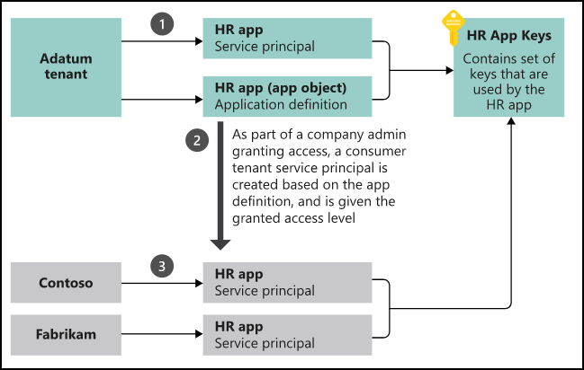
App registrations and service principals

Slide 9
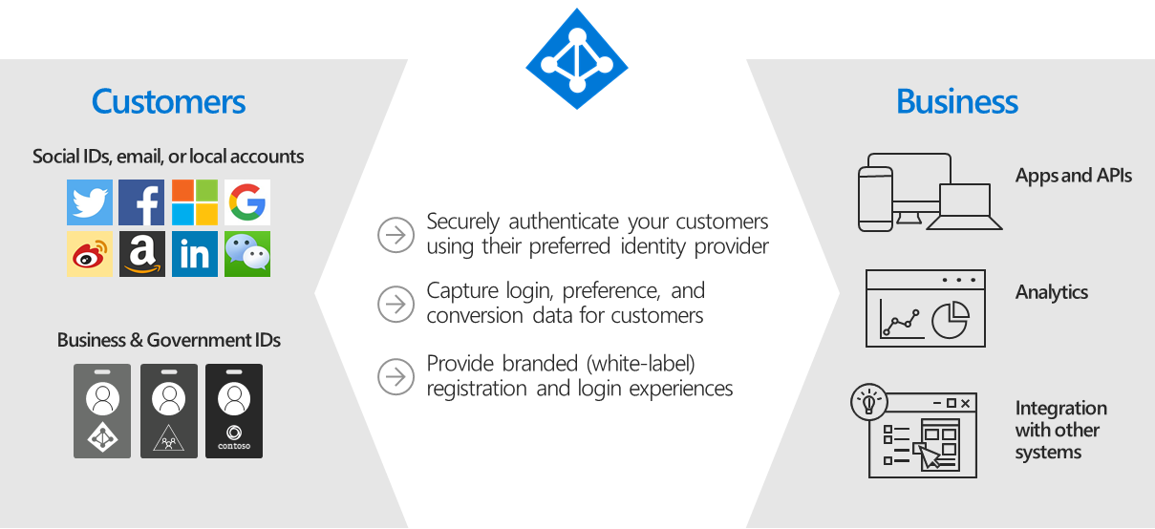
Azure AD B2C

Slide 10
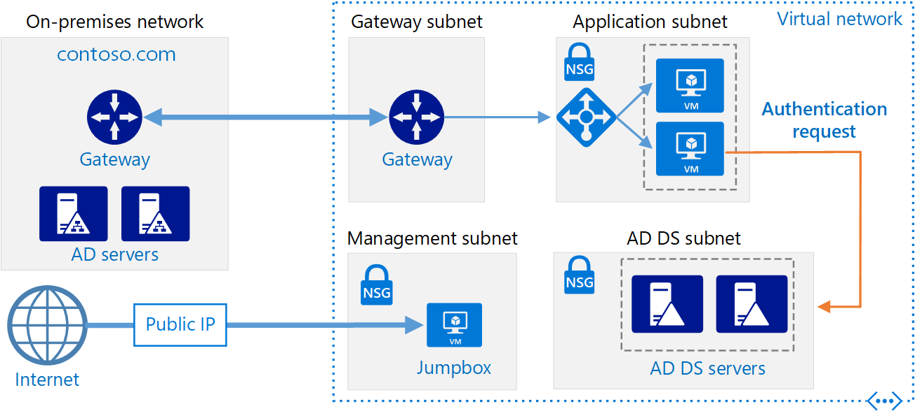
Azure AD Domain Services

Slide 11
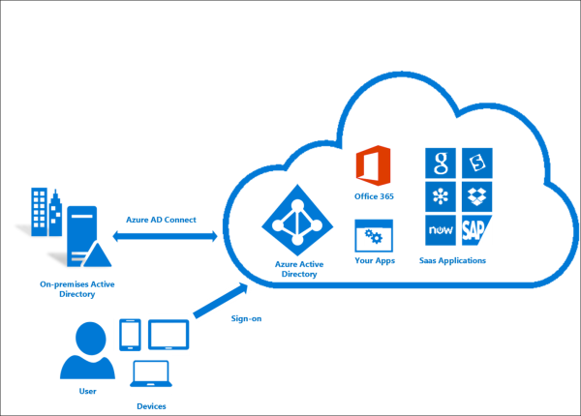
Azure AD SSO

Slide 12
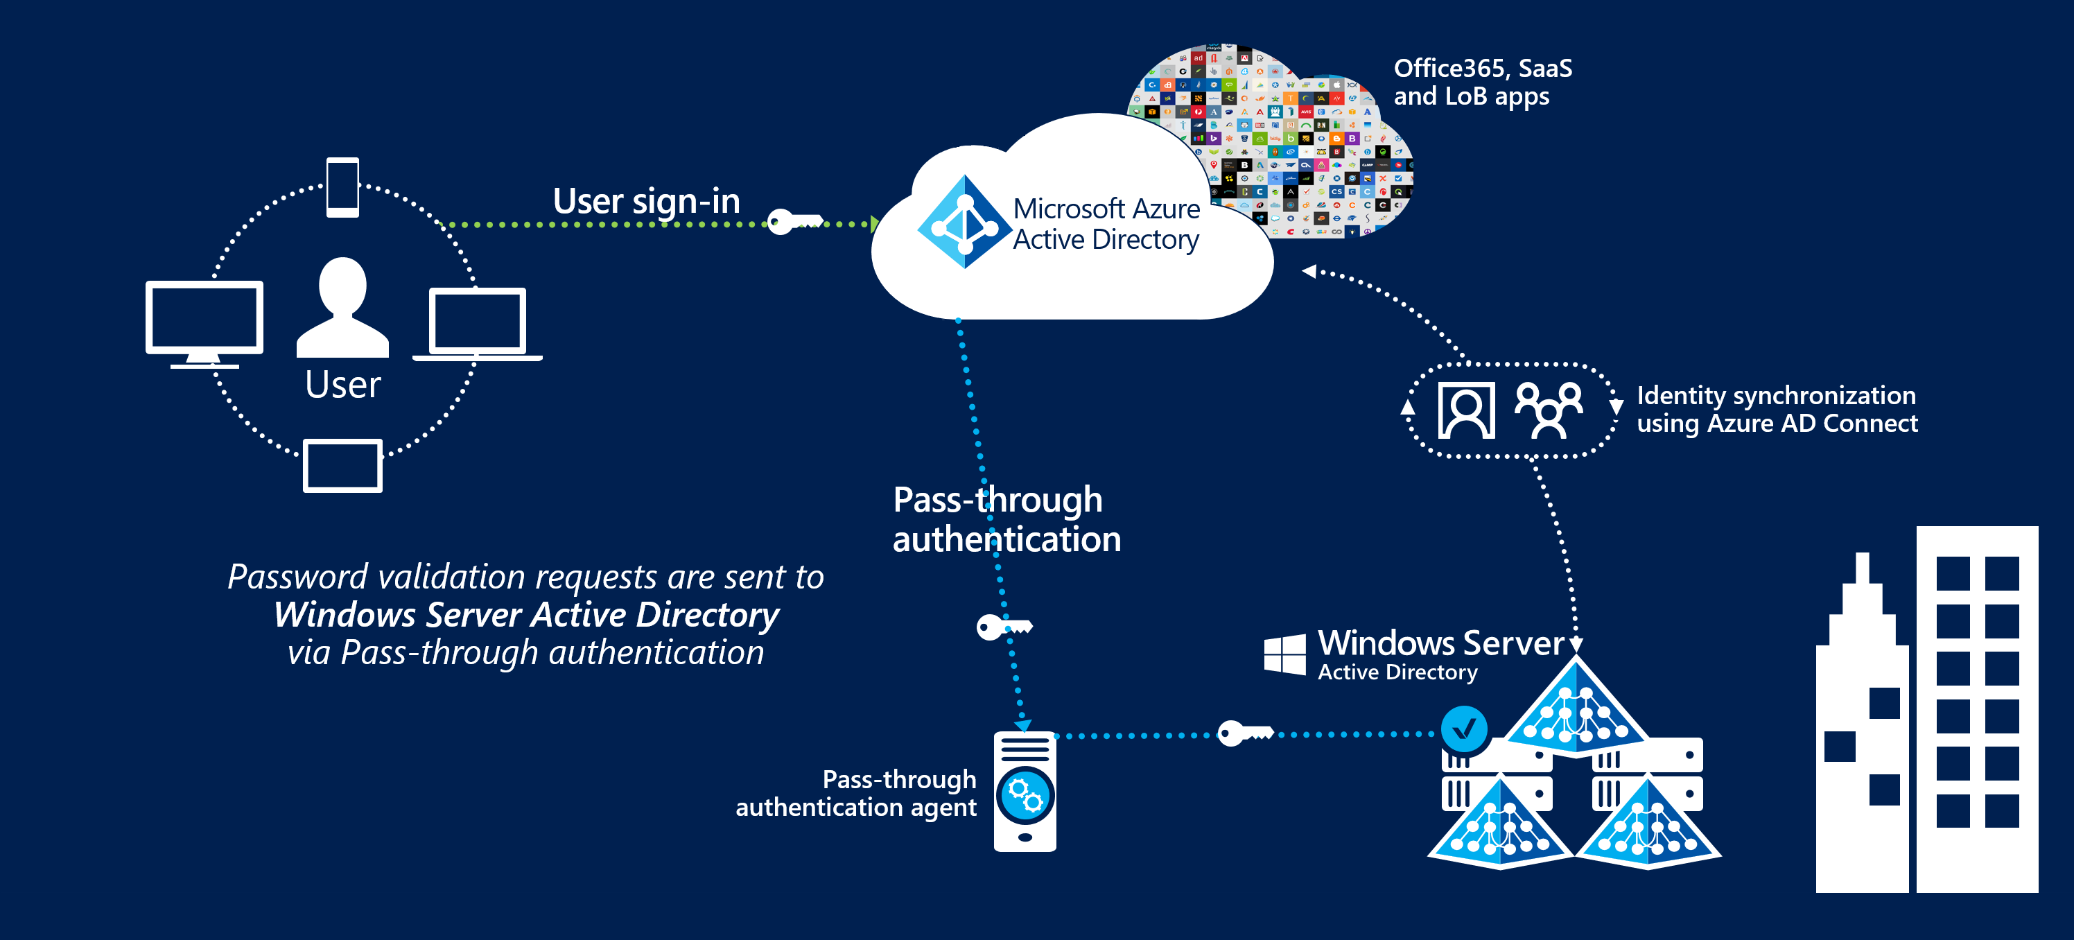
Passthrough Authentication

Slide 13
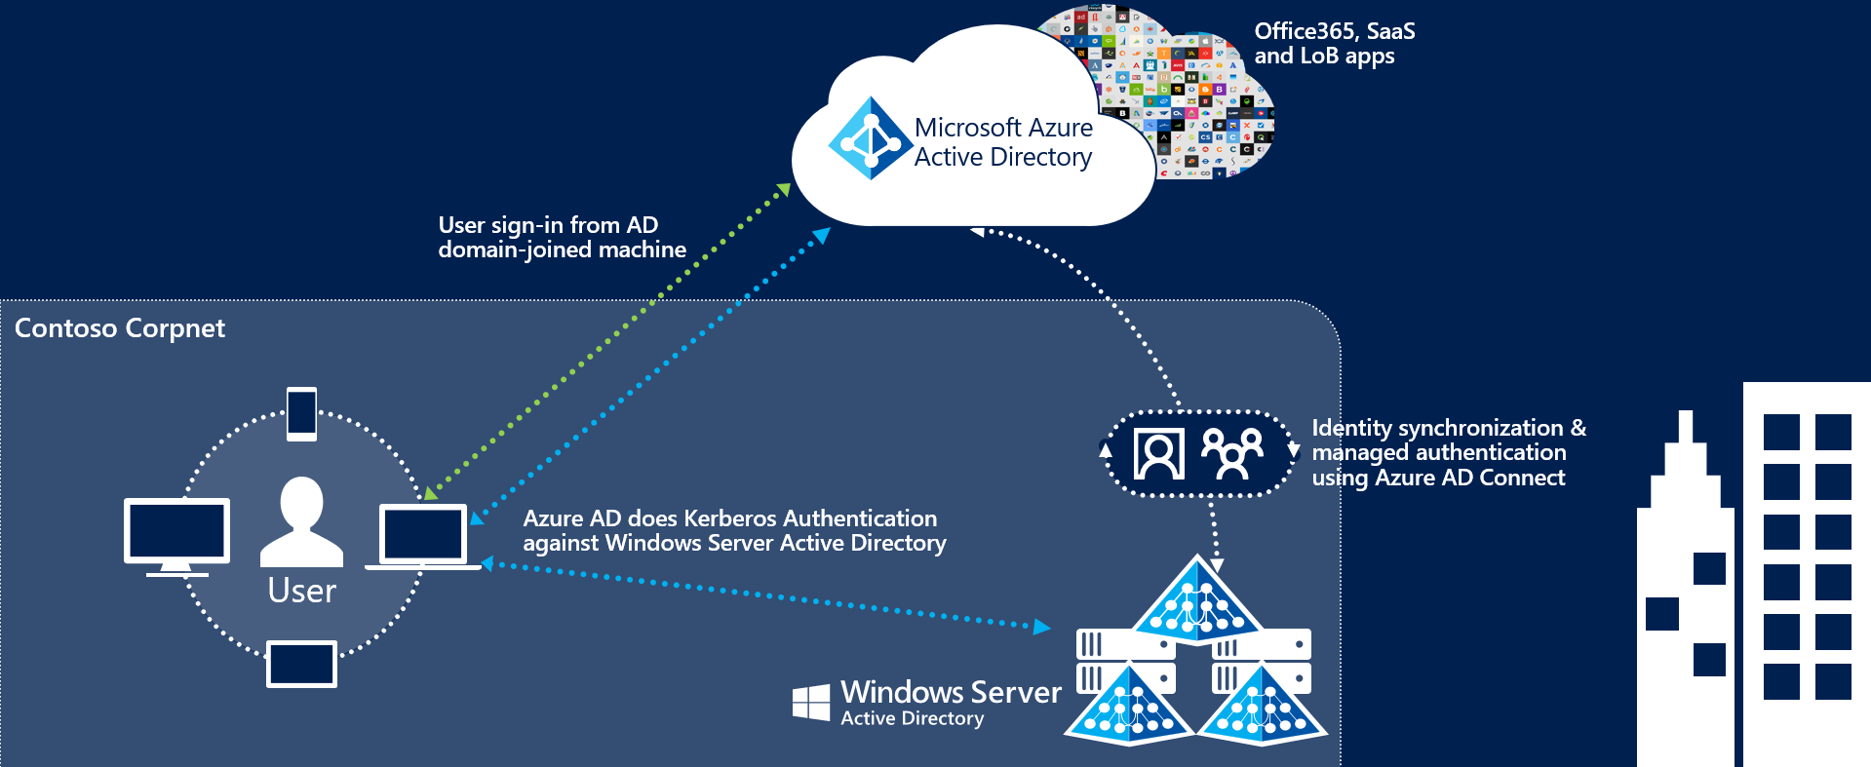
Seamless Single Sign-On

Slide 14
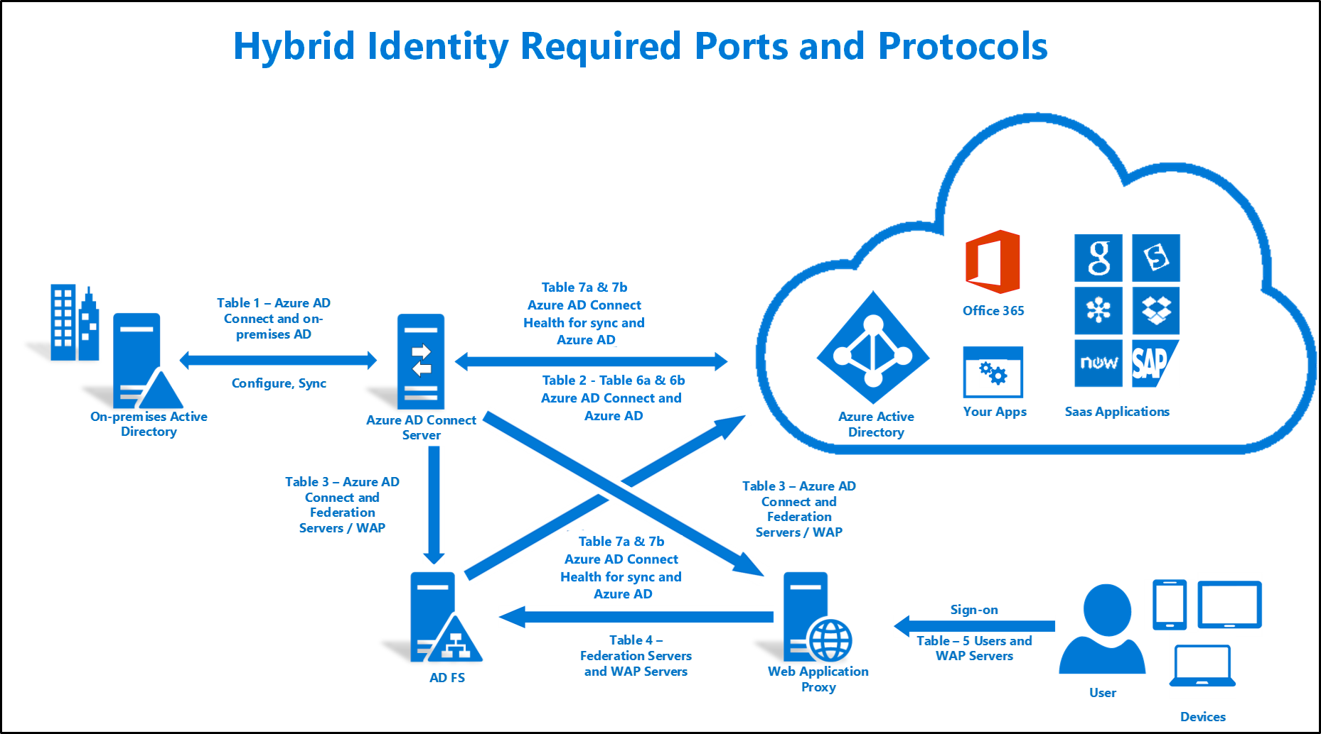
AD FS Federation

Slide 15
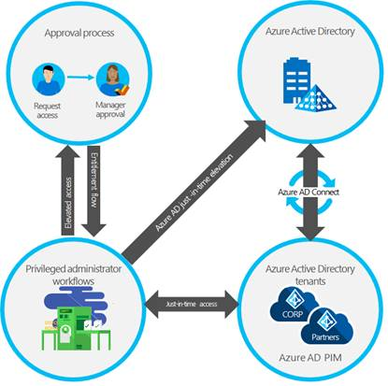
Azure AD PIM

Slide 16
Implement Platform Protection

Slide 17
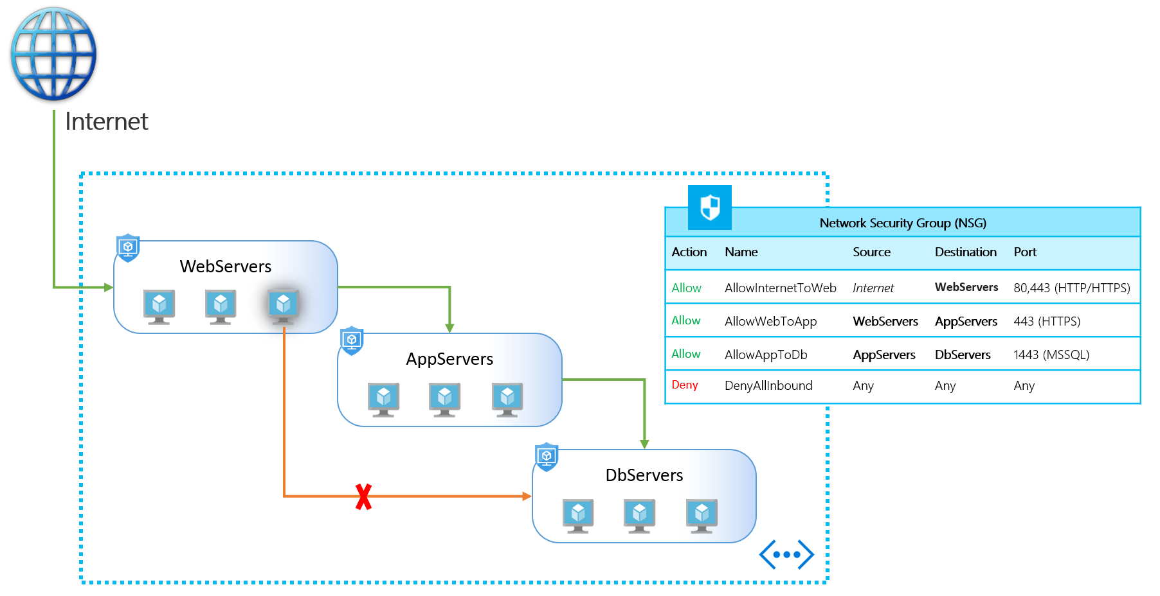
NSGs and ASGs

Slide 18
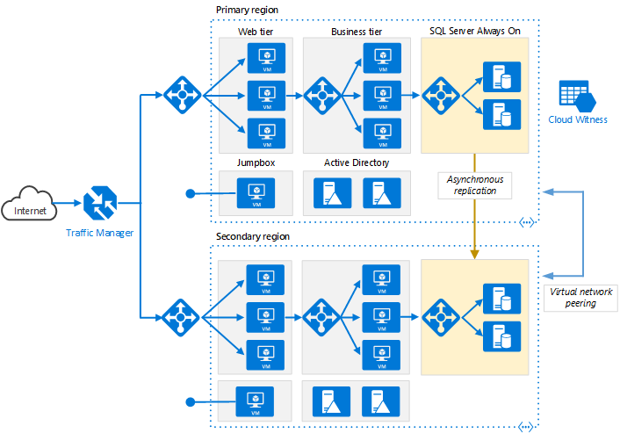
VM High Availability

Slide 19
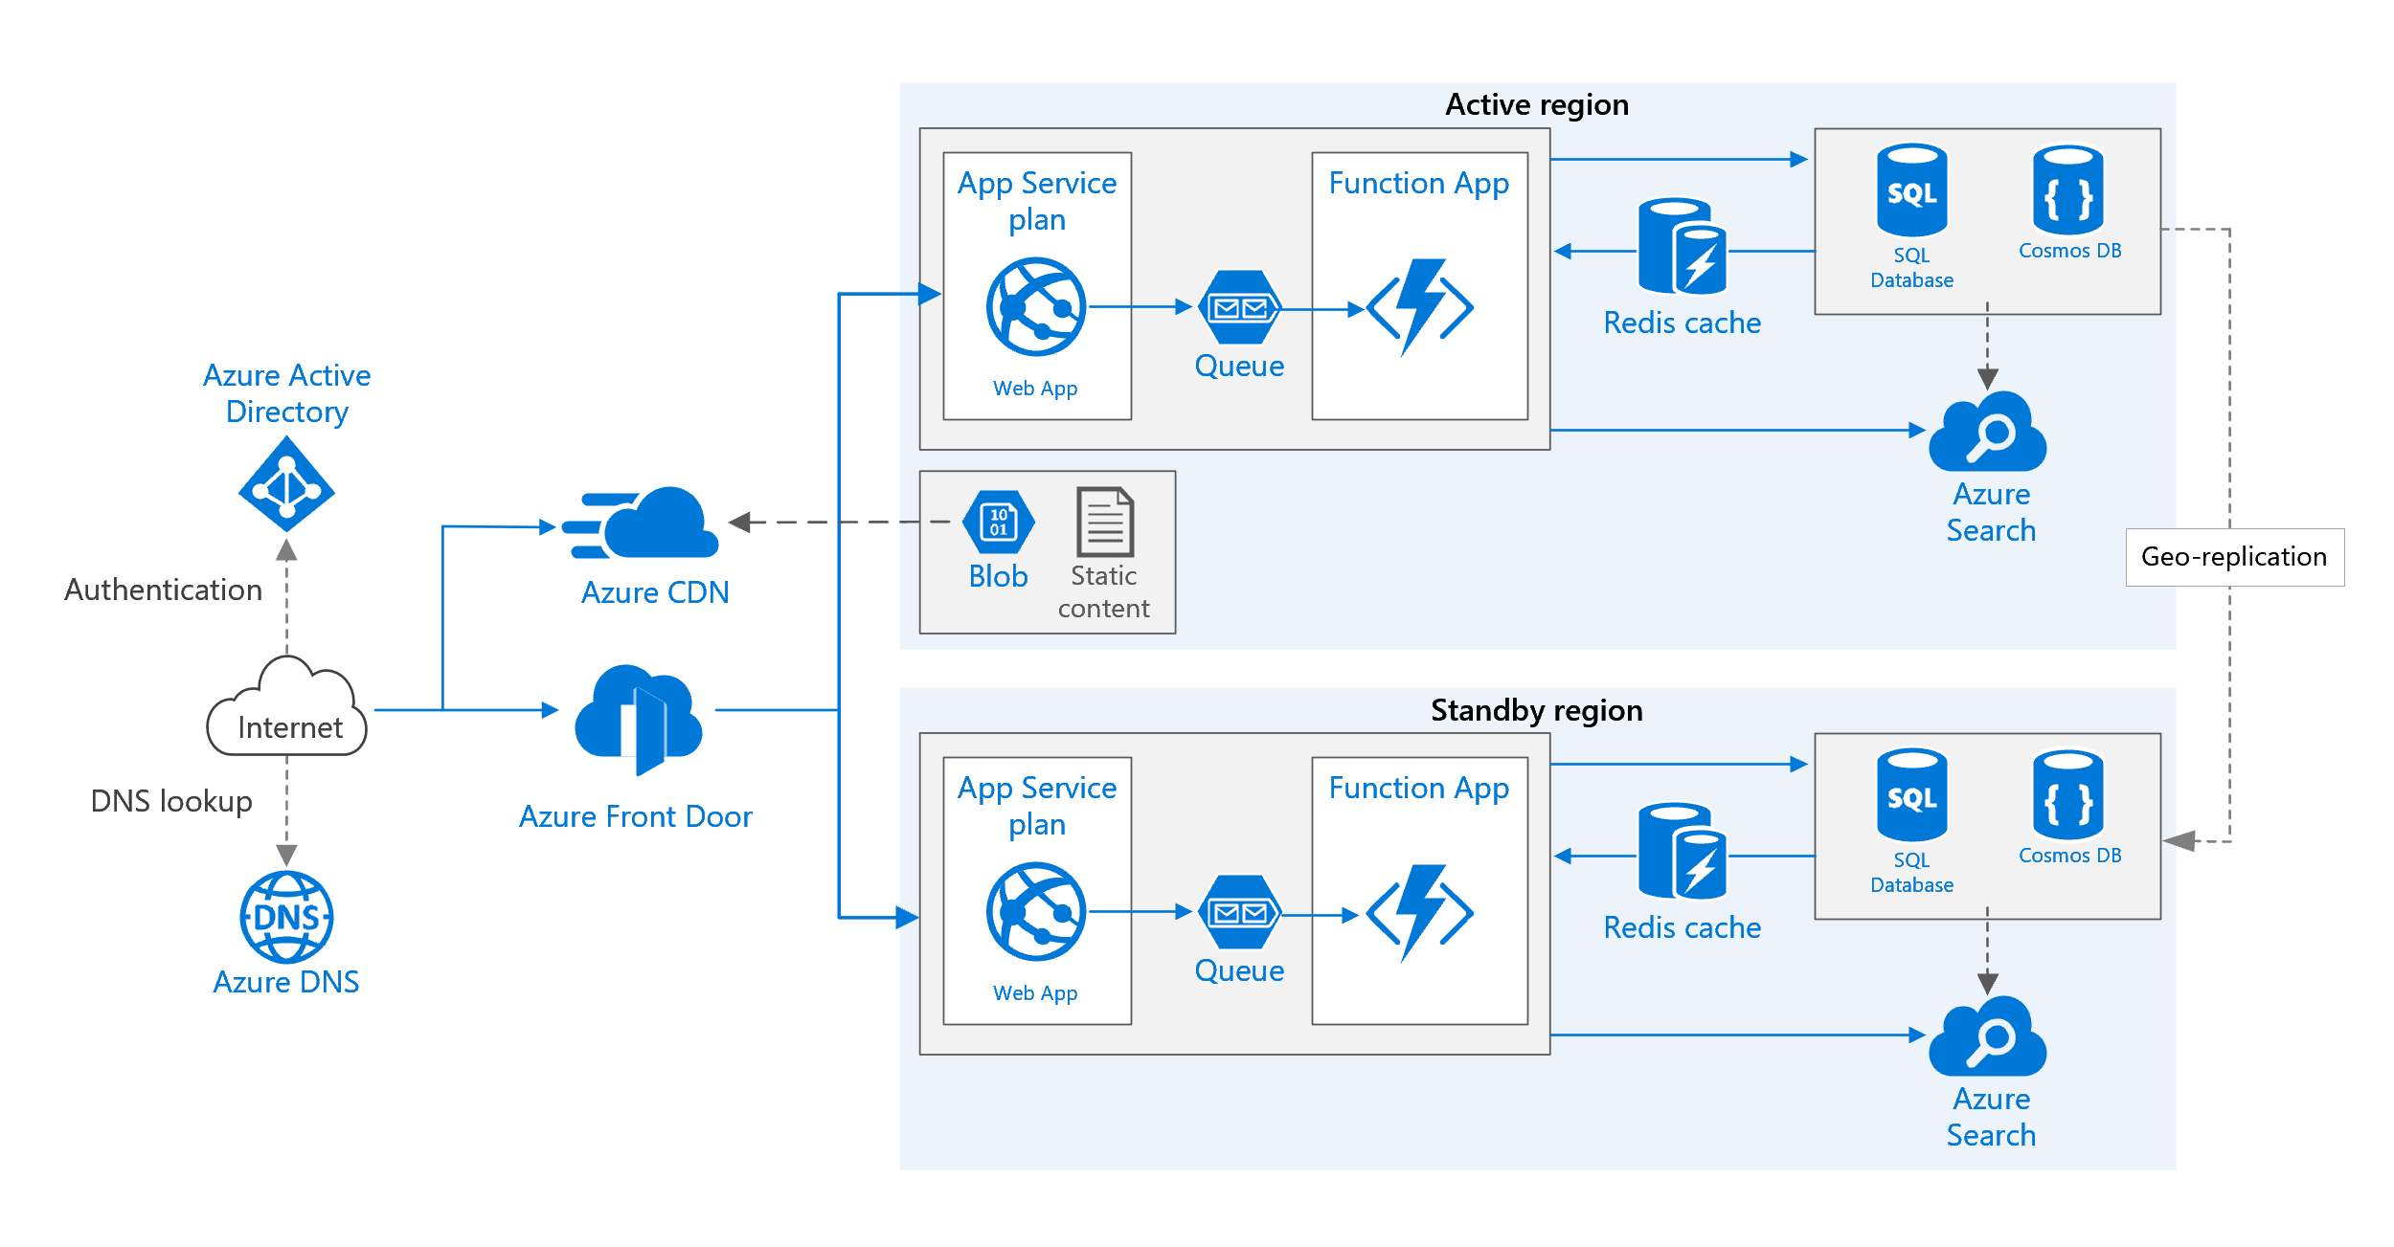
Web App High Availability

Slide 20
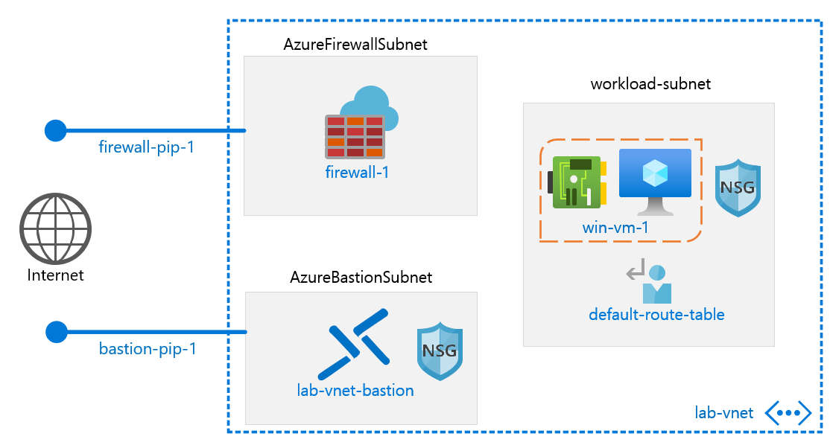
Azure Firewall

Slide 21
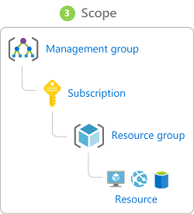
Azure Management Scopes
/ Tenant Root

Slide 22
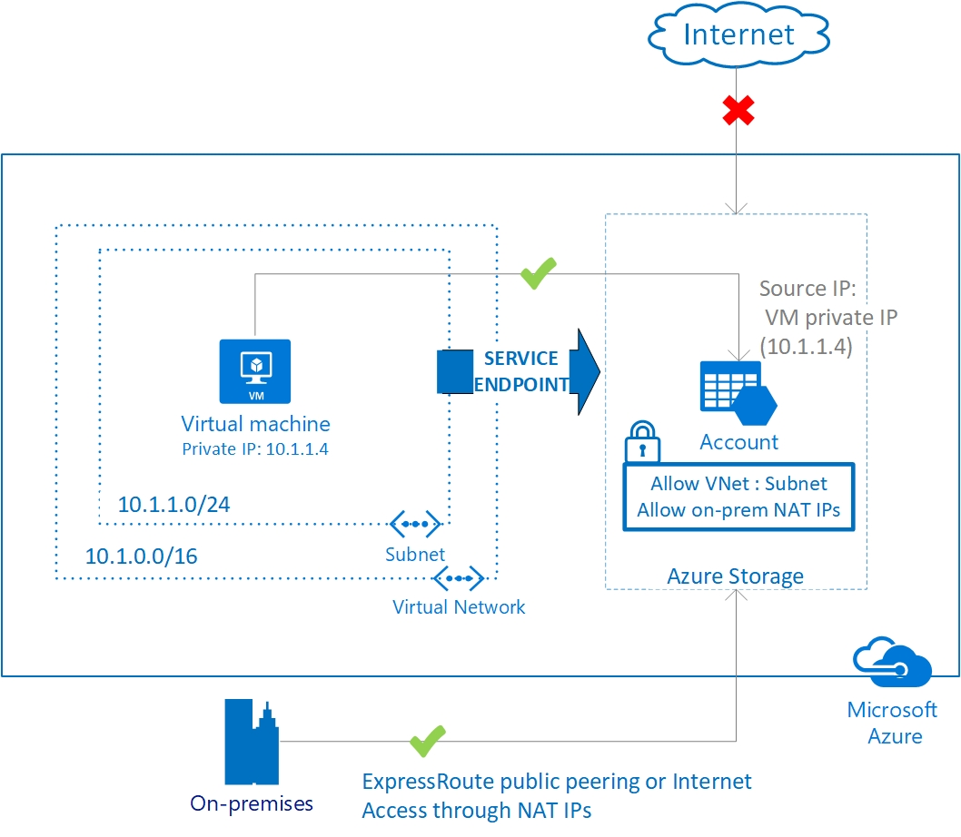
Service endpoints

Slide 23
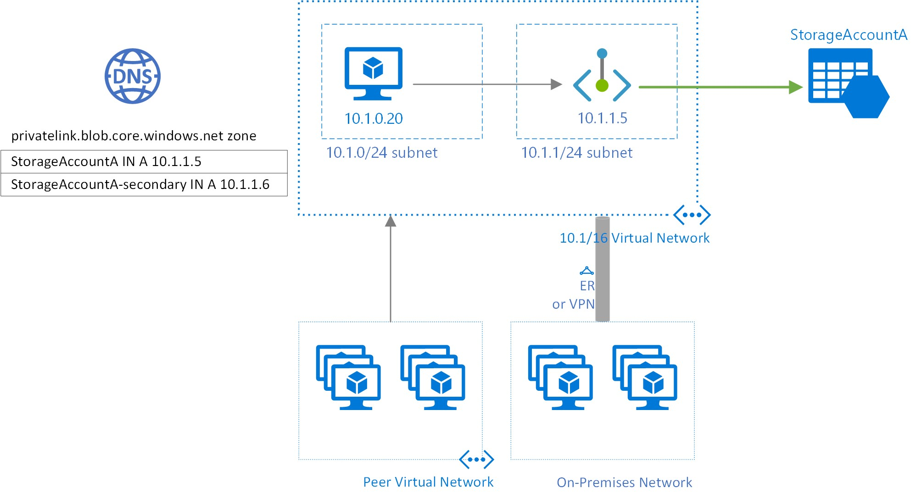
Private endpoints

Slide 24
Manage Security Operations

Slide 25
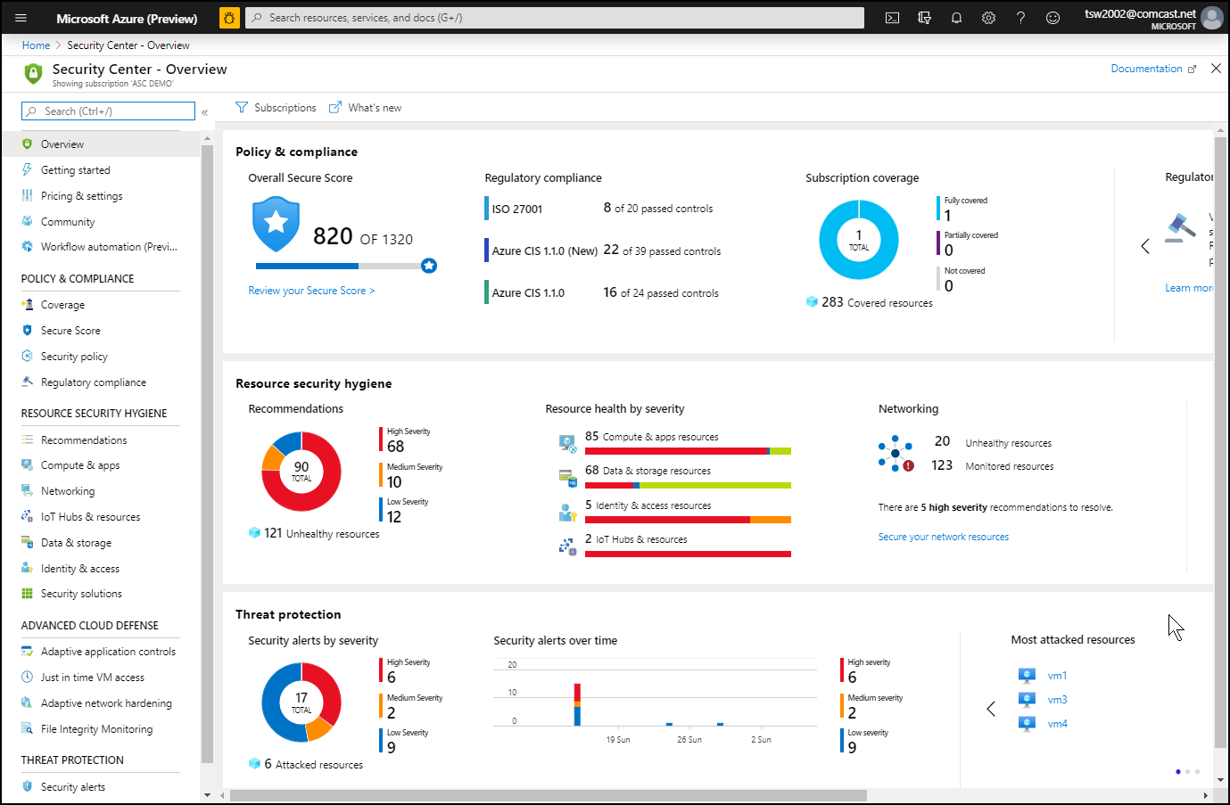
Azure Security Center

Slide 26
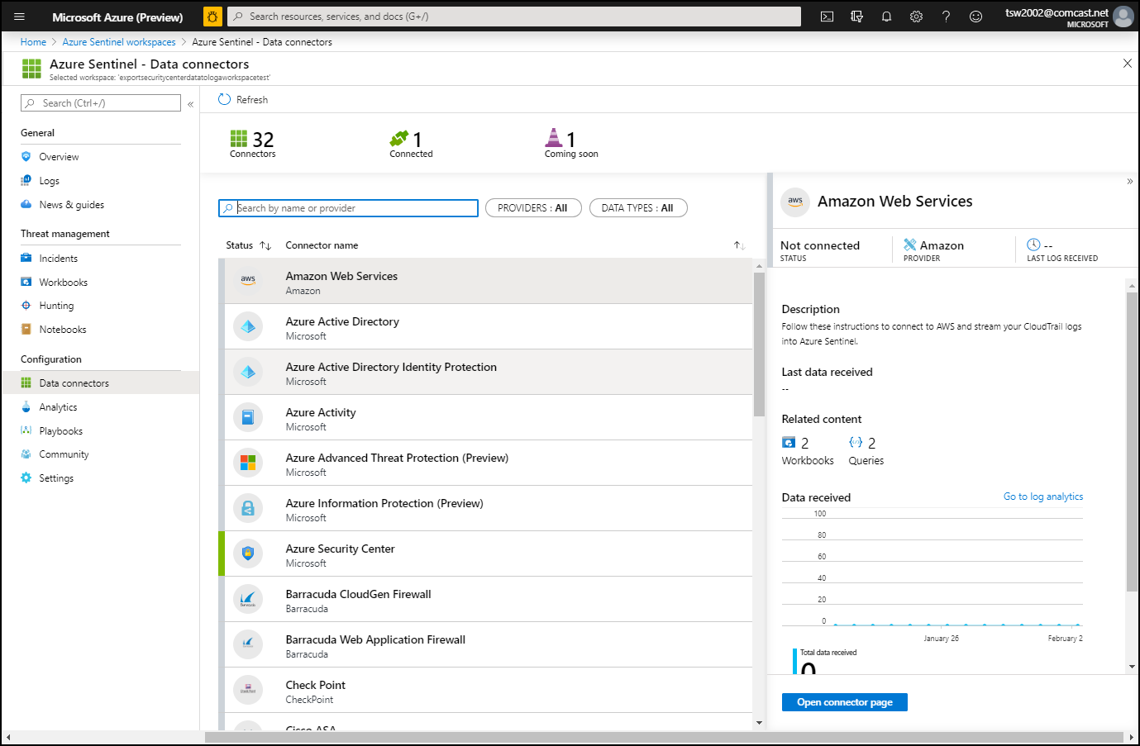
Azure Sentinel

Slide 27
Secure Data and Applications

Slide 28
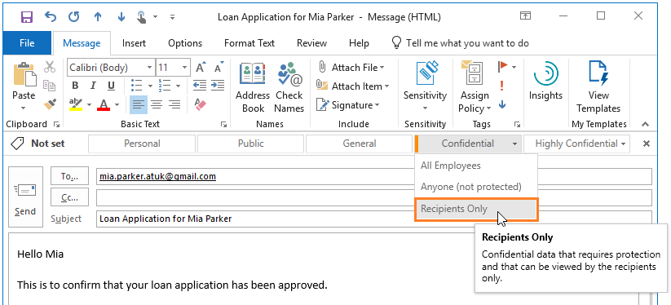
Azure Information Protection

Slide 29
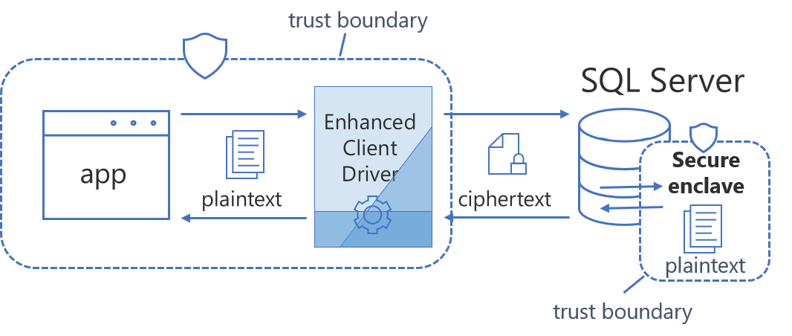
Always Encrypted

Slide 30
Exam AZ-500 Item Types

Slide 31
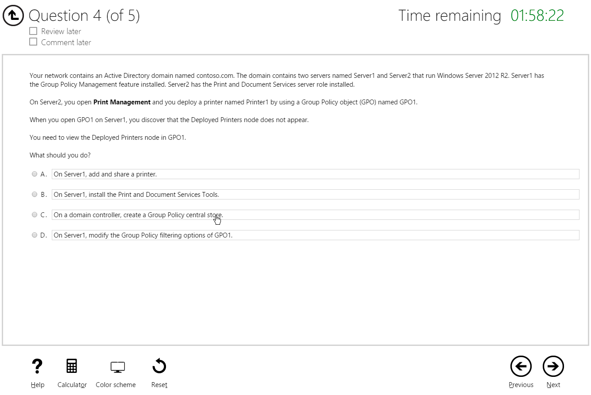
Single Answer Multiple Choice

Slide 32
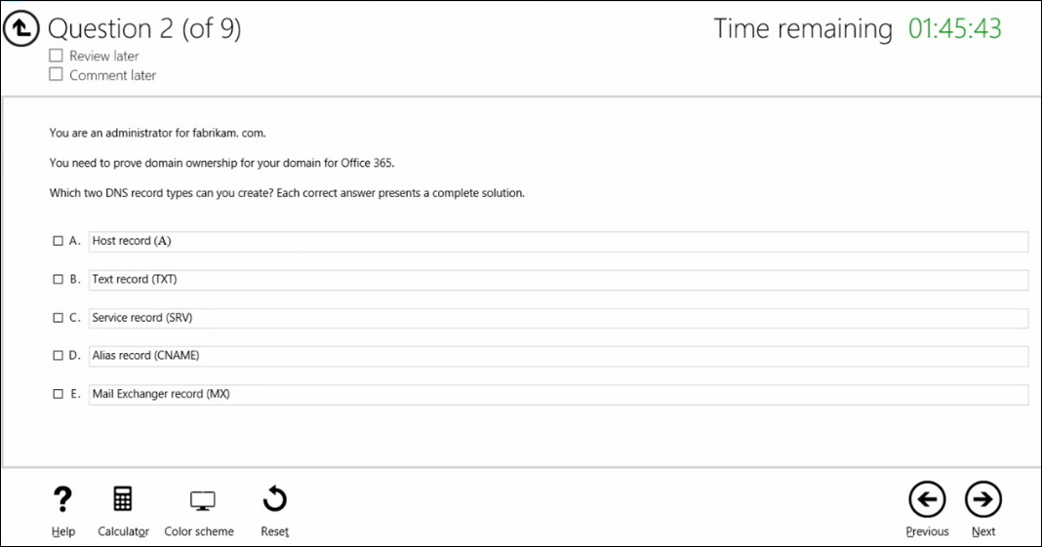
Multiple Answer Multiple Choice

Slide 33
Repeated Scenario
You need to move an Azure VM to another hardware host.
Solution: You redeploy the VM.
Does this solution meet the goal?
Yes
No

Slide 34
Repeated Scenario
You need to move an Azure VM to another hardware host.
Solution: You enable boot diagnostics.
Does this solution meet the goal?
Yes
No

Slide 35
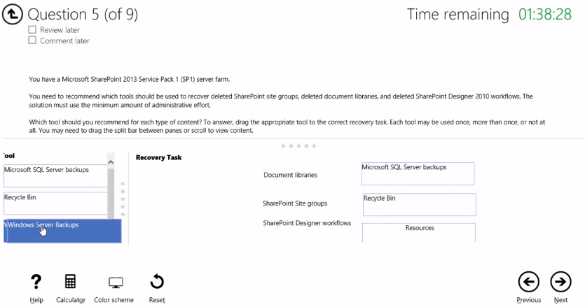
Select and Place

Slide 36
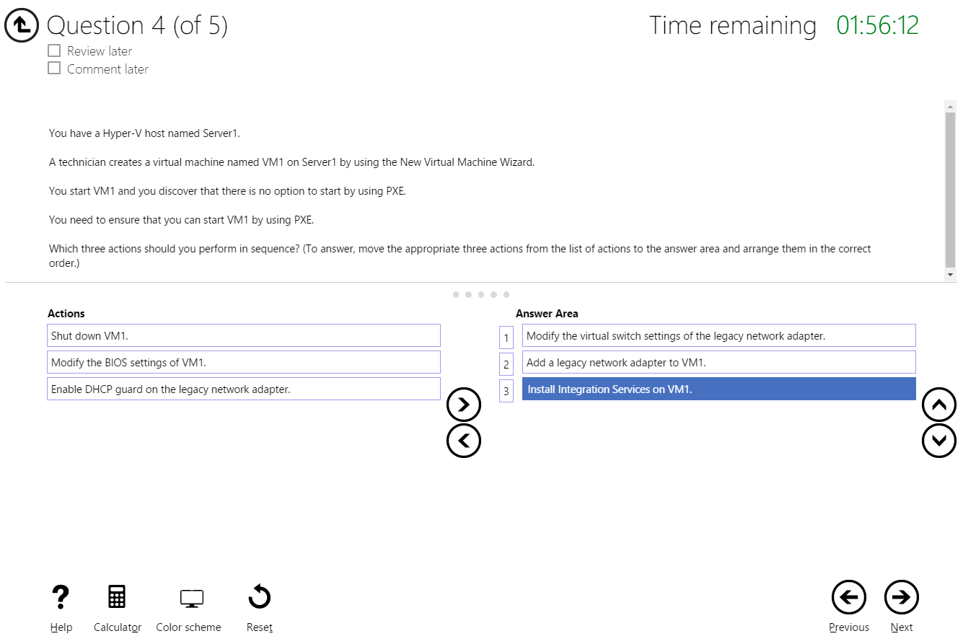
Build List and Reorder

Slide 37
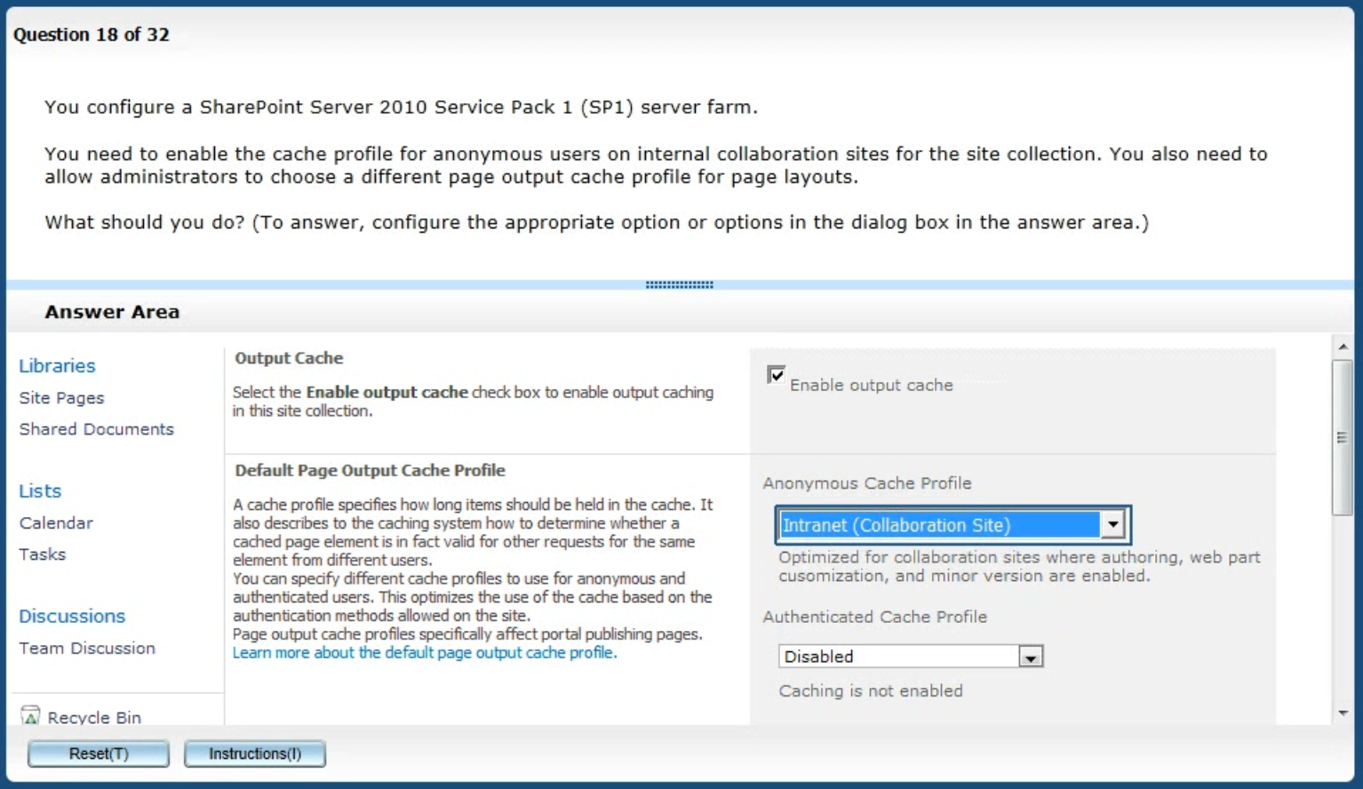
Active Screen/Fill in the Blank

Slide 38
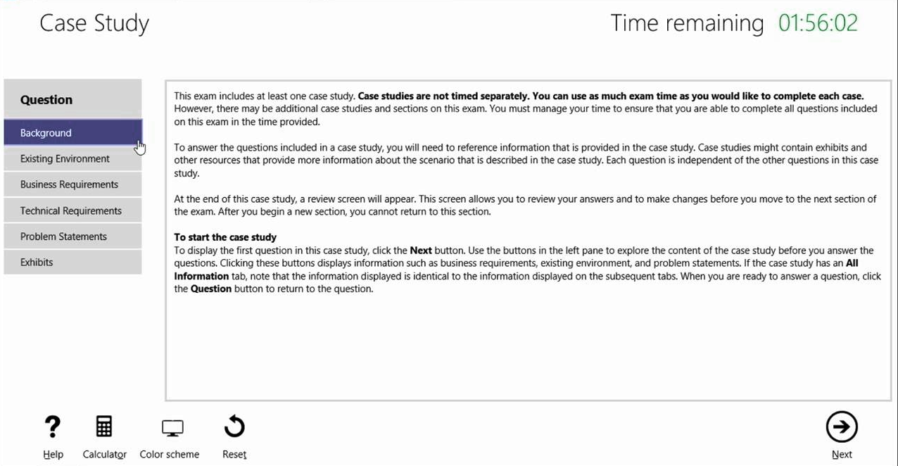
Case Study

Slide 39
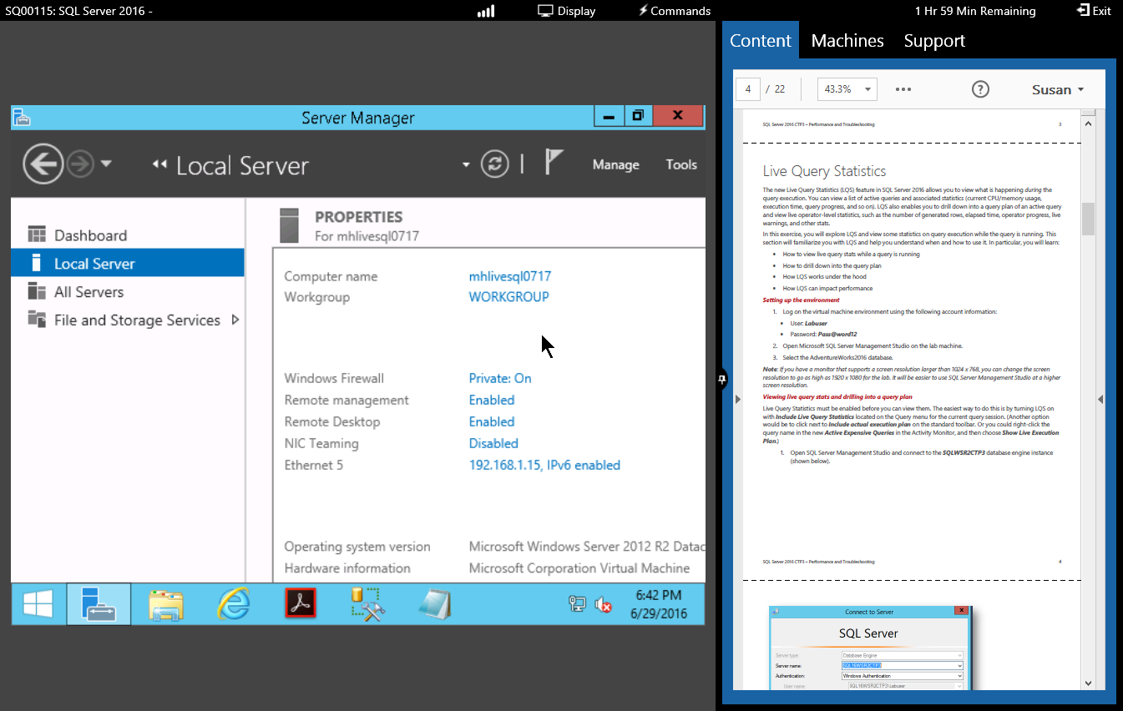
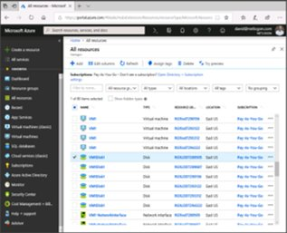
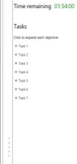



Performance-Based Lab

Slide 40
AZ-500 Exam Strategy/Tips
Be prepared for performance-based labs
Have intermediate skill with:
PowerShell
Have at least beginner skill with
KQL
Azure CLI
Be especially familiar with Azure AD PIM

