Slide 1

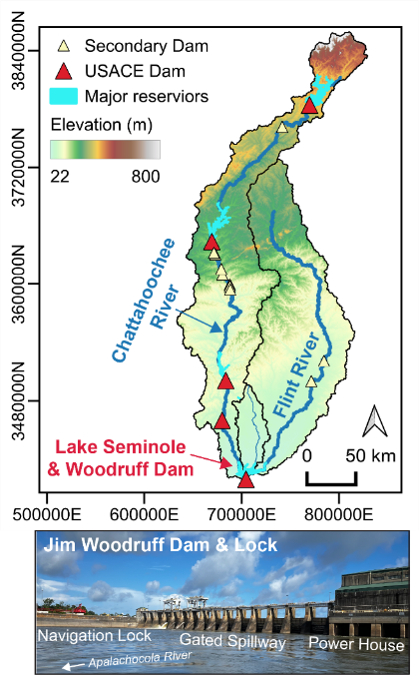


Modelling the Morphodynamic Response To Flow Regulation In An Artificial Reservoir
Session: HS9.2 – EGU26-13816
Vienna 7 May 2026
Luca Cortese¹, Mark Behn¹, Anthony Edgington¹, Sydney Crisanti², Travis Dahl², Christopher Sheehan³, Danielle Tarpley², Amanda Tritinger², and Noah Snyder¹
¹Boston College, Earth and Environmental Sciences, Chestnut Hill, MA, United States of America
²Coastal and Hydraulics Laboratory, U.S. Army Engineer Research and Development Center, Vicksburg, MS, United States of America
³College of Arts and Sciences: Earth and Environmental Geosciences, University of Dayton, Dayton, OH, United States of America
Contact: cortel@bc.edu

Slide 2
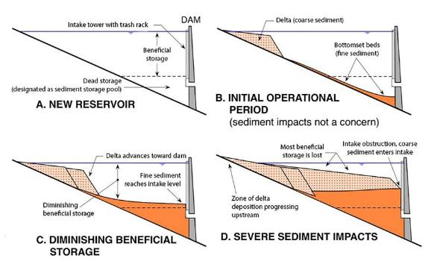
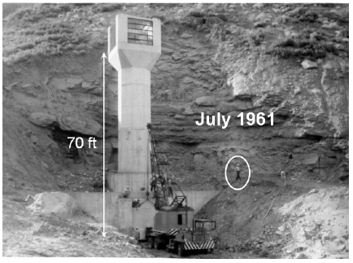
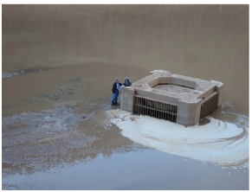
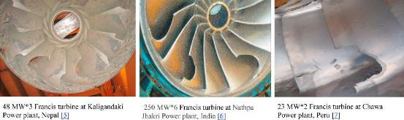
Why do we care about sediment in reservoirs?
Drawbacks of sedimentation (just a few)
Storage reduction
Interference with dam operations
Reduced hydropower reliability
Dam safety risks and machinery damage
Downstream erosion
Greg Morris, GLM Engineering
Singh Thapa et al. (2015)
Randle et al. (2019)

Slide 3
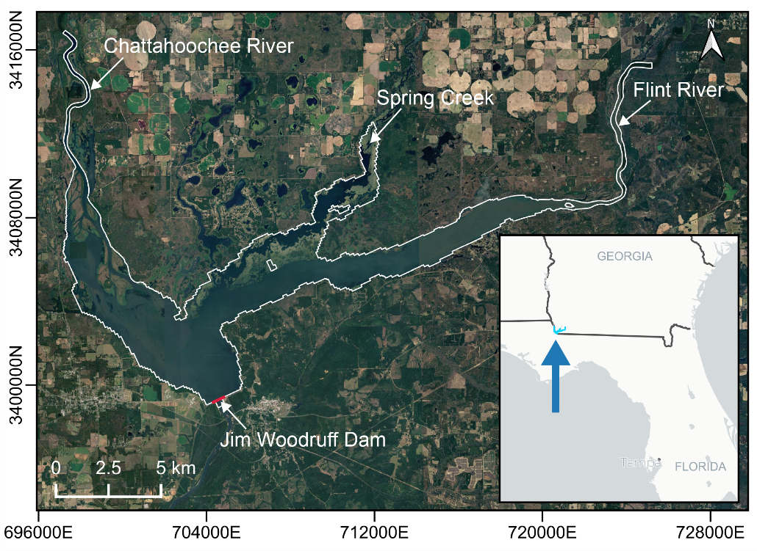
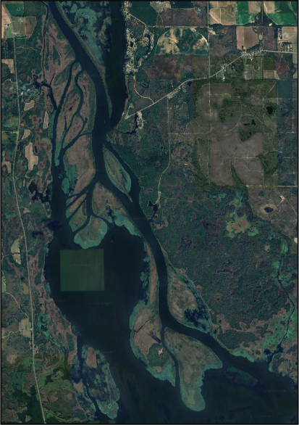
Goal: estimate sedimentation across Lake Seminole
Reservoir operations
Constant water level
Annual water volume inflow
Similar between the two rivers
Chattahoochee arm | Flint arm
Level of management
High | Low
Sub-daily hydropeaking | Natural (seasonal) flow
Depositional characteristics
Subaerial delta | Subaqueous only

Slide 4
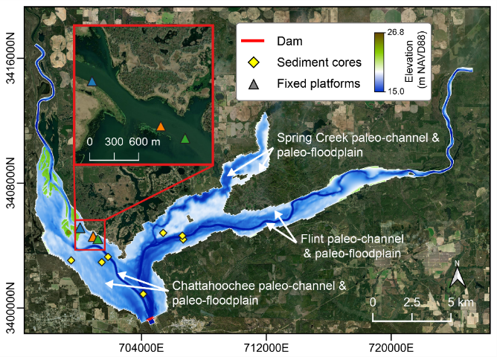
A Delft3D-FM model to estimate sedimentation
2D depth-averaged model
Delft3D-FM
(Flexible Mesh)
RTC
(Real Time Control)
Hydrodynamics
Sediment transport
Bed evolution
Control water level
Calibration/Validation
Hydrodynamic model | Flow velocity from ADCP
Sediment transport | SSC samples
Bed evolution | Sedimentation rates from cores

Slide 5
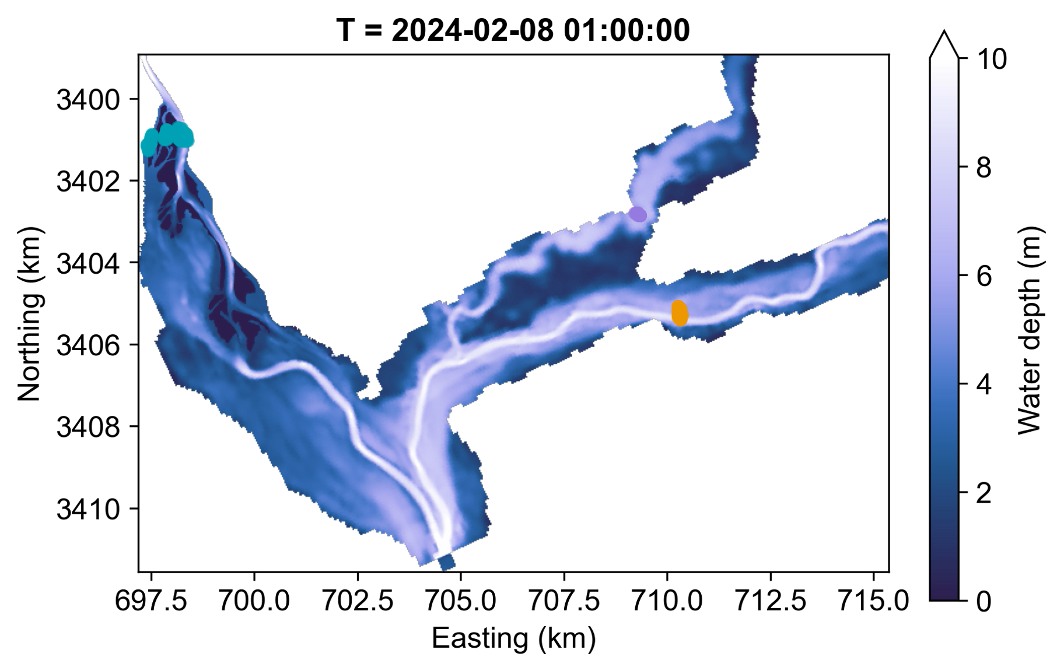
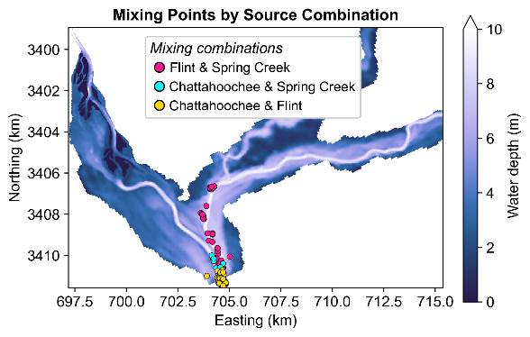
Chattahoochee and Flint waters have limited mixing
Particle tracking dorado (Hariharan et al., (2020)
Mixing only in proximity of the dam
Hariharan et al., (2020). dorado: A Python package for simulating passive particle transport in shallow-water flows. Journal of Open Source Software, 5(54), 2585, https://doi.org/10.21105/joss.02585

Slide 6
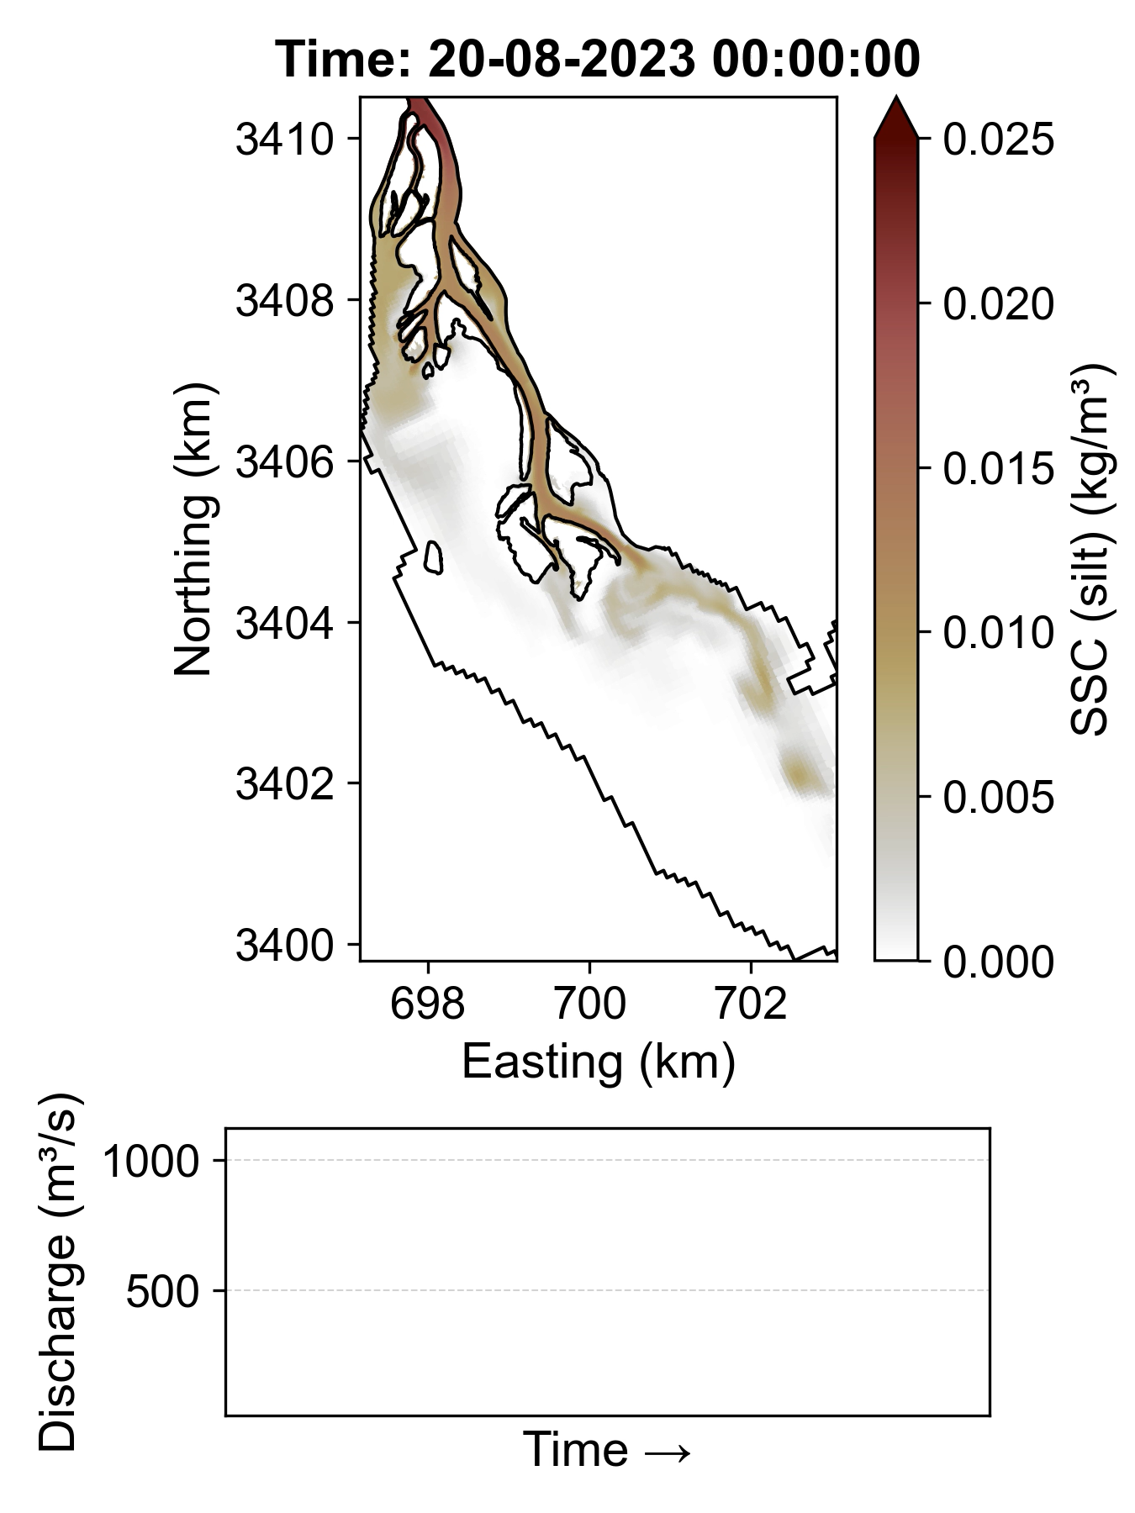
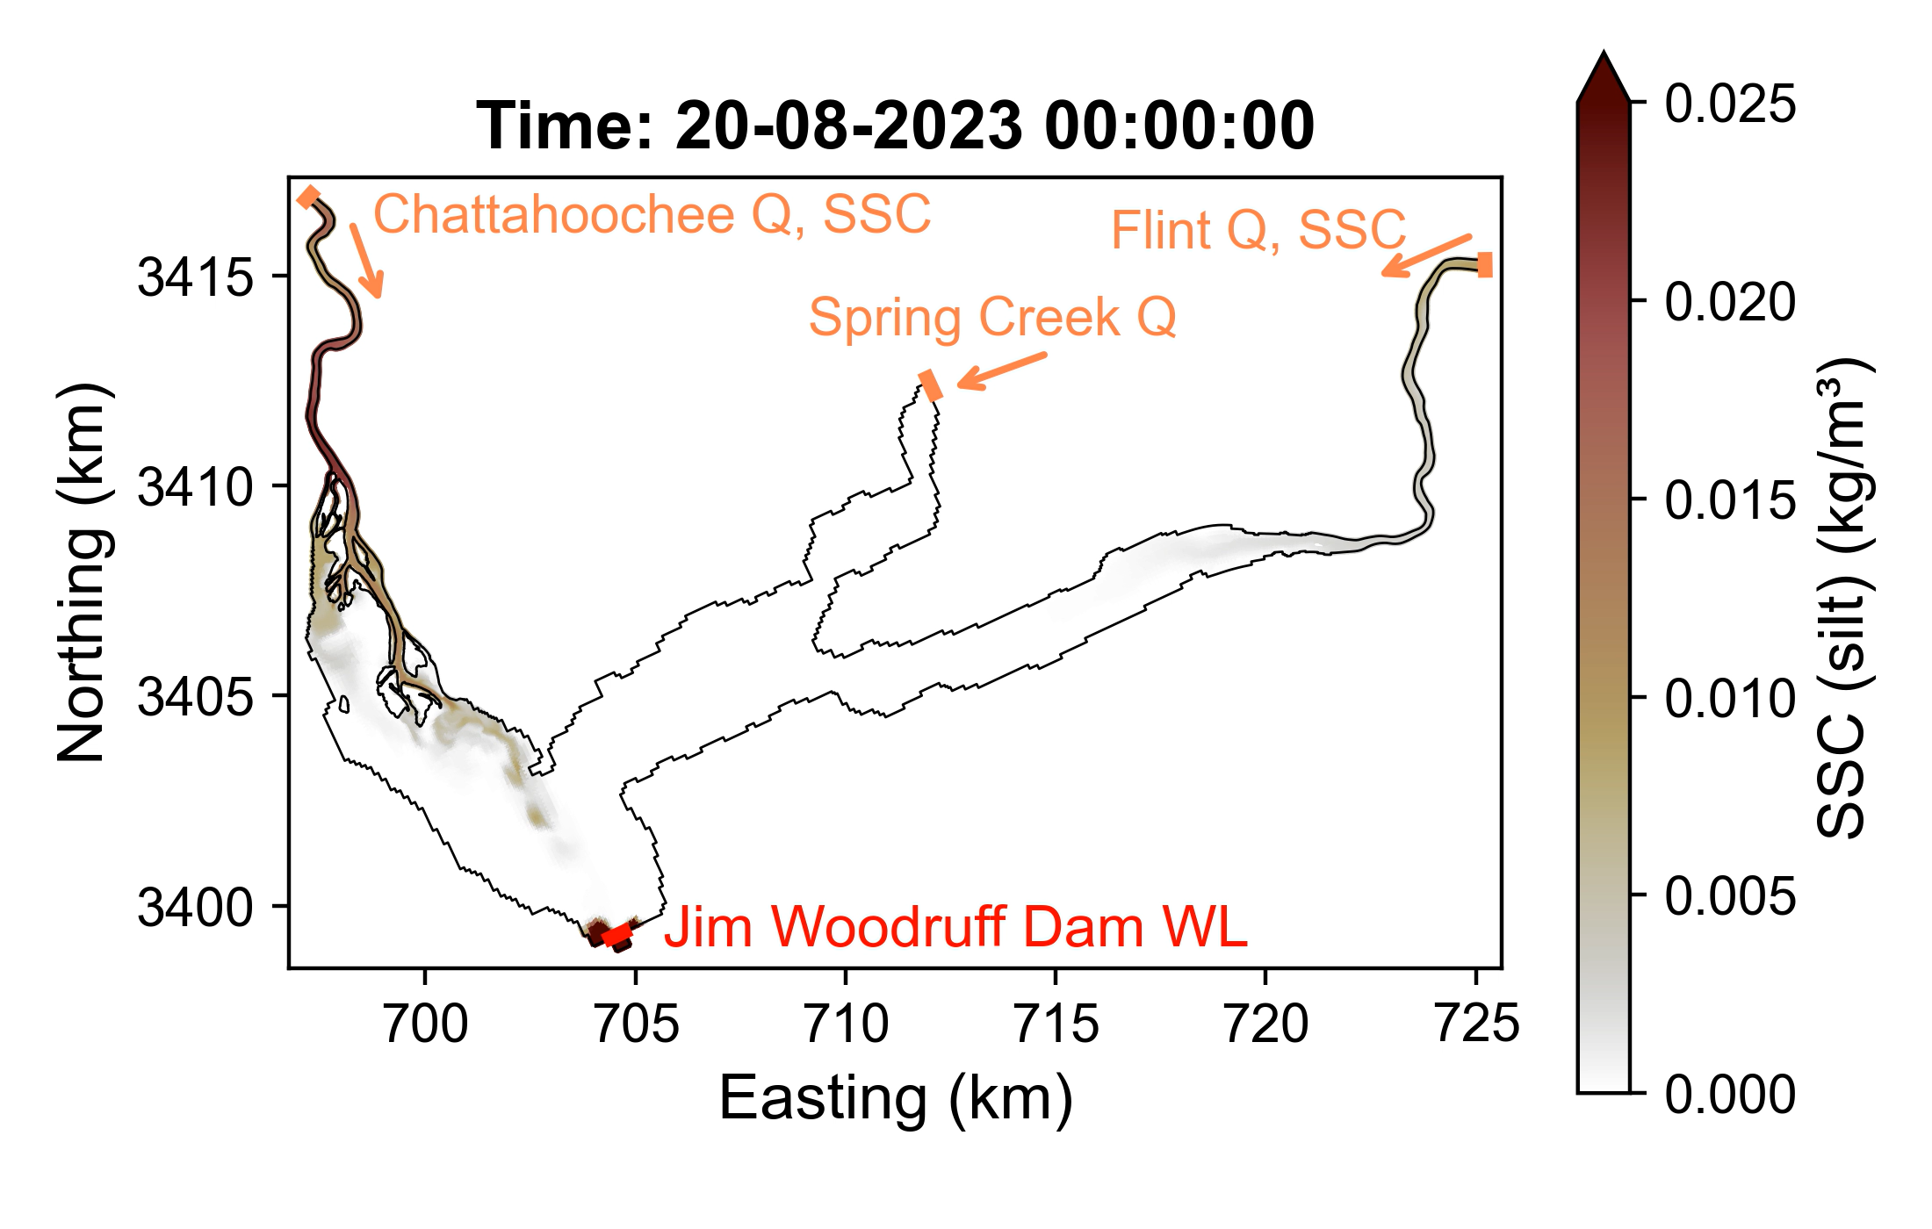
Hydropeaking regulates sediment delivery in the Chattahoochee
Suspended sediment transport is silt-dominated
Cohesive fraction

Slide 7
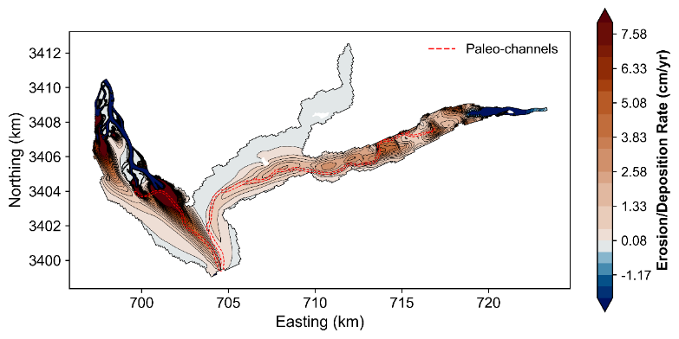
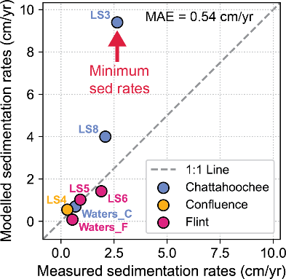
Sedimentation is highly heterogeneous
The model reproduces the measured sedimentation rates
Two very distinct depositional patterns
On average, the lake accumulates sediment at about 1 cm/yr (Trapping efficiency of 78%)

Slide 8
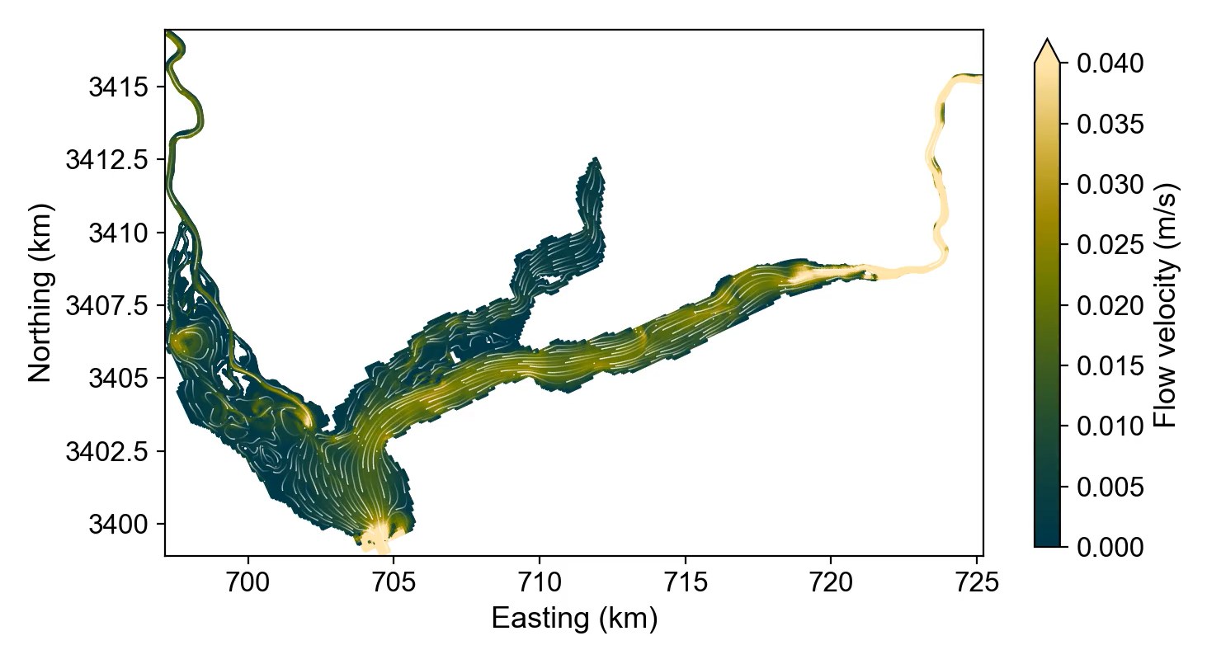
In summary …
The 2 arms are disconnected until proximity of the dam
Hydropeaking mobilizes higher volumes of sediments in the Chattahoochee
Different types of deposition: sedimentation is NOT an issue in Lake Seminole (for now…)
Thank you! Any questions? Contact: cortel@bc.edu

