Slide 1
Kubernetes Container Escape Demo
From Spring4Shell RCE to Cluster Takeover
Full attack chain on AWS EKS with automated detection by Cortex XDR and incident response via Cortex Playbooks + AWS Lambda containment
Palo Alto Networks | Cortex Cloud Demo

Slide 2
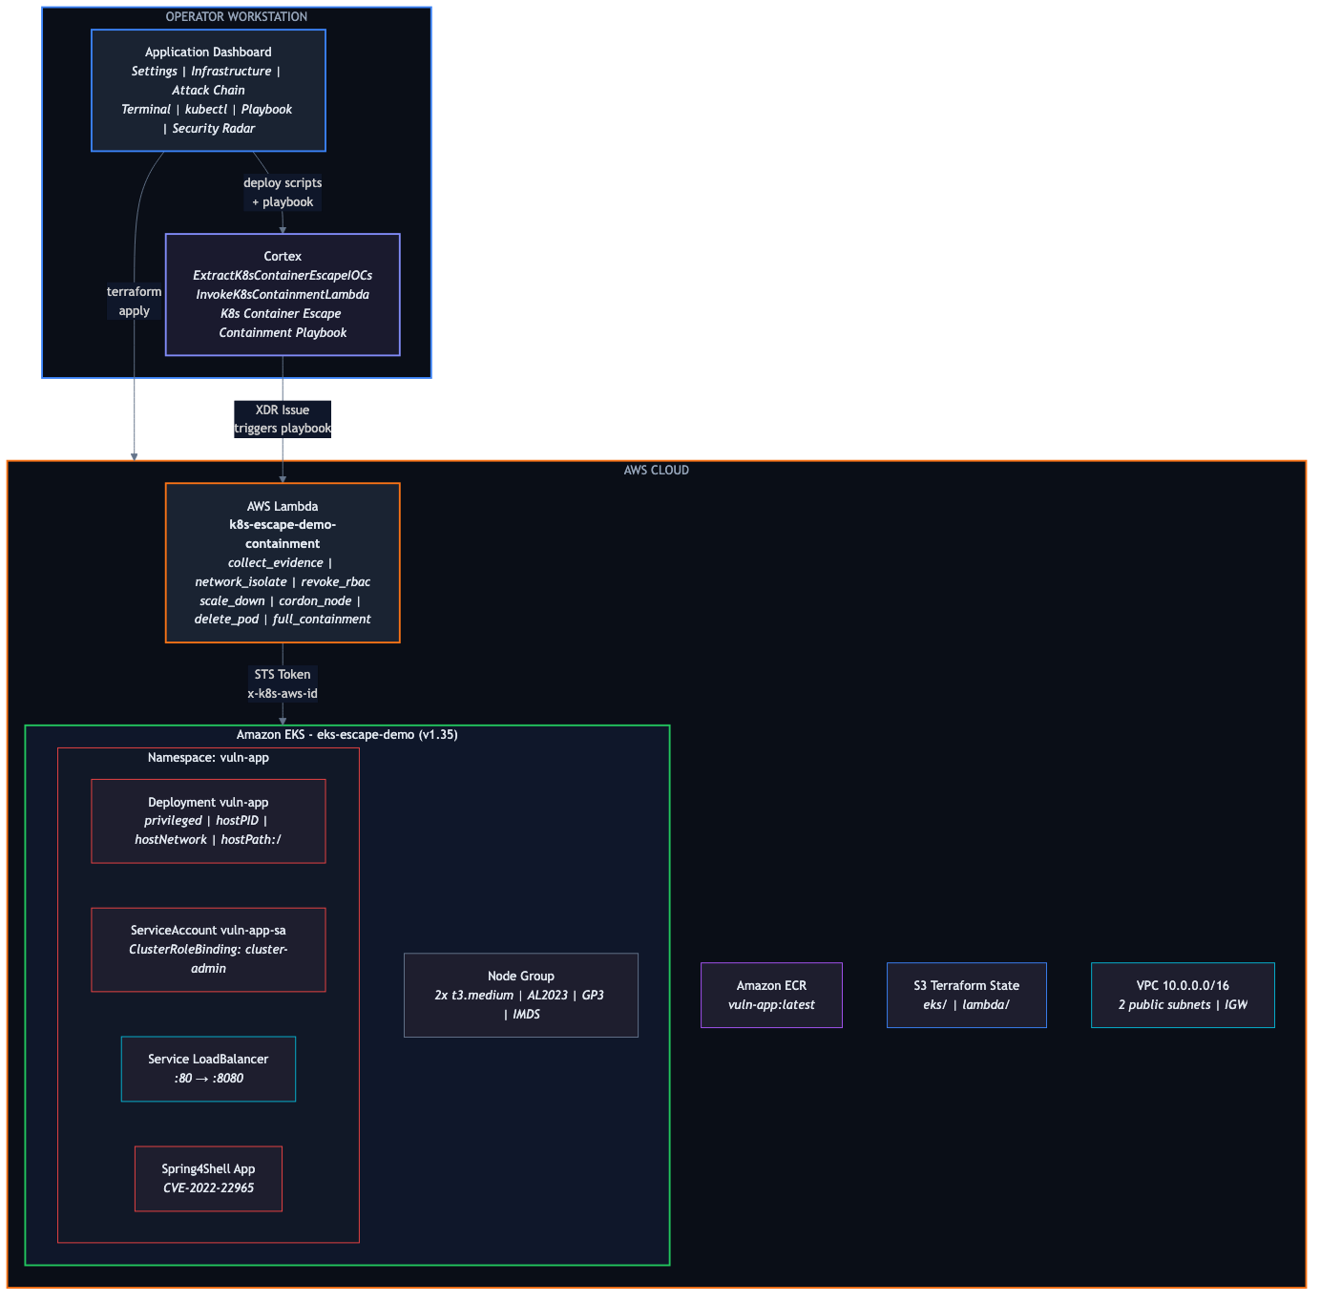
Architecture Overview

Slide 3
Attack Chain — 3 Steps
STEP 1: Spring4Shell RCE
STEP 2: Container Escape
STEP 3: Cluster Takeover
CVE-2022-22965 (CVSS 9.8)
1. Exploit ClassLoader via Spring
parameter binding
2. Manipulate Tomcat
AccessLogValve
3. Write JSP webshell to
webapps/app/
4. Verify RCE: id command
Result:
Remote Code Execution
on the container
Privileged + hostPID + hostPath
1. nsenter -t 1 -m -u -i -n -p
→ escape to host namespace
2. Read /etc/shadow, /etc/passwd
3. Access host filesystem via
/proc/1/root
4. IMDS 169.254.169.254
→ steal AWS credentials
Result:
Full node access +
AWS IAM credentials
SA cluster-admin token
1. Steal ServiceAccount token
from /var/run/secrets/
2. List all K8s secrets
(all namespaces)
3. Extract AWS credentials
from secrets
4. Full cluster control
Result:
Complete cluster +
AWS compromise

Slide 4
Pod Misconfigurations Exploited
Misconfiguration
Impact
Remediation
privileged: true
Full host kernel access
allowPrivilegeEscalation: false
hostPID: true
Host process visibility, nsenter escape
Disable hostPID
hostNetwork: true
Node network access, IMDS
Disable, IMDSv2 hop limit=1
hostPath: /
Read/write entire host filesystem
PVCs, restrict via PSA
SA cluster-admin
Full K8s API control
Least privilege RBAC
No Pod Security Standards
All misconfigs allowed
Enforce restricted PSA
No Network Policies
Unrestricted pod communication
Implement NetworkPolicies

Slide 5
MITRE ATT&CK Kill Chain
Initial Access
Exploit Public-Facing App
Spring4Shell CVE-2022-22965
T1190
Execution
Unix Shell
Webshell command execution
T1059.004
Persistence
Web Shell
JSP webshell deployed
T1505.003
Privilege Escalation
Escape to Host
nsenter + privileged pod
T1611
Credential Access
Container API
SA token theft, IMDS
T1552.007
Discovery
Container Discovery
K8s resource enumeration
T1613
Lateral Movement
Application Access Token
Cluster-admin token reuse
T1550.001
Collection
Data from Cloud Storage
AWS credentials exfiltration
T1530

Slide 6
Cortex Automated Response
Containment Playbook
Forensic Analysis Playbook
Search Similar Events
10 tasks — auto/manual gate
9 tasks — 5 XQL auto-exec
8 tasks — 3 XQL auto-exec
1. Triage (IOC extraction)
2. Collect Evidence (Lambda)
3. Severity Gate
Critical+Spring4Shell = auto
4. Network Isolation (deny-all)
5. Revoke RBAC (cluster-admin)
6. Scale Down (replicas=0)
7. Cordon Node
8. Kill Pods (force delete)
9. Verify Containment
1. Triage (IOC extraction)
2. CVE + MITRE + XQL generation
3. XQL: Causality Chain
4. XQL: File Operations
5. XQL: Network Connections
6. XQL: Container Escape
7. XQL: Credential Access
8. Live Evidence (Lambda)
1. Triage (IOC extraction)
2. Generate Hunt Queries
3. XQL: Webshell Hunt (all nodes)
4. XQL: Escape Hunt (all nodes)
5. XQL: IMDS Theft Hunt
6. Analyst Review
7/8. Escalate or Close

Slide 7
Cortex Automation Scripts (4)
ExtractK8sContainerEscapeIOCs
Triage & IOC Extraction
Analyzes XDR issue fields to extract IOCs (container ID, namespace, node FQDN, process SHA256). Determines severity (Critical/High/Medium/Low). Detects Spring4Shell + webshell patterns.
Output: K8sEscape.* context keys
InvokeK8sContainmentLambda
Lambda Containment (SigV4)
Invokes AWS Lambda from Cortex XSIAM (GCP). Pure SigV4 signing (no boto3). STS AssumeRole + Lambda Invoke. 7 containment actions.
Output: K8sContainment.* context keys
K8sForensicAnalysis
CVE / MITRE / XQL
CVE enrichment (Spring4Shell CVSS 9.8). MITRE ATT&CK mapping (9 techniques). Generates 5 XQL forensic queries for auto-execution.
Output: K8sForensic.* context keys
K8sSearchSimilarEvents
Cross-Tenant Threat Hunt
Generates targeted + broad XQL queries. Lateral movement detection, blast radius assessment, webshell/escape/IMDS hunts.
Output: K8sSimilar.* context keys

Slide 8
Lambda Containment Actions
AWS Lambda authenticates to EKS via STS presigned URL (x-k8s-aws-id)
collect_evidence
Pod details, logs, events, RBAC audit, node status
network_isolate
Apply deny-all NetworkPolicy in namespace
revoke_rbac
Delete cluster-admin ClusterRoleBinding
scale_down
Scale deployment to 0 replicas
cordon_node
Mark node as unschedulable
delete_pod
Force delete all pods in namespace
full_containment
Execute all actions in sequence

Slide 9
IAM Architecture
Dashboard (permanent credentials)
Cortex Playbook (permanent credentials)
dashboard-user (Access Key)
↓ AssumeRole
dashboard-operator (scoped role)
EKS, ECR, Lambda, IAM, VPC, Logs
cortex-playbook-user (Access Key)
↓ AssumeRole
lambda-invoker (scoped role)
lambda:InvokeFunction only
Bootstrap (one-time, admin credentials)
Admin credentials → terraform apply (terraform-infra/ + terraform-lambda/) Creates all IAM users, roles, EKS, Lambda. Admin credentials no longer needed after setup.

Slide 10
Demo Flow
1
Configure AWS
Enter admin credentials in dashboard
2
Deploy Infrastructure
terraform apply → VPC, EKS, ECR, IAM (~15 min)
3
Switch to Dashboard User
Permanent credentials from terraform output
4
Build & Push Image
Docker buildx (linux/amd64) + push to ECR
5
Deploy App
K8s manifests: privileged pod + LoadBalancer
6
Run Attack Chain
Step 1: RCE → Step 2: Escape → Step 3: Takeover
7
Deploy Cortex
Push 4 scripts + 3 playbooks + Lambda
8
Observe Detection
XDR creates issue → triggers playbook
9
Automated Response
Containment: NetworkPolicy, RBAC, scale, cordon, kill
10
Cleanup
Destroy Lambda + Destroy All

