Slide 1
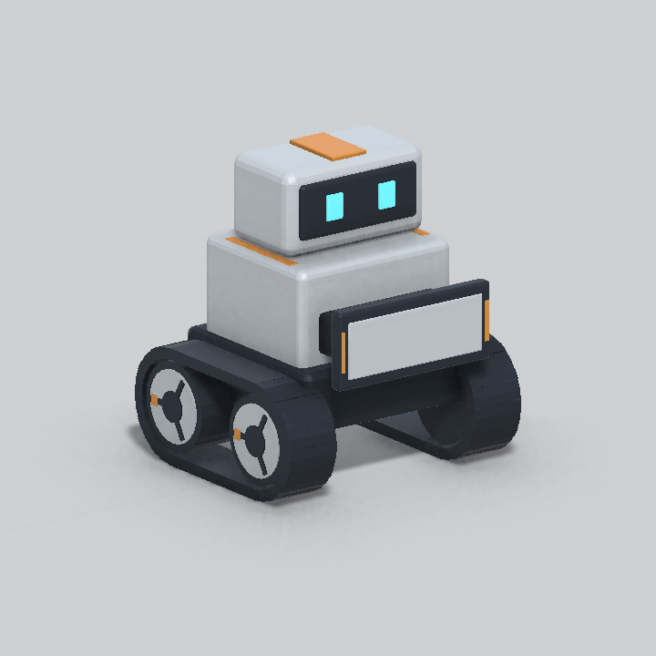
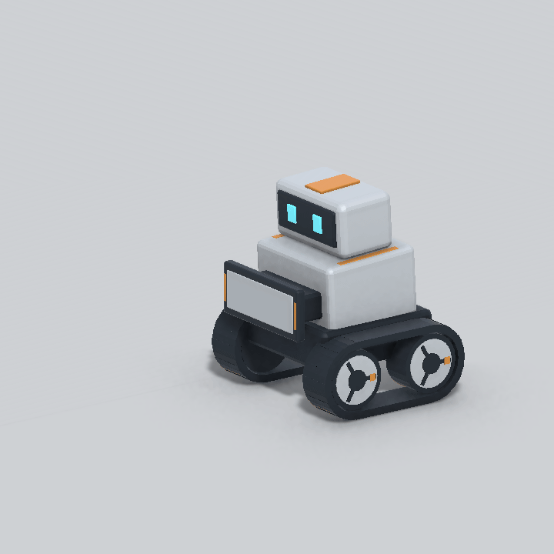
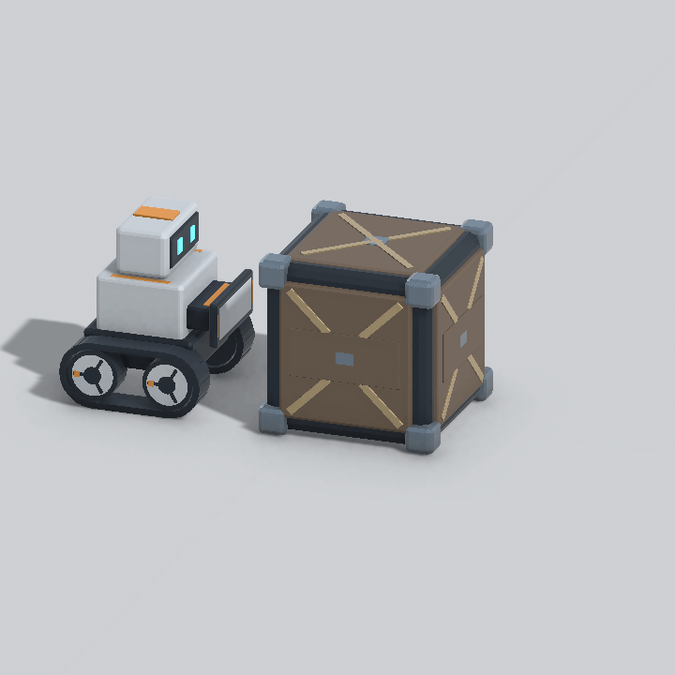
My first rigging experiment
This week, I learned rigging for the first time in Michael’s GSND 6000 class.
I experimented with Blender + MCP to create simple animations for my game jam robot.
Idle
Move
Push
Notes:
This week I encountered rigging for the first time in Michael’s GSND 6000 class. I used Blender with MCP to explore how to animate the robot character in my game jam project. The current robot uses a hierarchy of rigid mechanical parts with keyed pivots rather than deformable skinning. These examples show the existing Idle, Move and Push clips. The clips were captured in an isolated Unity preview scene with a simple floor, fixed cameras and one existing cargo crate for the push demonstration. The move path and short crate displacement are staging for the animation demonstration.
Sources: the user’s description of their course experience; ArtSource/Robot/README.md; ArtSource/Robot/robot_asset_manifest.json; Assets/Resources/prefabs/gameplay/player/Robot.prefab; Assets/Art/Robot/Meshes/Robot.fbx; Assets/Resources/prefabs/gameplay/StationKit/CargoCrate.prefab.

