Slide 1
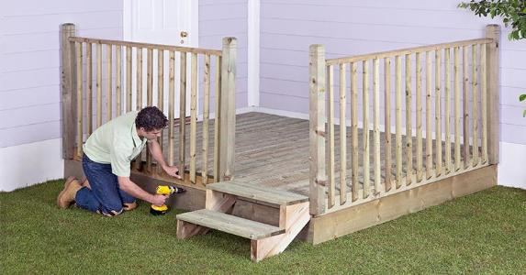
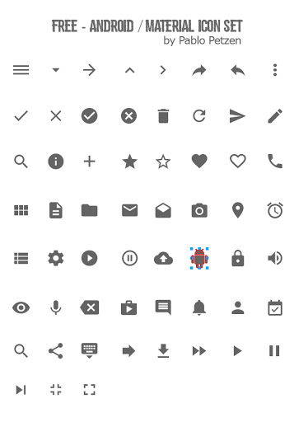

Home Screen
Couple Sync
The bills
An App to help couples stay on
the same page. Couples share a
list. From projects to groceries
List. Stay synced and productive
With Couple Sync.
On the Regular
Don’t Forget
Life Goals
Home Improvement Projects
Can I buy
Before You Come Home
Don’t Forget
Grocery List
EMERGENCY
Adds a new list
MY MOOD

Slide 2
List
Grocery List
Tomatoes 5
On the Regular
Milk 1 gal
Don’t Ever Forget
Sugar 1 bag
Chicken Soup 5 cans
Add Recipe
Adds a new list

Slide 3
List
Home Improvement
Fix door knob Urgent
On the Regular
Urgent
Don’t Ever Forget
Sugar 1 bag
Chicken Soup 5 cans
Add Recipe
Adds a new list

