Slide 1
xtUML and BridgePoint
Model Driven Testing
Notes:
1

Slide 2


Verification– Step 3 in the xtUML Method
Analysis – questioning, thinking, sketching...
Informal UML diagrams
use case, sequence, ...
Modeling – formalizing the analysis:
Component Diagrams (partitioning/interfaces)
Class Diagrams (data)
State Machines (control)
Activities (processing)
Verification
Interpretive Model Execution
Code generation
Template and Rule-Based Translation
Notes:
We started with Analysis and next we learned the tools and techniques to capture our system model
Is that enough? No, the model must be validated and then translated from platform independent to architecturally specific/platform specific. So validation and tranlation will be the focus of today’s discussion.

Slide 3
xtUML Model Driven Test
Model Driven Test delivers verified models to the next level

Slide 4
xtUML Model Driven Test
Abstraction accelerates verification
Models have lower complexity
Fewer requirements to check
Faster test execution
Easier to write tests
Lower Model decay

Slide 5
xtUML Model Driven Test
Translation provides traceable path to “Golden” Reference for architecture- specific and technology-specific models

Slide 6
xtUML Model Driven Test
MDT offers Test Driven Design benefits
Higher re-use with test component
Lower system model debris
Eliminates situation of design waiting for test

Slide 7
Validation vs Verification
Validation
Confirming that the system performs intended function under Intended Usage
Often emphasized by Modeling Analysis
Verification
Confirming that the system is validated and does not perform “Bad Things” under Unintended Usage

Slide 8
Validation vs Verification
xtMDT requires Verification

Slide 9
xtMDT Verification
xtMDT starts with Analysis

Slide 10
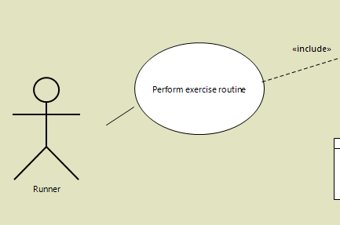
xtMDT Analysis - Use Cases
Test Environment models Actors

Slide 11
xtMDT Analysis - Use Cases
Use Cases must
Capture desired functionality
Constrain undesired functionality

Slide 12
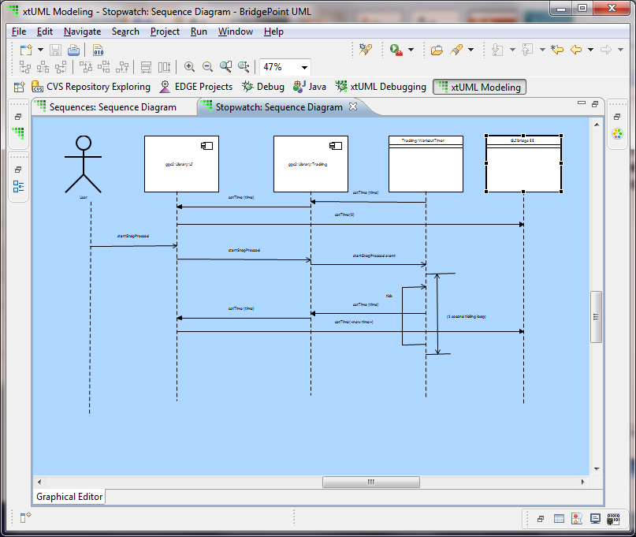
xtMDT Analysis - Sequence Diagrams
Interactions between External Actors and the system model are good test candidates

Slide 13
xtMDT Analysis - Sequence Diagrams
Analysis should include both intended and unexpected (ie. valid and invalid) messages
Pre-Conditions define constraints
Post-Conditions define “Golden” comparison

Slide 14
xtMDT Analysis - Scenarios
Scenarios are Sequence Diagrams with messages from the Actors constrained to give only an unique set of messages from the system.

Slide 15
xtMDT Analysis - Scenarios
Scenarios provide “Golden Data” to compare model generated messages against.

Slide 16
xtMDT Analysis - Scenarios
Scenario = initial state + sequence trajectory
Caution – emphasizing Scenarios in analysis can give false sense of completeness.

Slide 17
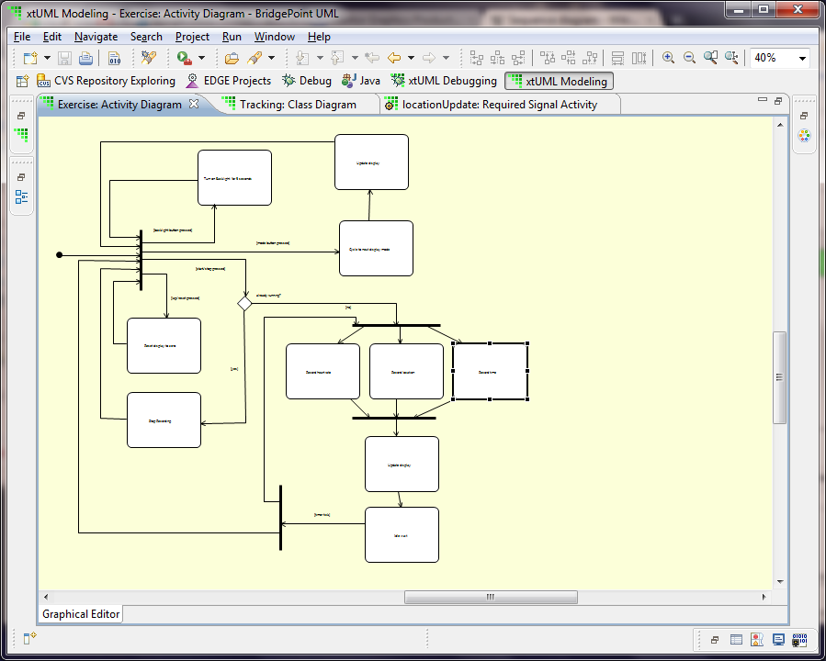
xtMDT Analysis - Activity Diagrams
Activity Diagrams show the flow of processing interactions
Capture “Behavior / Habits” of an Actor

Slide 18
Mapping Analysis to Tests
Use Case Diagrams
Identify components and message categories for test system
Sequence and Scenario Diagrams
Identify order of key behavior
Identify boundary constraints and correctness
Activity Diagrams
Identify classes and messages related to common “Behavior”

Slide 19
Mapping Analysis to Tests
Scenarios + Activity Diagrams provide a prototype of a test component.

Slide 20
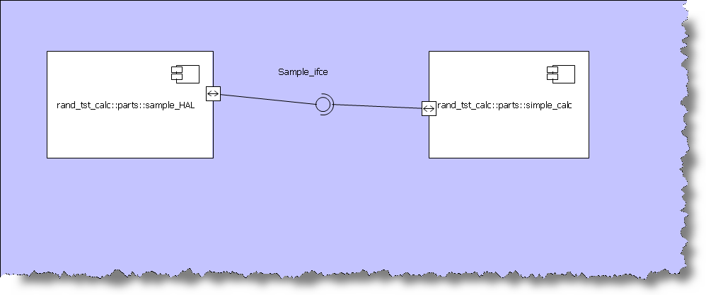
Suggested System Structure
Most Commonly split into Test Component and System Component

Slide 21
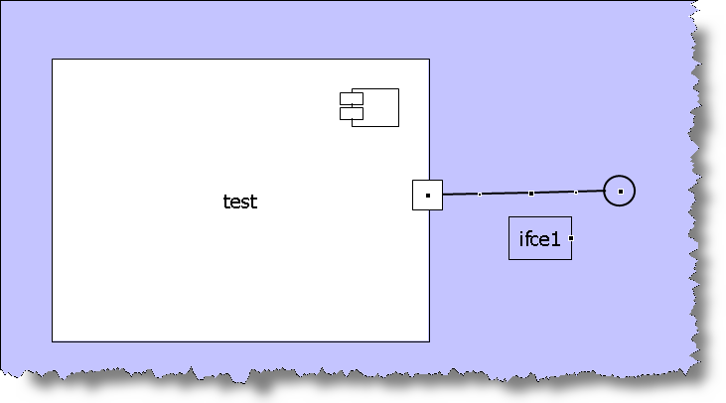
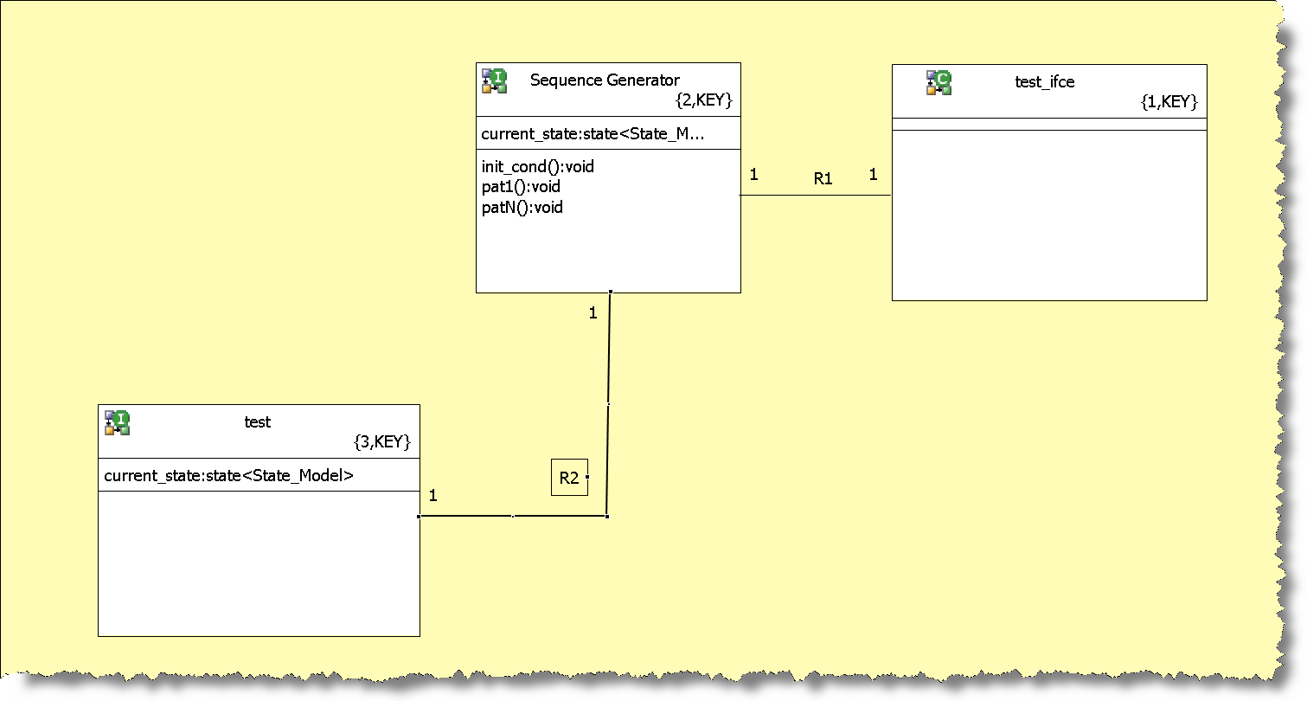
Structure of a Test

Slide 22
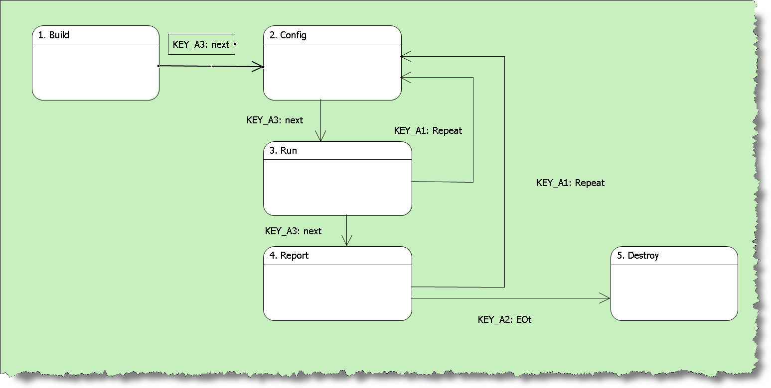
xtMDT– Test Component Phases

Slide 23
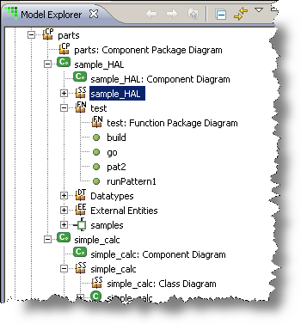
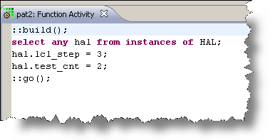
xtMDT– Test Component Phases

Slide 24
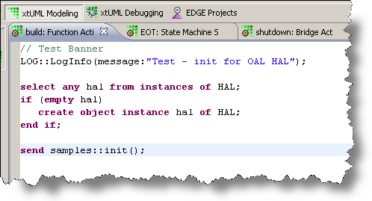
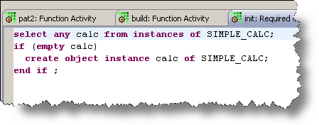
xtMDT– Test Component Phases

Slide 25
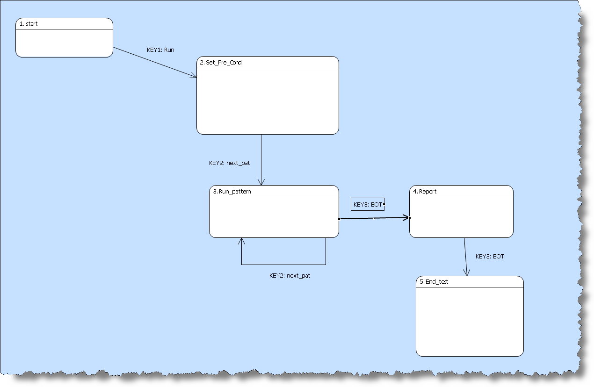
xtMDT– Test Phases

Slide 26
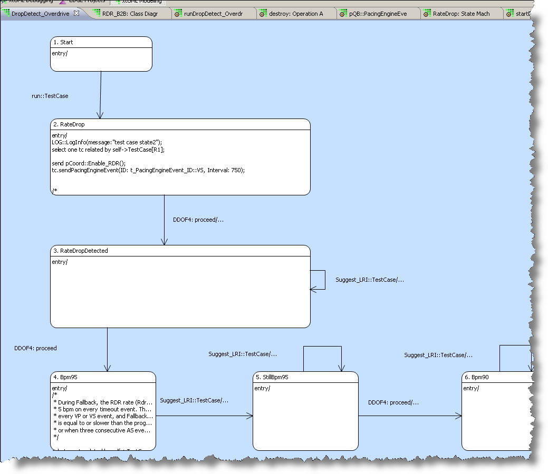
xtMDT Example from Application Model

Slide 27
xtMDT Summary
Benefits of Platform-Independence applies to test
Abstraction reduces complexity and simplifies test writing
Start with xtUML Analysis artifacts
Structure model and micro-sprints around component phases
xtMDT eases transition to Advanced Verification
Code generation enables easier path

Slide 28
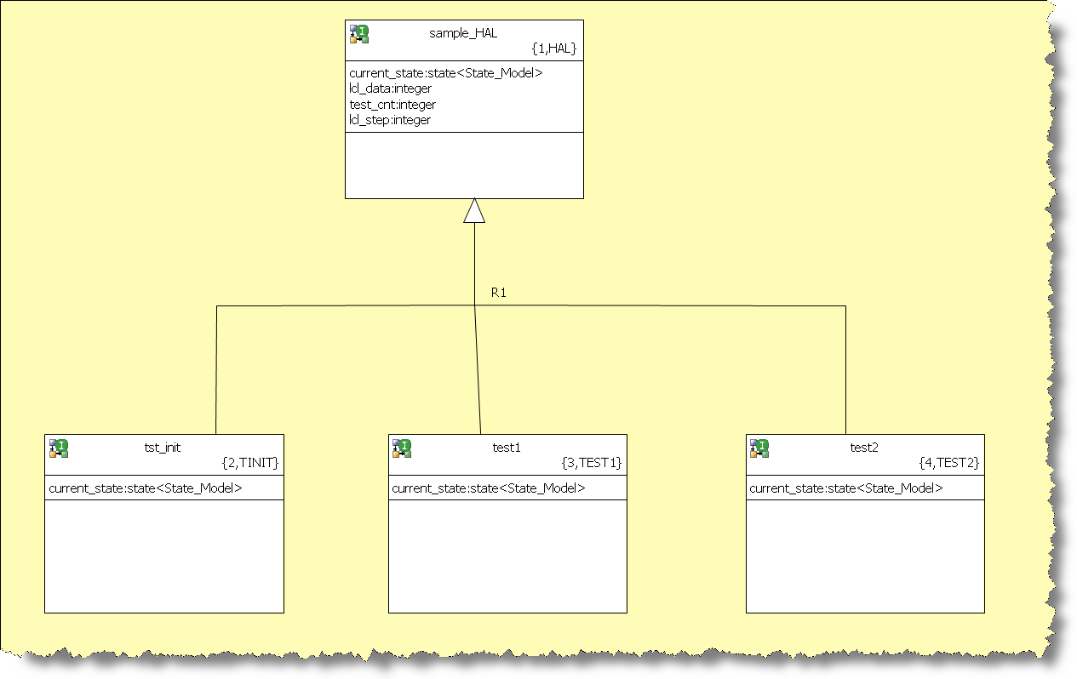
xtMDL – Advanced test Class
Use super-class and sub-class structure to generalize the test structure

Slide 29
xtMDL – Advanced test Class
Super-class contains OAL to implement collection of parameterized sequences

Slide 30
xtMDL – Advanced test Class
Sub-class contains configuration details and orders the sequences

Slide 31
xtMDL – Advanced test Class
Randomization + Sequences = Compact Test Suite Description

Slide 32


www.mentor.com
BP Training 2 Components

Slide 33
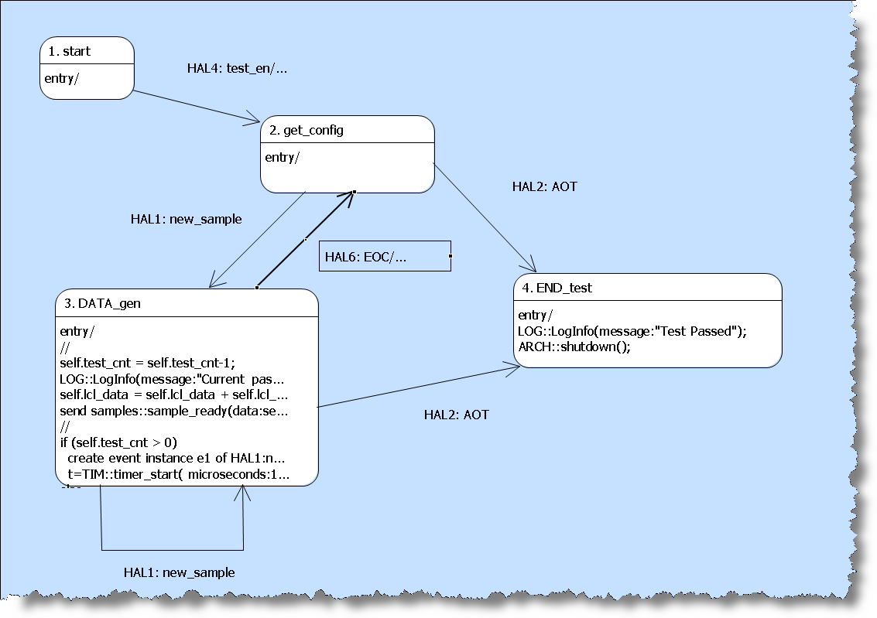

Slide 34
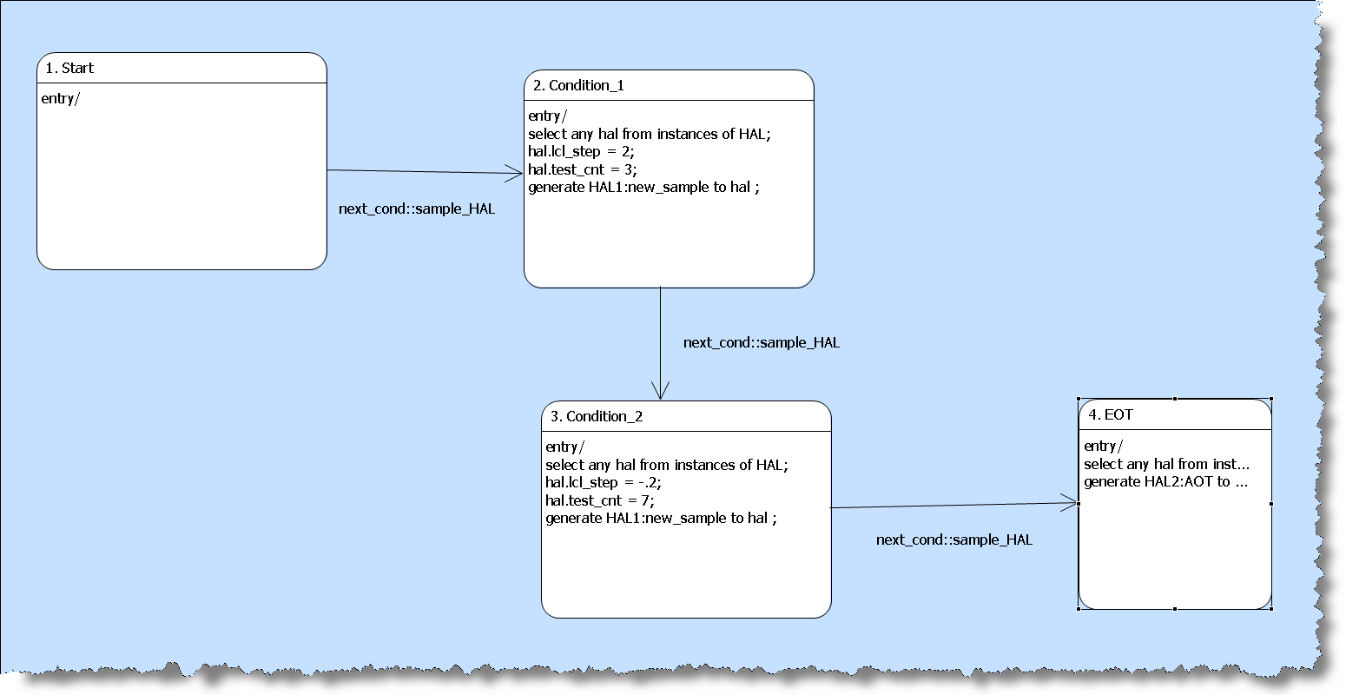
xtMDL - Test Classes

Slide 36
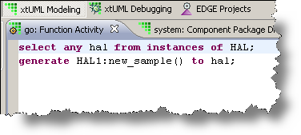

Slide 37
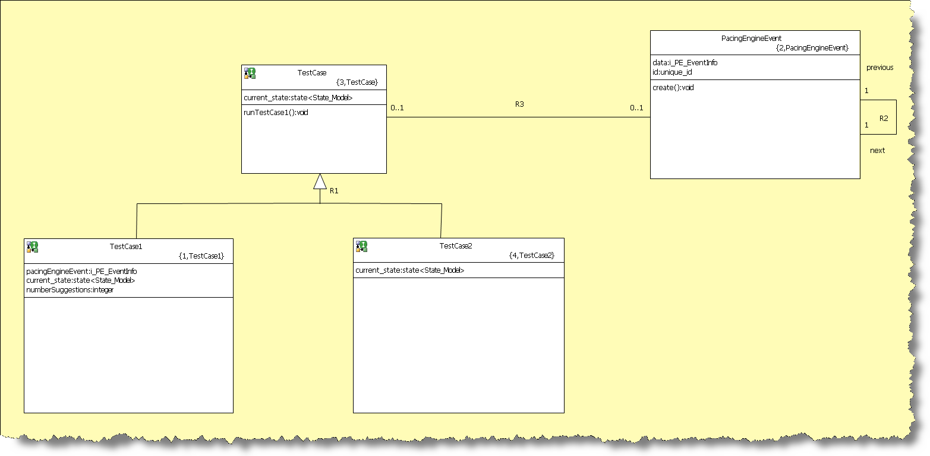
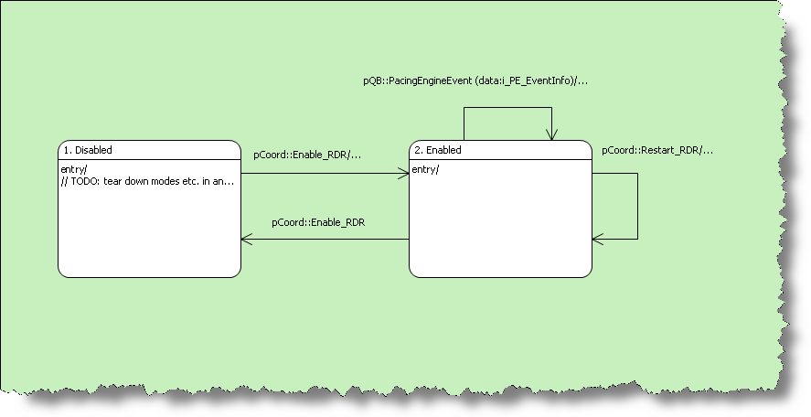
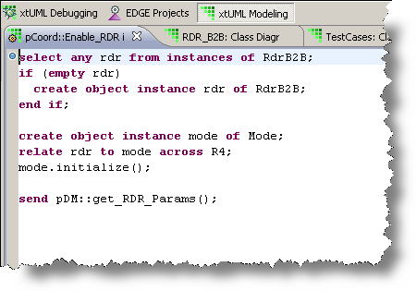
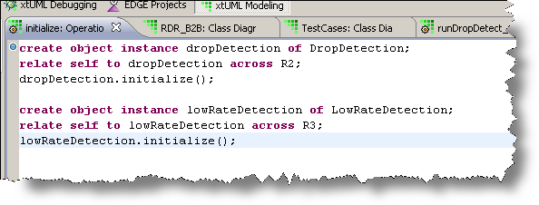

Slide 38
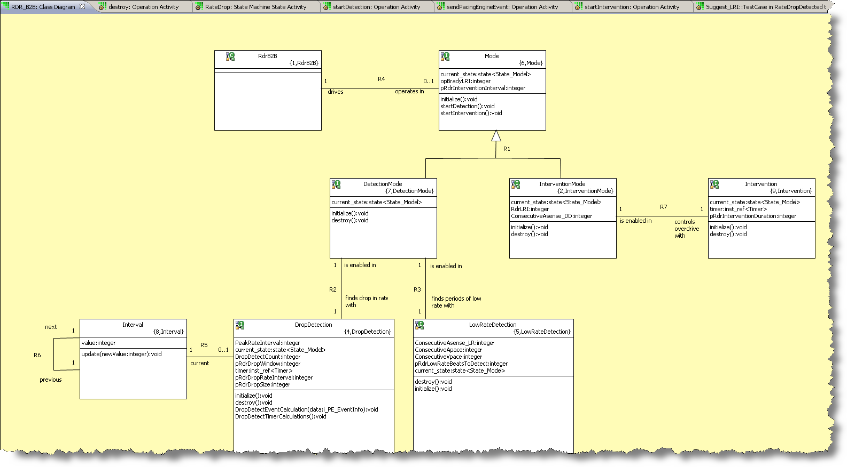

Slide 39
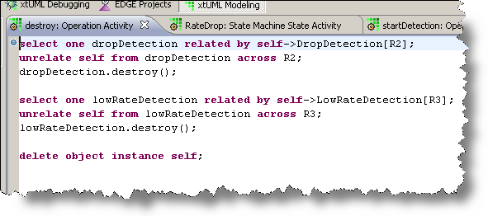

Slide 40
