Slide 1
BridgePoint Model Compiler Overview
Cortland Starrett
Model-Driven Engineering

Slide 2
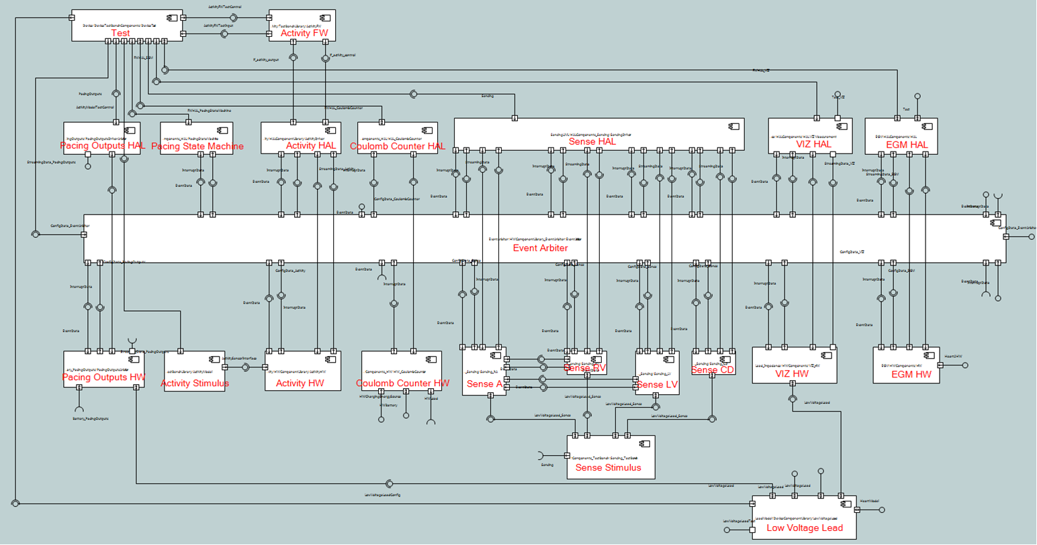
Galaxy

Slide 3
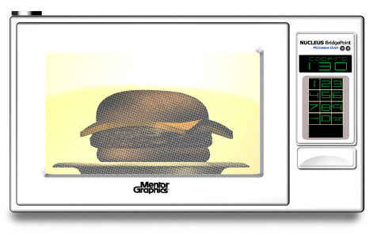
Code for a Microwave Oven
struct Oven_s {
ArbitraryID_t OvenID; /* OvenID */
/* Association storage */
Door_s * Door _R1;
Cooking_Step_s * Cooking_Step _R2;
Cooking_Step_s * Cooking_Step_R3;
Magnetron_s * Magnetron_R4;
/* State machine current state */
StateNumber_t current_state;
};

Slide 4
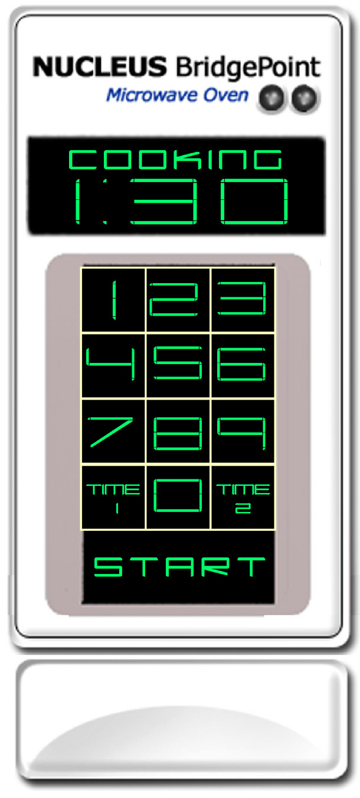
Another Piece of Code
struct Cooking_Step_s {
i_t stepNumber; /* * StepNumber */
i_t cookingTime; /* - cookingTime */
i_t powerLevel; /* - powerLevel */
Timer_t * executionTimer; /* - executionTimer */
/* Association storage */
Oven_s * Oven_R2;
Oven_s * Oven_R3;
/* State machine current state */
StateNumber_t current_state;
};

Slide 5
The Code Follows Rules
struct <class name>_s {
<attr₁ type> <attr₁ name>; /* <attr₁ description> */
<attr₂ type> <attr₂ name>; /* <attr₂ description> */
<attr₃ type> <attr₃ name>; /* <attr₃ description> */
. . .
/* Association storage */
<ref₁ class name>_s * < ref₁ class name >_<assoc₁ number>;
<ref₂ class name>_s * < ref₂ class name >_<assoc₂ number>;
. . .
/* State machine current state */
StateNumber_t current_state;
};

Slide 6
Class Diagram
This code is derived from a class diagram.
What would the Magnetron look like?
Door
isOpen
R1
R2
Cooking Step
stepNumber
cookingTime
powerLevel
Oven
R3
Magnetron
powerOutput
pulseTimer
R4

Slide 7
State Machines
CookingStep
setStep( time, level)
Oven
Ready
NotCooking
startStep
start
interrupt
start
Executing
Checking
stop
cook
finishStep
finishStep
Cooking
Complete

Slide 8
Event dispatching code for the Oven
. . .
state = instance->current_state;
next_state = Oven_StateEventMatrix[ state ][ event_number ];
/* Update state and execute the state action */
instance->current_state = next_state;
( *Oven_Actions[ next_state ] )( instance, eventData );
. . .

Slide 9
Event dispatching code for the Cooking Step
. . .
state = instance->current_state;
next_state = CookingStep_StateEventMatrix[ state ][ event_number ];
/* Update state and execute the state action */
instance->current_state = next_state;
( *CookingStep_Actions[ next_state ] )( instance, eventData );
. . .

Slide 10
..and the rule to produce it
. . .
state = instance->current_state;
next_state = <class name>_StateEventMatrix[ state ][ event_number ];
/* Update state and execute the state action */
instance->current_state = next_state;
( *<class name>_Actions[ next_state ] )( instance, eventData );
. . .

Slide 11
xtUML – Executable Modeling
Door
isOpen
R1
Oven
R2
Cooking Step
stepNumber
cookingTime
powerLevel
R3
Magnetron
powerOutput
pulseTimer
setStep( time, level)
R4
Ready
Lifecycle for
Cooking Step
startStep
interrupt
Executing
Entry/
select one magnetron
related by oven->[R4];
magnetron.powerOutput =
self.powerLevel;
generate powerOn to magnetron;
Executing
finishStep
finishStep
Complete
Action for state Executing

Slide 12
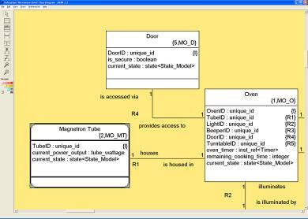

xtUML:
(X) Executes models
Verify early and eliminate defects
Verify application before:
HW is available
Processor/language have been selected
Reuse your legacy code
(T) Translates models
Generate 100% complete code
Customize the compilation rules
Produce optimized code
Application
Model Builder
L e g a c y
xtUML Repository
M / W
M / W
Translation
Rules
Architecture

Slide 13
Model Builder
xtUML Repository

Slide 14
Model Builder
xtUML Repository
class
attribute
datatype
state
transition
event

Slide 15
Model Builder
Translation
Rules
archetypes:
queries and templates
xtUML Repository
class
attribute
datatype
state
transition
event

Slide 16
Model Builder
Translation
Rules
archetypes:
queries and templates
xtUML Repository
generator
class
attribute
datatype
state
transition
event

Slide 17
Model Builder
Translation
Rules
archetypes:
queries and templates
xtUML Repository
generator
class
attribute
code
datatype
this_state = instance->m_object_state;
next_state = CookingStep_StateEventMatrix[ this_state ][ event_number ];
if ( next_state <= 3 )
{
/* Execute the state action and update 'object state' */
( *CookingStep_Actions[ next_state ] )( instance, event );
instance->m_object_state = next_state;
}
state
transition
event

Slide 18
xtUML Repository
component
class
attribute
port
satisfaction
datatype
state
transition
interface
event
Notes:
Here is a small representation of the BP repository. (We are inside the BP tool now.) The model shown here represents the structure of the data repository where BP models are stored. The structure allows the storage of the model elements in a way that preserves their meaning. (For you nerd modelers, this is the meta-model.)

Slide 19
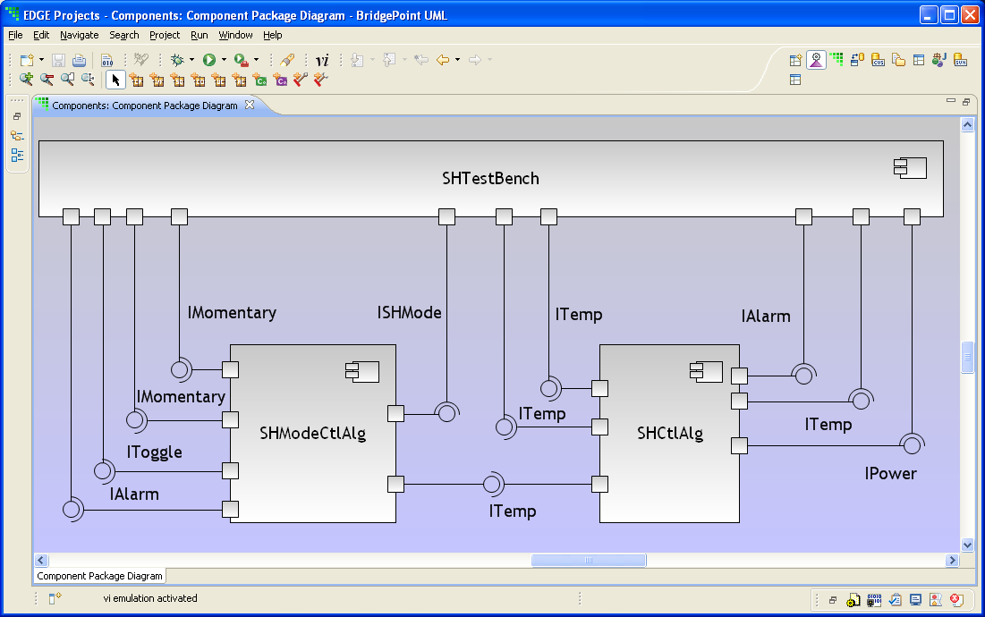
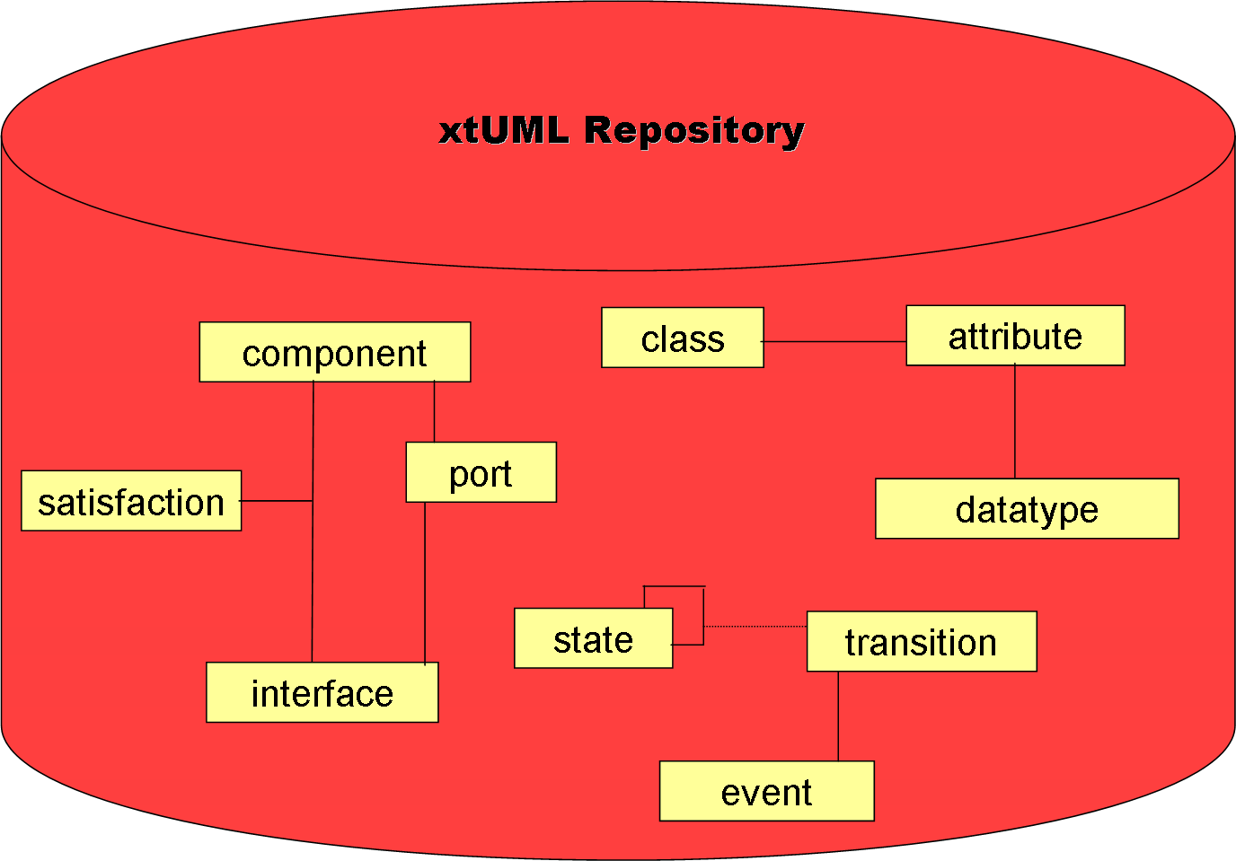
Notes:
So, imagine you are the BP user and you are building a model (of a SeatHeater). As you draw elements on the model, the BP database is “populated” with instances of the elements you are building.
Note that the BP database does not “speak SeatHeater”, but instead “speaks xtUML”, which allows any application to be captured and stored.

Slide 20
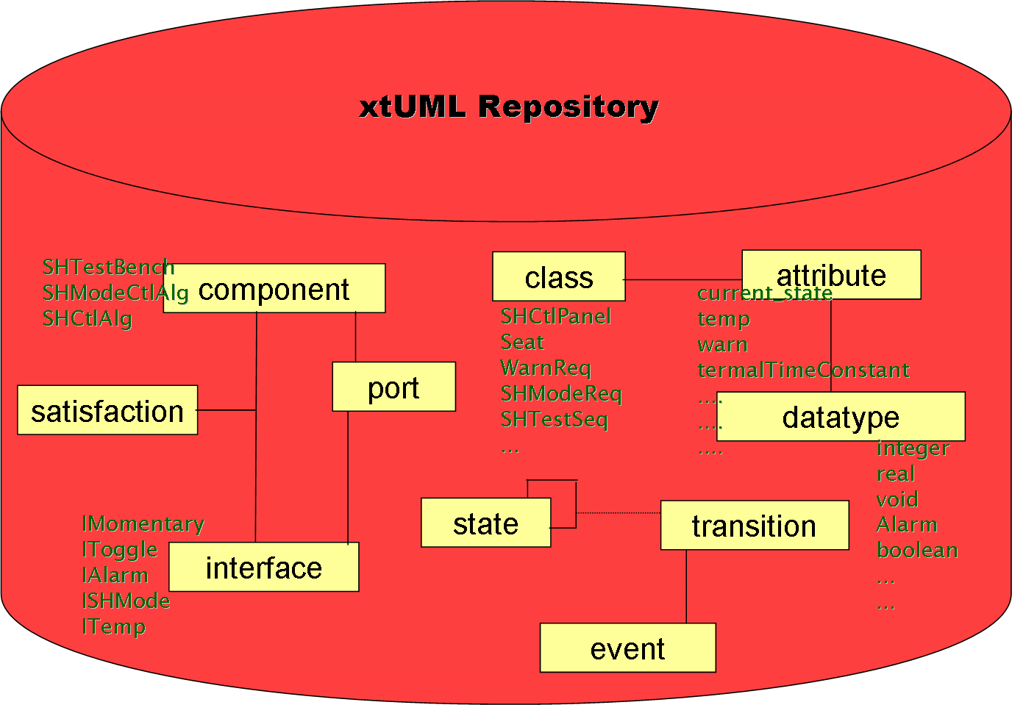
Notes:
Here I have shown representations of the model data (instances) being stored in the repository.

Slide 21
xtUML Repository
SHTestBench
SHModeCtlAlg
SHCtlAlg
component
class
attribute
current_state
temp
warn
termalTimeConstant
....
....
....
SHCtlPanel
Seat
WarnReq
SHModeReq
SHTestSeq
...
port
satisfaction
datatype
integer
real
void
Alarm
boolean
...
...
IMomentary
IToggle
IAlarm
ISHMode
ITemp
state
transition
interface
event
Notes:
Here is a closer look at a representation of the model data in the BP repository.
This data lets us store a model... but it also allows us to execute the model (by interpreting it with Verifier) or to _translate_ the model using a model compiler.

Slide 22
Model Builder
Translation
Rules
archetypes:
queries and templates
xtUML Repository
generator
class
attribute
code
datatype
this_state = instance->m_object_state;
next_state = CookingStep_StateEventMatrix[ this_state ][ event_number ];
if ( next_state <= 3 )
{
/* Execute the state action and update 'object state' */
( *CookingStep_Actions[ next_state ] )( instance, event );
instance->m_object_state = next_state;
}
state
transition
event

Slide 23
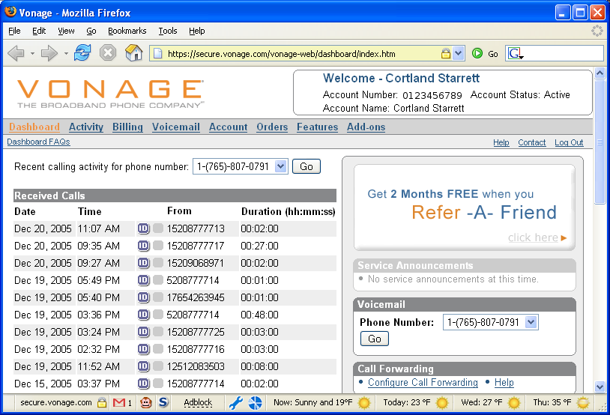
A Templated Web Application

Slide 24
Rules
Rules direct the generation of text.
text - (which happens to be C)
Placeholder
introduced by ${...}
this_state = instance-> ${object_state.name};
.invoke sem_name = GetStateEventMatrixName( object )
next_state = ${sem_name.result} [ this_state ][ event_number ];
if ( next_state <= ${max_state.number} )
{ …
Notes:
I color-coded the C-source in text blue

Slide 25
Thank you

