Slide 1
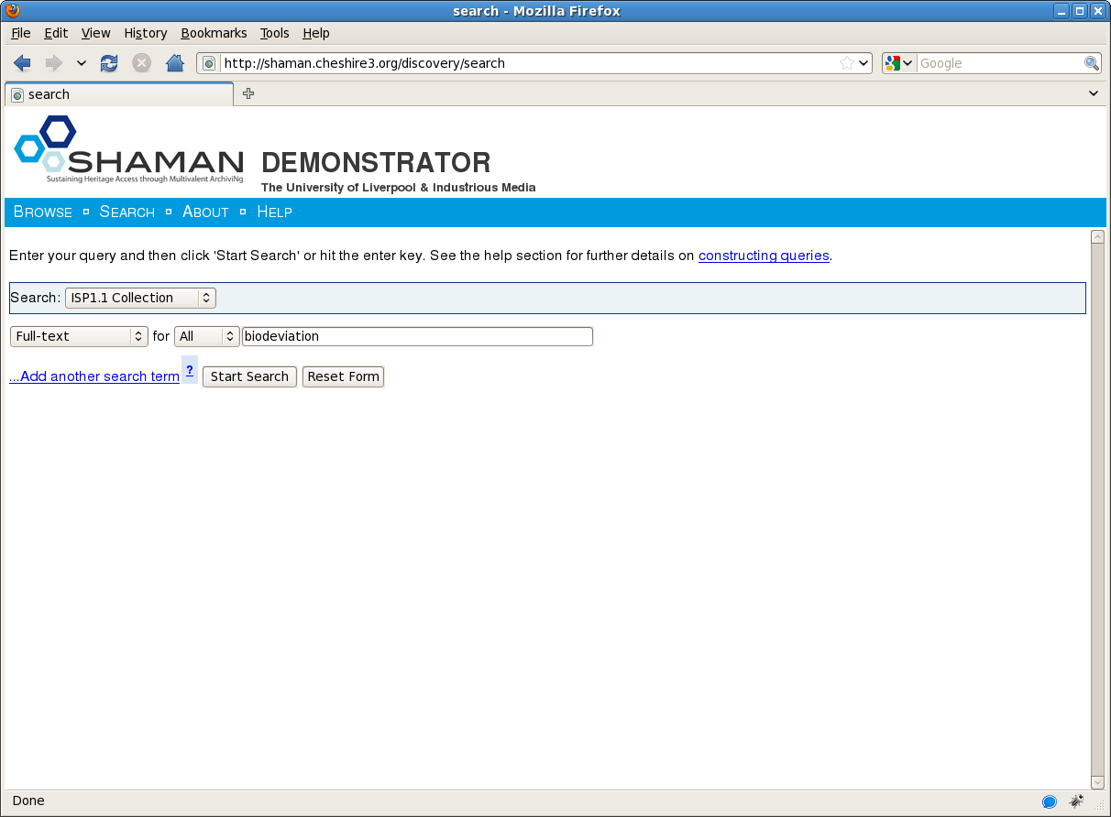
Demonstrations
Notes:
Access
Searching for Digital Objects
Searching for Digital Objects within the Archive using a full-text search engine.

Slide 2
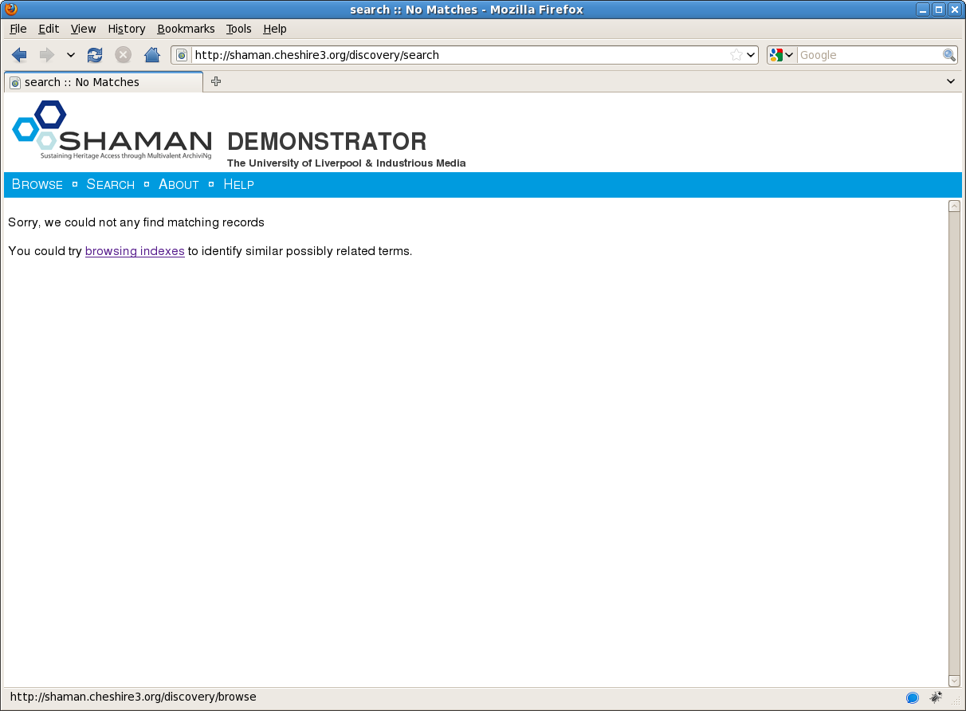
Demonstrations

Slide 3
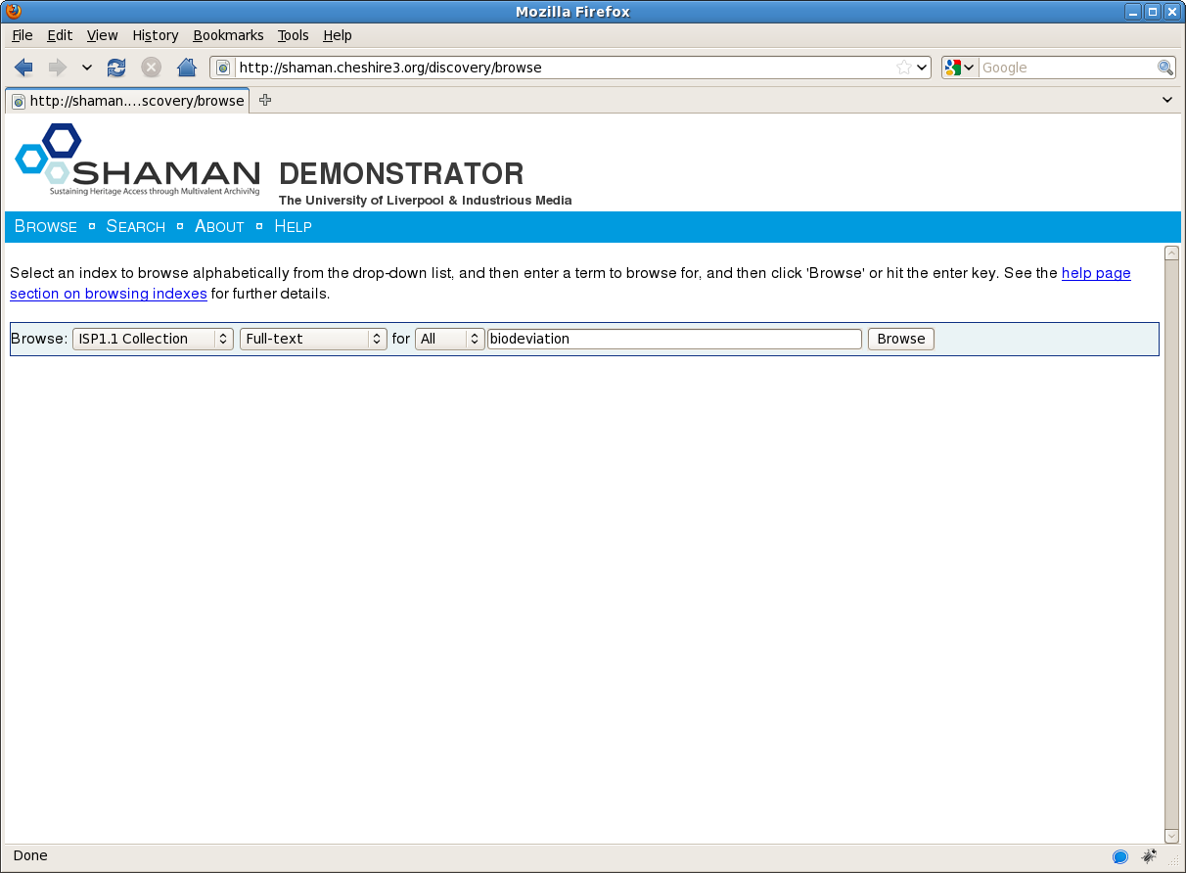
Demonstrations

Slide 4
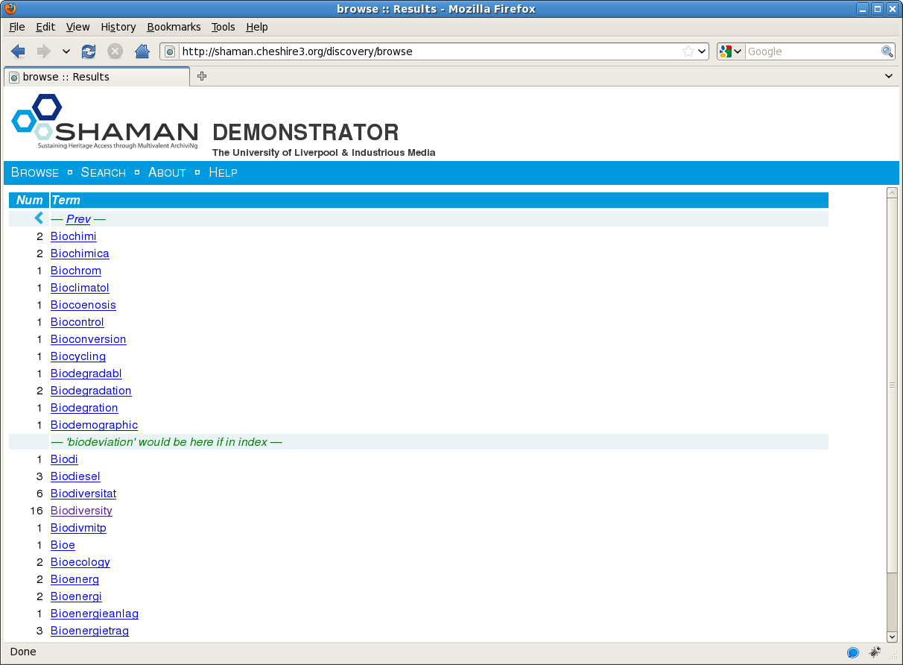
Demonstrations

Slide 5
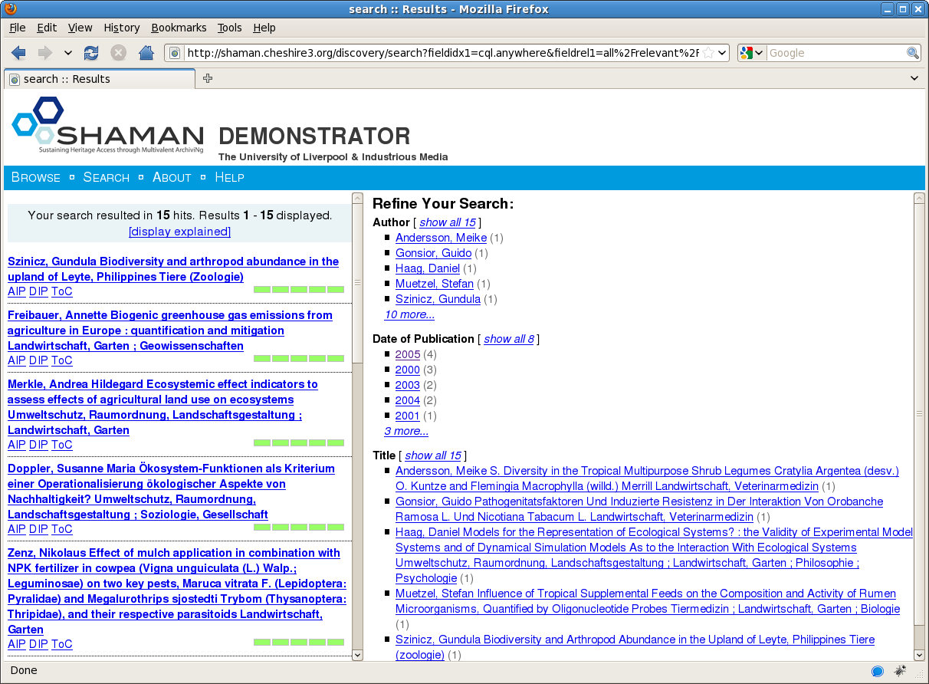
Demonstrations
Notes:
Access
Searching for Digital Objects
Matching objects and display options in the left-hand column.
Options to refine the search in the right-hand column.

Slide 6
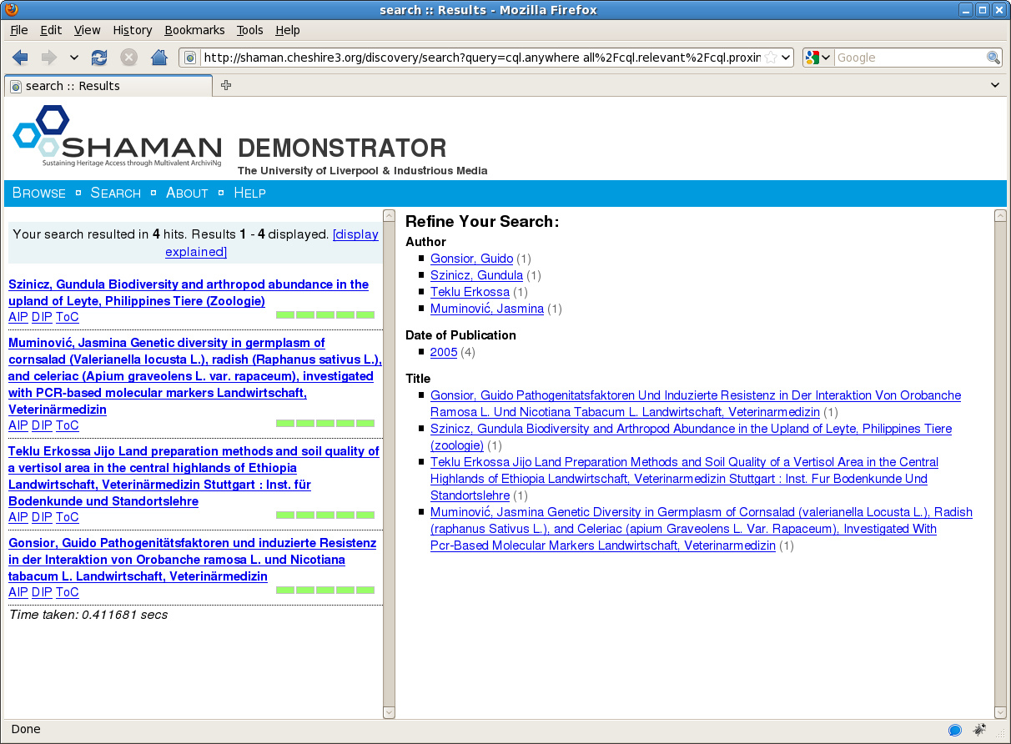
Demonstrations

Slide 7
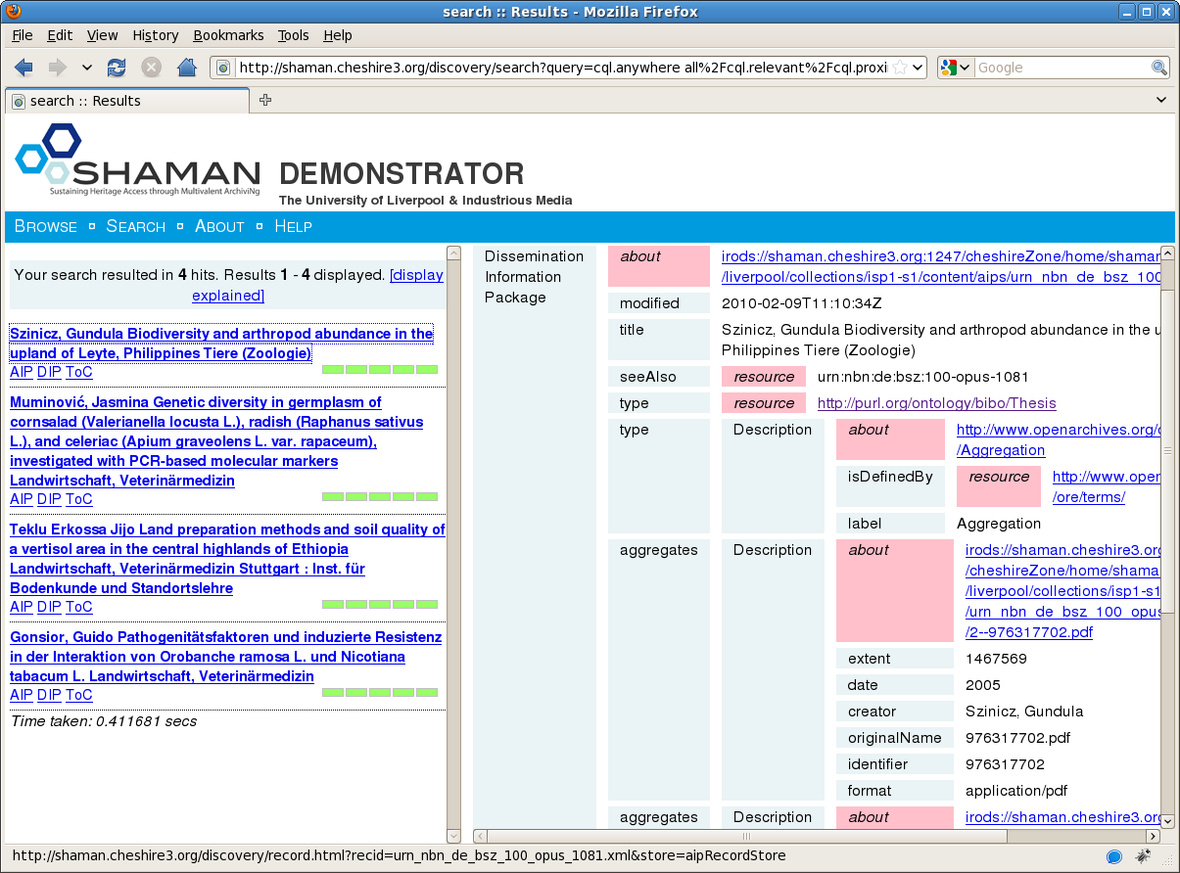
Demonstrations
Notes:
Access
Dissemination Information Package
Display DIP including:
Title
Creator
Date

Slide 8
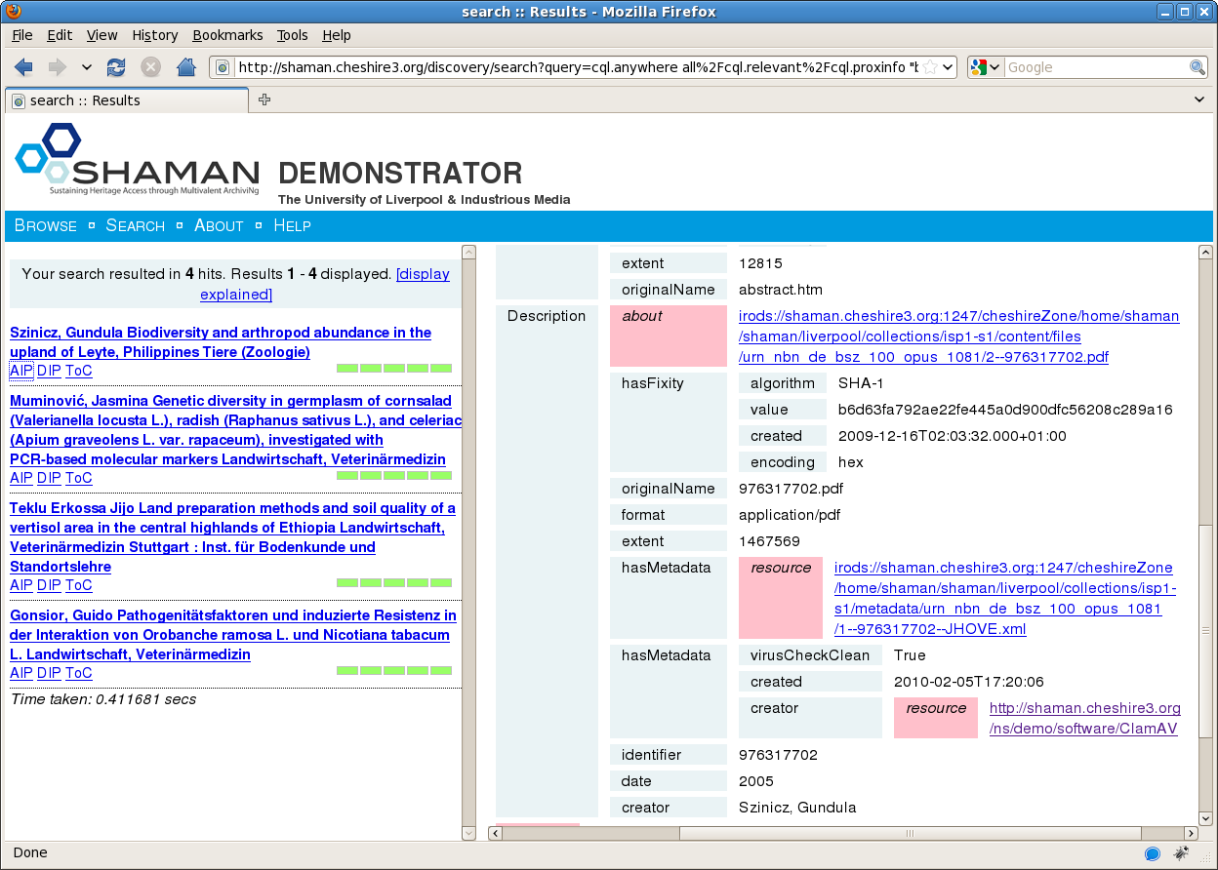
Demonstrations

Slide 9
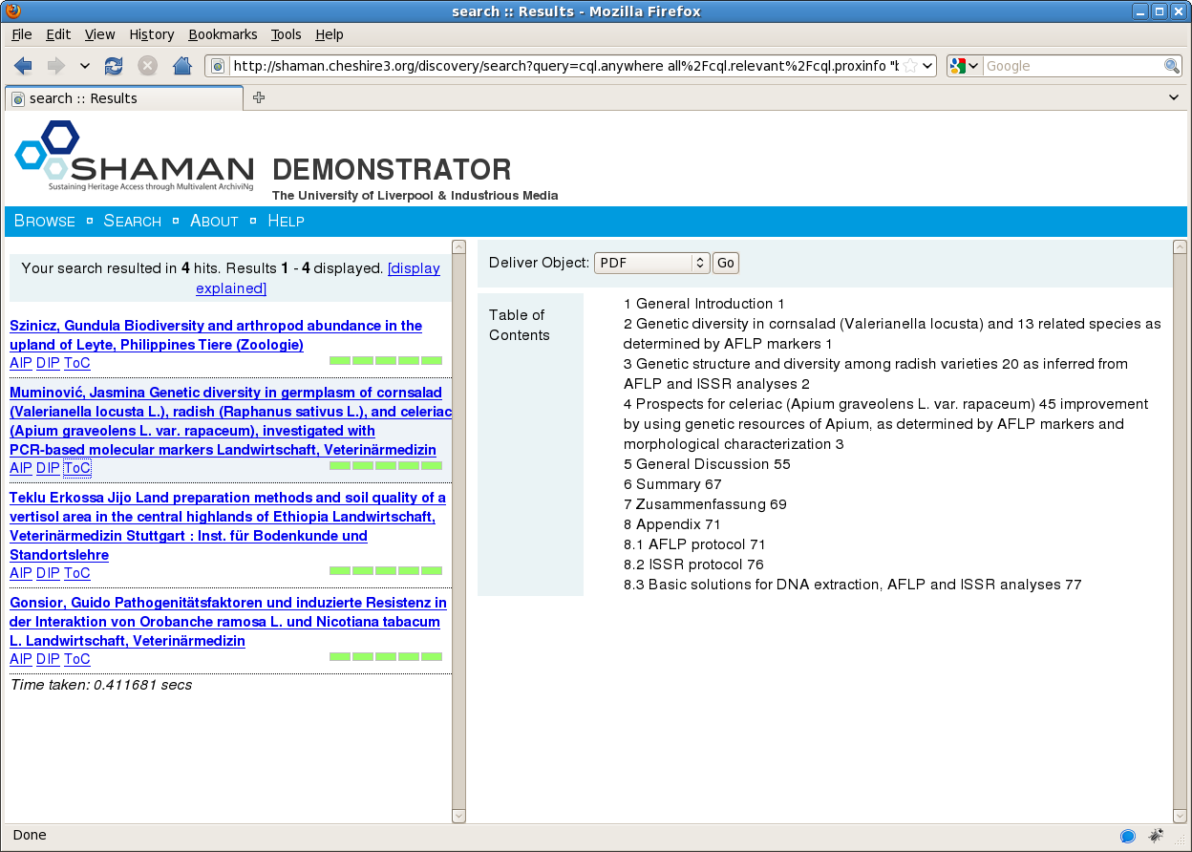
Demonstrations
Notes:
Access
XeProc Table of Contents
Table of Contents Derived from structural analysis carries out by the XeProc workflow

Slide 10
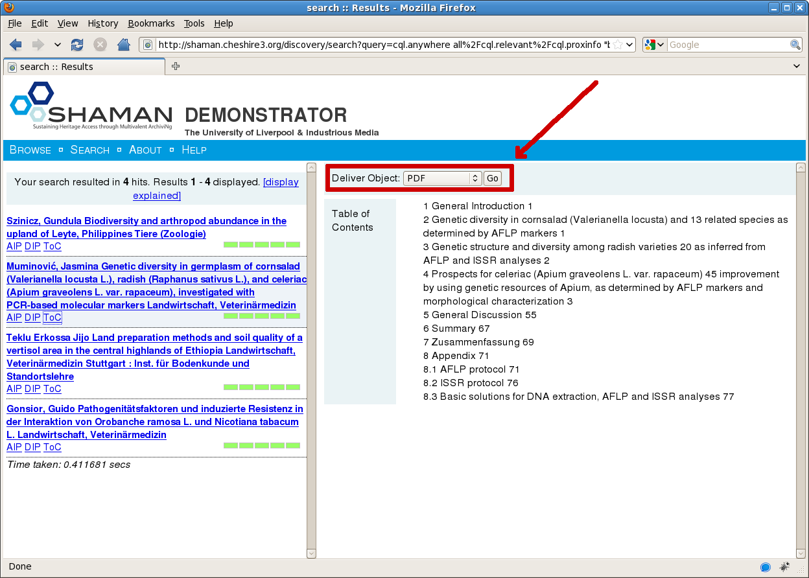
Demonstrations
Notes:
Access
Alternative representation
The user is presented with a choice of available representations for the delivery of the Object.
When selected, the Access System allocates the most appropriate display technology for the representation.

Slide 11
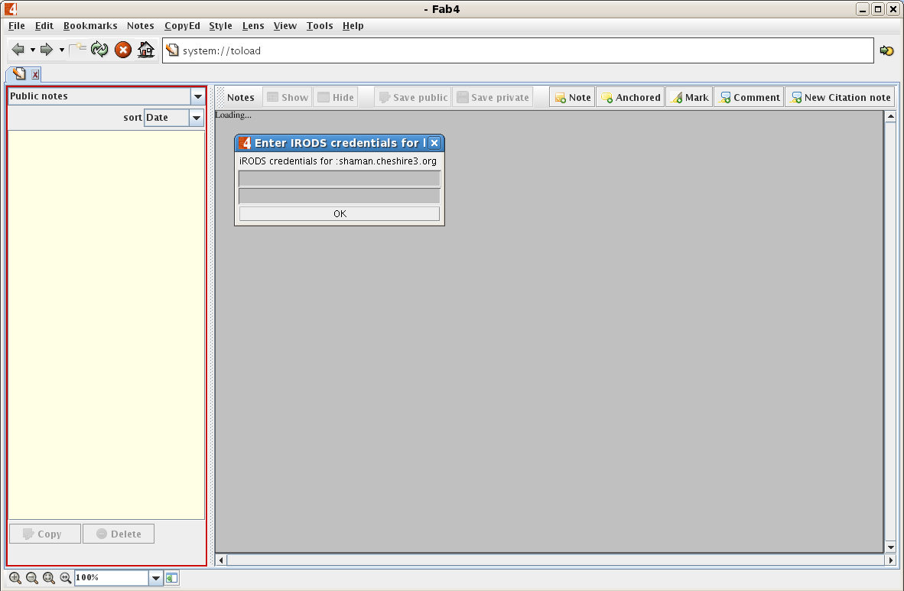
Demonstrations
Notes:
Access
Content Provider Authentication
Fab4 Multivalent Browser is downloaded and run via Java webstart on the client.
The URI of the Digital Object is accessed, login credentials are requested to ensure that the user is authorized to access the material.

Slide 12
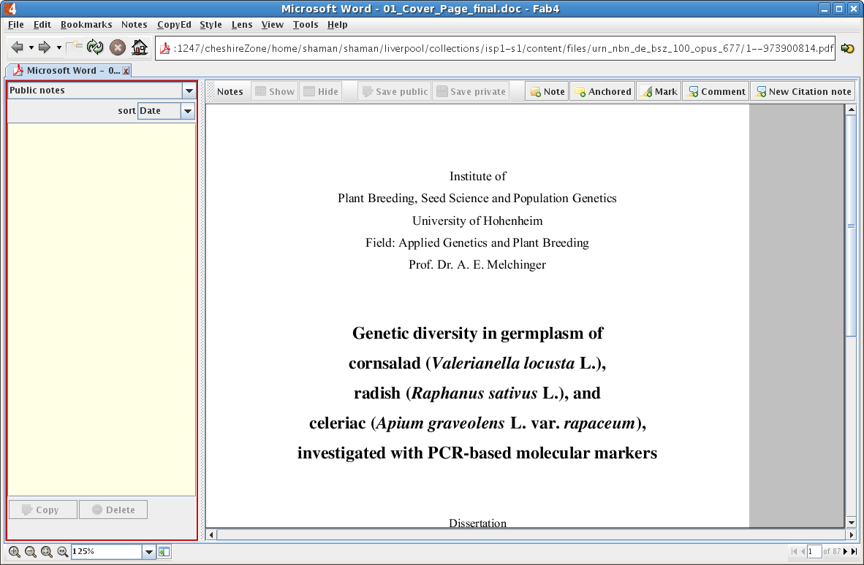
Demonstrations
Notes:
Access
Content Provider Display

Slide 13
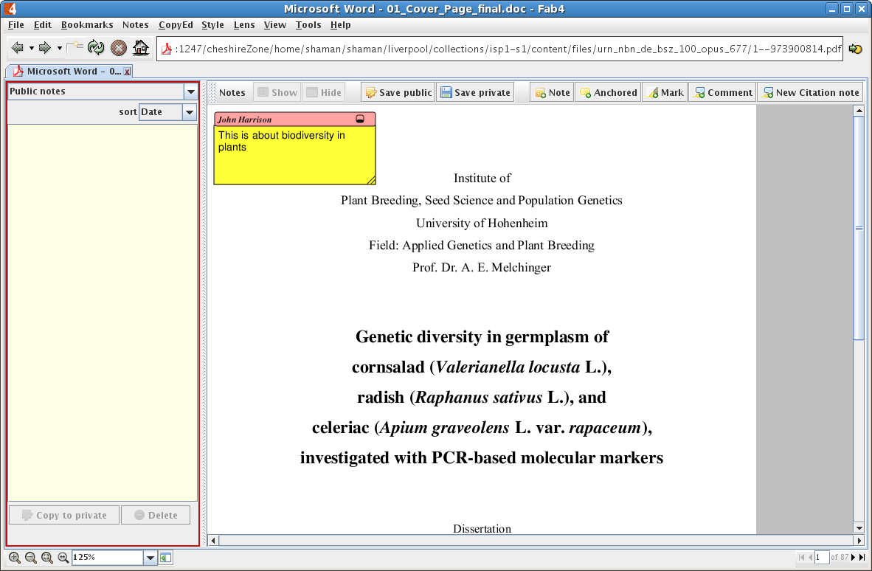
Demonstrations
Notes:
Adoption
Annotating Content

Slide 14
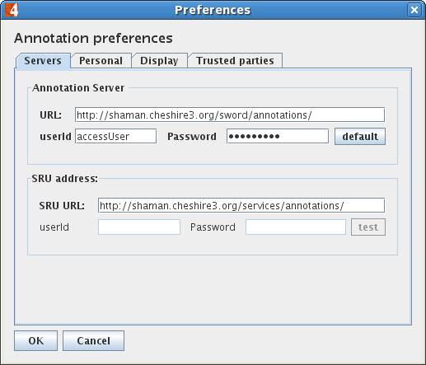
Demonstrations

Slide 15
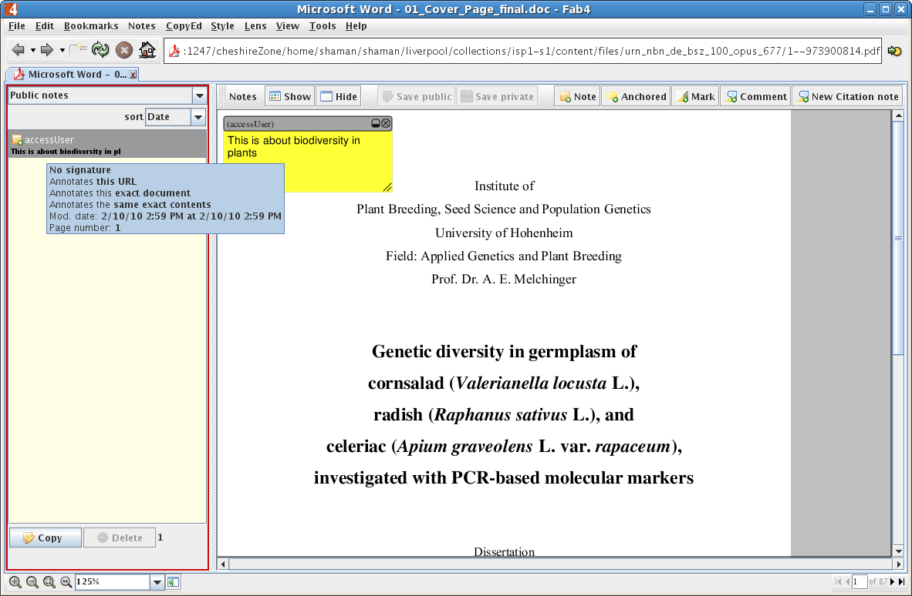
Demonstrations

