Slide 1

DIGITAL MARKETING ANALYSIS
DEPLOYMENT PLAN
TEAM:
CINTIA VÁRHEGYI
PÉTER VÁNDOR

Slide 2

OUR AGENDA
01
PROJECT PURPOSE AND SCOPE
02
COMPLIANCE REQUIREMENTS
03
DEPLOYMENT REQUIREMENTS
04
DEPLOYMENT SCHEDULE PLAN
05
APPLICATION SHOWCASE

Slide 3




PROJECT PURPOSE AND SCOPE
PROBLEM
PURPOSE
BUSINESS CASE
Suboptimal marketing spending leads to lower conversion rates
Develop predictive model to predict conversions based on internal historical data
Increase conversions by 15-20% and increase marketing ROI
METRICS
DELIVARABLE
OUT OF SCOPE
Conversion rates, accuracy of prediction
Best machine learning model for prediction with a clear interface and retraining each week
Offline marketing efforts & Analysing third-party sources (Google Analytics)

Slide 4
COMPLIANCE REQUIREMENTS
Data Privacy
Comply with GDPR
Ensure customer data is collected with explicit, informed consent
Allow users to opt out of profiling and automated targeting
Data Minimization
Use only the data necessary for conversion prediction
Avoid processing sensitive or irrelevant personal attributes
Fairness
Avoid using features that
may result in bias
Conduct bias audits regularly
Model Accountability
Maintain logs and audit trails of predictions and outcomes
Implement human oversight
Explainability
Customers may have the right to understand decisions
Provide transparent explanations using feature importance
Purpose Limitation
Predictions should only be used for the intended marketing purpose

Slide 5
Deployment Requirements I.
Hardware & Software
Model training hardware (AWS)
Training (m5.4xlarge): 16 vCPUs, 64 GiB RAM, attached 500 GiB gp3 EBS—enough in-memory horsepower and I/O for a weekly XGBoost re-train. Cost: $0.768 per hour, $1.54 each week
01
Model inference hardware (AWS)
Inference (c5.large): with Auto Scaling: 2 vCPUs, 4 GiB RAM per node—lightweight, low-cost, scales out under load and scales in when idle. Cost: $0.085 per hour, 10$ per month with light usage
02
Cloud deployment
Advantages: true pay-as-you-go billing, seamless autoscaling, managed infrastructure (no OS or cluster ops), and built-in cost optimization via the AWS Pricing Calculator.
Software
TensorFlow and Scikit-learn are open-source and free but need in-house expertise. AWS Managed Grafana starts at $9 per active editor user/month and $0.5/GB ingested. Hadoop and other large scale data processing tools would be overkill for our usage at ~10000 rows.
03

Slide 6
Deployment Requirements II.
Personnel & Change Management
System operators
Data engineers and ML engineers will build, deploy, and maintain the data pipelines, model retraining jobs, and inference endpoints. They need proficiency with AWS (S3, SageMaker) and our monitoring stack (Grafana).
Plan & Communicate
Define a clear process for introducing the new workflow - what changes, when, and why - and share the schedule (roadmap) with all teams.
End-users
Marketing analysts and campaign managers use the model’s conversion-rate predictions via the application and adjust budgets and targeting accordingly.
Identify challenges
Focus first on the marketing department (the “Select Few”) while gathering diverse feedback from sales, analytics, and IT (“Diverse Many”) to anticipate obstacles.
Stakeholders
Marketing Directors expect accurate, timely predictions to inform spend decisions and ROI tracking. CTO expects reliable uptime, cost transparency, and security/compliance adherence.
Motivate adoption
Logical arguments: accuracy improvements, cost savings, marketing ROI gains.
Emotional drivers: vision sharing, reduced manual work, reduced manual work.

Slide 7
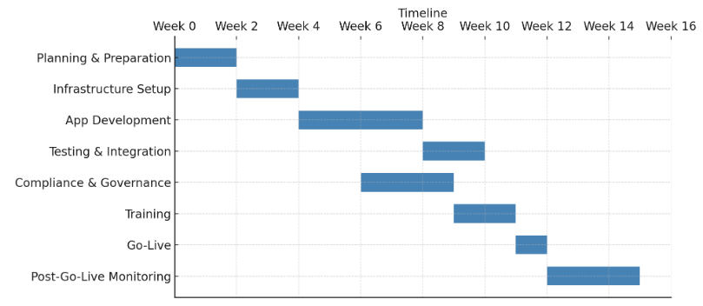
DEPLOYMENT SCHEDULE PLAN
May 13
June 5
June 13
Project duration:
6-8 weeks
Go-Live
June 5th

Slide 8

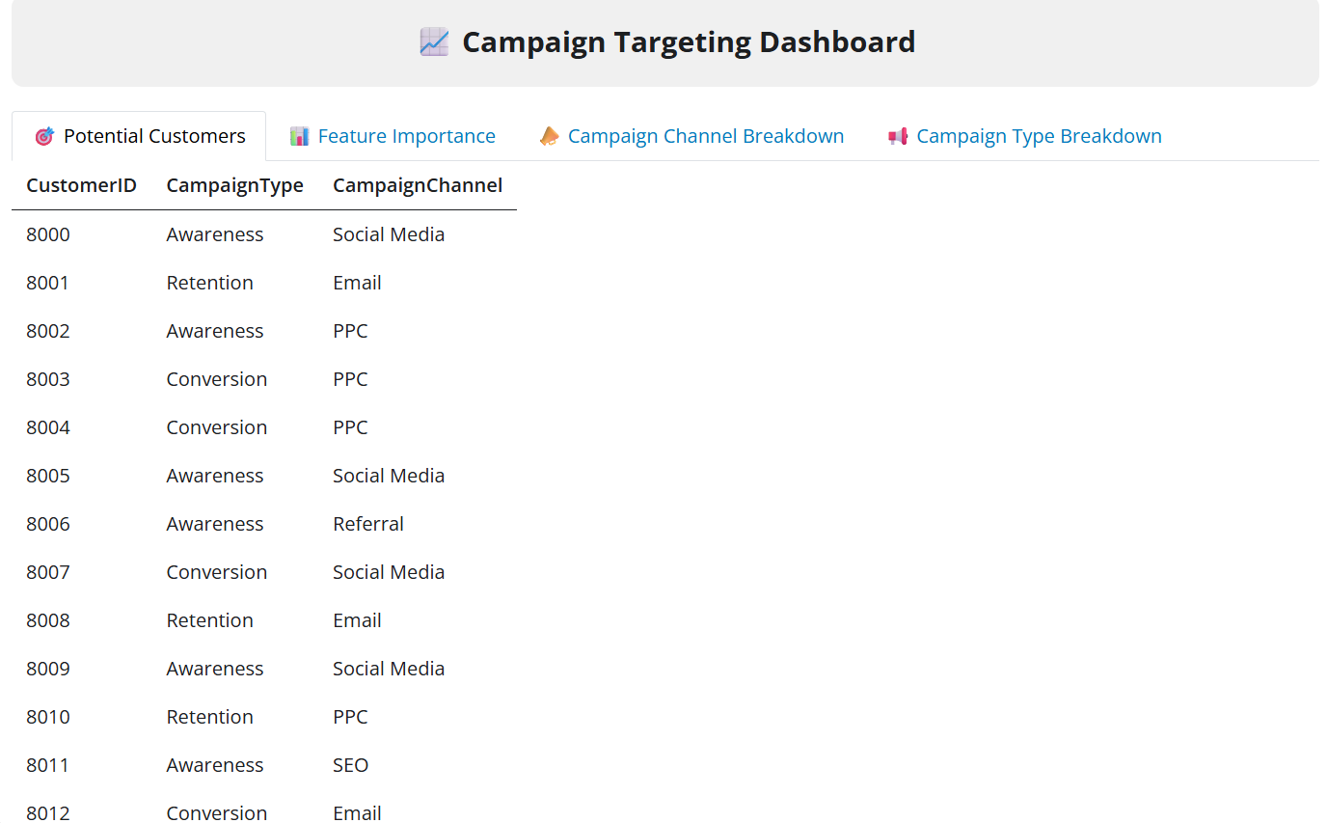
Application showcase
Conversion prediction, feature importance and marketing breakdown
Model performance
XGBoost Model Achieved 92% Accuracy on Test Data
Potential customers
Display top conversion candidates (prediction ≥ 80%)
Feature importance
Campaign Channel & Type Breakdown

