Slide 1


SEICHE 2022 Basic Arduino Programming
Instructor: Paul Frommeyer
www.paulfrommeyer.com
Corporate Sponsor: DXC Technology

Slide 2
Lesson Plan Overview
Lesson 5 – Binary Images, Arrays, Characters, Strings, Loops
Loading Binary Images
Arrays
Characters and Character Codes
Strings
Conditional Loops Part 1
Lesson 6 – Loops (cont.), LED Matrix Displays, Nested Loops Advanced Functions, Binary Numbers Part 1
For-Next Loops
SPI Peripherals
Using a MAX7219 LED Matrix Display
Lighting and clearing individual pixels
Advanced Functions
Nested Loops
Lesson 7 – The Binary Number System (may take 2 lessons)
Numerals vs numbers
Review: the base 10 system and digit place values
New: the base 2 system and digit place values
Bits and bytes and nybbles
Binary addition and subtraction
Lesson 8 – Producing Sound
Formatting printed output in Serial Monitor
Shifting and exponents
Bitwise operations and masking
Displaying text on the LED matrix display
Review of sound wave theory
Analog vs Pulse Width Modulation
Producing sound tones with an Arduino microcontroller
Lesson 9 – Reading Analog and Digital pins
Millis
Reading buttons
Debouncing buttons
Reading analog values from a potentiometer
Lesson 10 – The I2C Bus and Peripherals
I2C Bus Operation
Initializing the I2C bus
Accessing an I2C temperature sensor
Real Time Clocks
Accessing a DS3231 RTC
Lesson 11 – NTP and Text Management
Time representations and conversions
Network Time Protocol
Displaying the time on an LED matrix display
Changing the default font
Text Effects
Using multiple display zones
Lesson 1 – Intro and Setup [may require 2 classes]
Introduction to class format
Overview of lesson plan
Presentation format (monitor, camera, screen, whiteboard)
Review of microcontrollers and types of boards
SEICHE LED display architecture
ESP8266 pinout
High level architecture
Lesson 2 – Laptop operation review – Windows and Linux
Inventory of USB drives
Installation of Arduino IDE software
Installation of CH340/ESP8266 serial port drivers (Windows only)
Control panel/settings location
Home directories and folder hierarchy
Arduino file locations
Search functions
(Windows) Device Manager
(Linux) Konsole
Copying flash drive contents [critical]
Open questions and issues
IDE essentials
Starting the Arduino IDE
Basic Arduino sketch (program) structure
Loading example sketches
Loading and configuring new boards
Connecting boards
Identifying the microcontroller serial port
Linux
Windows
Lesson 3 – Libraries, Sketch structure, Serial Monitor, Variables, Binary Number System Pt1
Libraries
Sketch structure (A note on brace formatting)
The serial port monitor
Printing to the serial port monitor
Variables and the assignment operator
Binary number system Pt. 1.
Lesson 4 – Expressions, Conditionals, Blocks and Functions
Arithmetic Expressions and Operators
Incrementing and Decrementing Variables
Truth Values in C++
The If-Then Statement
Code Blocks
Functions

Slide 3
Lesson 10 – I2C and Sensors
Parola followup – library syntax
Displaying plain text with the Parola library
The I2C bus – Theory of operation
LED Matrix Display – I2C review
Classroom Exercise – Temperature sensor
Real Time Clocks
Accessing a DS3231 RTC
Classroom Exercise – DS3231 Display

Slide 4
MD_Parola Syntax Review
The MD_Parola library method setIntensity(uint8_t intensity) changes the brightness of your LED display
This breaks down as: uint8_t This is the data type of the parameter intensity This names the parameter itself
Methods must be called from/in their objects!
So as an example: uint8_t display_intensity=6; pmx.setIntensity(display_intensity);
“pmx” is the Parola display object that you created earlier in the sketch; it’s what you set intensity for.

Slide 5
Plain text with Parola
As we saw previously, there are many text effects available with Parola. But what if we just want to put some text on the LED matrix without any fancy animations?
For that, we use the PA_PRINT text effect. This effect “just prints” the specified text
An example of PA_PRINT: pmx.setTextEffect(PA_PRINT, PA_NO_EFFECT);
That function call specifies the plain PRINT effect as the “text on” effect for all display zones and NO_EFFECT for “text off” for all display zones

Slide 6
Display Plain Text – Sketch 10A
Go ahead and load SKETCH10A into your IDE and upload it
Once again, feel free to modify the text you are displaying to your personal preference
#include <SPI.h>
#include <MD_MAX72xx.h>
#include <MD_Parola.h>
#define HARDWARE_TYPE MD_MAX72XX::FC16_HW
#define MAX_DEVICES 4
#define CLK_PIN 14 // or SCK
#define DATA_PIN 13 // or MOSI
#define CS_PIN 15 // or SS
// MD_MAX72XX ledmx = MD_MAX72XX(HARDWARE_TYPE, DATA_PIN, CLK_PIN, CS_PIN, MAX_DEVICES);
MD_Parola pmx = MD_Parola(HARDWARE_TYPE, CS_PIN, MAX_DEVICES);
// We always wait a bit between updates of the display
#define DELAYTIME 100 // in milliseconds
void setup()
{
// put your setup code here, to run once:
pmx.begin();
pmx.setZoneEffect(0, true, PA_FLIP_LR);
pmx.setZoneEffect(0, true, PA_FLIP_UD);
}
void loop()
{
if(pmx.displayAnimate())
pmx.displayText("SEICHE",PA_CENTER,50,0,PA_PRINT,PA_NO_EFFECT);
}

Slide 7
The I2C Bus
Recall that a “bus” in electronics is a group of wires/circuits all carrying related signals that work together to jointly perform certain operations
Last semester, we looked at WS2812 smart LEDs (“Neopixels”) which used the so-called OneWire or Wire single-wire signal bus to transmit color and position data to a strip of smart LEDs
We have also looked at the SPI (Serial Peripheral Interface) bus which comprises five wires to access and control active devices connected to microcontrollers (such as our LED matrix displays)
Today we are going to learn how to use the I2C bus. The I2C bus is a two-wire bus. I2C is an abbreviation (ofc) for Inter-Integrated Circuit. This name was chosen because the I2C bus is designed to allow active electronic components to communicate with each other over (relatively) short distances, namely the distances within a single electronics device such as a computer, MP3 player, or game console.
The I2C bus uses data and clock wires, and I2C is a master-slave architecture (no social commentary intended or implied) where a master control unit handles all communications on the bus.

Slide 8
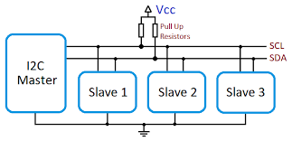
The I2C Bus
The master unit is responsible for generating the clock signal on the Synchronous Clock (SCL) wire, issuing commands on the Synchronous Data (SDA) wire, and receiving data back (when applicable) from slave units
Slave units have addresses (registers holding binary data) and they listen for commands from the master sent to their address, then they execute those commands

Slide 9
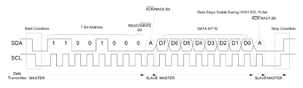
The I2C Bus
The below diagram, which we will not be reviewing in detail ☺, shows how the SCL clock works with commands sent from the master and data returned from the slaves
The TL;DR is that during certain clock states the master sends data, and during other clock states the slaves send data

Slide 10
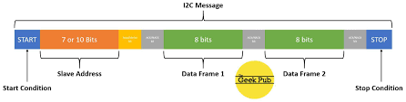
The I2C Bus
The below diagrams, which we will not be reviewing in detail ☺, shows how the SCL clock works with commands sent from the master and data returned from the slaves
The TL;DR is that during certain clock states the master sends commands, and during other clock states the slaves send back data

Slide 11
The I2C Bus
The critical information you need as a programmer/developer in order to use I2C peripherals is how slave addressing works
Originally, only 8 bits were used for slave addresses, permitting (wait for it!) up to 255 devices to exist on a single bus
Quite predictably, this proved woefully insufficient for large devices such as server motherboards, so a hack was contrived that allowed the use of 10-bit addresses, with the possibility of expanding to even larger address ranges in the future

Slide 12

The I2C Bus - Addressing
The way the 10-bit addressing hack works is that not one but two addressing fields are transmitted by the master.
A bit-challenged slave will ignore the first field because it’s invalid, and only pay attention to the second
While a modern, sophisticated slave device is smart enough to parse both fields and extract the full 10-bit address.
With this scheme, only the master has to be fully aware of how the 10-bit addressing hack works.
8-bit and 10-bit slaves will happily co-exist together, as long as the cardinal rule of unique device addresses is followed

Slide 13
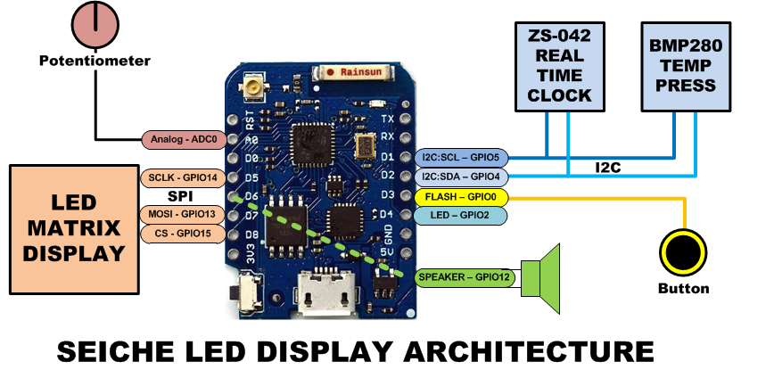
LED Matrix Display – I2C Bus
Review the graphic for the signal architecture used in your LED matrix displays, and notice how the I2C bus is structured
What pins does the I2C bus use on the ESP8266?
What devices are connected via I2C?

Slide 14
LED Matrix Display – I2C Bus
Temperature Sensors
Your displays exclusively use the BMP180 sensor. (Yeah, the graphic is wrong– that’s because I ended up changing components at the last second)
BME680, BME280, BMP280, BMP180, and BMP085 sensors can use the same address, however they require completely different libraries.
So if you have more than one on a single bus, the addresses must be different, even if they are different model sensors
Sensor Model | Addr Width | Type | I2C Address
BMP085 | 7-bit | Tmp | 0x77
BMP180 | 7-bit | Tmp, Bar | 0x77
BMP280 | 10-bit | Tmp, Bar | 0x76 or 0x77 (selectable)
BME280 | 10-bit | Tmp, Bar, Hum | 0x76 or 0x77 (selectable)
BME680 | 10-bit | Tmp, Bar, Hum, VOC | 0x76 or 0x77 (selectable)
Ref: https://randomnerdtutorials.com/dht11-vs-dht22-vs-lm35-vs-ds18b20-vs-bme280-vs-bmp180/#:~:text=The%20BME280%20and%20BMP180%20are,be%20used%20to%20estimate%20altitude.

Slide 15
Read and Display Temperature Sketch 10B
Go ahead and load SKETCH10B into your IDE (do not upload it!)
How is your BMP180 temperature sensor initialized and accessed according to what you see in the code?
What happens when you validate the sketch?
If you receive an error message, do you remember how you solve such a message?

Slide 16
Sketch 10B
Once you have installed the correct library, now upload the sketch
Verify in the Serial Monitor that you are able to retrieve output from your BMP180
Next, modify your sketch to display the temperature output on your LED matrix
And then, modify your sketch so the LED display is in degrees Fahrenheit, not Celsius

Slide 17
Real Time Clock
A real-time clock (RTC) is an electronic device (most often in the form of an integrated circuit) that measures the passage of time. The term real-time clock is used to avoid confusion with ordinary hardware clocks which are only signals that govern digital electronics, and do not count time in human units. RTCs often have an alternate source of power, so they can continue to keep time while the primary source of power is off or unavailable. Most RTCs use a crystal oscillator,[8][9] but some have the option of using the power line frequency.[10] The crystal frequency is usually 32.768 kHz,[8] the same frequency used in quartz clocks and watches. Being exactly 215 cycles per second, it is a convenient rate to use with simple binary counter circuits. The low frequency saves power, while remaining above human hearing range. The quartz tuning fork of these crystals does not change size much from temperature, so temperature does not change its frequency much.
– Wikipedia

Slide 18
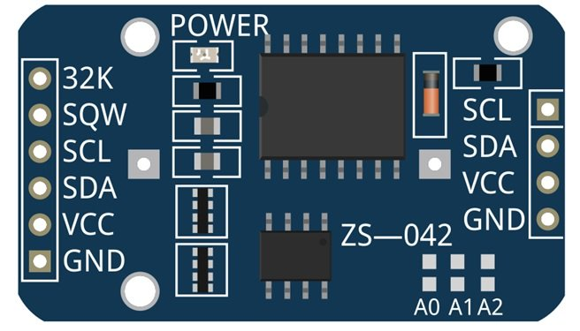
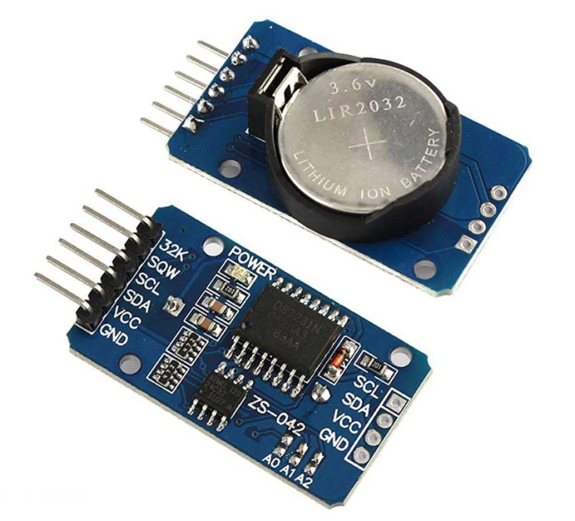
Real Time Clock – DS3231
The DS3231 is a very common RTC
It is often found in the ZS-042 form factor– a specific circuit board and component layout that provide I2C access to the DS3231

Slide 19
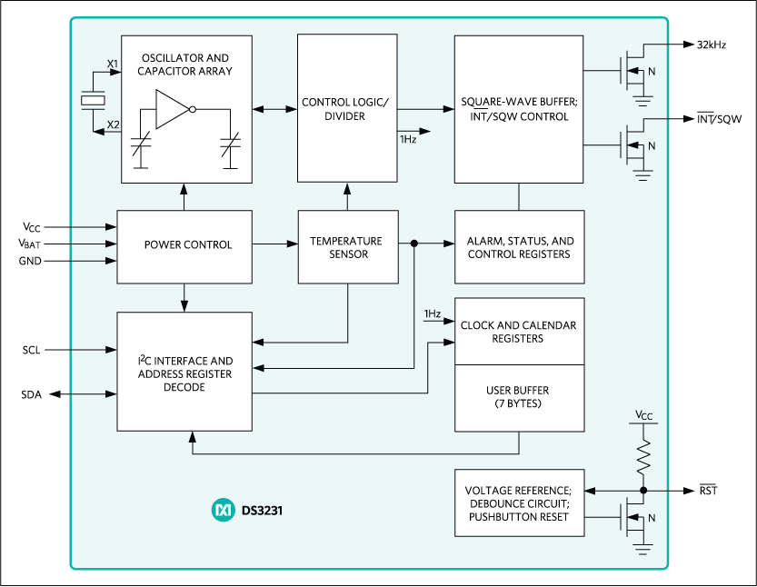
The DS3231 Real Time Clock
The datasheet for the DS3231 explains that this part is an "Extremely Accurate I²C-Integrated RTC/TCXO/Crystal". And, hey, it does exactly what it says on the tin! This Real Time Clock (RTC) is the most precise you can get in a small, low power package. – Adafruit
The block diagram of the DS3231 from its manufacturer, Maxim Electronics, is at left
Likewise per the datasheet, the DS3231 default I2C address is 0x68, and the I2C address of the on-board EEPROM is 0x57

Slide 20
Accessing a DS3231 RTC
You now have the I2C address of the DS3231 used in your displays
What else do you need before you can access and use the RTC?
Go ahead and load SKETCH10C
What happens when you validate the sketch?
How do you propose we solve this error message?

Slide 21
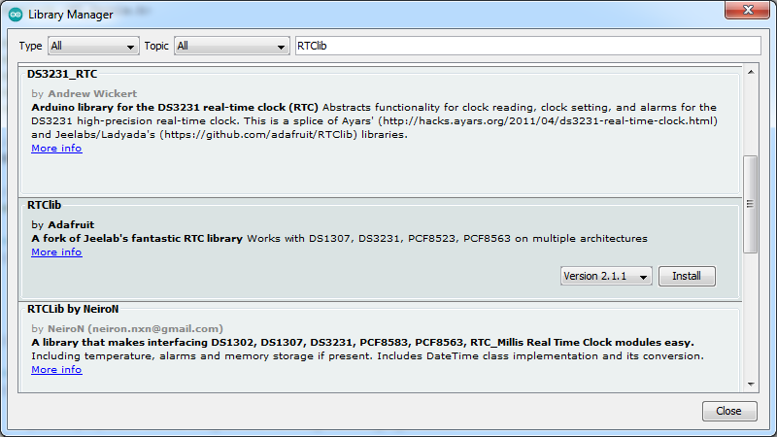
Choosing a DS3231 RTC Library
Select and install the Adafruit RTClib library– and ONLY the Adafruit library!

Slide 22
Read and Display RTC Time Sketch 10C
Go ahead and upload Sketch 10C into your display (after completing the RTClib installation on the previous slide!)
What Serial Monitor output do you see?
What does your display show?
How does your display relate to what’s show in the Serial Monitor
Could anything be wrong or need to be changed?
Are there any parts of your sketch that introduce new concepts? If so, what are they?

Slide 23
Formal End of Lesson 10
HOMEWORK!
Go online and study how DS3231 RTCs are used with Arduinos
Also search online for how time is displayed on MAX7219 LED matrix displays
In next week’s exciting episode
Time formats and conversions
Network Time Protocol
Getting and displaying network time
Setting an RTC manually
Setting an RTC from NTP

Slide 24
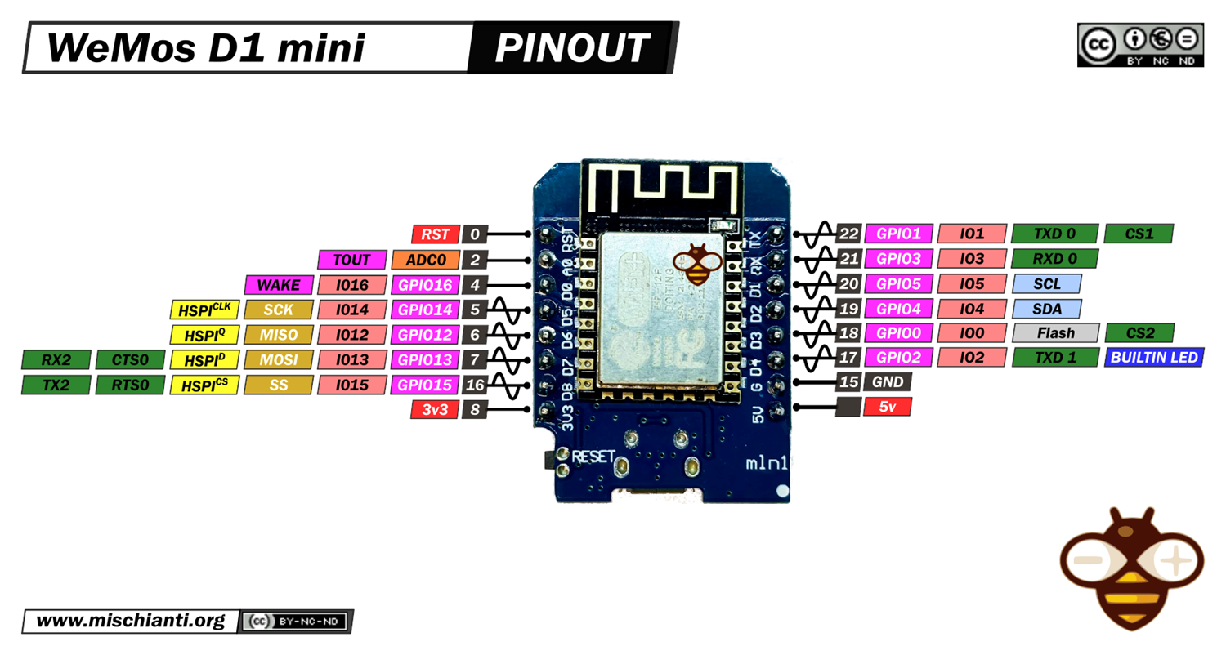
LESSON REFERENCE

Slide 25
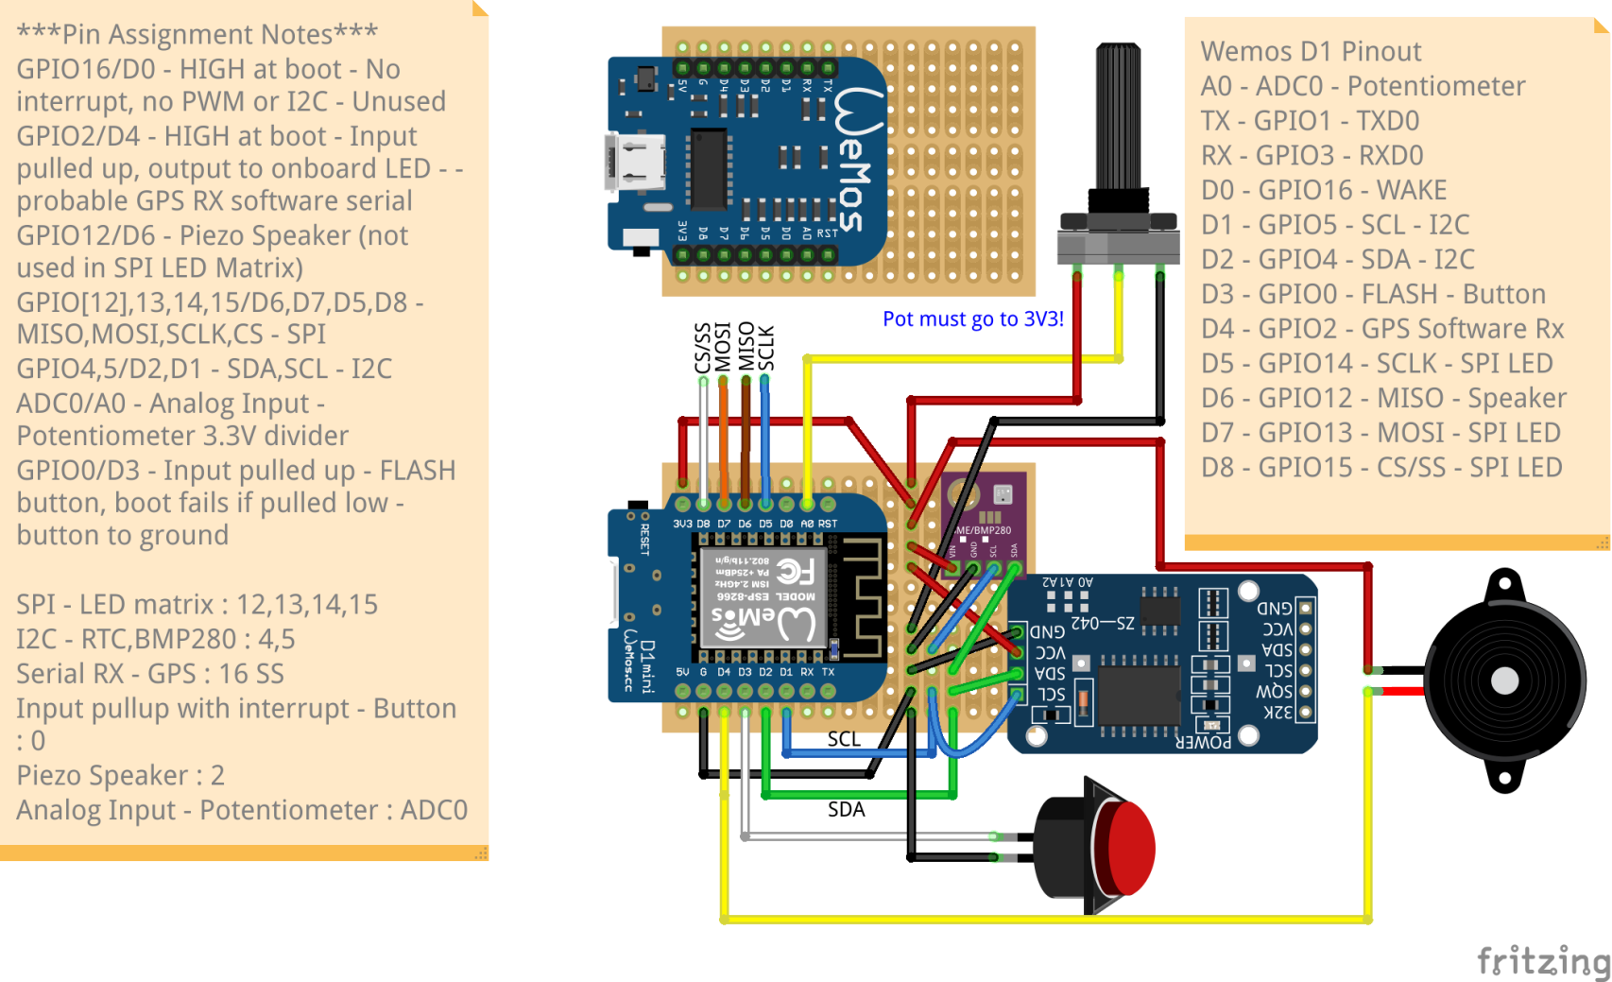
LESSON REFERENCE

