Slide 1


SEICHE 2022 Basic Arduino Programming
Instructor: Paul Frommeyer
www.paulfrommeyer.com
Corporate Sponsor: DXC Technology

Slide 2
Lesson Plan Overview
Lesson 5 – Binary Images, Arrays, Characters, Strings, Loops
Loading Binary Images
Arrays
Characters and Character Codes
Strings
Conditional Loops Part 1
Lesson 6 – Loops (cont.), LED Matrix Displays, Nested Loops Advanced Functions, Binary Numbers Part 1
For-Next Loops
SPI Peripherals
Using a MAX7219 LED Matrix Display
Lighting and clearing individual pixels
Advanced Functions
Nested Loops
Lesson 7 – The Binary Number System (may take 2 lessons)
Numerals vs numbers
Review: the base 10 system and digit place values
New: the base 2 system and digit place values
Bits and bytes and nybbles
Binary addition and subtraction
Lesson 8 – Producing Sound
Formatting printed output in Serial Monitor
Shifting and exponents
Bitwise operations and masking
Displaying text on the LED matrix display
Review of sound wave theory
Analog vs Pulse Width Modulation
Producing sound tones with an Arduino microcontroller
Lesson 9 – Reading Analog and Digital pins
Millis
Reading buttons
Debouncing buttons
Reading analog values from a potentiometer
Lesson 10 – The I2C Bus and Peripherals
I2C Bus Operation
Initializing the I2C bus
Accessing an I2C temperature sensor
Real Time Clocks
Accessing a DS3231 RTC
Lesson 11 – NTP and Text Management
Numeric to ASCII Conversions
Time representations and conversions
Network Time Protocol
Displaying the time on an LED matrix display
Lesson 12 – Text Management
Changing the default font
Text Effects
Using multiple display zones
Lesson 1 – Intro and Setup [may require 2 classes]
Introduction to class format
Overview of lesson plan
Presentation format (monitor, camera, screen, whiteboard)
Review of microcontrollers and types of boards
SEICHE LED display architecture
ESP8266 pinout
High level architecture
Lesson 2 – Laptop operation review – Windows and Linux
Inventory of USB drives
Installation of Arduino IDE software
Installation of CH340/ESP8266 serial port drivers (Windows only)
Control panel/settings location
Home directories and folder hierarchy
Arduino file locations
Search functions
(Windows) Device Manager
(Linux) Konsole
Copying flash drive contents [critical]
Open questions and issues
IDE essentials
Starting the Arduino IDE
Basic Arduino sketch (program) structure
Loading example sketches
Loading and configuring new boards
Connecting boards
Identifying the microcontroller serial port
Linux
Windows
Lesson 3 – Libraries, Sketch structure, Serial Monitor, Variables, Binary Number System Pt1
Libraries
Sketch structure (A note on brace formatting)
The serial port monitor
Printing to the serial port monitor
Variables and the assignment operator
Binary number system Pt. 1.
Lesson 4 – Expressions, Conditionals, Blocks and Functions
Arithmetic Expressions and Operators
Incrementing and Decrementing Variables
Truth Values in C++
The If-Then Statement
Code Blocks
Functions

Slide 3
Lesson 11 – Numeric Conversions, Time Formats, Network Time Protocol
Numeric to ASCII conversions
printf and sprintf
Time bases and formats in Linux and Windows
Time Data Structures and Conversions
Network Time Protocol
Classroom Exercise – Using NTP
Classroom Exercise – NTP LED Display

Slide 4
Numeric Conversions
We previously looked at some ways to convert strings (arrays of data type char) into numbers
Today we will look at two ways to convert numbers into strings
Arduino and other C implementations offer the itoa(), ltoa() and ultoa functions to convert from the respective numeric data types into strings
Using these functions requires a character array which acts a buffer to receive the ASCII text result
So as an example: char textbuffer[33]; long longvariable; ltoa(longvariable,textbuffer,32);

Slide 5
Numeric Conversions (cont.)
There are several problems with the xtoa functions
Require careful buffer sizing
Unavailable for conversion of floating point (decimal fractionated) numbers
Trailing null processing can be tricksy
Non-portable
Use of the standard conversions requires that the programmer know in advance the size of the data type(s) being converted
Code must be specific to the type size(s) on a given platform
This makes portability difficult at best, where extensive compile-time options must be deployed in an attempt to accommodate all possible platforms where the code might be used
This is undoubtedly the biggest problem with the standard conversion functions, and why they are rarely used with Arduino

Slide 6
fprintf(), printf() and sprintf()
fprintf() and printf() are functions included in the standard I/O library of most C compilers (#include <stdio.h>)
The fprintf() function formats and then outputs variables into so-called standard I/O streams. It provides extensive and precision control over how the output is structured
Because microcontrollers do not have standard I/O streams, fprintf() is not used with the Arduino IDE, C++, or Processing
However, fprintf() has a non-I/O counterpart called sprintf()
Instead of sending its results directly to an output data stream, sprintf() puts the results in a character array buffer
This makes sprintf() extremely versatile, and thus it is the preferred method for performing numeric conversions in Arduino

Slide 7
Output Format Descriptors
Numerous programming languages make use of constructs called output format descriptors
You have seen very simple ones used with the Serial.println() function; remember DEC, HEX, and BIN?
The idea behind a format descriptor is that a variable or value is supplied to function along with a description of how that variable or value is to be formatted and then returned from the function.
Format descriptors can provide extensive and very precise control over how the resulting formatted output looks: left-justified, zero-filled, how many decimal places included in fractional numbers, how many characters converted, etc.
And this is the level of control which the format descriptors in sprintf() provide, making it so very useful
sprintf() calls its format descriptors format strings

Slide 8
sprintf() Function Syntax
sprintf()’s formal syntax is: sprintf(char *buffer, const char *format, variable list)
buffer is an array of type char (the parameter when passed can also be a pointer [address] for such an array) which will contain the formatted output of the function
format is an unmodifiable (constant) array of char containing the format descriptors for all variables subsequently passed to the function, which is to say, it’s the format string.
The variable list are just the comma separated variables that are to be formatted
All variables passed in a single call to sprintf() are combined into a single output string
sprintf() automagically puts a terminating NULL (\0) at the end of the ASCII output

Slide 9
sprintf() Format Strings
sprintf() format strings contain conversion specifiers that specify how each individual variable is to be converted
sprintf() conversion specifiers have the following general syntax (all begin with a percent-sign):
%[flags][minimum field width][.][precision][length][conversion character]
% - special token that indicates the start of a conversion specifier
Flags – these modify the behavior of the specification
Minumum field width – as it says on the tin; this the minimum number of characters to be converted
. – The period is a separator between field width and precision
Precision – means one of the following depending on the variable type and conversion specifier
The maximum number of characters to be generated from a string
The number of digits after the decimal point for type float conversions (e, E, or f)
The zero-filled minimum number of digits for an integer
Conversion character – A single character which determines the output type of the conversion specifier; a single character that specifies the type of output format for the corresponding data or variable

Slide 10
sprintf() Conversion Specifiers
Below are the general conversion specifiers and what they do.
Specifier | What it does
d, i | int - integer; signed decimal notation
o | int – unsigned octal (no leading zero)
x, X | int – unsigned hexadecimal, no leading 0x
u | int – unsigned decimal
c | int – single character, after conversion to unsigned char
s | char * - characters from string are printed until \0 (NULL) or precision is reached
f | double – decimal notation of form [-]mmm.ddd where number of decimals is specified by precision; precision of zero (0) suppresses the decimals altogether
e, E | double - exp notation; default precision of 6, 0 suppresses
g, G | double – Use %f for <10^4 or %e for >10^4
p | void * - print output as a pointer, platform dependent
n | Number of characters generated so far; goes into output
% | No conversion, put a % percent sign in the output

Slide 11
sprintf() Conversion Specifiers
Below are the flags and what they do.
Flag | What it does
- | Left justification
+ | Always print number with a sign
spc (space) | Prefix a space if first character is not a sign
0 (zero) | Zero fill left for numeric conversions
# | Alternate output form depending on conversion character o – first digit will be zero x or X – 0x or 0X (respectively) prefixed to non-zero results e, E, f, g and G – Output will always have a decimal point g and G – trailing zeroes will never be removed

Slide 12
sprintf() Example
Below is an example of how sprintf() can be used in actual code
#include <stdio.h>
int i=99; char c=65; double d=999999999;
float f = 1234567.9133333; unsigned int u = 65536;
char sometext[] = “hello world”;
char buffer[255];
void setup()
{
Serial.begin(9600);
sprintf(buffer,”%i @@ %c @@ %d @@ %f @@ %e @@ %u @@ %s, I, c, d, f, u, sometext);
Serial.println(buffer);
}
void loop()
{
}

Slide 13
Timekeeping Epochs
Nearly all operating systems have the concept of an epoch, the date and time from which the operating system measures time
For Unix and Linux, the epoch is January 1, 1970
For Windows, the epoch is January 1, 1601
By contrast, for humans our epoch is January 1, 0 AD (or BCE if we are being secularly correct about it)
Most computer systems determine present time as the amount of time elapsed since the epoch.
For Unix/Linux systems, this is seconds passed since the epoch
For Windows, it’s 100-nanosecond (.1 uS) intervals passed since the epoch
Epochs are not relative to any timezone, so they are all UTC (Universal Coordinated Time aka Greenwich Mean Time aka Zulu Time).

Slide 14
Epoch Problems
At some point, the variable or register used to store time in the operating system will “roll over” when it reaches its maximum value
For older mainframes that used January 1, 1900 as the epoch and stored the elapsed delta time using a 2-digit year, the rollover occurred at 23:59PM on December 31, 1999 leading to the so-called Year 2000 Crisis or Y2K
Many Unix/Linux systems will experience an overflow problem on 19 January 2038 if not fixed beforehand. This is known as the Year 2038 problem.
GPS (Global Positioning System) calculates its time from an epoch, transmits the offset between UTC time and GPS time, and must update this offset every time there is a leap second, requiring GPS receiving devices to handle the update correctly.

Slide 15
C++ struct tm
C/C++ utilize a standard data structure for storing and handling time
This data structure is struct tm, defined in time.h
Member | Type | Meaning | Range
tm_sec | int | seconds after the minute | 0-60*
tm_min | int | minutes after the hour | 0-59
tm_hour | int | hours since midnight | 0-23
tm_mday | int | day of the month | 1-31
tm_mon | int | months since January | 0-11
tm_year | int | years since 1900
tm_wday | int | days since Sunday | 0-6
tm_yday | int | days since January 1 | 0-365
tm_isdst | int | Daylight Saving Time flag

Slide 16
C/C++ ctime and localtime
However, pursuant to the use of an epoch, it is often necessary to convert between epochal time, local time, and either of those in struct tm format
time_t is the data type most commonly used in C implementations for storing epochal time, and is typically a long.
mktime() is used to convert a struct tm to time_t time_t mktime (struct tm * timeptr);
Likewise, localtime() is used to convert time_t formatted time into a struct tm struct tm * localtime (const time_t * timer);

Slide 17
Network Time Protocol
The Network Time Protocol (NTP) is a networking protocol for clock synchronization between computer systems over packet-switched, variable-latency data networks. In operation since before 1985, NTP is one of the oldest Internet protocols in use.
NTP is intended to synchronize all participating computers to within a few milliseconds of Coordinated Universal Time (UTC).[1]: 3 It uses the intersection algorithm, a modified version of Marzullo's algorithm, to select accurate time servers and is designed to mitigate the effects of variable network latency. NTP can usually maintain time to within tens of milliseconds over the public Internet, and can achieve better than one millisecond accuracy in local area networks under ideal conditions
Usually seen implemented as client-server

Slide 18
Network Time Protocol
The Network Time Protocol (NTP) is a networking protocol for clock synchronization between computer systems over packet-switched, variable-latency data networks. In operation since before 1985, NTP is one of the oldest Internet protocols in use.
NTP is intended to synchronize all participating computers to within a few milliseconds of Coordinated Universal Time (UTC).[1]: 3 It uses the intersection algorithm, a modified version of Marzullo's algorithm, to select accurate time servers and is designed to mitigate the effects of variable network latency. NTP can usually maintain time to within tens of milliseconds over the public Internet, and can achieve better than one millisecond accuracy in local area networks under ideal conditions
Usually seen implemented as client-server

Slide 19
ESP8266 and NTP
With network capable microcontrollers, the typical practice is to capture UTC from the NTP server, then make whatever adjustments are needed for local time.
A good NTP client implementation will only require polling of the NTP servers at wide intervals, in most cases several hours apart
In no case should NTP servers be polled more frequently than every 15 minutes, lest the polling be interpreted as a denial-of-service attack by the organization running the servers
If the organization is NIST– the Federal Government– things could go very badly wrong indeed if a DoS attack was perceived!

Slide 20
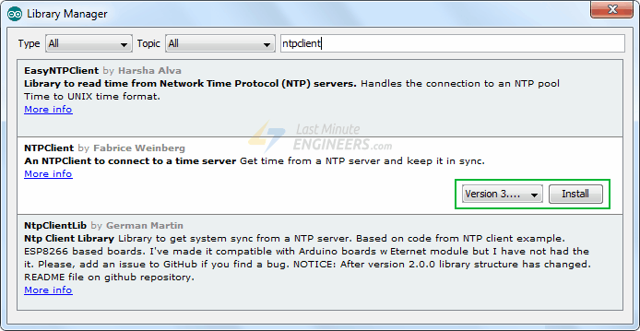
The NTP Library
As usual, we will need to install an NTP client library in order to connect to NTP servers
Go ahead and install this one now

Slide 21
Classroom Exercise - NTP
And here is our class sketch for NTP. Go ahead and load and run!
#include <NTPClient.h>
#include <ESP8266WiFi.h>
#include <WiFiUdp.h>
const char *ssid = “CFC_Public";
const char *password = "";
const long utcOffsetInSeconds = 3600;
char daysOfTheWeek[7][12] = {"Sunday", "Monday", "Tuesday", "Wednesday", "Thursday", "Friday", "Saturday"};
// Define NTP Client to get time
WiFiUDP ntpUDP;
NTPClient timeClient(ntpUDP, "pool.ntp.org", utcOffsetInSeconds);
void setup(){
Serial.begin(9600);
WiFi.begin(ssid, password);
while ( WiFi.status() != WL_CONNECTED ) {
delay ( 500 );
Serial.print ( "." );
}
timeClient.begin();
}
void loop() {
timeClient.update();
Serial.print(daysOfTheWeek[timeClient.getDay()]);
Serial.print(", ");
Serial.print(timeClient.getHours());
Serial.print(":");
Serial.print(timeClient.getMinutes());
Serial.print(":");
Serial.println(timeClient.getSeconds());
//Serial.println(timeClient.getFormattedTime());
delay(1000);
}

Slide 22
Classroom Exercise – NTP Display
Let’s see how y’all do with this one!
Combine SKETCH10B and SKETCH11A to display NTP time on your LED matrix display
Remember that you can use sprintf() to create a string that MD_Parola will print on the LED display
It might be easier to copy the necessary bits of 10B into 11A, but that’s entirely up to y’all!
Go to it and good luck! ☺

Slide 23
Formal End of Lesson 10
HOMEWORK!
Read up on how NTP works
Study the MD_Parola documention and see if you can figure out how to blink the colon when displaying time
In next week’s exciting episode
Changing the default font
Text Effects
Using multiple display zones

Slide 24
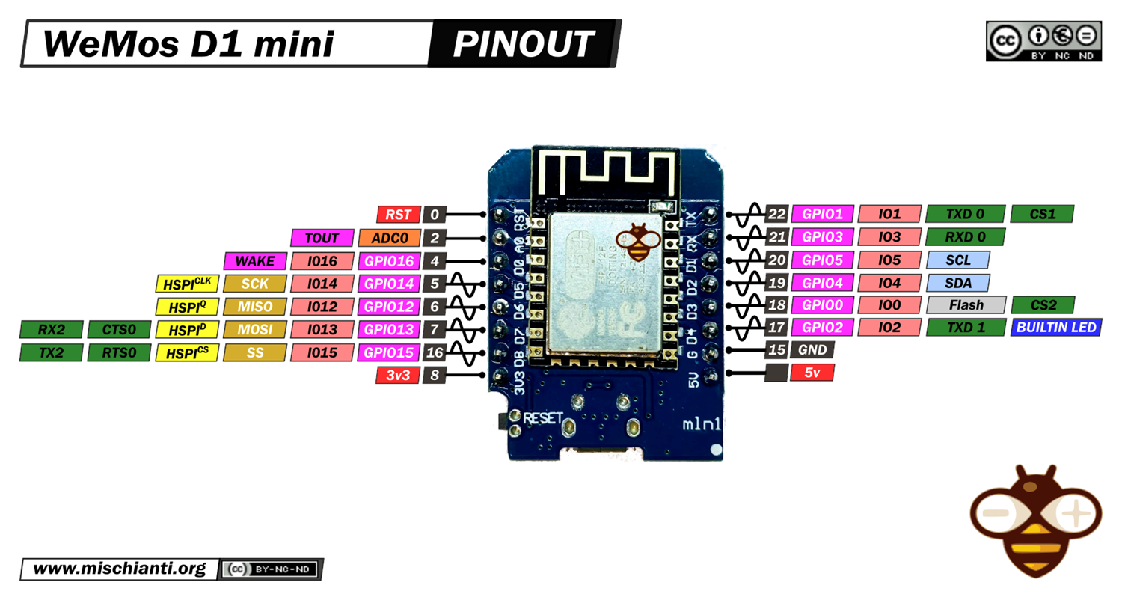
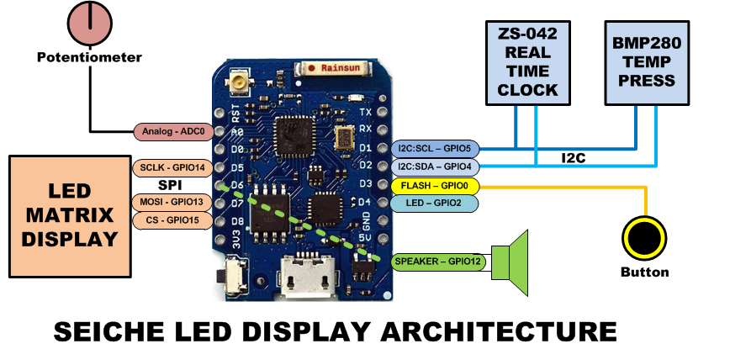
LESSON REFERENCE

Slide 25
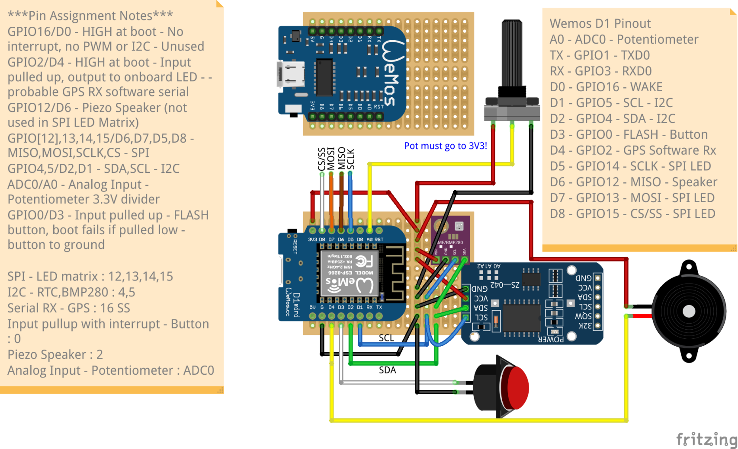
LESSON REFERENCE

