Slide 1


SEICHE 2022 Basic Arduino Programming
Instructor: Paul Frommeyer
www.paulfrommeyer.com
Corporate Sponsor: DXC Technology

Slide 2
Lesson Plan Overview
Lesson 1 – Intro and Setup [may require 2 classes]
Introduction to class format
Overview of lesson plan
Presentation format (monitor, camera, screen, whiteboard)
Review of microcontrollers and types of boards
SEICHE LED display architecture
ESP8266 pinout
High level architecture
Lesson 2 – Laptop operation review – Windows and Linux
Inventory of USB drives
Installation of Arduino IDE software
Installation of CH340/ESP8266 serial port drivers (Windows only)
Control panel/settings location
Home directories and folder hierarchy
Arduino file locations
Search functions
(Windows) Device Manager
(Linux) Konsole
Copying flash drive contents [critical]
Open questions and issues
IDE essentials
Starting the Arduino IDE
Basic Arduino sketch (program) structure
Loading example sketches
Loading and configuring new boards
Connecting boards
Identifying the microcontroller serial port
Linux
Windows
Lesson 3 – Libraries, Sketch structure, Serial Monitor, Variables, Binary Number System Pt1
Libraries
Sketch structure (A note on brace formatting)
The serial port monitor
Printing to the serial port monitor
Variables and the assignment operator
Binary number system Pt. 1.
Lesson 4 – Expressions, Conditionals, Blocks and Functions
Arithmetic Expressions and Operators
Incrementing and Decrementing Variables
Truth Values in C++
The If-Then Statement
Code Blocks
Functions
Lesson 5 – Binary Images, Arrays, Characters, Strings, Loops
Loading Binary Images
Arrays
Characters and Character Codes
Strings
Conditional Loops Part 1
Lesson 6 – Loops (cont.), LED Matrix Displays, Nested Loops Advanced Functions, Binary Numbers Part 1
For-Next Loops
SPI Peripherals
Using a MAX7219 LED Matrix Display
Lighting and clearing individual pixels
Advanced Functions
Nested Loops
Lesson 7 – The Binary Number System (may take 2 lessons)
Numerals vs numbers
Review: the base 10 system and digit place values
New: the base 2 system and digit place values
Bits and bytes and nybbles
Binary addition and subtraction
Formatting printed output
Shifting and exponents
Lesson 8 – Producing Sound
Review of sound wave theory
Analog vs Pulse Width Modulation
Producing sound tones with an Arduino microcontroller
Lesson 9 – Reading pins
Reading buttons
Millis() and debouncing buttons
Reading analog values from a potentiometer
Lesson 10 – The I2C Bus and Peripherals
I2C Bus Operation
Initializing the I2C bus
Accessing an I2C temperature sensor
Displaying text on the LED matrix
Default fonts

Slide 3
Lesson 6 – Loading Binary Images; Arrays, Characters, Strings and Loops
Part A – Homework Exercises
Write a sketch to increment a number until reaches 200, then decrement it until it reaches 0, then start incrementing it again. You can use either the ++/-- operators or selfassignment for variable updating. You’ll execute the sketch next week.
Take your homework sketch from last week and modify it to print the contents of an integer array of 99 elements, starting from the first element to the last, then from the last to the first. Use while instead of if-then. You’ll execute the sketch next week.
Part B
The For Loop
SPI Peripherals
Using a MAX7219 LED display
Lighting and clearing individual pixels
Advanced Functions
Nested For- Loops

Slide 4
Homework Review 1
Write a sketch to increment a number until reaches 200, then decrement it until it reaches 0, then start incrementing it again. You can use either the ++/-- operators or selfassignment for variable updating. You’ll execute the sketch next week.
Who was able to come up with a solution to this?
Remember that you can use the IDE to validate your code, even if you do not have a microcontroller connected to run it on!
Discussion of different approaches to solving the problem

Slide 5
Homework Review 2
Take your homework sketch from last week and modify it to print the contents of an integer array of 99 elements, starting from the first element to the last, then from the last to the first. Use while instead of if-then. You’ll execute the sketch next week.
Who was able to come up with a solution to this?
Notice that you were not required to initialize the array (fill it with data)
Discussion of different approaches to solving the problem
What did you see when printing out the values stored in the array?

Slide 6
The for Loop
The for loop is a control structure that is more efficient than a while loop and, in C++, incredibly flexible
It is intended to combine the conditional iteration of a while loop with iterative variable modification
The formal syntax of the for loop is: for (start statement; conditional test; repeating statement) statement;
For-next is almost always used with a code block for (i=0; i < 256; i++) { Serial.print(“ASCII: ”); Serial.println(i); Serial.print (“DEC: ”); Serial.println(i, DEC); }
Historical note: In BASIC and other languages, the for loop is implemented more simply as a FOR-NEXT combination using only a single variable, and typically only single increment, thus: FOR N = 1 TO 100 NEXT N

Slide 7
The For Loop – Let’s Give It A Go
Load Sketch 6A, then modify it to use a for-next loop instead of while. Remember that ; semicolon statement terminators are never optional, and C is case-sensitive!
char c;
void setup()
{
// Setup port for serial monitor
Serial.begin(9600);
}
// Still printing the ASCII character set!
void loop()
{
c = 0;
while(c < 256)
{
Serial.print("ASCII: "); Serial.println(c);
Serial.print ("DEC: "); Serial.println(c, DEC);
c++;
delay(500);
}
}
Did it work? If not, what went wrong?

Slide 8
The SPI Protocol
Serial data transmission protocols transmit the bits of a number (which may also be a character) sequentially
SPI, the Serial Peripheral Interface, is a very fast serial protocol used for communication between microcontrollers and peripherals (devices that are attached to the uC).
SPI uses a so-called master-slave architecture (not a social statement!) where the microcontroller (master) selects the peripheral (slave) it wants to talk to and tells it what to do. Peripherals cannot initiate communication or issue to commands to the microcontroller.
More than one SPI peripheral can be attached to a given set of SPI control and data wires, making SPI a bus based architecture

Slide 9
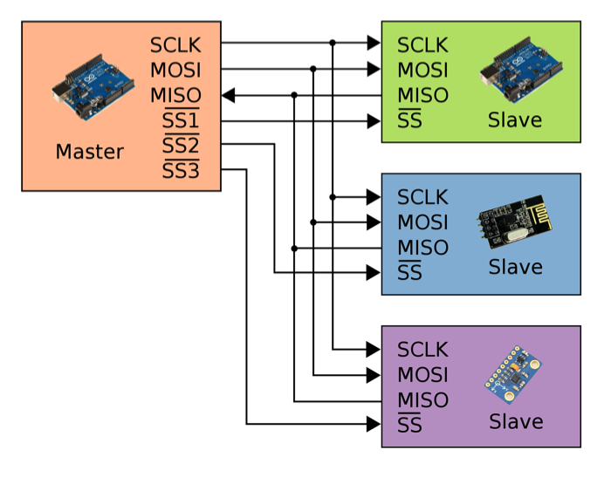
The SPI Protocol
SPI control and data lines are:
SCLK – System clock
MOSI – Master Out, Slave In
MISO – Master In, Slave Out
SS or CS – Slave Select

Slide 10
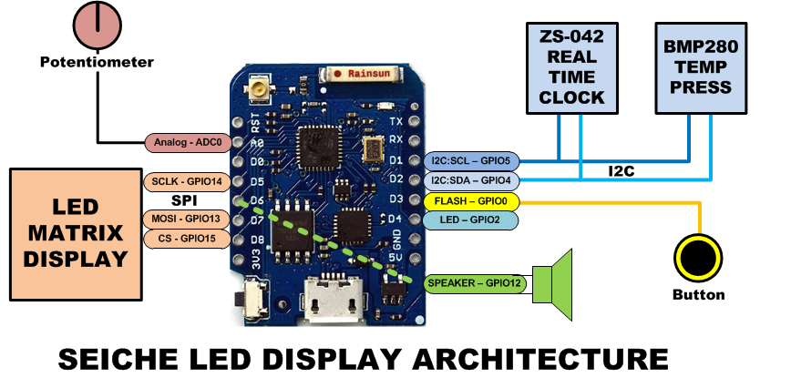
The SPI Protocol
You must know the pins an SPI device is using in order to use it!
In your LED displays, SPI is the protocol used to connect the MAX7219 display to the ESP8266 microcontroller
Note the pin numbers that are used for this! You will need them in your sketches!

Slide 11
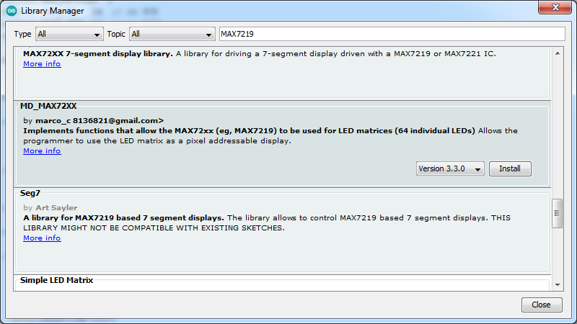
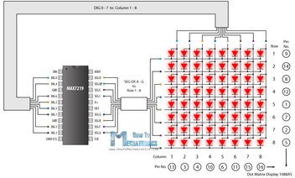
The MAX7219 LED Display
Your displays use the MAX7219 chip to drive the LED display. The MAX7219 abstracts the 8x8 LED array into a coordinate addressable X-Y matrix.
Using a MAX7219 requires a special library, which we must load using the Library Manager
Go ahead and install the MD_MAX72XX library
MAX7219 LED Array

Slide 12
Working with LED Matrices
Each LED in a matrix, or any X-Y display, is called a pixel from “picture element”
The MD_MAX72XX library provides ways to individually control pixels
LED matrices are first created as software objects: MD_MAX72XX ledmx = MD_MAX72XX(HARDWARE_TYPE, DATA_PIN, CLK_PIN, CS_PIN, MAX_DEVICES); Note that this is where you need those GPIO pin numbers!
Next we have to initialize the LED array: ledmx.begin(); And tell it to continuously update the display ledmx.control(MD_MAX72XX::UPDATE, MD_MAX72XX::ON);
Now we are ready to actually display information on the LED matrix!

Slide 13
Clearing and Setting Pixels
The command to illuminate a single pixel using MD_MAX72XX is ledmx.setPoint(5,5,true); whose parameters are (x-coordinate, y-coordinate, true|false)
To clear/turn off a single pixel, we use the same statement only with false as the state parameter: ledmx.setPoint(5,5,false);
Some libraries require the programmer to manually “refresh” the display, however MD_MAX72XX allows us to specify “continuous” updates (see previous slide)

Slide 14
MAX7219 LED Matrix Let’s Give It A Go
Load and execute Sketch6B:
#include <MD_MAX72xx.h>
#define HARDWARE_TYPE MD_MAX72XX::FC16_HW
#define MAX_DEVICES 4
#define CLK_PIN 14 // or SCK
#define DATA_PIN 13 // or MOSI
#define CS_PIN 15 // or SS
MD_MAX72XX ledmx = MD_MAX72XX(HARDWARE_TYPE, DATA_PIN, CLK_PIN, CS_PIN, MAX_DEVICES);
// We always wait a bit between updates of the display
#define DELAYTIME 100 // in milliseconds
void setup() {
// put your setup code here, to run once:
ledmx.begin();
ledmx.control(MD_MAX72XX::UPDATE, MD_MAX72XX::ON);
// ledmx.clear();
Serial.begin(9600);
Serial.println("MAX7219 TEST");
}
void loop() {
// put your main code here, to run repeatedly:
delay(DELAYTIME);
ledmx.setPoint(5,5,true);
delay(DELAYTIME+500);
ledmx.setPoint(5,5,false);
delay(DELAYTIME+500);
}
Did it work? What do you see on your display?

Slide 15
Function Definitions Part 2
We already covered how to define functions to group frequently re-used code together.
some_function() { // code goes here }
Now we will learn about how to receive a value back from a function, and how to pass information to a function
Functions can have return values. The type of data that is returned is specified in the declaration of the function. So int some_function() has been defined so that it can return an integer value. However, it doesn’t have to. If no return value is specified, it will default to zero (false).
The way we return information from a function is with the– wait for it!– return statement: return(return_value);

Slide 16
Function Definitions (cont.)
When functions are invoked we say they are called. So from the calling code, using a return value would look like this:
int bar; bar = foo(); int foo() { return(2+2); }
This code will ultimately place the value of 4 in the variable bar. See how that worked?
Return values are typically used for determining success, failure, or some error condition of a function. This is really useful, and you will see it used a lot: if(Serial.begin(9600)) { Serial.println(“Serial monitor started”); } else { abort (); } // Halt (And Catch Fire)

Slide 17
Function Definitions (cont.)
So how do we define a function so it can accept parameters? Like this:
int foo(int bar) { bar = bar + 8; return(bar); }
This code accept an integer parameter at the time the function is called, place that value in the variable bar, then add 8 to bar, then return the value of bar to the calling function.
Thus, baz = foo(24) would return the number 32 and place it in the variable baz.
If a variable is passed as a function parameter, it is not modified! Only the value of the variable is passed to the function at the time the function is called. Int baz = 16, rvalue=0; rvalue = foo(baz); Serial.println(baz,DEC); Serial.println(rvalue,DEC); would print 16 and then 24. Baz is not modified.
Also– and this is critical– all local variables in a function are reset every time it is called; this works just like the loop() function in that way.

Slide 18
Nested Loops
It is possible to “nest” loops, that is, have one inside the other like those Russian matrioshka dolls.
This is an extremely common construct, and the combination of while, if-next-else, and for loops can get quite deep.
Here is but one example; you will see, and use, many others:
int i=99;
byte j=88;
void loop() {
for (i=0; i<16; i++) {
for(j=1; j<16536; j = j*2;) { Serial.println(i*j,DEC); }
}

Slide 19
Formal End of Lesson 6
HOMEWORK!
Arduino Cookbook – You can begin reading Chapter 4; we will not be covering all of Chapter 4 in class
Another programming assignment! Yay! Modify Sketch6B to use one or more for loops to light all the pixels at the edge of the first LED square Remember that you can validate your sketch without a microcontroller attached!
In next week’s exciting episode
Homework review and testing
The binary number system (should finally be ready)

Slide 20
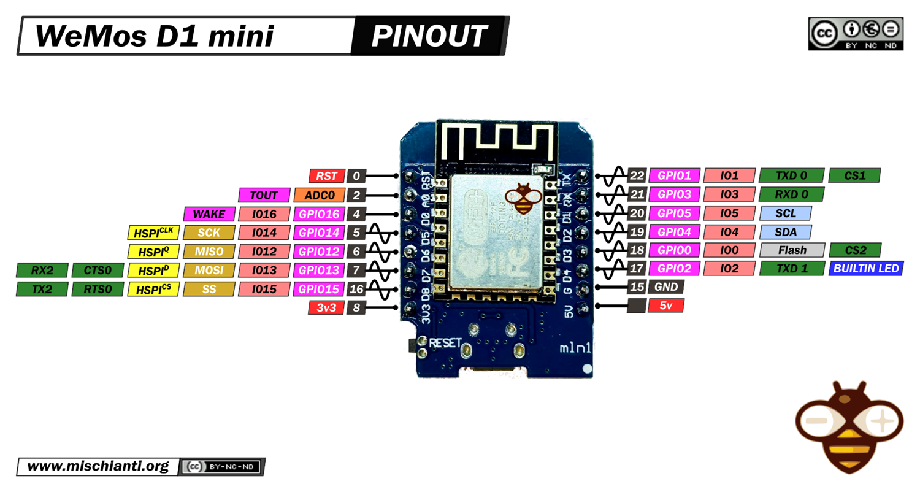
LESSON REFERENCE

Slide 21
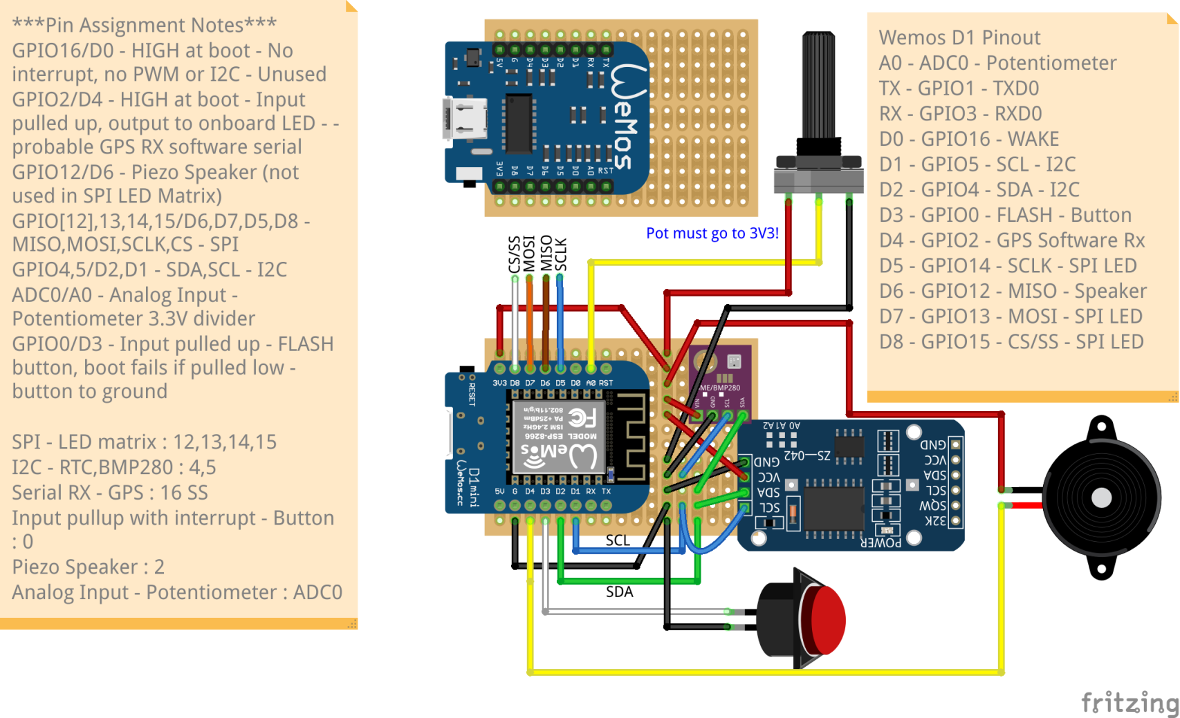
LESSON REFERENCE

