Slide 1


SEICHE 2022 Basic Arduino Programming
Instructor: Paul Frommeyer
www.paulfrommeyer.com
Corporate Sponsor: DXC Technology

Slide 2
Lesson Plan Overview
Lesson 1 – Intro and Setup [may require 2 classes]
Introduction to class format
Overview of lesson plan
Presentation format (monitor, camera, screen, whiteboard)
Review of microcontrollers and types of boards
SEICHE LED display architecture
ESP8266 pinout
High level architecture
Lesson 2 – Laptop operation review – Windows and Linux
Inventory of USB drives
Installation of Arduino IDE software
Installation of CH340/ESP8266 serial port drivers (Windows only)
Control panel/settings location
Home directories and folder hierarchy
Arduino file locations
Search functions
(Windows) Device Manager
(Linux) Konsole
Copying flash drive contents [critical]
Open questions and issues
IDE essentials
Starting the Arduino IDE
Basic Arduino sketch (program) structure
Loading example sketches
Loading and configuring new boards
Connecting boards
Identifying the microcontroller serial port
Linux
Windows
Lesson 3 – Libraries, Sketch structure, Serial Monitor, Variables, Binary Number System Pt1
Libraries
Sketch structure (A note on brace formatting)
The serial port monitor
Printing to the serial port monitor
Variables and the assignment operator
Binary number system Pt. 1.
Lesson 4 – Expressions, Conditionals, Blocks and Functions
Arithmetic Expressions and Operators
Incrementing and Decrementing Variables
Truth Values in C++
The If-Then Statement
Code Blocks
Functions
Lesson 5 – Binary Images, Arrays, Characters, Strings, Loops
Loading Binary Images
Arrays
Characters and Character Codes
Strings
Conditional Loops Part 1
Lesson 6 – Loops (cont.), LED Matrix Displays, Nested Loops Advanced Functions, Binary Numbers Part 1
For-Next Loops
SPI Peripherals
Using a MAX7219 LED Matrix Display
Lighting and clearing individual pixels
Advanced Functions
Nested Loops
Lesson 7 – The Binary Number System (may take 2 lessons)
Numerals vs numbers
Review: the base 10 system and digit place values
New: the base 2 system and digit place values
Bits and bytes and nybbles
Binary addition and subtraction
Lesson 8 – Producing Sound
Formatting printed output in Serial Monitor
Shifting and exponents
Displaying text on the LED matrix display
Review of sound wave theory
Analog vs Pulse Width Modulation
Producing sound tones with an Arduino microcontroller
Lesson 9 – Reading pins
Reading buttons
Millis() and debouncing buttons
Reading analog values from a potentiometer
Lesson 10 – The I2C Bus and Peripherals
I2C Bus Operation
Initializing the I2C bus
Accessing an I2C temperature sensor
Displaying text on the LED matrix
Default fonts

Slide 3
Lesson 7 – The Binary Number System
Part A – Homework Exercises
Take your homework sketch from last week and modify it to print the contents of an integer array of 99 elements, starting from the first element to the last, then from the last to the first. Use while instead of if-then. You’ll execute the sketch next week.
Modify Sketch6B to use one or more for loops to light all the pixels at the edge of the first LED square
Part B – The Binary Number System
Classroom Exercise – Count the dots!
Classroom Exercise – Chips ahoy!
Numerals vs numbers
New: the base 2 system and digit place values
Bits and bytes and nybbles
Binary addition and subtraction

Slide 4
Homework Review 1
Take your homework sketch from last week and modify it to print the contents of an integer array of 99 elements, starting from the first element to the last, then from the last to the first. Use while instead of if-then. You’ll execute the sketch next week.
Who was able to come up with a solution to this?
Notice that you were not required to initialize the array (fill it with data)
Discussion of different approaches to solving the problem
What did you see when printing out the values stored in the array?

Slide 5
Homework Review 2
Modify Sketch6B to use one or more for loops to light all the pixels at the edge of the first LED square
Who was able to come up with a solution to this?
Notice that you were not required to light only the pixels at the first edge
Discussion of different approaches to solving the problem
Did anyone try to light all the pixels on all the 8x8 square modules? What happened?

Slide 6
Let there be light?
Think about a light switch; how many positions or “states” can it have?
Based on the number of states of a single switch, how many different arrangements of lighting can we make with:
2 switches?
3 switches?
4 switches?
Hold this thought.

Slide 7
Classroom Review – Roman Numerals
The Arabic numeral system that we use was not the first used in Western civilization (such as it is). In addition to Babylonian Cuneiform and Hebrew logographics, the Roman system was the most widely used in the ancient world during the days of the Roman Empire.
Romans did not use or understand the zero. That was a Hindu invention that found its way to the mid east via trade routes.
Thus, Roman numerals use explicit digits for the first through the eighth cardinal numbers, and a “subtraction arrangement” for the ninth, with a new explicit symbol for the tenth and significant decimal “mileposts” like fifty or one-hundred
Here the Roman numerals through twenty:
I, II, III, IV, V, VII, VIII, IX, X, XI, XII, XIII, XIV, XV, XVI, XVII, XVIII, XIX, XX, … XL, L [fifty]

Slide 8
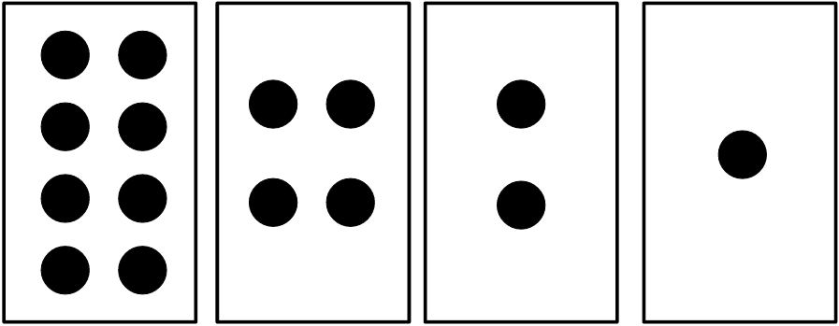
Classroom Exercise #1!
Using the cards that you have just been given, represent the following Roman numerals by displaying the corresponding number of dots, flipping over any cards that you do not need, assuring that the cards aren’t covering each other, and arranging them from largest on the left to smallest on the right. (Each student should represent just one numeral with their cards, starting widdershins from the instructor)
V
VII
IX
XI
XII
XIII
XV

Slide 9
Classroom Exercise #2!
Now, instead let’s use poker chips to represent the four cards. The great state of Texas (hook ‘em Horns!) will represent a card being turned face-up, and the initials (PLF) will indicate a card being turned face down (down with your instructor?).
It’s very important to use the chips with the same numerical order as the cards, from greatest on the left to least on the right.
Represent: 7, 9, 3, 4, 8, 12, 14

Slide 10

Map vs Territory
Title translation: “This is not a pipe.”
Why on Earth did the artist René Magritte choose that title for his work?
What is he trying to help us understand?

Slide 11
Map vs Territory (cont.)
3
This is not a number
Explain my title

Slide 12
Numbers vs. Numerals
CRITICAL IDEA: The type of symbol used to represent a number is completely arbitrary!
We could design our own set of symbols to represent numbers if we wanted: Φ = Δ = ● ‡ = ● ● Ξ = ● ● ● □ = ● ● ● ● Λ= ● ● ● ● ● Π = ● ● ● ● ● ● Γ= ● ● ● ● ● ● ●
Note that there are only eight (8) symbols. How would you represent ● ● ● ● ● ● ● ● ● using these symbols?

Slide 13
From Cards to Numerals
So now, going back to our cards and poker chips
Instead of using poker chips to represent whether a card is flipped or not, let’s simplify things and just use the numerals one (1) and zero (0). These are the symbols, not the numbers!
Thus, one (1) represents a card that is turned up
And zero (0) represents a card that is turned down.
Thus: 1010

Slide 14
The Road to Binary Numbers
Now, let’s put that all together and label each card/box with the number of dots each card/box contains.
To simplify things, we will stop calling them “cards” or “boxes”, and start calling them columns or places.
8
4
2
1
This makes it easier to translate the 1’s and 0’s representation:
8
4
2
1
0
0
1
0

Slide 15
Binary Number System (cont.)
We already discovered that the largest number we can represent with four cards, or with four binary symbols, is 15 (1111). However, the existing columns can easily be extended:
32
16
8
4
2
1
And we can keep right on going, until we have eight columns or places.
128
64
32
16
8
4
2
1
We will henceforth refer to these as “the eights place”, or “the sixty-fours place”
Can anyone explain how the values for the new columns were figured out?

Slide 16
Binary Number System (cont.)
The “secret decoder ring” is that each column or place is a power of two.
So this is how the place values for BASE2, or the Binary Number System, are formally written in Mathematics and Computer Science:
128
64
32
16
8
4
2
1
2⁷
2⁶
2⁵
2⁴
2³
2²
2¹
2⁰
Notice that there are eight columns
And remember that a binary digit, a one or a zero, is called a bit
So what we have here is eight bits. What is the term for eight bits or eight binary digits in computer science and programming?
And this one should be easy because you already proved it yourselves with Arduino code: what is the largest number that can be represented with eight bits?

Slide 17
Binary Number System (cont.)
Let’s review everything so far.
We have learned how binary number system place values are assigned
128
64
32
16
8
4
2
1
2⁷
2⁶
2⁵
2⁴
2³
2²
2¹
2⁰
And, using the binary place values, we have learned how to represent numbers using the two binary symbols one (1) and zero (0)
We have rediscovered that single binary digits, a 1 or a 0, are called bits
And we have rediscovered that eight bits constitute a byte
A new term is that four (4) bits– since they are half of a byte— are called a nybble. Get it? Gotta love that programmer humor!
Now let’s revisit addition and explore subtraction

Slide 18
Adding Binary Numbers
We already covered basic addition: when we go to add a third dot to a column, instead we have to add it to the next place to the left, and then clear the place to the right.
0
0
0
1
0
0
1
0
What we are doing is “carrying” the extra one to the next column. This works exactly like it does in our decimal number system, only “the next column” is a power of two instead of a power of ten.

Slide 19
Subtracting Binary Numbers
It should come as no surprise that binary subtraction works the same way. If there is a zero in a column, we have to “borrow” a one from the next higher place value.
0
0
1
0
0
0
1
0
0
1
0
0
0
1
0
0
0
1

Slide 20
Subtracting Binary Numbers
Class exercise?
1101 – 0101
1110 – 0111
1010 – 0010
Of course, feel free to “cheat” by converting the binary number to decimal then back again (but no calculators, apps, online utilities, Siri, or Alexa; abaci are permitted ☺ )
Multiplication and division work as you would expect, but they are fraught from a paper desk check perspective due to so many digits flying around. It’s easier to convert to decimal or hex, then back. ☺

Slide 21
Formal End of Lesson 7
HOMEWORK!
Hackspace – Get Started With Arduino – pp. 24 through 39
Arduino Cookbook – You can continue reading Chapter 4; we will not be covering all of Chapter 4 in class
In next week’s exciting episode
Binary number system – bitwise operations
Displaying text on the LED matrix display
Making sounds with Arduino (and your displays)

Slide 22
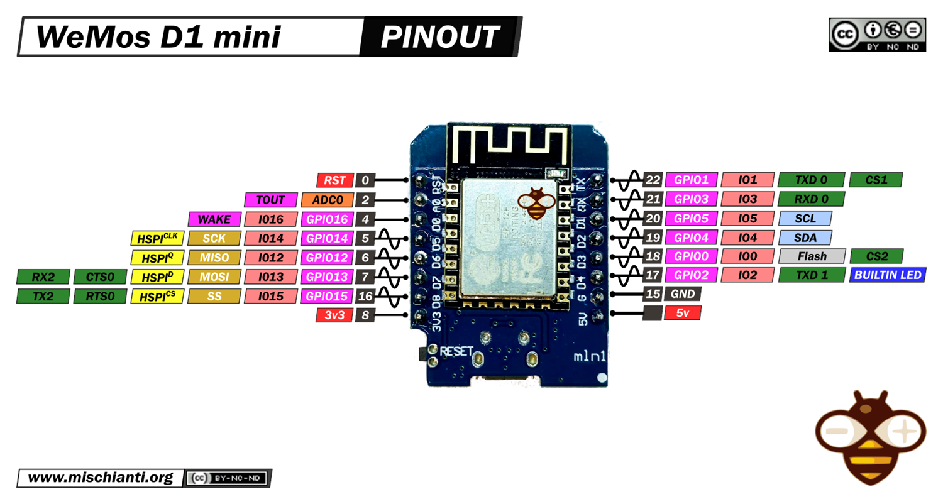
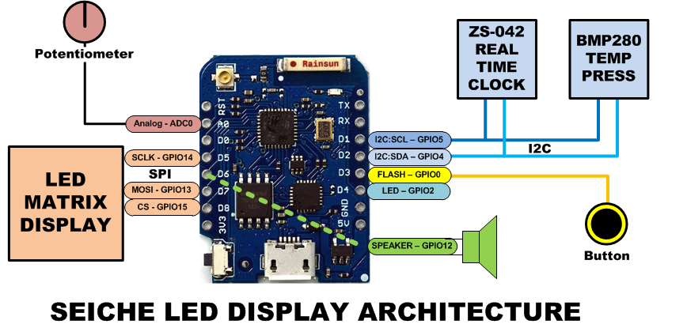
LESSON REFERENCE

Slide 23
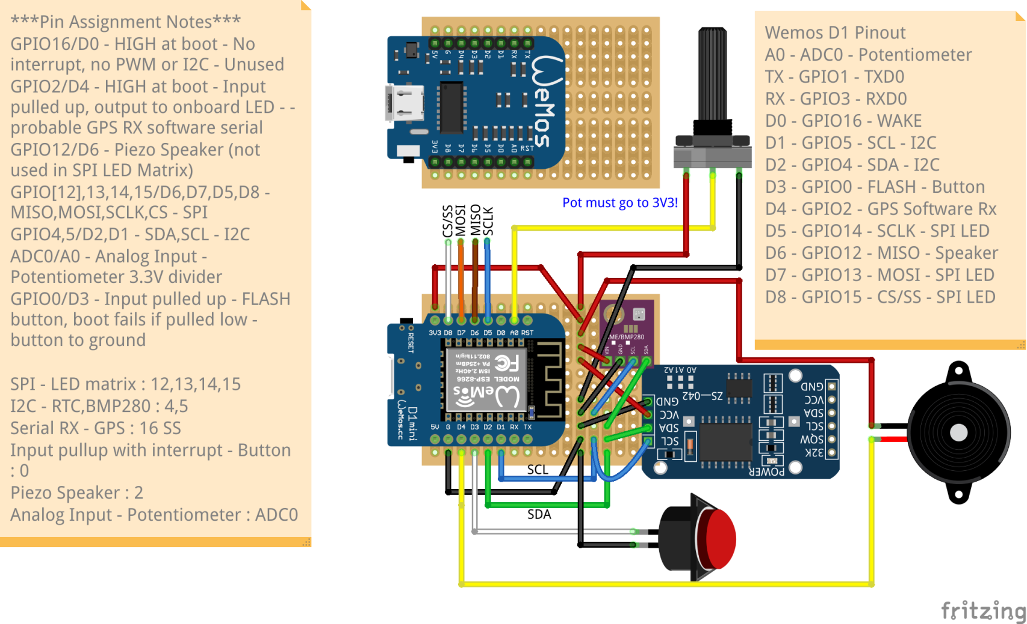
LESSON REFERENCE

