Slide 1


SEICHE 2022 Basic Arduino Programming
Instructor: Paul Frommeyer
www.paulfrommeyer.com
Corporate Sponsor: DXC Technology

Slide 2
Lesson Plan Overview
Lesson 1 – Intro and Setup [may require 2 classes]
Introduction to class format
Overview of lesson plan
Presentation format (monitor, camera, screen, whiteboard)
Review of microcontrollers and types of boards
SEICHE LED display architecture
ESP8266 pinout
High level architecture
Lesson 2 – Laptop operation review – Windows and Linux
Inventory of USB drives
Installation of Arduino IDE software
Installation of CH340/ESP8266 serial port drivers (Windows only)
Control panel/settings location
Home directories and folder hierarchy
Arduino file locations
Search functions
(Windows) Device Manager
(Linux) Konsole
Copying flash drive contents [critical]
Open questions and issues
IDE essentials
Starting the Arduino IDE
Basic Arduino sketch (program) structure
Loading example sketches
Loading and configuring new boards
Connecting boards
Identifying the microcontroller serial port
Linux
Windows
Lesson 3 – Libraries, Sketch structure, Serial Monitor, Variables, Binary Number System Pt1
Libraries
Sketch structure (A note on brace formatting)
The serial port monitor
Printing to the serial port monitor
Variables and the assignment operator
Binary number system Pt. 1.
Lesson 4 – Expressions, Conditionals, Blocks and Functions
Arithmetic Expressions and Operators
Incrementing and Decrementing Variables
Truth Values in C++
The If-Then Statement
Code Blocks
Functions
Lesson 5 – Binary Images, Arrays, Characters, Strings, Loops
Loading Binary Images
Arrays
Characters and Character Codes
Strings
Conditional Loops Part 1
Lesson 6 – Loops (cont.), LED Matrix Displays, Nested Loops Advanced Functions, Binary Numbers Part 1
For-Next Loops
SPI Peripherals
Using a MAX7219 LED Matrix Display
Lighting and clearing individual pixels
Advanced Functions
Nested Loops
Lesson 7 – The Binary Number System (may take 2 lessons)
Numerals vs numbers
Review: the base 10 system and digit place values
New: the base 2 system and digit place values
Bits and bytes and nybbles
Binary addition and subtraction
Lesson 8 – Producing Sound
Formatting printed output in Serial Monitor
Shifting and exponents
Bitwise operations and masking
Displaying text on the LED matrix display
Review of sound wave theory
Analog vs Pulse Width Modulation
Producing sound tones with an Arduino microcontroller
Lesson 9 – Reading pins
Reading buttons
Millis() and debouncing buttons
Reading analog values from a potentiometer
Lesson 10 – The I2C Bus and Peripherals
I2C Bus Operation
Initializing the I2C bus
Accessing an I2C temperature sensor
Displaying text on the LED matrix
Default fonts

Slide 3
Lesson 8 – Binary Operations, Matrix Text, and Sound Output
Formatting numbers in Serial Monitor
Binary shifting and exponents
Bitwise operations
Displaying text on the LED matrix – MD Parola Library
Classroom Exercise – Scrolling text display!
Review of sound wave theory
Analog vs pulse width modulation
Producing tones with a microcontroller
Classroom Exercise

Slide 4
Formatting Serial Monitor numbers
We’ve studied the three major number systems used in computing: binary, decimal, and hexadecimal
It’s possible to “force” the output of a number printed in Serial Monitor to be one of these data types
You’ve already seen us use decimal: Serial.println(foo,DEC);
But there are two more options: Serial.println(foo,BIN); Serial.println(foo,HEX);
Go ahead and modify SKETCH6A to print in binary and hex, as well as decimal!

Slide 5
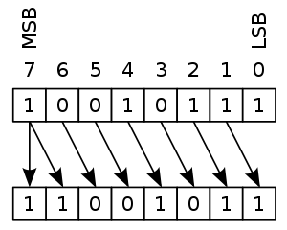
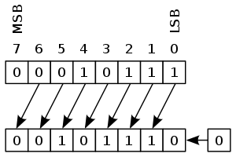
Binary Shifting and Exponents
In computer programming, it is frequently useful to perform “bitwise shifts” on numbers, also called “arithmetic shifts”
In a left shift, all the bits in a number, a byte or integer, say, are shifted one position to the left, and “ones-filled” from the left
In a right shift, all the bits in a number, a byte or integer, say, are shifted one position to the right, and “zero-filled” from the left
Because binary is a base-2 radix number system, a left shift multiplies the number by two, and a right shift divides it by two

Slide 6
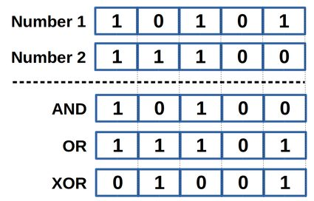
Bitwise Operations
The C language allows us to perform “bitwise comparisons” of numbers, comparing each bit one at a time using certain logical operators
The primary bitwise logical operators are AND, OR, and XOR (exclusive OR)
In C, the operators for these are &, |, and ^
Caution: Arithmetic exponent and bitwise XOR use the same symbol!

Slide 7
LED Matrix – Displaying Text
Due to a manufacturing error with the circuit board silk screening, I installed our LED matrices “upside-down” ☹
As a result, when displaying text, we have to “flip” the display 😐
This is very difficult to do with the MD_MAX72XX library we’ve been using so far
However, it’s pretty trivial with the MD_Parola library (which itself uses MD_MAX72XX)
So y’all need to install MD_Parola; go ahead and do that now!

Slide 8
LED Matrix – Sketch 8A
The Parola library works similar to MD_MAX72XX; you must define your SPI pins, then call a constructor to create an MD_Parola display object.
In this sketch, the LED display object is called “pmx”
#define HARDWARE_TYPE MD_MAX72XX::FC16_HW
#define MAX_DEVICES 4
#define CLK_PIN 14 // or SCK
#define DATA_PIN 13 // or MOSI
#define CS_PIN 15 // or SS
// MD_MAX72XX ledmx = MD_MAX72XX(HARDWARE_TYPE, DATA_PIN, CLK_PIN, CS_PIN, MAX_DEVICES);
MD_Parola pmx = MD_Parola(HARDWARE_TYPE, CS_PIN, MAX_DEVICES);
// We always wait a bit between updates of the display
#define DELAYTIME 100 // in milliseconds
void setup()
{
// put your setup code here, to run once:
pmx.begin();
pmx.setZoneEffect(0, true, PA_FLIP_LR);
pmx.setZoneEffect(0, true, PA_FLIP_UD);
}
void loop()
{
if(pmx.displayAnimate())
pmx.displayText("SEICHE 2022",PA_LEFT,50,0,PA_SCROLL_LEFT,PA_SCROLL_LEFT);
}

Slide 9
LED Matrix – Parola
The Parola library is capable of some truly sophisticated animations, both graphics and text
But the most typical use case is some sort of “scrolling text”, like a so-called “ticker tape display” seen in various public venues
Take some time now to modify SKETCH8A to display additional scrolling text of your own choice
There are many other animations available with MD_Parola, feel free to experiment https://majicdesigns.github.io/MD_Parola/_m_d___parola_8h.html#acf3b849a996dbbe48ca173d2b0b82eda
And you may also want to check out the examples for the MD_Parola library in the IDE
We will work a lot more with Parola next semester!

Slide 10
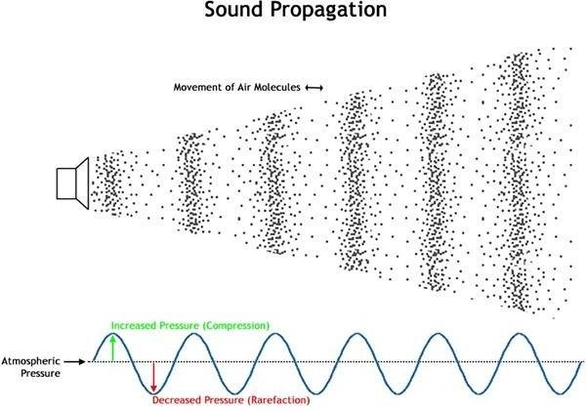
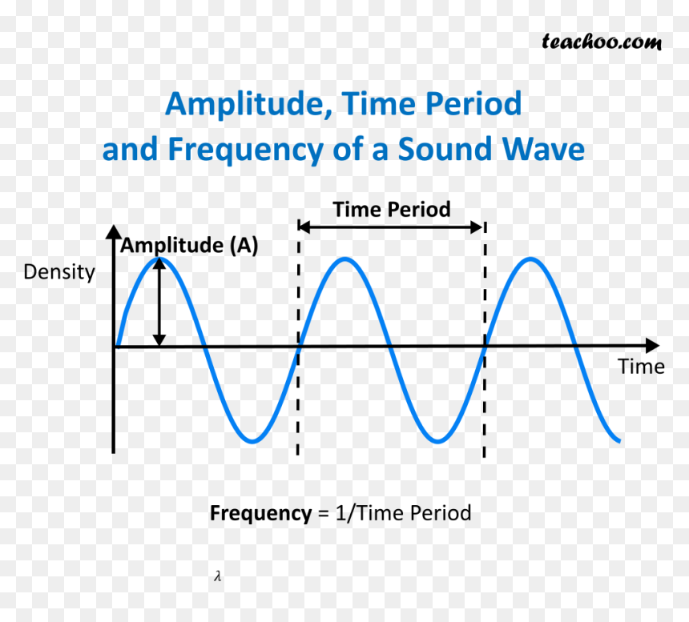
Sound Wave Theory - Review
Sound waves are successive pulses of air pressure
They have both amplitude (loudness) and frequency (pitch)
Electronics produce sound waves using some sort of audio transducer, like a speaker

Slide 11
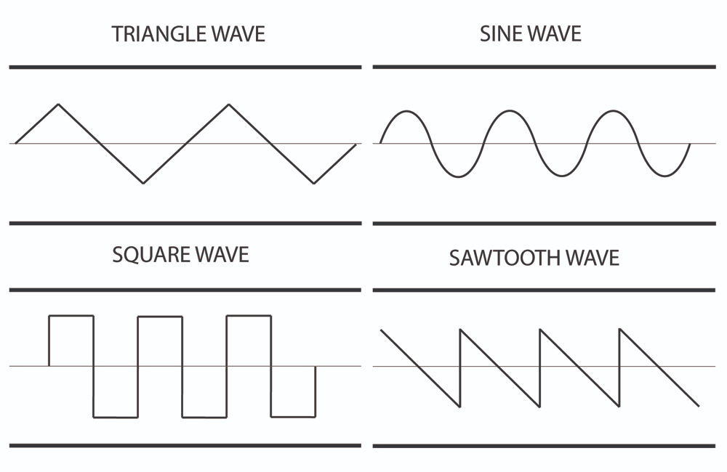
Types of Sound Waves
There are different types of sound waves, depending on their waveform
The easiest, and most typical sound wave produced by microcontrollers is the square wave

Slide 12
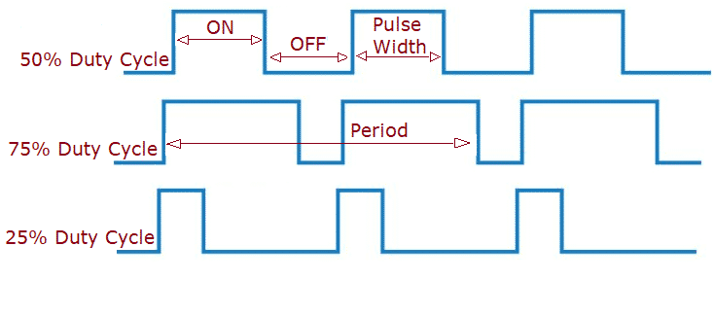
Pulse Width Modulation
The method which microcontrollers use to produce sound is called pulse width modulation, or PWM
The ratio of the amount of time a signal is high vs how long it is low is called duty cycle
PWM works by changing the duty cycle of an electrical signal
When this signal is then fed to a speaker, it produces a square wave of varying duty cycle

Slide 13
The Arduino tone() function
The Arduino C++ language offers a handy function for generating square waves of 50% duty cycle
This is the tone() function
The formal format of the tone() function is: tone(frequency, duration)
Frequency is specified in Hertz, or cycles-per-second
Duration is specified in milliseconds
On certain microcontrollers, tone() is non-blocking: processing continues after the tone is started.
What this means in practice is that each call to tone() must be followed by a delay() of equal duration to that used in the tone() command.
But, y’know, feel free to leave that delay out and see what happens! ☺

Slide 14
Let’s Make Some Waves!
Go ahead and open up SKETCH8B and upload it to your displays
Now, go ahead and adjust the sketch to change any or all of the tones being generated
A list of frequencies for octaves 3-5 is included at the top of the sketch; can anyone make their display produce a melody using this information?
#define note_F2 87.31
#define note_C3 130.81
#define note_C3s 138.59
#define note_D3 146.83
#define note_D3s 155.56
#define note_E3 164.81
#define note_F3 174.61
#define note_F3s 185
#define note_G3 196
#define note_G3s 207.65
#define note_A3 220
#define note_A3s 233.08
#define note_B3 246.94
#define note_C4 261.63
#define note_C4s 277.18
#define note_D4 293.66
#define note_D4s 311.13
#define note_E4 329.63
#define note_F4 349.23
#define note F4s 369.99
#define note_G4 392
#define note_G4s 415.30
#define note_A4f 415.30
#define note_A4 440
#define note_A4s 466.16
#define note_B4f 466.16
#define note_B4 493.88
#define note_C5 523.25
#define note_C5s 554.37
#define note_D5s 622.25
#define note_D5 587.33
#define note_E5 659.25
#define note_F5 698.46
#define note_F5s 739.99
#define note_G5 783.99

Slide 15
CLASS ASSIGNMENT
Combine SKETCH8A and SKETCH8B
Using SKETCH8A and SKETCH8B as references, create a sketch which generates sounds when certain events happen on the display
What those events are, and what tones you generate, are up to you!
This shouldn’t be terribly tricky, however I’ve structured this as an in-class assignment so that I’m available for any questions

Slide 16
Formal End of Lesson 8
HOMEWORK!
No homework this week!
In next week’s exciting episode
Reading pin values
Debouncing buttons
Reading analog values from a potentiometer
The I2C bus and I2C sensors
Reading I2C sensors

Slide 17
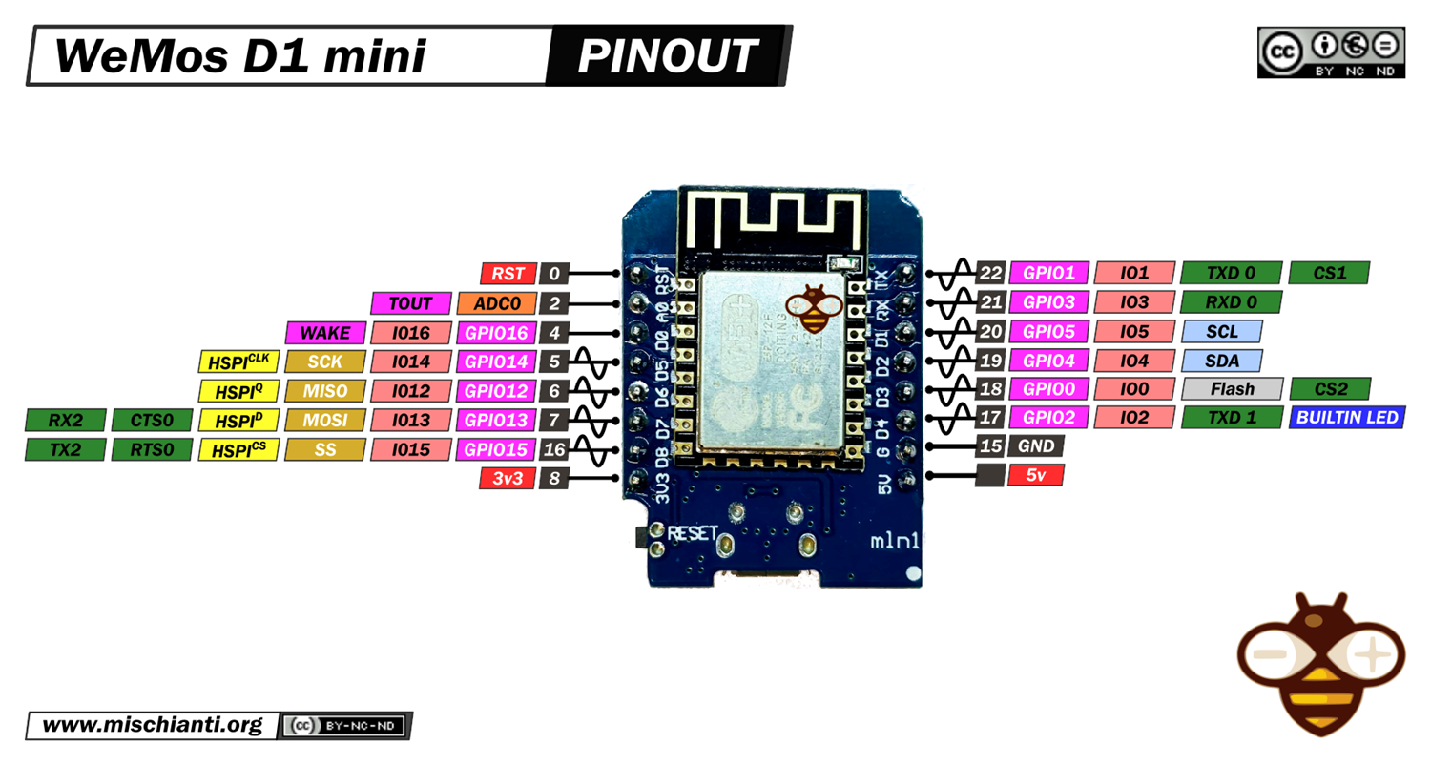
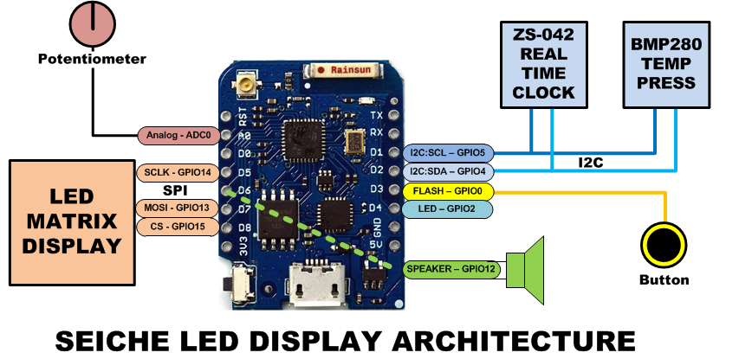
LESSON REFERENCE

Slide 18
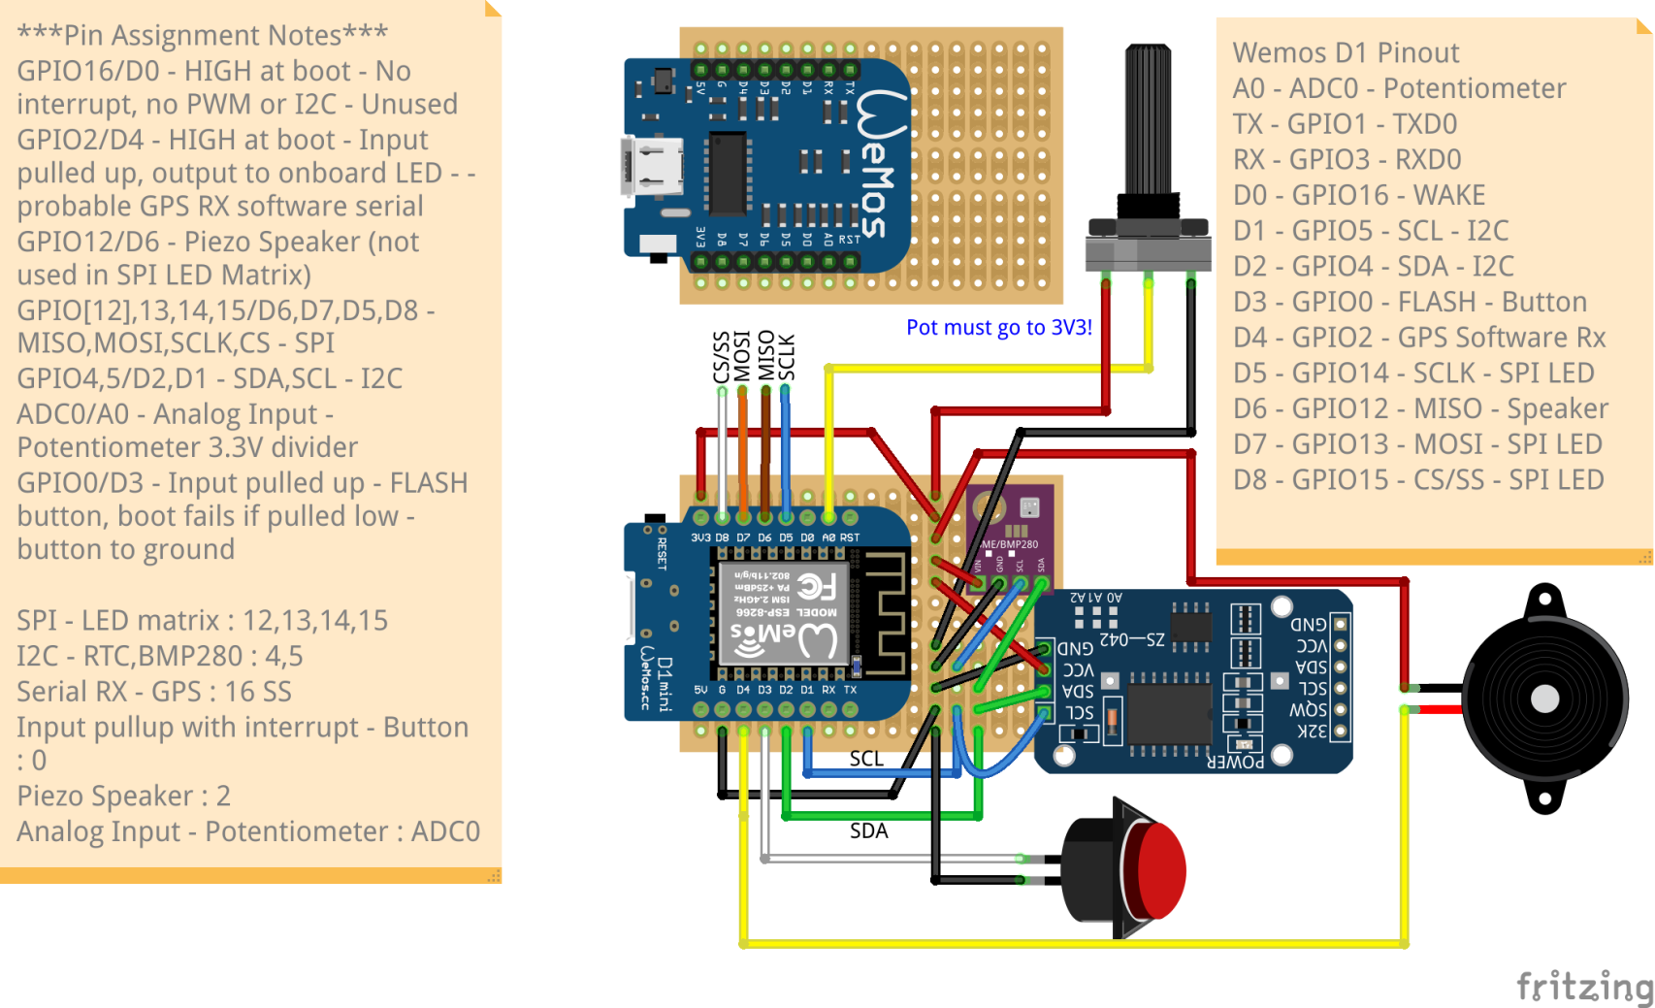
LESSON REFERENCE

