Slide 1


SEICHE 2022 Basic Arduino Programming
Instructor: Paul Frommeyer
www.paulfrommeyer.com
Corporate Sponsor: DXC Technology

Slide 2
Lesson Plan Overview
Lesson 5 – Binary Images, Arrays, Characters, Strings, Loops
Loading Binary Images
Arrays
Characters and Character Codes
Strings
Conditional Loops Part 1
Lesson 6 – Loops (cont.), LED Matrix Displays, Nested Loops Advanced Functions, Binary Numbers Part 1
For-Next Loops
SPI Peripherals
Using a MAX7219 LED Matrix Display
Lighting and clearing individual pixels
Advanced Functions
Nested Loops
Lesson 7 – The Binary Number System (may take 2 lessons)
Numerals vs numbers
Review: the base 10 system and digit place values
New: the base 2 system and digit place values
Bits and bytes and nybbles
Binary addition and subtraction
Lesson 8 – Producing Sound
Formatting printed output in Serial Monitor
Shifting and exponents
Bitwise operations and masking
Displaying text on the LED matrix display
Review of sound wave theory
Analog vs Pulse Width Modulation
Producing sound tones with an Arduino microcontroller
Lesson 9 – Reading Analog and Digital pins
Millis
Reading buttons
Debouncing buttons
Reading analog values from a potentiometer
Lesson 10 – The I2C Bus and Peripherals
I2C Bus Operation
Initializing the I2C bus
Accessing an I2C temperature sensor
Real Time Clocks
Time representations and conversions
Accessing a DS3231 RTC
Lesson 11 – NTP and Text Management
Network Time Protocol
Displaying the time on an LED matrix display
Changing the default font
Text Effects
Using multiple display zones
Lesson 1 – Intro and Setup [may require 2 classes]
Introduction to class format
Overview of lesson plan
Presentation format (monitor, camera, screen, whiteboard)
Review of microcontrollers and types of boards
SEICHE LED display architecture
ESP8266 pinout
High level architecture
Lesson 2 – Laptop operation review – Windows and Linux
Inventory of USB drives
Installation of Arduino IDE software
Installation of CH340/ESP8266 serial port drivers (Windows only)
Control panel/settings location
Home directories and folder hierarchy
Arduino file locations
Search functions
(Windows) Device Manager
(Linux) Konsole
Copying flash drive contents [critical]
Open questions and issues
IDE essentials
Starting the Arduino IDE
Basic Arduino sketch (program) structure
Loading example sketches
Loading and configuring new boards
Connecting boards
Identifying the microcontroller serial port
Linux
Windows
Lesson 3 – Libraries, Sketch structure, Serial Monitor, Variables, Binary Number System Pt1
Libraries
Sketch structure (A note on brace formatting)
The serial port monitor
Printing to the serial port monitor
Variables and the assignment operator
Binary number system Pt. 1.
Lesson 4 – Expressions, Conditionals, Blocks and Functions
Arithmetic Expressions and Operators
Incrementing and Decrementing Variables
Truth Values in C++
The If-Then Statement
Code Blocks
Functions

Slide 3
Lesson 8 – Reading Analog and Digital Pins
The millis() built-in function
Setting pin modes (review)
Reading a digital input
Debouncing buttons
Classroom Exercise – Button debouncing
Analog vs Digital Inputs
ADC resolution and you
Reading A0 on an ESP8266
Classroom Exercise – Utilizing A0 input to set display brightness

Slide 4
Note On Integer Data Options
We’ve already looked at bytes (8 bits) and integers (32 bits on ESP8266, or 4 bytes)
There are some additional data types in Arduino for working with integers
You will often see unsigned numeric data types declared like this: uint16_t someinteger; or uint8_t somebyte;
What are these weird data types? They are used for more clearly declaring unsigned integer variables
You can find these– and more!– in the c_types.h header file
Linux: ~/.arduino15/packages/esp8266/hardware/esp8266/3.0.2/tools/sdk/include/c_types.h
Arduino convention | Traditional C convention
Uint8_t | byte or unsigned char
Uint16_t or Uint32_t | unsigned int
Uint32_t or Uint64_t | unsigned long

Slide 5
The millis() built-in function
millis() is a built-in function that returns the number of milliseconds since the last time the processor was started or reset
The return value from millis() is 64 bits wide; this means you can must use either a long or uint64_t for capturing the value
Thusly: uint64_t elapsedtime; elapsedtime=millis();
Or: long elapsedtime; elapsedtime=millis();
Using smaller variable storage will result in a truncated value; this may be desirable in certain cases, but is probably not what you want!

Slide 6
Review: Pin Modes
Microcontroller GPIO pins can be configured to either send data (OUTPUT mode) or receive data (INPUT mode)
Output pins are declared like this: pinMode(6, OUTPUT);
As you might expect, input pins are declared this way: pinMode(2,INPUT);
There is an additional mode available for input pins, where an integral (part of the microcontroller SoC) pullup resistor can be engaged; doing it this way will “pull up” the input line to the running voltage of the processor: pinMode(1,INPUT_PULLUP);
The latter is the preferred way to handle buttons, such that the button is wired to ground and pressing it will drop the input line to zero voltage

Slide 7
Read a Button – Sketch 9A
Go ahead and load SKETCH9A into your IDE
You may recall from the functional diagram of your LED displays that GPIO1 (Wemos pin D2) is connected to the button on top of your display
Pins are read with the digitalRead() function
#define BUTTON D3
int ivalue;
void setup()
{
Serial.begin(9600);
pinMode(BUTTON,INPUT_PULLUP);
}
void loop()
{
ivalue = digitalRead(BUTTON);
Serial.println(ivalue,DEC);
delay(250);
}
Upload the sketch and try pressing the button on your display
What output do you see in the serial monitor?
Why are you seeing the output that you are?

Slide 8
Debouncing Buttons
Buttons use mechanical contacts, and mechanical contacts take some time to “settle” into their final state when actuated.
While the settle time of several milliseconds is unnoticeable to us, it’s very noticeable to a computer or microprocessor because of their fast sampling speed
The result is that a microcontroller will see a single button press by an operator as multiple button presses and releases as the contacts “bounce” several times before settling into a connected state
As a result of this behavior, it becomes necessary to “debounce” button contacts
Debouncing can be performed in hardware (tricky) or in software (much easier and cheaper.)

Slide 9
Class Exercise - Debouncing
Class discussion: how can we use software to debounce a button press – that is, record only the first connection of the contacts?
Go ahead and modify your sketch to use one of the ways that was discussed
Did it work? If so, why not?

Slide 10
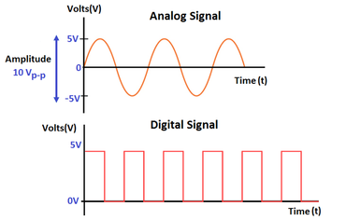
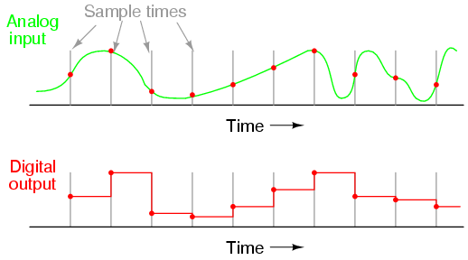
Analog vs Digital Inputs
Digital signals are discrete or finite; they can only have certain values
Analog signals (like audio)
Circuitry that converts from analog to digital is called an Analog-to-Digital Converter (ADC)
ADCs perform conversion by sampling an analog signal at intervals, then generating a digital value that represents the signal at that point in time.

Slide 11
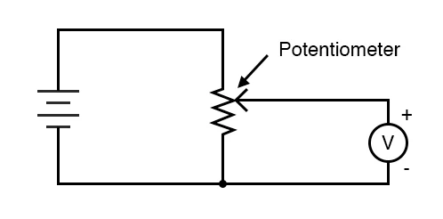
Reading Analog Inputs
The sampling interval of an ADC determines it’s resolution. Common resolutions for microcontrollers are 10-bit and 20-bit.
The ADC resolution means that the analog input will have values within the range of that number of bits, that is, 2^10 or 2^20 possible values.
The ESP8266 has a single analog input, on pin A0, and it uses a 10-bit ADC.
To provide stable input, ADCs connected to potentiometers are connected using voltage divider (one end of the potentiometer is connected to ground, the other to VCC).

Slide 12
Read Analog Input – Sketch 9B
Go ahead and load SKETCH9B into your IDE
You may recall from the functional diagram of your LED displays that A0 on the ESP8266 is connected to the potentiometer (knob) on the back of the display
Pins are read with the analogRead() function; analog pins do not need to be initialized
int avalue;
void setup()
{
Serial.begin(9600);
}
void loop()
{
avalue = analogRead(A0);
Serial.println(avalue,DEC);
delay(250);
}
Upload the sketch and rotate the potentiometer on your display
What output do you see in the serial monitor?
Why are the largest and smallest what they are?

Slide 13
CLASS ASSIGNMENT
The MD_Parola library method setIntensity(uint8_t intensity) changes the brightness of your LED display
Combine SKETCH8A and SKETCH9B
Using SKETCH8A and SKETCH9B as references, create a sketch which sets the display brightness based on the setting of the potentiometer
Note: There are 255 possible brightness settings, and 1024 possible potentiometer values, so you will need to map one to the other!
Hint: Start with Sketch 8A and add the analog read statements there
I’ve structured this as an in-class assignment so that I’m available for any questions

Slide 14
Formal End of Lesson 9
HOMEWORK!
No homework this week!
In next week’s exciting episode
I2C Bus Operation
Accessing a temperature sensor
Accessing a DS3231 Real Time Clock (RTC)
Setting an RTC

Slide 15
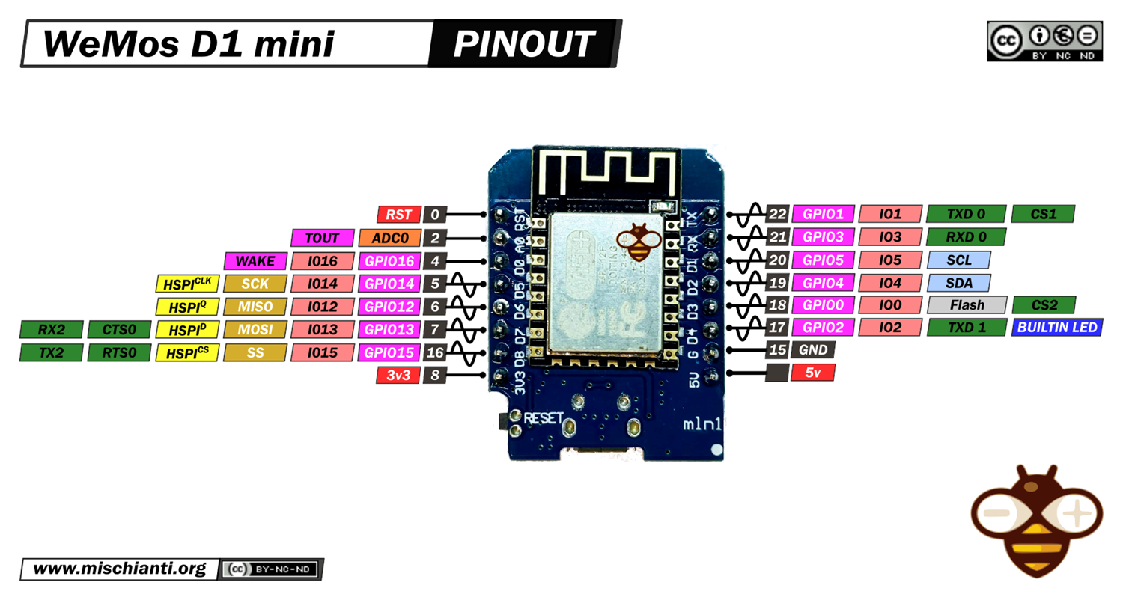
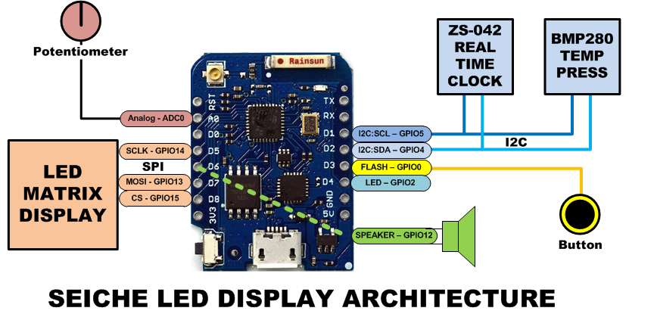
LESSON REFERENCE

Slide 16
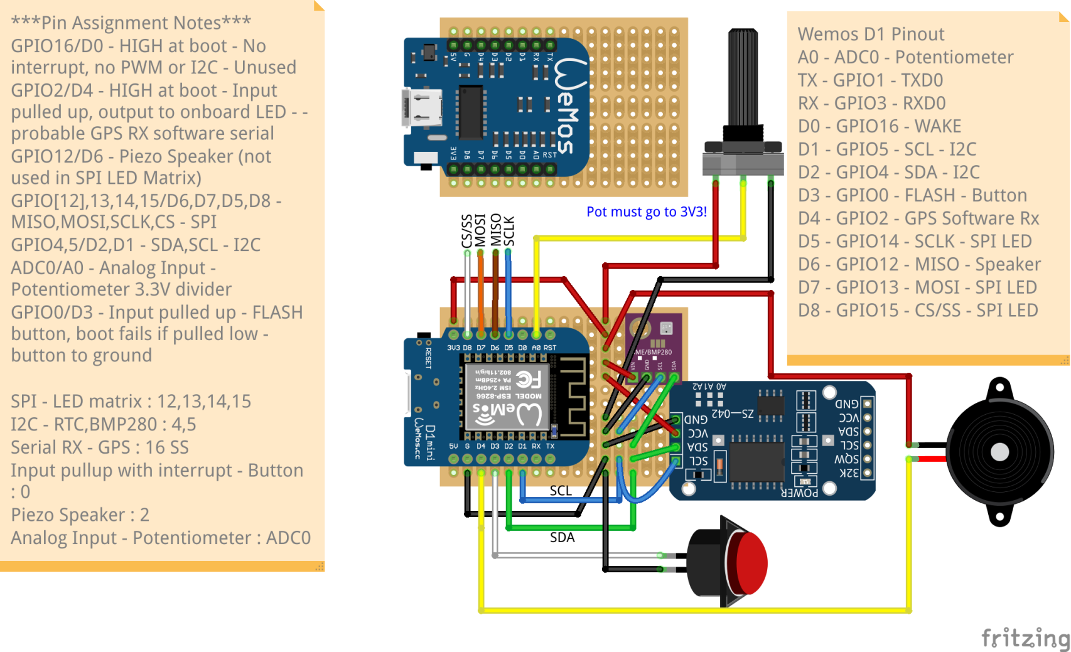
LESSON REFERENCE

