Slide 1
How to launch Python in Azure

Slide 2
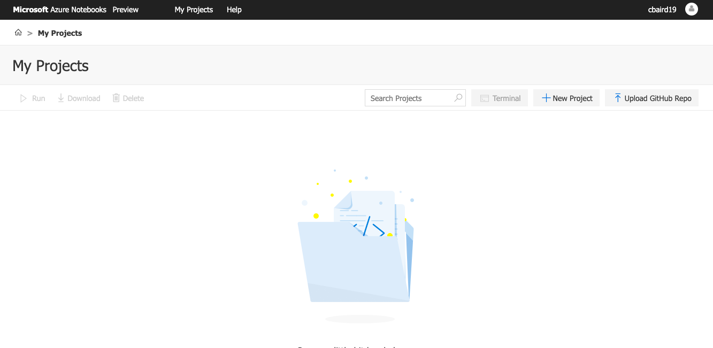

Slide 3
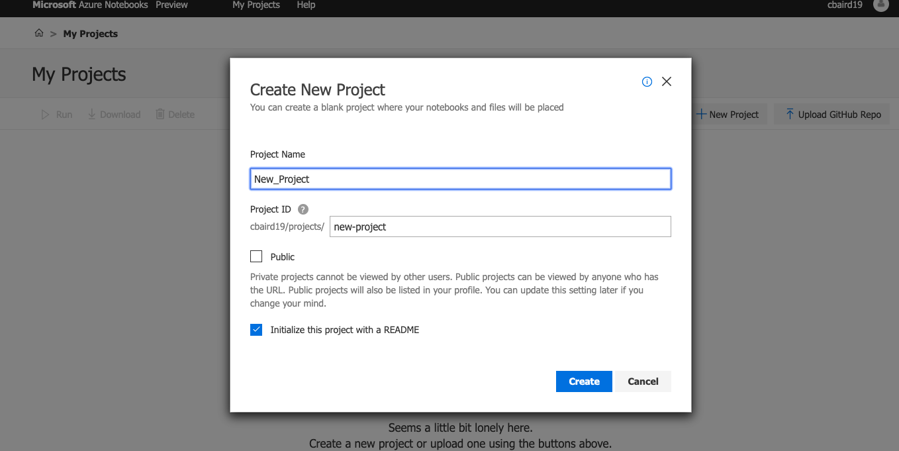

Slide 4


Slide 5
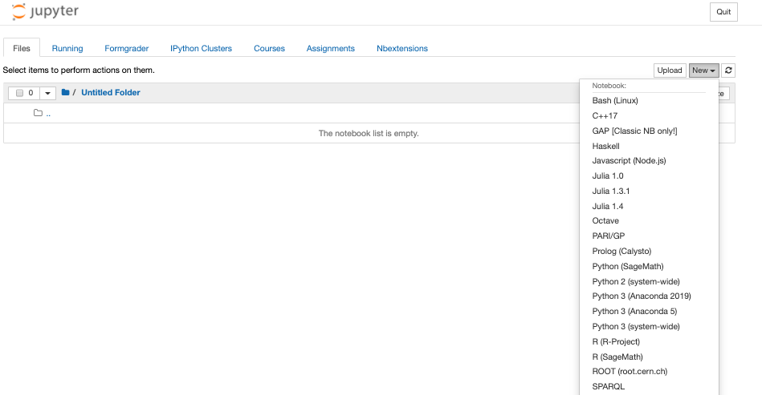

Slide 6


