Slide 1
How to launch Python in Cocal

Slide 2
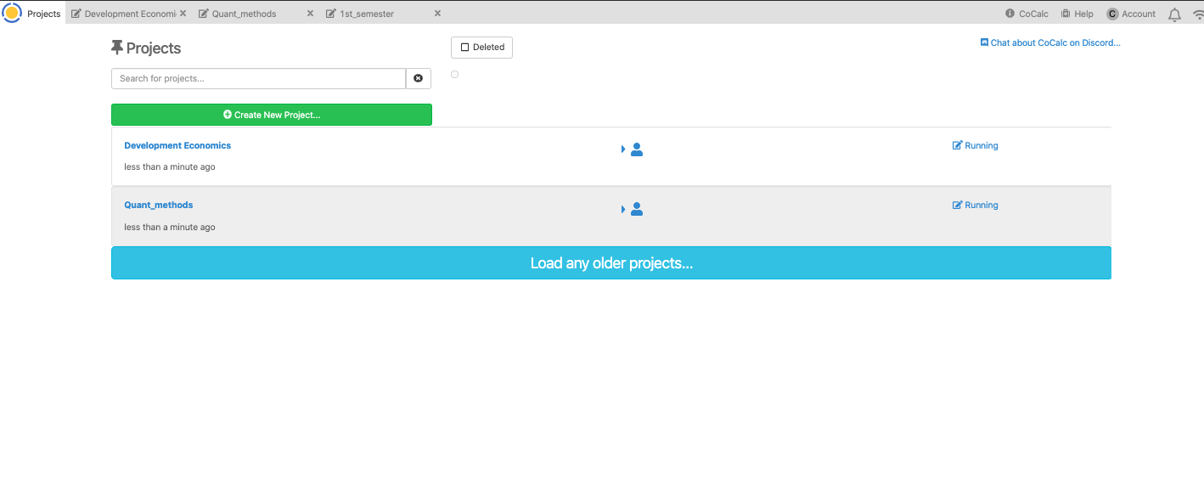

Slide 3
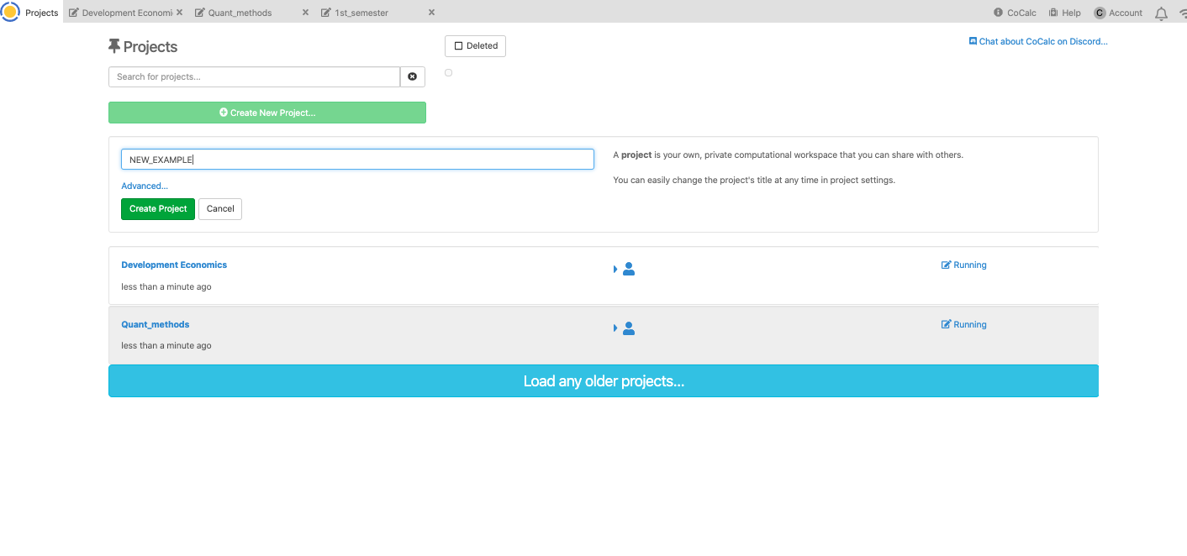

Slide 4
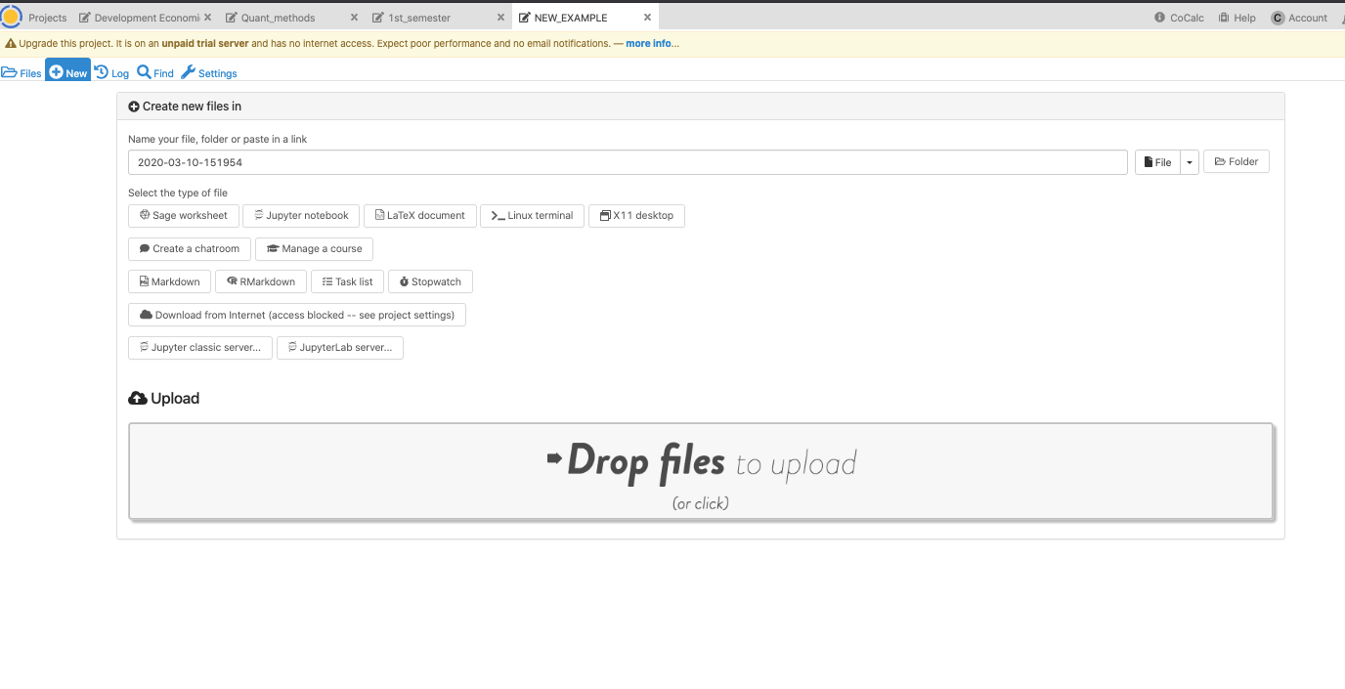
Click on the new tab

Slide 5
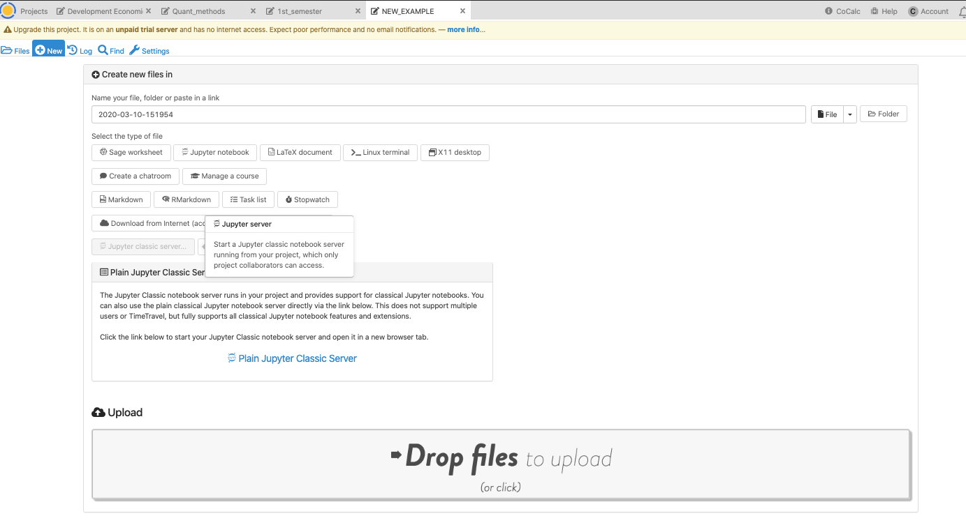
Click on the plain jupyter classic server. Make sure you have your popups unblocked because it will launch in a separate tab.

Slide 6
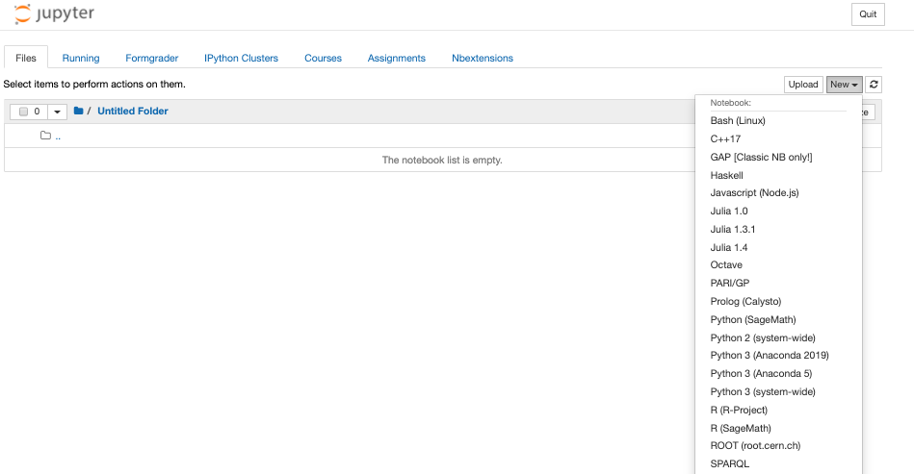

Slide 7
