Slide 1
Google Cloud Platform
How-to

Slide 2
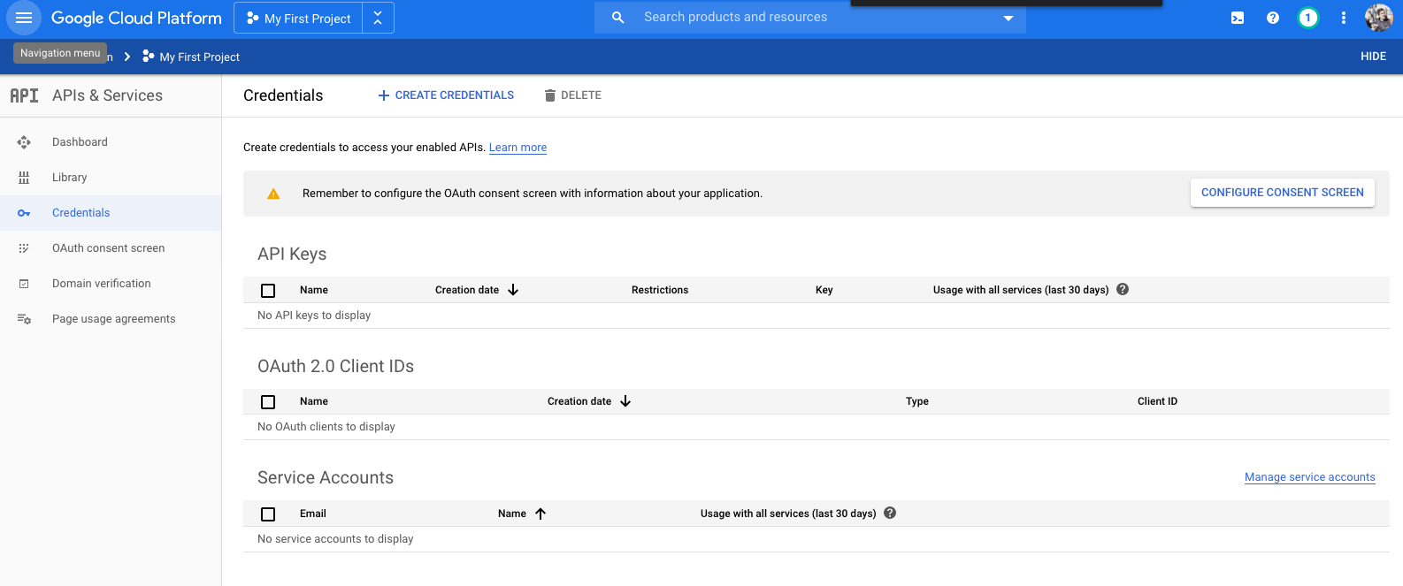

Slide 3
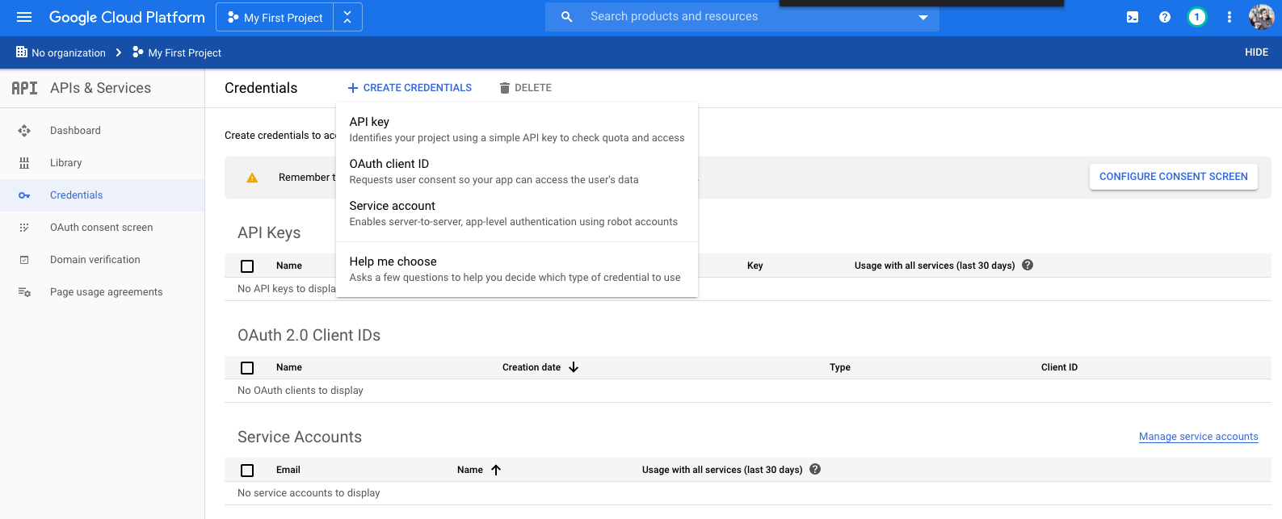

Slide 4
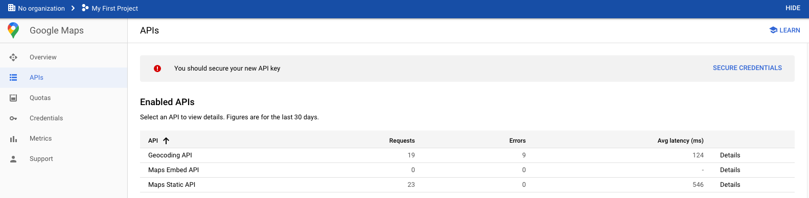
Two APIs are needed:
Maps Static API
Geocodig API

