Slide 1
Afloat - Design

Slide 2


User Workflow
Log in
Any stale transactions (more than 2 days away from their original date) must be answered: confirm or remove from the pending txn list
View prediction graph and pending transactions Done
  Icons, Mouseovers show where txns are in graph
View recent 3 large debits, recent 3 (any) deposits Done
View ledger and available balance, and holds contributing to available Partial – still need ledger register
<select> to switch between savings and checking Done
Text box to schedule a payment
  This saves it to GVENT as well as now displaying it on pending transactions

Slide 3



Backend Operations
Every 12 (1?) hours retrieve Holds and bank statement via OFX
  Parse them
  Then retrieve scheduled transactions from GVENT for next 2 days
    Only unpaid – PAID get a special marker (see below)
  Search parsed transactions and holds for matches against any GVENT transactions.
    If there is a match (same or next day, within $0.05, keywords matched with high probability) just apply it, marking it PAID in GVENT
  At the end of each day, unmatched transactions are swept ahead to the next day. They move up to to 2 days before we ask whether to remove/reschdule them; checks (with check numbers) move up to 2 weeks

Slide 4
Backend Operations, Procedural
Get OFX Transactions
  Download bank statement ofx, write to sql db - Done
  Download account ofx (holds), write to sql db - Done
Download unpaid gvents for today:today+16 - Done
“fixup” step on transactions entered through gcal directly - Done
“matchup” step – Mostly done, still need to handle LATE/unclosed
Update storm database
  Write all new register transactions to banktxn table - Done
  Write scheduled transactions (from goog) (including paid data from matchup) to scheduledtxn table - Done
  Write network log to networklog table – Done

Slide 5

Matchup Step
A scheduled transaction which isn't [PAID] still counts against your balance and gets pushed ahead when a day elapses without paying it
To account for a transaction, it must match a transaction from the bank. Matching is done by:
  expectedDate = day the bank reports it paid
  Its keywords match all words in the memo of the txn; text [inside brackets] is a comment; #nnn check numbers automatically match in lieu of keywords
  Amount match within $0.05
Unmatched are pushed ahead, up to two days (checks >2days)
  Must confirm a LATE transaction is still pending before Afloat will push it ahead any more.
  Which just reschedules it as if you had typed it in new.
When matched, a txn's gvent is updated with extended paid attribute (value = the date it was matched), and retitled [PAID]

Slide 6

GVENTs (1)
We are interested in getting/setting the following properties of calendar events
  event.GetSelfLink().href
    Id, for marshalling
  event.title.text
    Rename to indicate things as “[PAID]”
  event.content.text
    For From: and To: accounts
  event.extended_property
    http://thesoftworld.com/2007/afloat#paid
      The date when a PAID bill was paid
    http://thesoftworld.com/2007/afloat#originalDate
      The date user originally scheduled a transaction. We change the dates on txns when they are missed, and this property helps keep track of by how much we have moved the txn

Slide 7
GVENTs (2)
We are interested in getting/setting the following properties of calendar events
  event.extended_property
    http://thesoftworld.com/2007/afloat#amount
      How much money, positive or negative
    http://thesoftworld.com/2007/afloat#fromAccount
      In a transfer, use this to indicate the debited account
    http://thesoftworld.com/2007/afloat#toAccount
      Use this to indicate the receiving account of a transfer
      Otherwise, the target account of a debit or deposit
    http://thesoftworld.com/2007/afloat#bankId
      Foreign key to match google events to the ofx
  event.when.start_time
  event.when.end_time
    duh

Slide 8
GVENTs (3)
We are interested in the following calendar methods and objects
  CalendarService.ProgrammaticLogin()
  CalendarService.CalendarQuery()
    Needs a CalendarEventQuery()
  CalendarService.QuickAdd()
    Needs a CalendarEventEntry() and atom.Content()
  CalendarService.DeleteEvent()
  CalendarService.UpdateEvent()
    To rename events
  CalendarService.GetCalendarEventEntry()
    Used to unmarshal an event from the main service

Slide 9
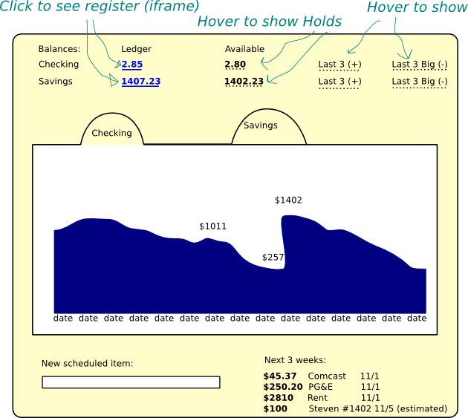
Screenies

