Slide 1
Dilemmas and debates

Slide 2
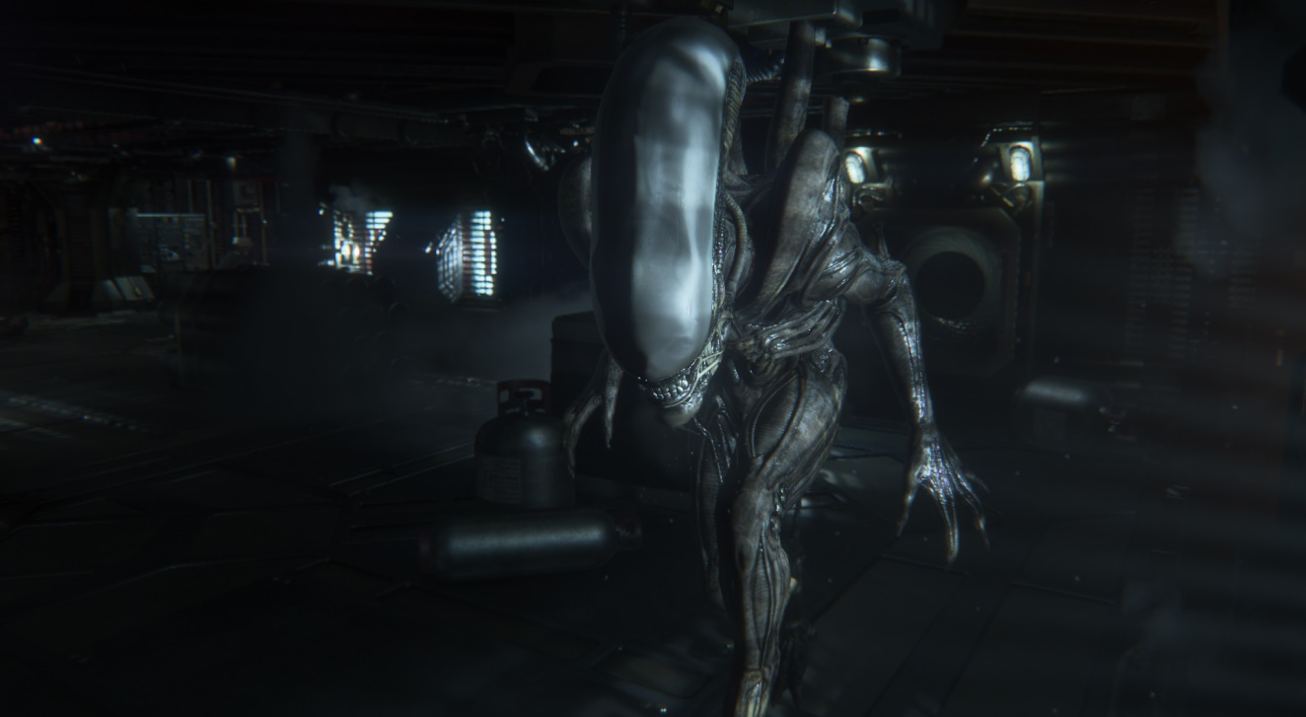
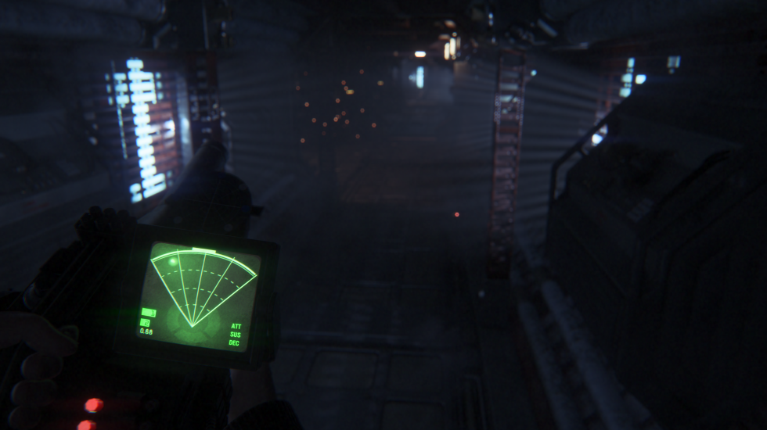
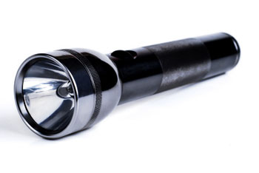
You’re on a spaceship which is infested with killer aliens, you can either have a motion detector or a torch. Which one do you take?

Slide 3
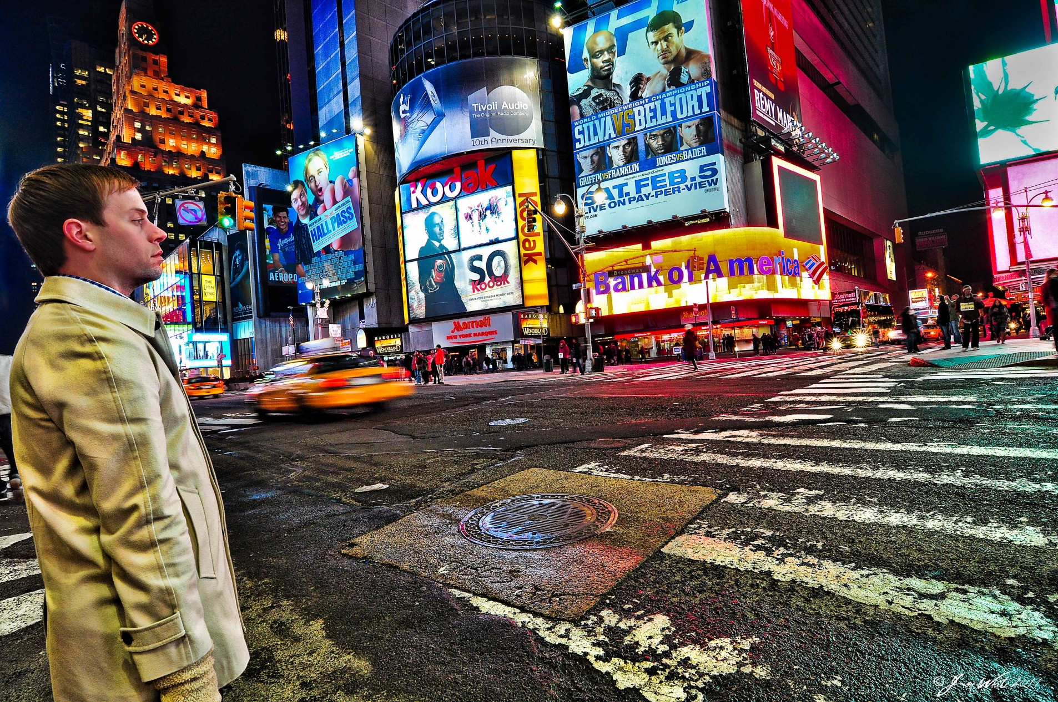
You’re lost in a strange city with no money or phone and you don’t speak the language.

Slide 4
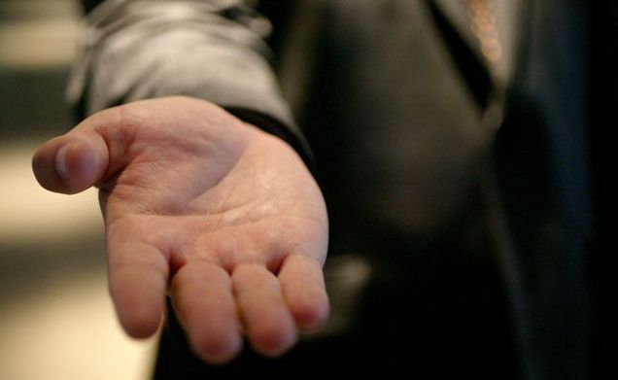
A person walks up to you in the street and tells you they have been robbed and they need €1 to make a phone call.

Slide 5
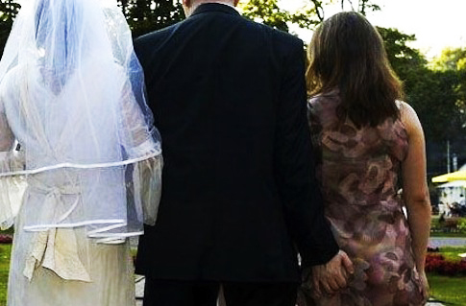
The day before a friends wedding you find out that the groom has been cheating on the bride.

Slide 6
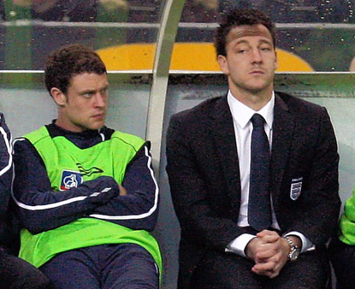
The captain of the football team has an affair with the star striker’s wife. You are the manager.

Slide 7
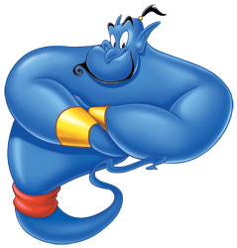
A genie gives you three wishes.

Slide 8
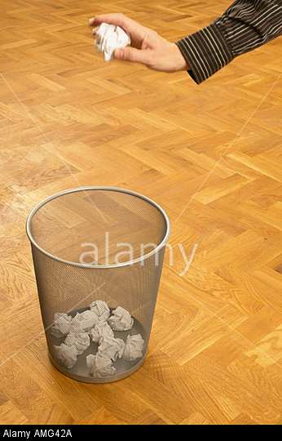
You find the answers to the final maths exam in the bin outside the teacher’s room.

Slide 9
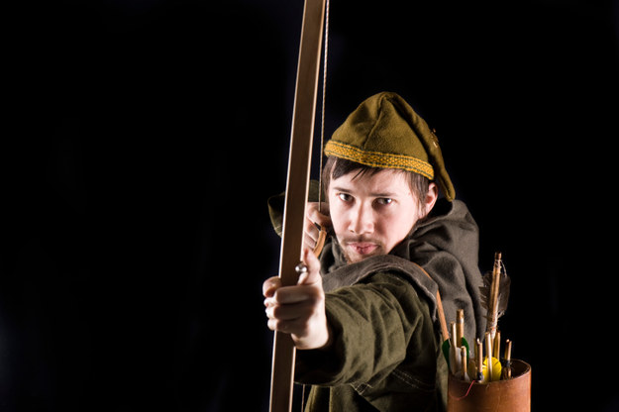
You are an eyewitness to a crime: A man has robbed a bank, but instead of keeping the money for himself, he donates it to a poor orphanage that can now afford to feed, clothe, and care for its children. You know who committed the crime. If you go to the authorities with the information, there’s a good chance the money will be returned to the bank, leaving a lot of kids in need. What do you do?

Slide 10
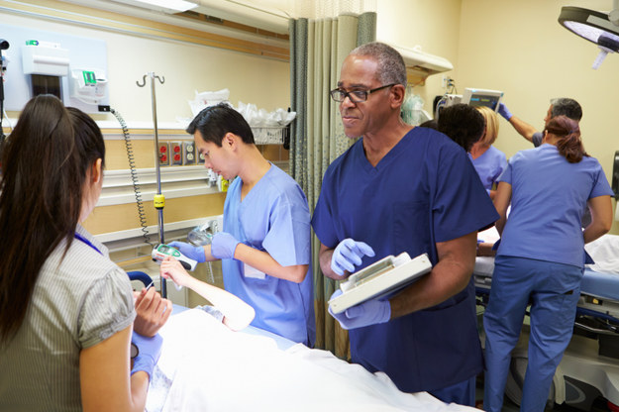
You are a doctor at a top hospital. You have six gravely ill patients, five of whom are in urgent need of organ transplants. You can’t help them, though, because there are no available organs that can be used to save their lives. The sixth patient, however, will die without a particular medicine. If s/he dies, you will be able to save the other five patients by using the organs of patient 6, who is an organ donor. What do you do?

Slide 11
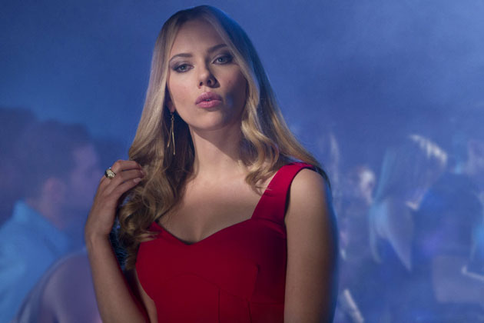

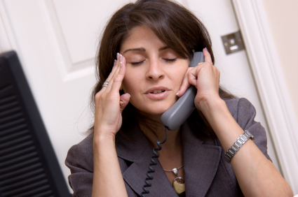
You’re on your way to meet the boy/girl of your dreams for you first date. You have been waiting for this day for months. Suddenly you receive 2 whatsapps: One is from your Mum saying that she urgently needs your help, the other is from your best friend saying that they have just broken up with their boy/girlfriend.

Slide 12
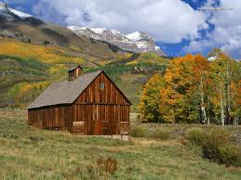
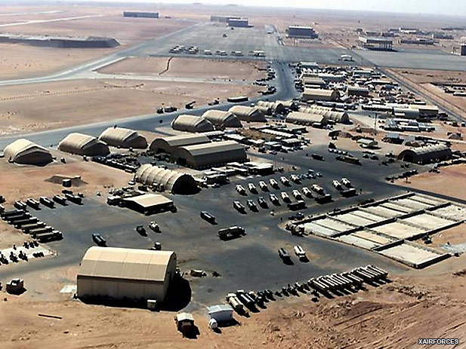
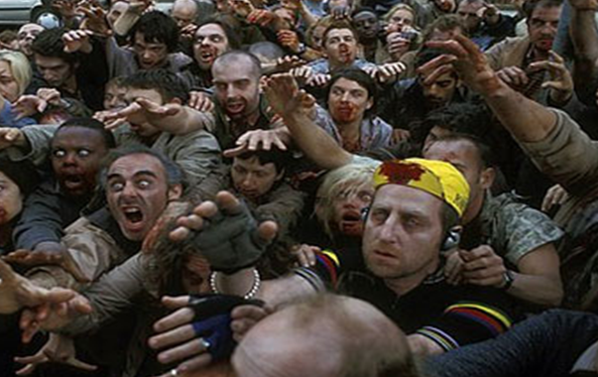
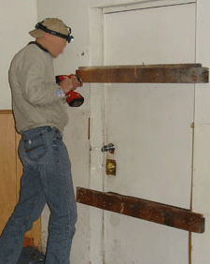
You’re in a zombie apocalypse. Where would you go?

Slide 13
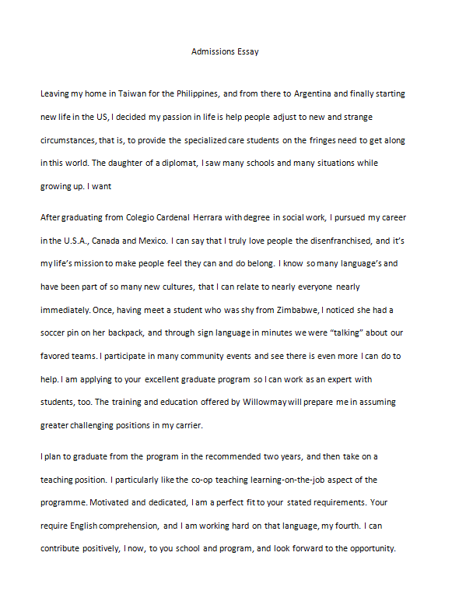

You find a website which offers to write your English compositions for you; it costs €5 for each piece.

Slide 14

A mad scientist needs a test subject for a magic potion; if you drink it there’s a 20% chance that you will be able to turn invisible on demand but there’s an 80% chance that you will be invisible forever.

Slide 15

You discover that your teacher is having an affair with another teacher at school. What do you do?

Slide 16
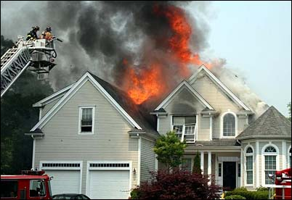
Your house is burning down. You can run in and save 1 item, what do you choose?

