Slide 1
How often…….

Slide 2
Look at the picture
Read the answer and
choose the correct word
Ask the question

Slide 3
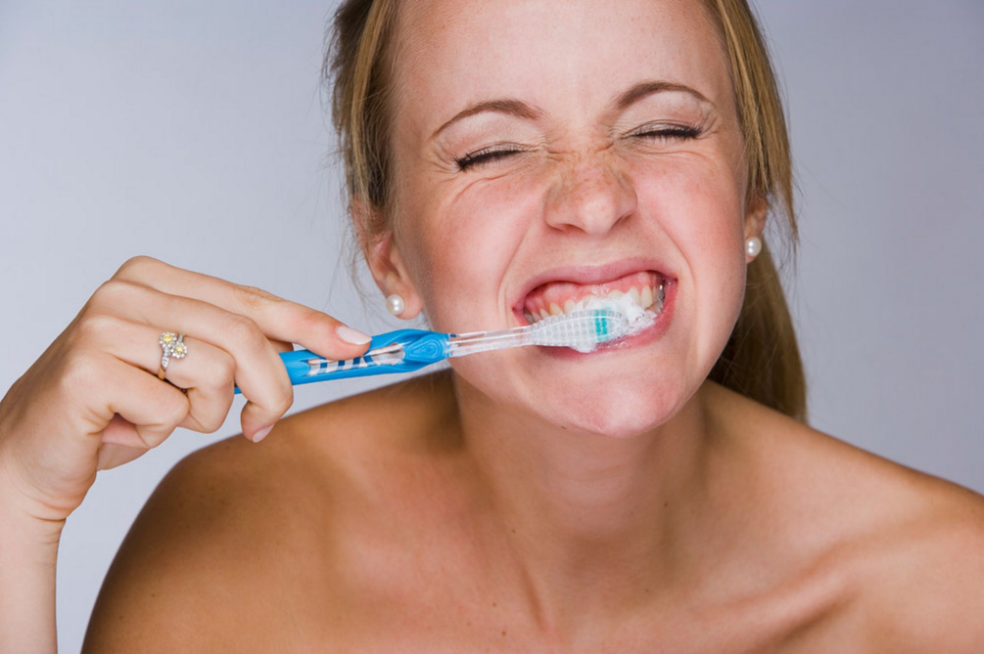
How often do you brush your teeth?
I ………………… ……………………. my teeth
Ask the question
never
always
I always brush my teeth.

Slide 4
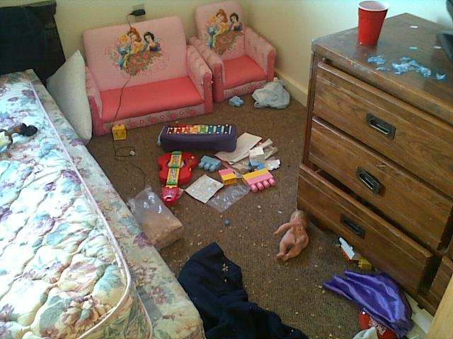
How often do you tidy up your room?
I ………………… ……………………. my room.
Ask the question
sometimes
never
I sometimes tidy up my room .

Slide 5

Do you sometimes help your parents with the shopping?
Yes, I …………… ………. my parents with the shopping.
Ask the question
sometimes
never
Yes, I sometimes help my parents with the shopping.

Slide 6
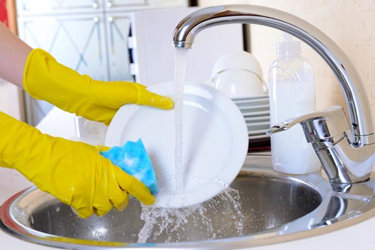
Do you always wash the dishes ?
No , I …………… ………. the dishes. I don’t like it.
Ask the question
always
No, I never wash the dishes .
I don’t like it.
never

Slide 7
Part Two
Look at the picture .
Choose the correct verb action
Read the answer.
Ask the question.

Slide 8
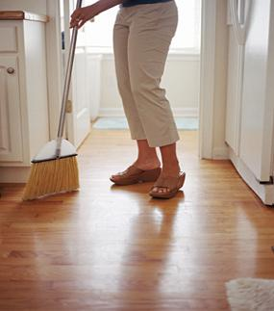
How often does Sue sweep the floors?
Sue always sweeps the floors in the mornings.
Ask the question
wash up
sweep

Slide 9
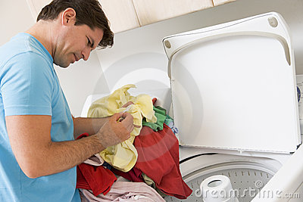
How often does your father do the laundry?
Ask the question
My father sometimes does the laundry .
do the laundry
wash up

Slide 10
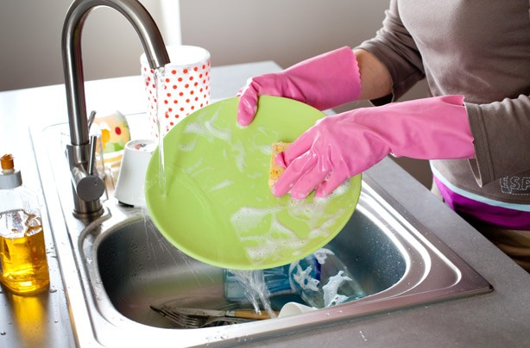
How often does she wash up ?
Ask the question
She sometimeswashes up.
tidy up
wash up

Slide 11
Good Job!

