Slide 1
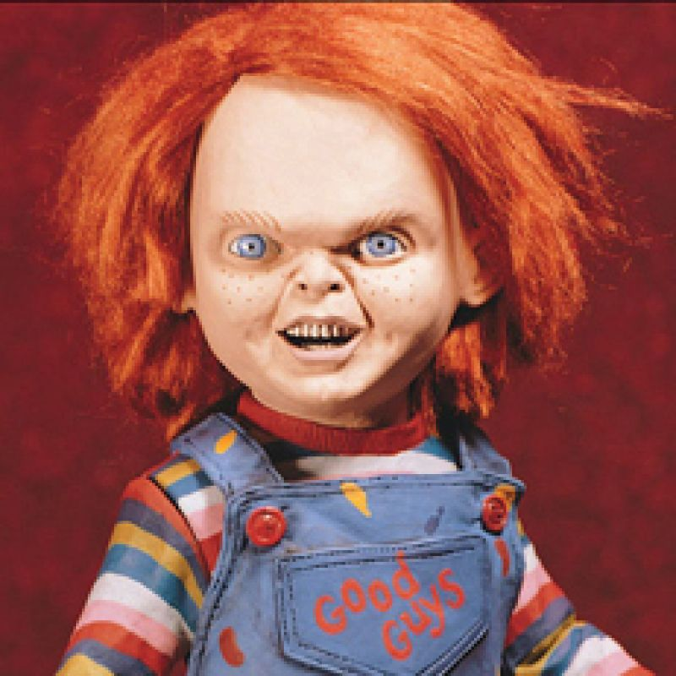
Chucky’s Participle Clauses

Slide 2
Complete the sentences below using the present participles (gerunds) in the box.
They spent 3 hours ___________ the fake bus shelter.
_________ a bus, she stood up.
_________ scared, he moved closer to his mother.
_________ the glass break, they jumped up.
_________ Chucky running after them, they ran away.
Not __________ that it was a joke, they were absolutely petrified.
___________ a knife, he waited behind the sign.
building
seeing
feeling
hearing
seeing
knowing
holding
seeing(x2) knowing hearing holding feeling building

Slide 3
We can use the present participle (gerund) in several ways:
After the verbs spend, waste and the phrase be busy
To express because/as/since/so when both actions are by the same subject.
c. When two actions by the same subject happen at the same time.
d. When one action is immediately followed by another.
Match the rules to the examples below:
(1 + 8)
(3 + 6)
(7)
(2 + 4 + 5)
They spent 3 hours building the fake bus shelter.
Seeing a bus, she stood up.
Feeling scared, he moved closer to his mother.
Hearing the glass break, they jumped up.
Seeing Chucky running after them, they ran away.
Not knowing that it was a joke, they were absolutely petrified.
he waited behind the sign, holding a knife.
He was so busy looking at his phone that he didn’t notice Chucky behind him.
Look at the sentences, where is the participle? How does the position change for the different rules?

Slide 4
Change the sentences using a participle
He didn’t know what to do so he phoned me.
2. Because it was a sunny day, we went for a picnic in the park.
3. He was feeling tired, so he went to bed.
4. Joe walked into the room. He was whistling a song.
5. He opened the door. He was carrying a gun.
6. Because he was a genius he found the exam easy.
7. He saw the teacher coming so he hid the chewing gum.
Not knowing what to do, he phoned me.
It being a sunny day, we went for a picnic in the park
Feeling tired, he went to bed.
Joe walked into the room whistling a song.
He opened the door, carrying a gun,
Being a genius, he found the exam easy.
Seeing the teacher coming, he hid the chewing gum

Slide 5
Perfect Participle clauses
Because I have visited Rome before, I know the best places to go.
After brushing my teeth I went to bed.
Change these sentences to use a perfect participle (have + past participle)
We can use a perfect participle to change:
Sentences in the present or past perfect instead of as/since/because/so etc.
To replace time expressions like after.
After finishing her homework she watched some TV.
I had seen the film before so I didn’t find it scary.
I didn’t eat any of the pasta because I had already eaten.
I had never been to that part of town so I was a little apprehensive.
As she’d been pickpocketed twice before she was more careful this time.
Having visited Rome before, I know the best places to go
Having brushed my teeth, I went to bed.
Having finished her homework, she watched some TV
Having seen the film before, I didn’t find it scary.
Having already eaten, I didn’t eat any of the pasta.
Having never been to that part of town, I was a little apprehensive.
Having been pickpocketed twice before, she was more careful this time.

Slide 6
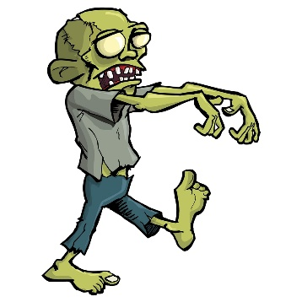

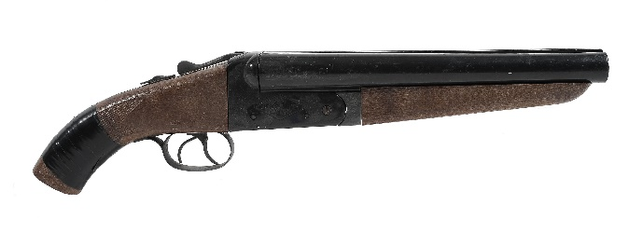

A Horror Story
Finish the sentences to make your own horror story.
Being an experienced vampire hunter,__________________.
Feeling thirsty for blood,_________________________.
Having reloaded his shotgun,________________________.
Seeing the zombies running towards him,__________________.
Never having fired a gun before,_______________________.
Having run out of bullets,___________________________.

