Slide 1


Slide 2
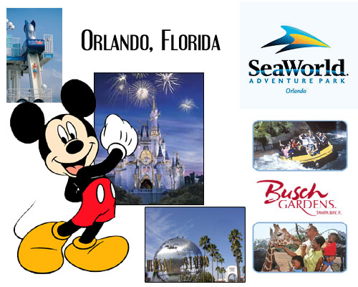
If you go to Orlando, you will meet Micky Mouse.

Slide 3
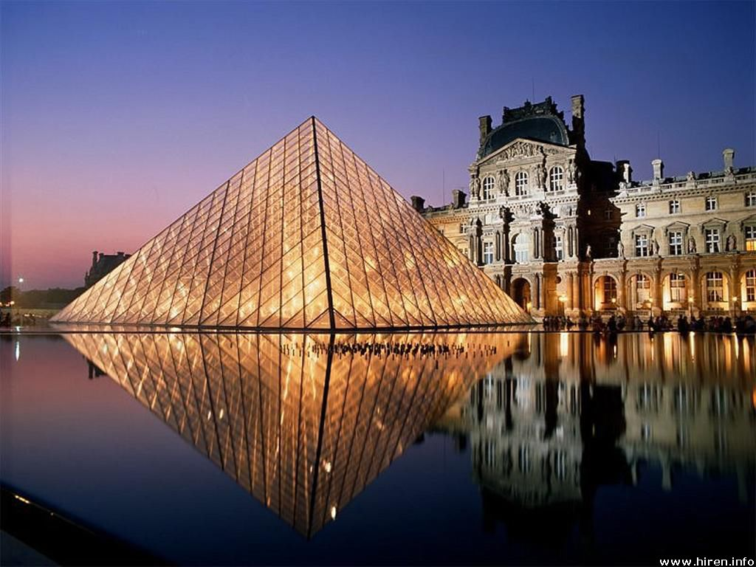

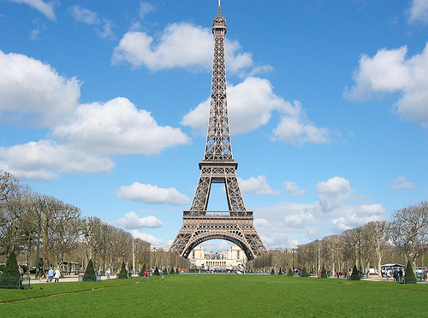
If you go to Paris,
you will see the Eiffel Tower.

Slide 4

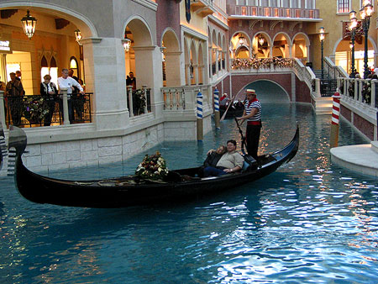

If you travel to Venice,
you will try delicious food.

Slide 5
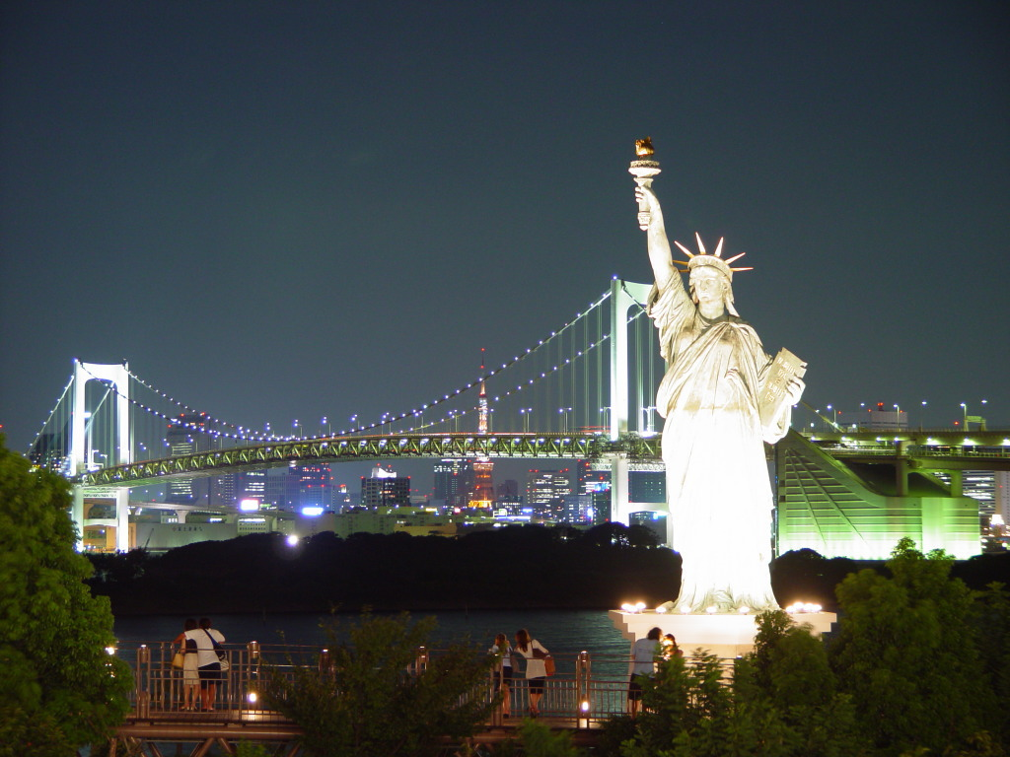

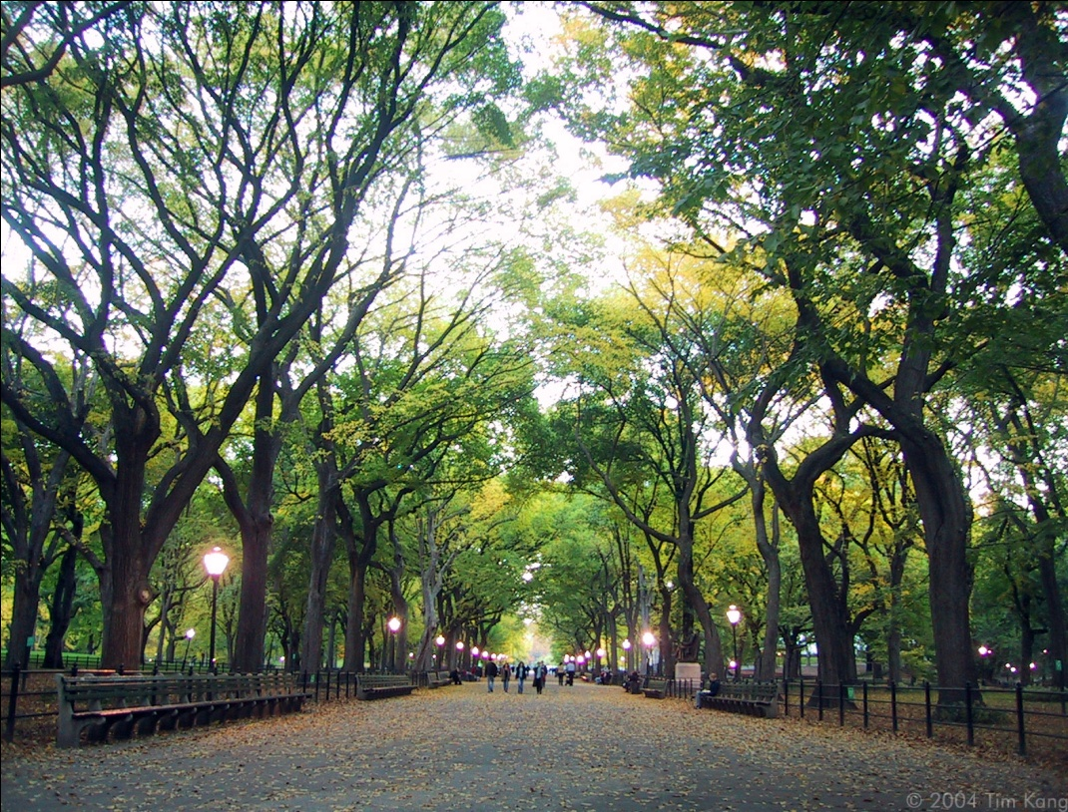

If you go to New York,
you won't get bored.

Slide 6

FIRST CONDITIONAL
We use it to talk about the result of a possible event
or situation in the future.
IF | Condition | Result
 | Present simple talks about the possible future condition | WILL + base verb talks about the possible future result
If | you buy a playstation 4 , | you will have a great time.
You will have a great time if you buy a playstation 4.

Slide 7
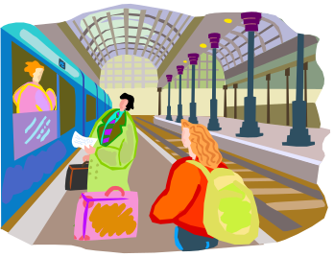



We use the First Conditional for different situations……..
Predictions: If we do not leave now, we will miss the train.
Offers: If you want, I will do the dishes.
Warnings: If you touch that wire, you will get an electric shock.
Threats: If you do that again, I will call the police.

Slide 8

Now get in pairs and write sentences for the following images…

Slide 9

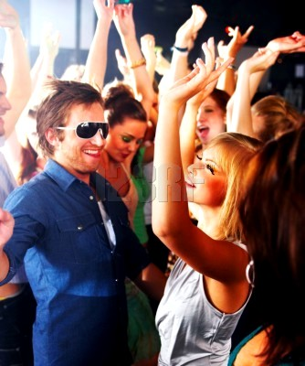

Slide 10

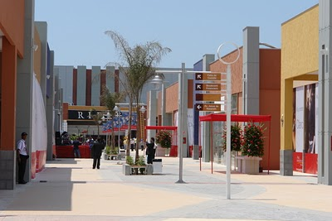

Slide 11
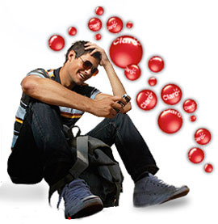


http://web2.uvcs.uvic.ca/elc/StudyZone/330/grammar/1cond1.htm

