Slide 1
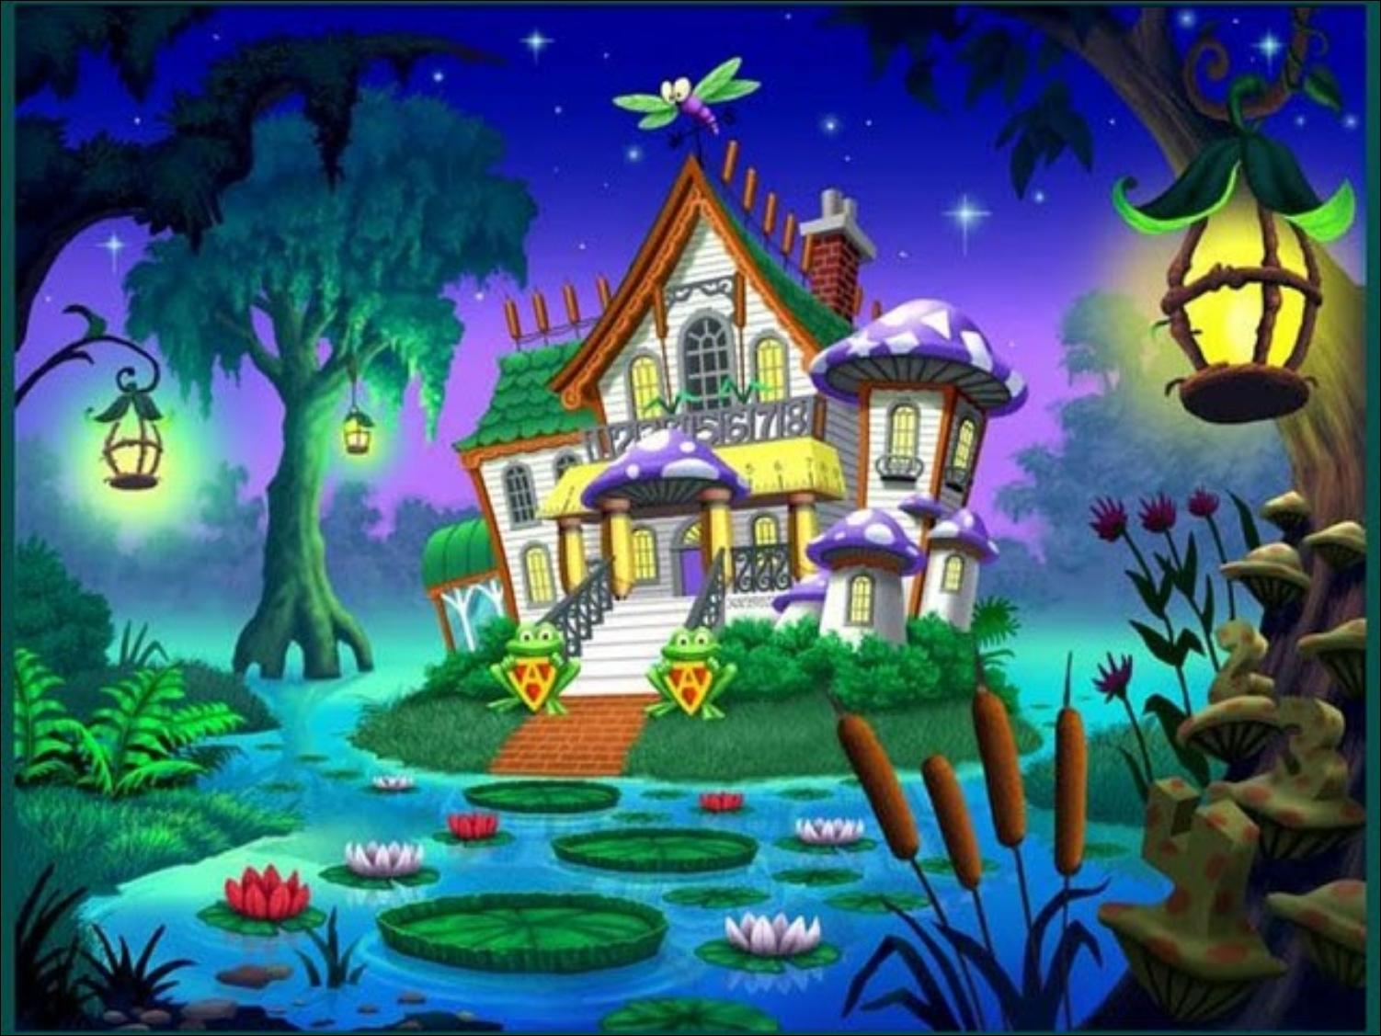


HALLOWEEN
GAME

Slide 2


Choose the right option.
GREAT
witch
ghost
mummy

Slide 3
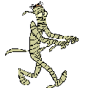

Choose the right option.
GREAT
mummy
ghost
witch

Slide 4
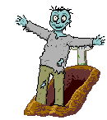

Choose the right option.
GREAT
ghost
mummy
zombie

Slide 5


Choose the right option.
GREAT
spider
haunted house
scarecrow

Slide 6
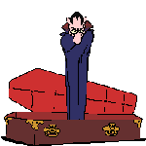

Choose the right option.
GREAT
ghost
bat
dracula

Slide 7
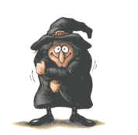

Choose the right option.
GREAT
bat
witch
spider

Slide 8
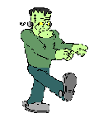

Choose the right option.
GREAT
Frankenstein
ghost
dracula

Slide 9

Choose the right option.
GREAT
mummy
ghost
Jack o’ lantern

Slide 10
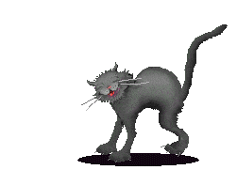
Choose the right option.
GREAT
spider
black cat
trick or treat

Slide 11
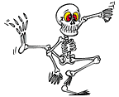
Choose the right option.
GREAT
ghost
skeleton
mummy

Slide 12

Choose the right option.
GREAT
coffin
ghost
mummy

Slide 13
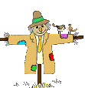
Choose the right option.
GREAT
cookies
candy
scarecrow

Slide 14
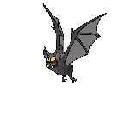

Choose the right option.
GREAT
dragon
bat
cat

Slide 15

Choose the right option.
GREAT
coffin
ghost
death

Slide 16
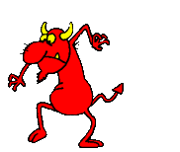
Choose the right option.
GREAT
ghost
devil
witch

Slide 17
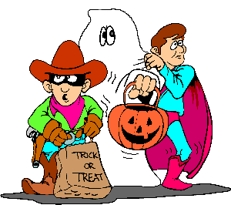
Choose the right option.
GREAT
trick or treat
bat
black cat

Slide 18
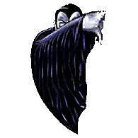
Choose the right option.
GREAT
dragon
vampire
cat

Slide 19
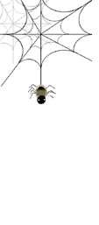
Choose the right option.
GREAT
black cat
vampire
spider

