Slide 1
Reporting Verbs

Slide 2
Reporting verbs
Uses:
We can use 'he said...', 'they said...' etc effectively, but to add more meaning and express how something was said we use reporting verbs.
accused
ordered
denied
agreed
apologised
asked
claimed
refused
stated
insisted
threatened
suggested
warned
blamed
decided
recommended
promised
offered

Slide 3
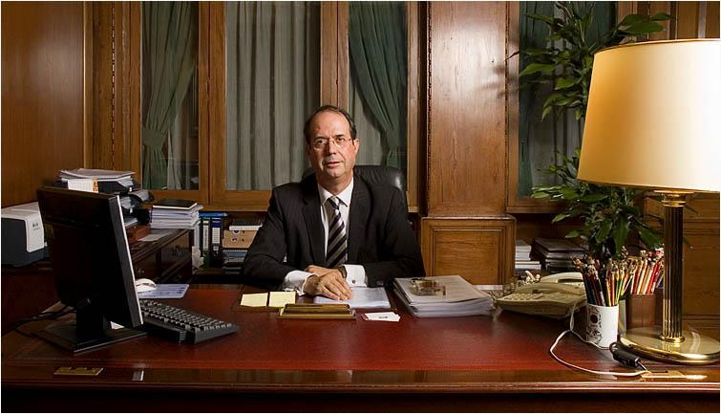

Denied, recommended, suggested
reporting verb + verb(-ing)
e.g. The boy denied breaking the window.
e.g. The doctor suggested having an operation.
Bank: Your bank account has been in the negative for 6 months now. I think you should get a loan.
The bank recommended getting a loan.

Slide 4

Advised, encouraged, reminded, warned
reporting verb + object + verb (infinitive)
e.g. The coach encouraged the players to play dirty football.
e.g. The manager advised the chef to add more salt to the food.
Mum: Be careful with your money my son!
My mum encouraged me to be careful with my money..

Slide 5

Apologised, insisted
reporting verb + preposition + verb (-ing)
e.g. The man apologised for shouting at the boy on a bike.
Friend: I insist you borrow some money from the company, they'll never know!
My friend insisted on borrowing money from the company.

Slide 6

Agreed, decided, offered, refused, promised, threatened
reporting verb + verb (infinitive)
e.g. The children decided to play on the swings.
Manager: You borrowed money without telling us. I'm going to take you to court!
My manager threatened to take me to court.

Slide 7
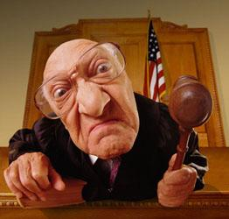
Accused, blamed
reporting verb + object + preposition + verb(-ing)
e.g. My wife accused me of having an affair with the neighbour.
e.g. Her daughter blamed my son for bullying her at school.
Judge: You have stolen $50,000 from your company.
The judge accused me of stealing $50,000.

Slide 8
Admitted, agreed, decided, denied, explained, insisted, promised, recommended, suggested
reporting verb + that
e.g. The school agreed that Joey is an excellent student.
e.g. The police explained that the fire was accidental.
Judge: You will go to jail for five years.
The judge decided that I will go to jail for 5 years.

