Slide 1
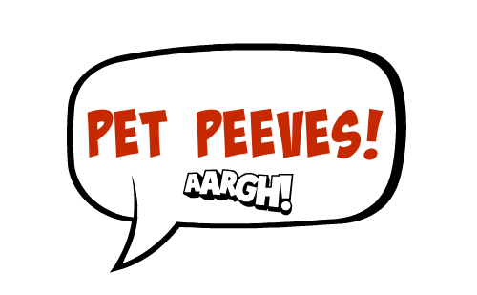
Pet Peeves/Hates

Slide 2
Memory Test – Annoyance
Can you remember the expressions with these words?
stand goat nerves wall hair bull bend off wrong out
I can’t STAND it when people….
It really gets my GOAT when people….
It really gets on my NERVES when people….
It drives me up the WALL when people….
When people…. it makes me tear my HAIR out.
When people…. it’s like a red rag to a BULL for me.
It drives me round the BEND when people….
It really pisses me OFF when people….
It really rubs me up the WRONG way when people…
It really stresses me OUT when people…

Slide 3
Memory Test – Anger
Can you remember the expressions with these words?
red roof rag top flew out fuming ballistic mind head
When she sees READ, there’s no holding her back.
He went through the ROOF when the builders damaged his motorcycle.
I really lost my RAG when they told us our flight was delayed again.
My dad blew his TOP when he saw how much the taxi cost.
My mum FLEW off the handle when she saw the mess we had made.
He flipped OUT when he realised he’d missed the start of the match.
I was absolutely FUMING when the pizzas finally arrived.
My parents went BALLISTIC when they saw my phone bill.
I went back into the shop and gave the shop assistant a piece of my MIND.
He bit my HEAD off when I asked him how the meeting had gone.

Slide 4
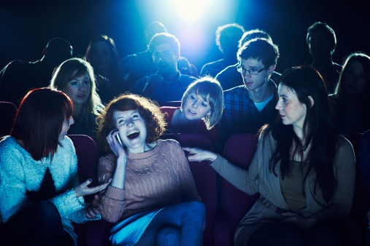
People who use their phones in the cinema.

Slide 5
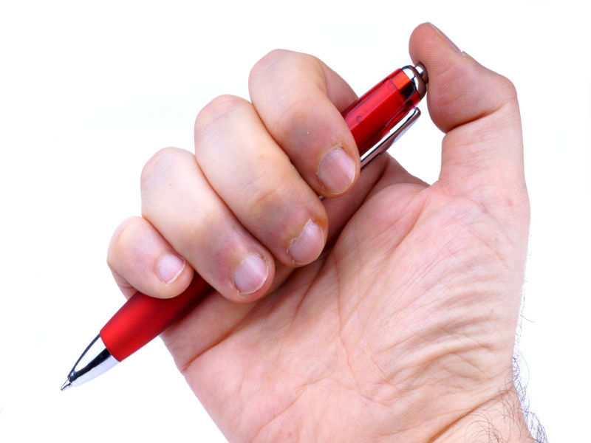
Pen clicking

Slide 6

People slurping their drink

Slide 7
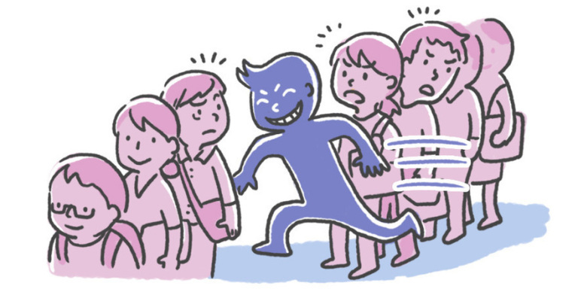
Queue jumping/line cutting

Slide 8
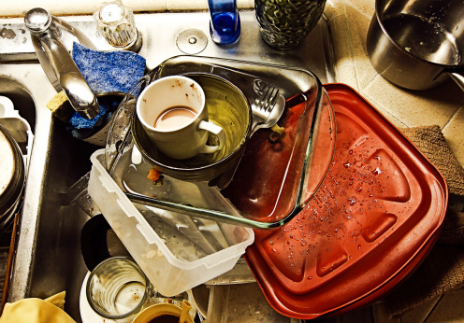
Leaving dirty dishes in the sink

Slide 9
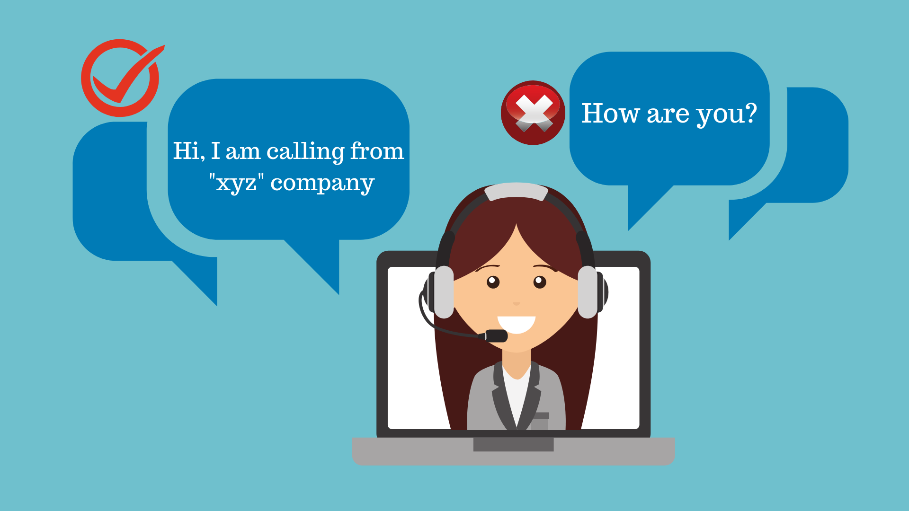
Telesales calls

Slide 10
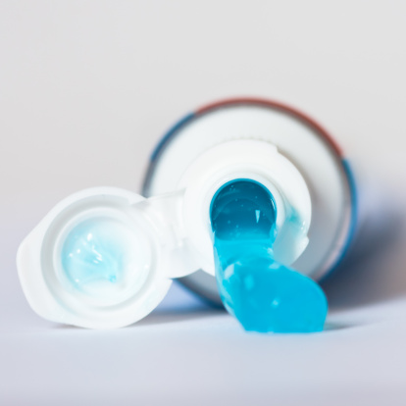
Leaving the cap off the toothpaste

Slide 11
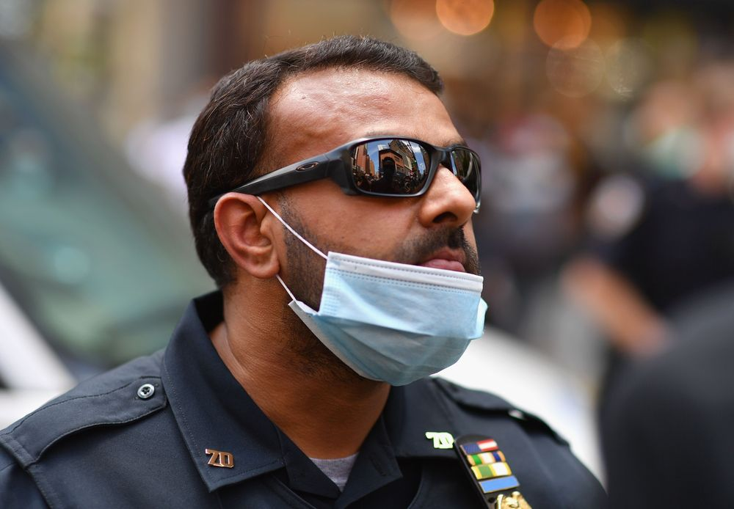
Wearing a mask like this…

Slide 12
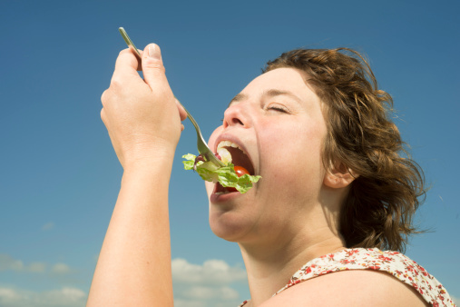
Chewing with your mouth open

Slide 13
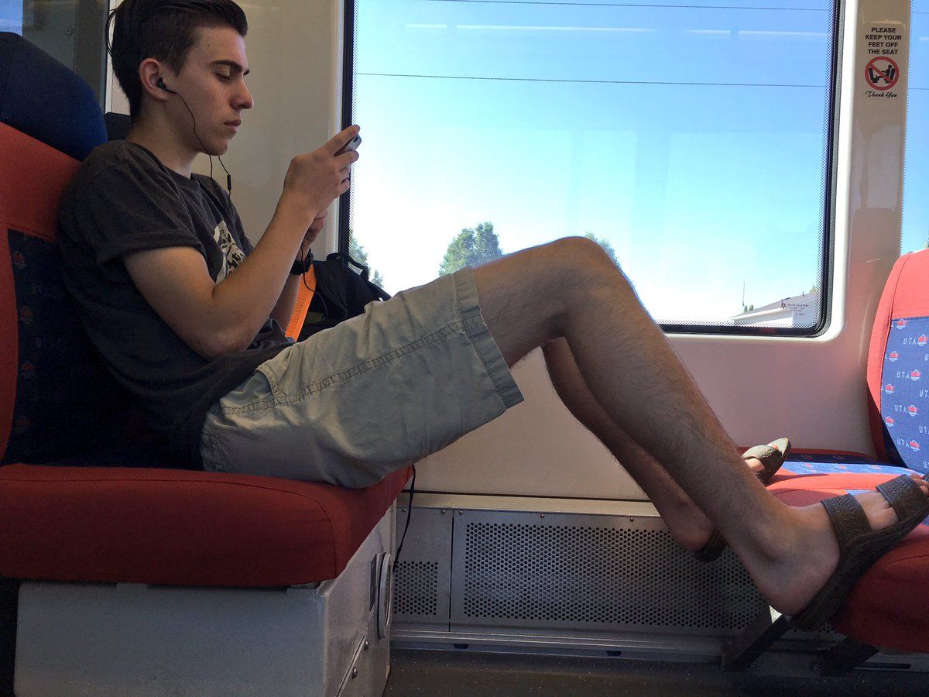
Putting your feet on the seat

Slide 14

Email spam

Slide 15
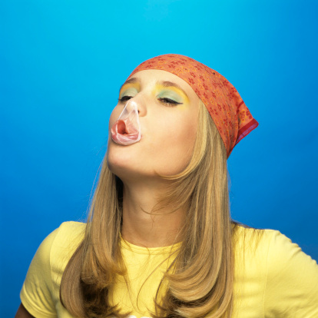
Popping gum

Slide 16
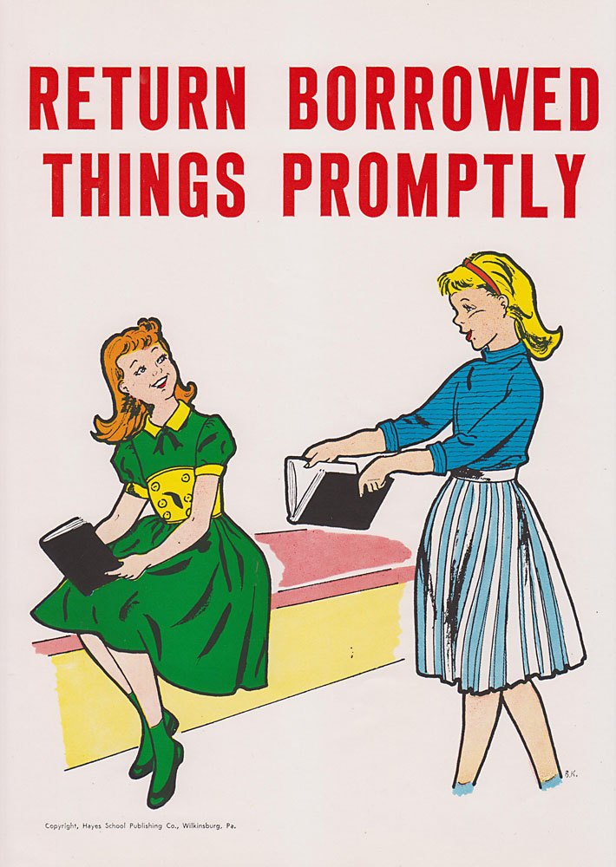
Not returning borrowed things

Slide 17
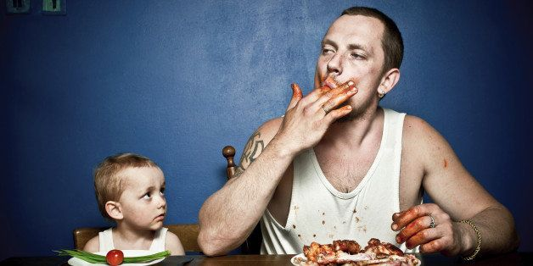
Having bad table manners

Slide 18
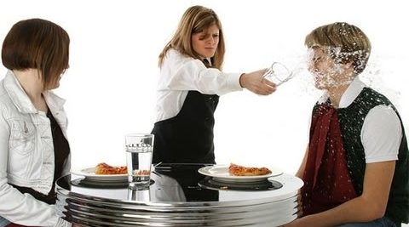
Bad customer service

Slide 19
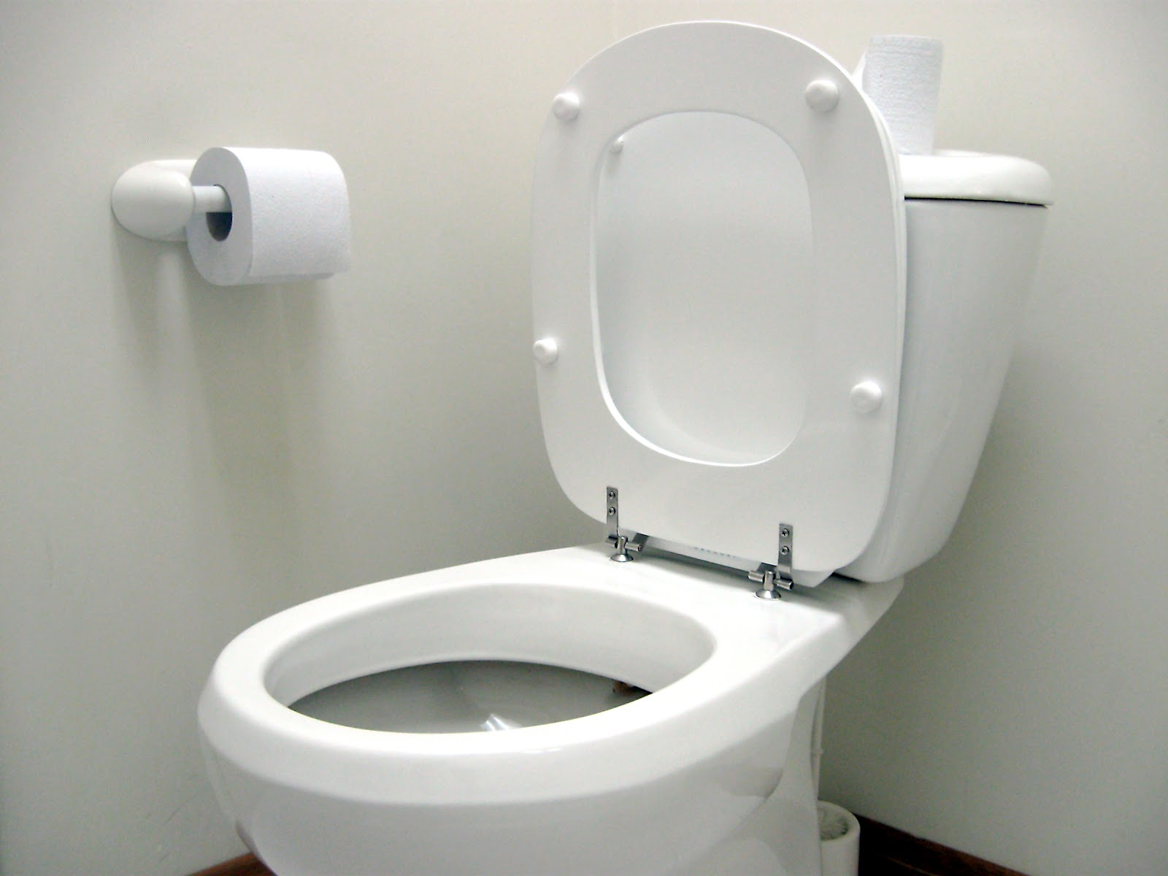
Leaving the toilet seat up

Slide 20
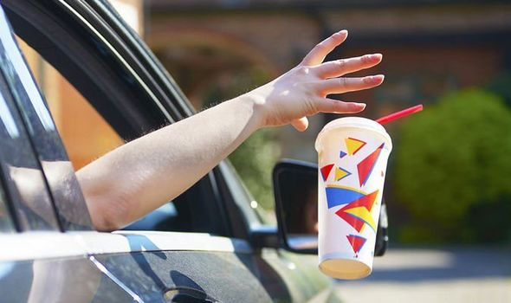
Littering

Slide 21
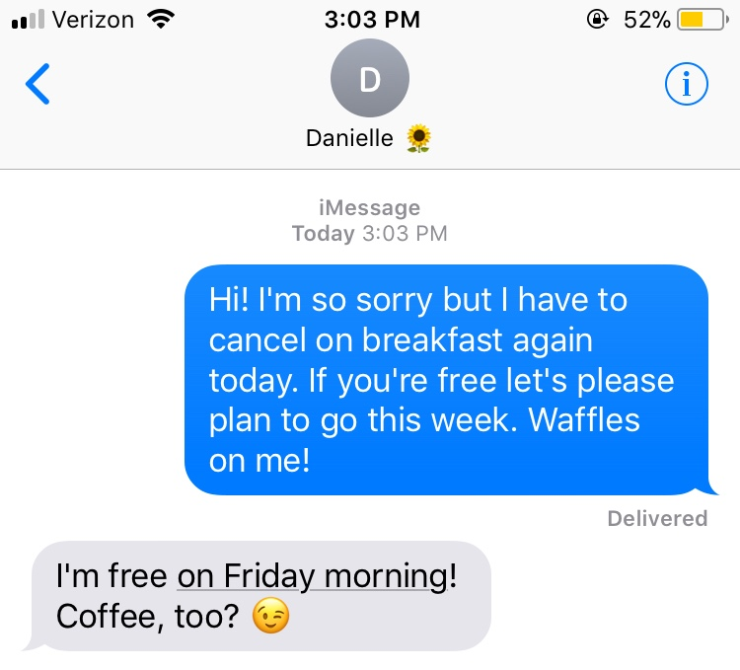
Cancelling at the last minute

Slide 22
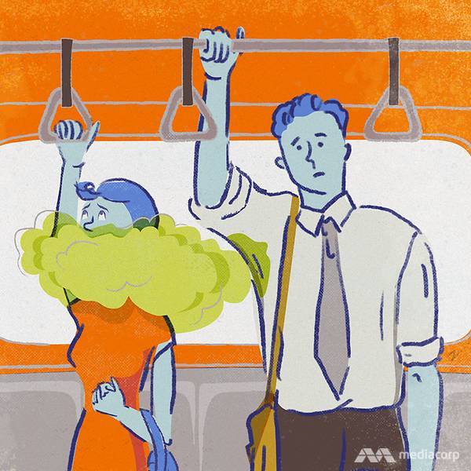
Poor personal hygiene

Slide 23

Not minding your ps and qs

Slide 24
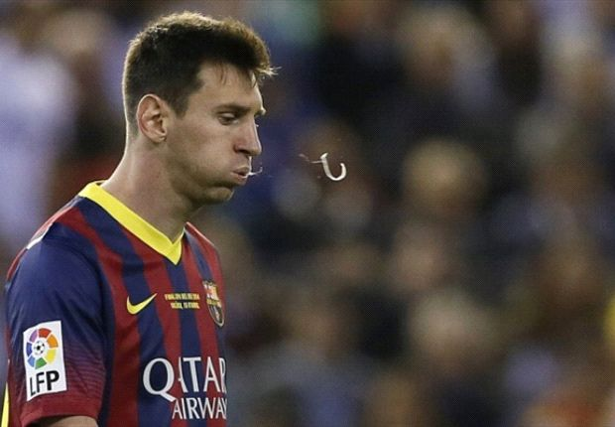
Spitting

Slide 25

Badly behaved kids

Slide 26
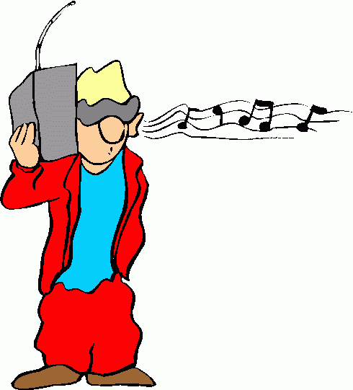
Listening to music without headphones

Slide 27

Adverts

