Slide 1
Mega Revision Pub Quiz

Slide 2
Rules
Work in teams
There will be 8 rounds of 8 questions each
You will have 5 minutes to complete each round
No cheating or copying, try to use your memory!
Content is language we have studied throughout the year

Slide 3
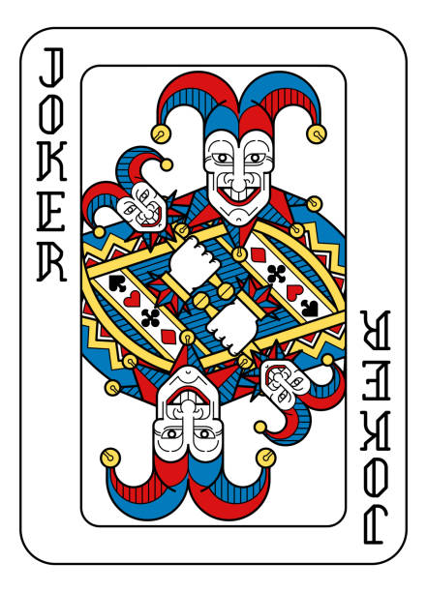
Joker Round
Play your joker card to get double points in one specific round.
However, you must decide when you’re going to play your card before you see the questions. Here are the categories, decide which round you want to play your card now.
Proverbs (Two wrongs don’t make a right)
Theatre/plays/shows
Save the Planet: Phrasal Verbs
Complaining & Criticising
The Heist (bank robbery)
Phrasal Verbs with Up and Down
Idioms & Dependent Prepositions
Key Word Transformation Expressions

