Slide 1
Seasons and Weather

Slide 2



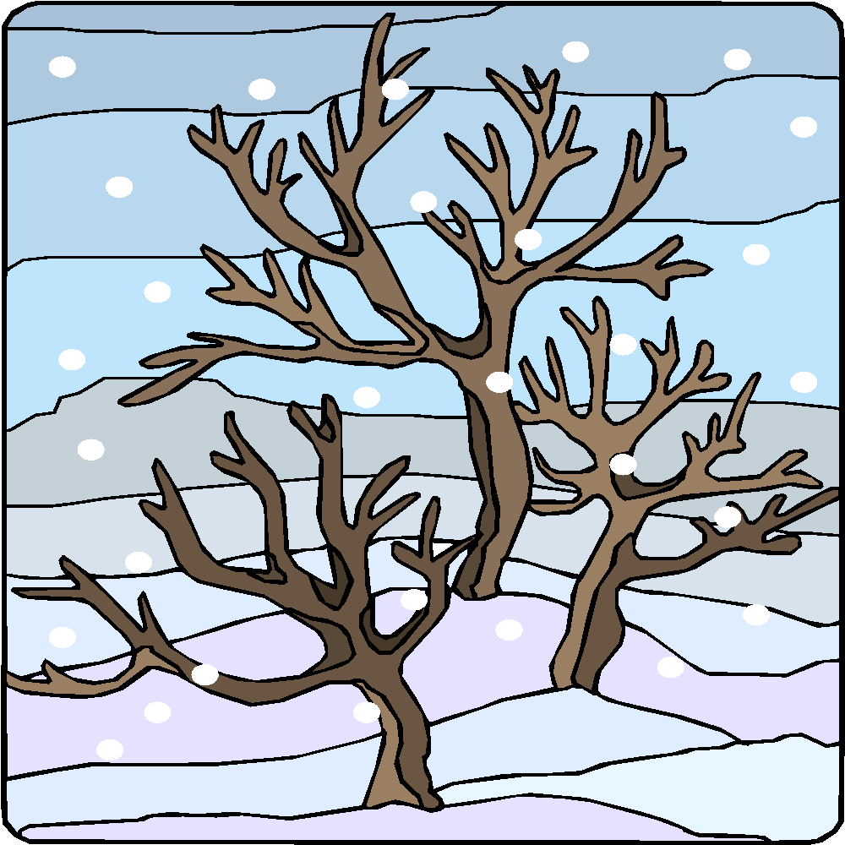
In which season do you see the following:
spring
summer
autumn
winter

Slide 3




In which season do you see the following:
spring
summer
autumn
winter

Slide 4
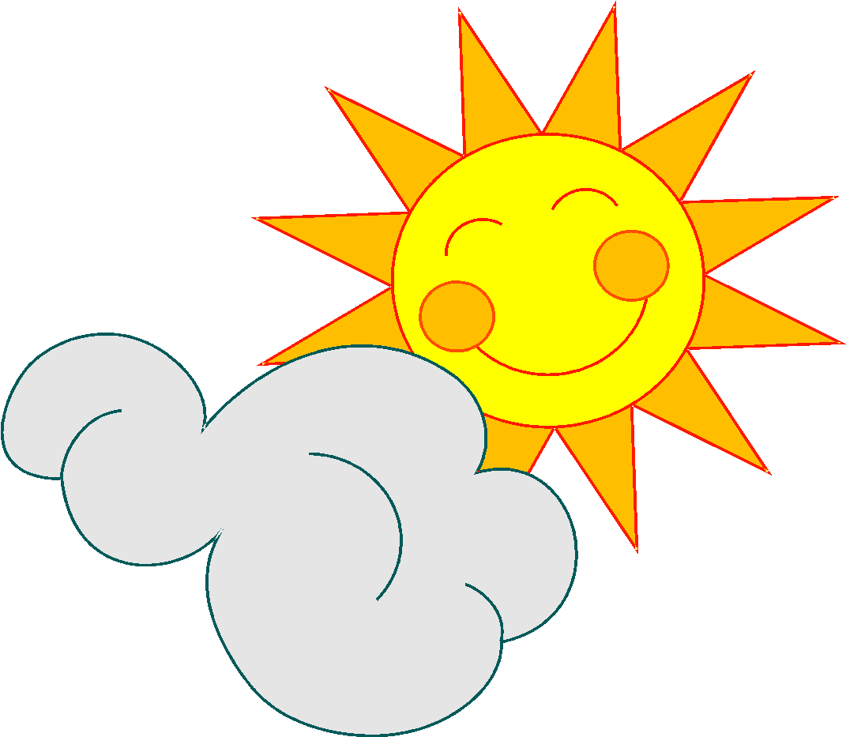
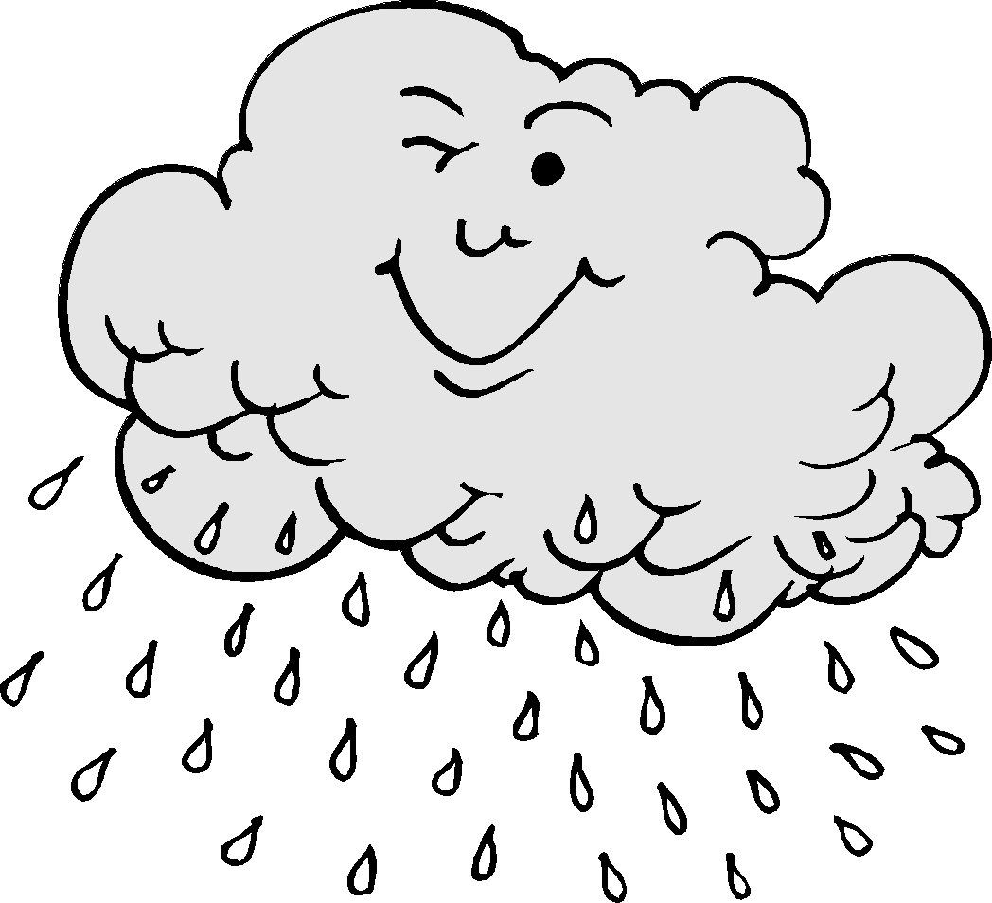
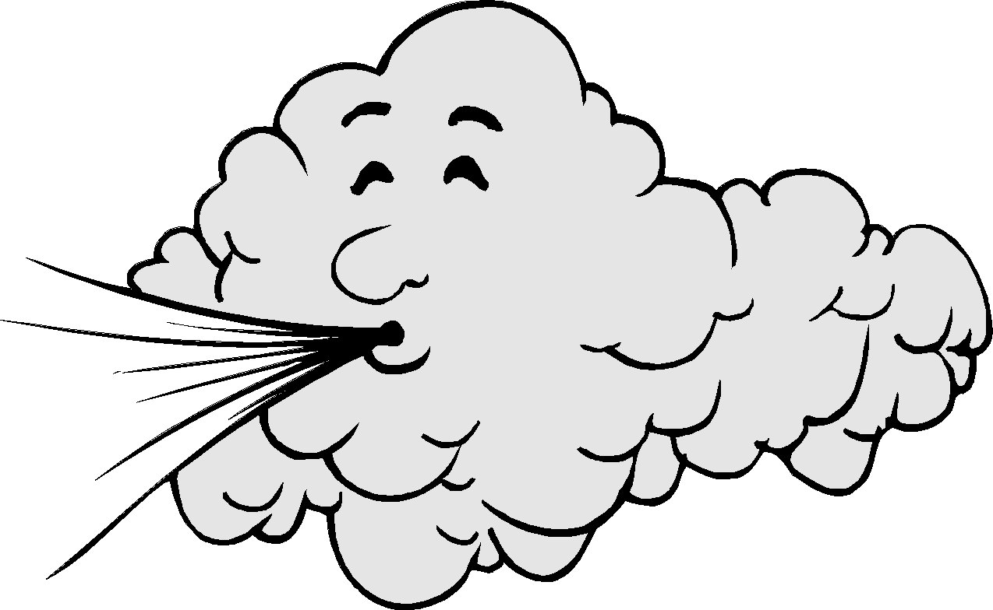
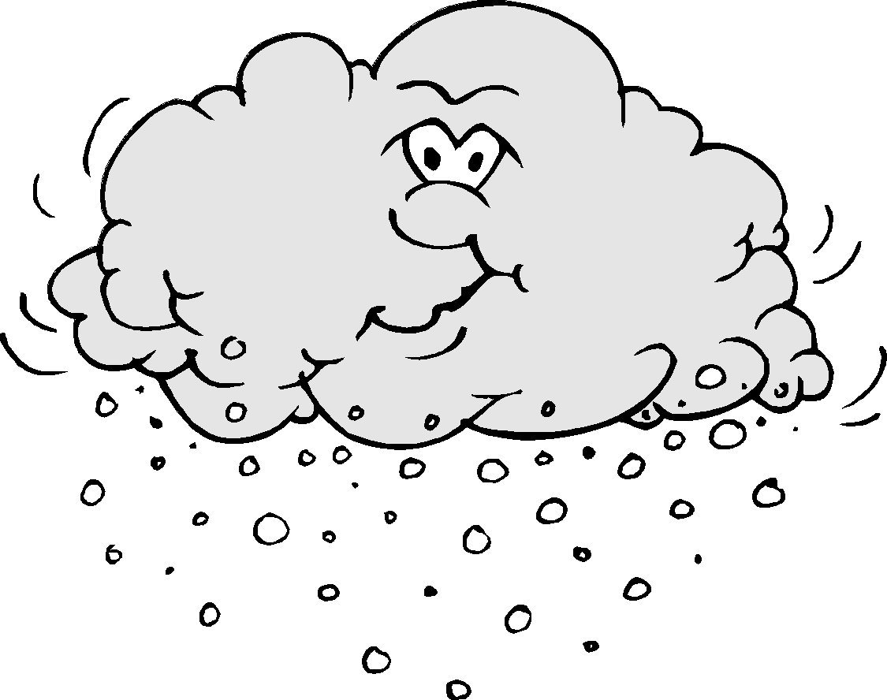
Say what the weather condition is.
sunny
rainy
windy
snowy

Slide 5


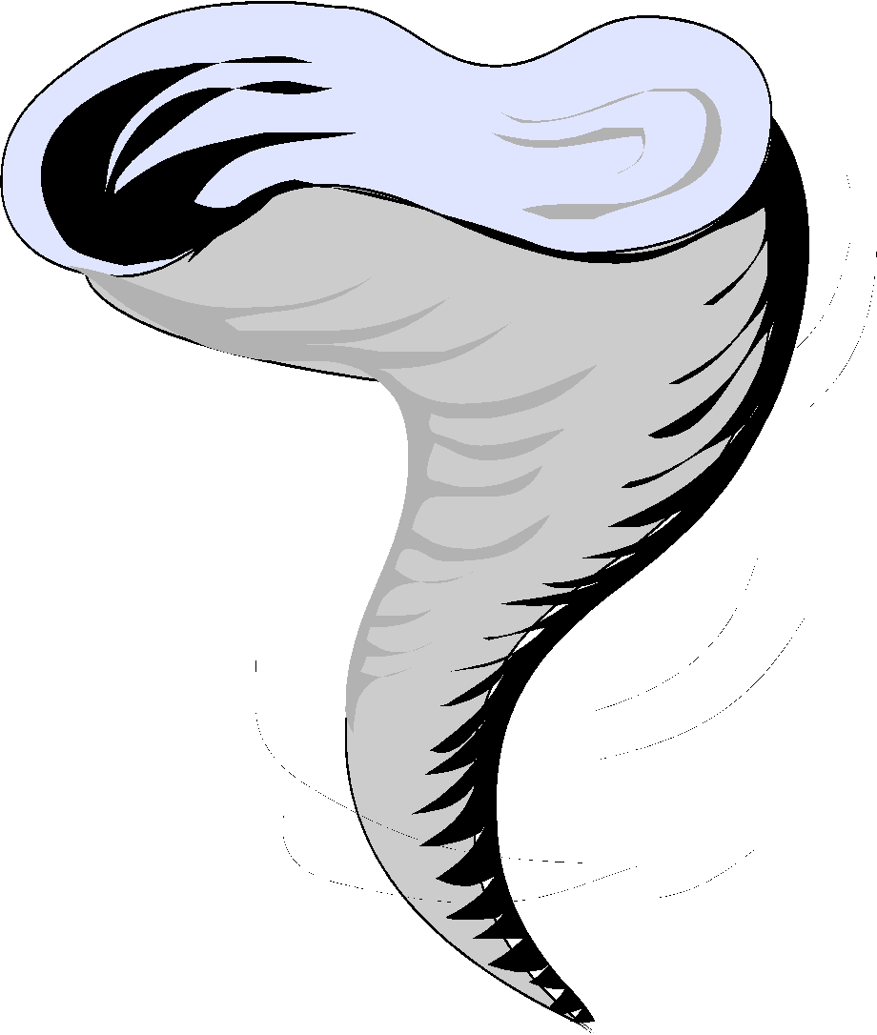

Say the name of the items below.
cloud
sun
tornado
rainbow

Slide 6

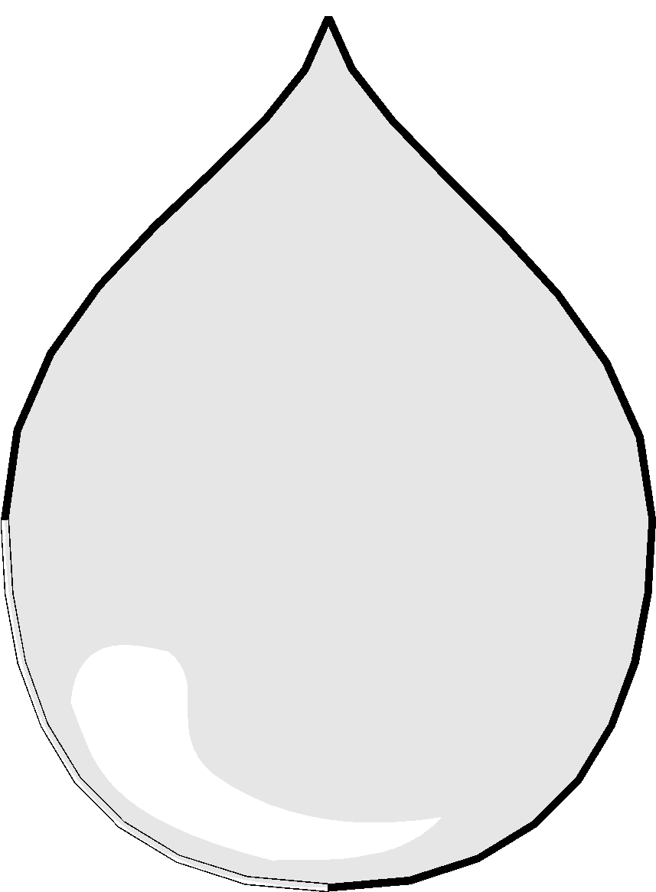
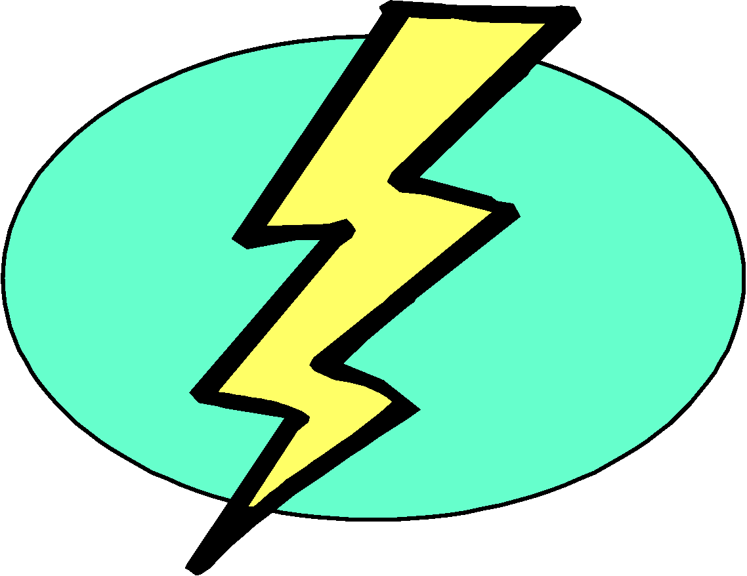

Say the name of the items below.
raindrop
snowflake
lightning
wave

Slide 7
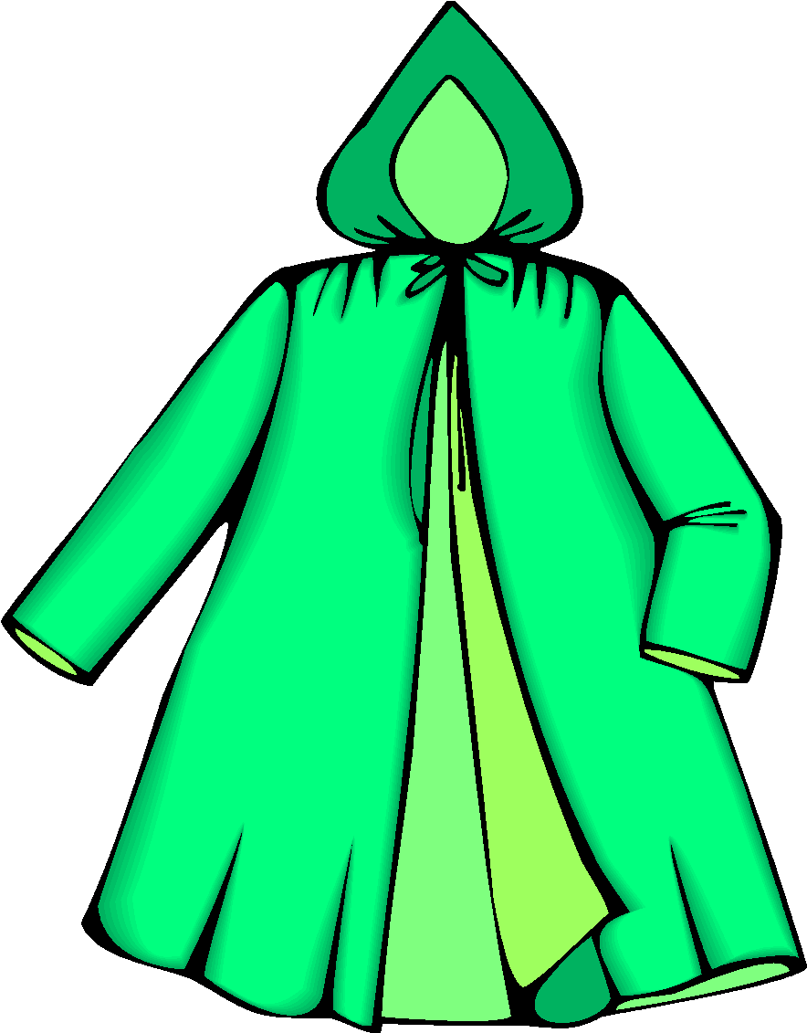

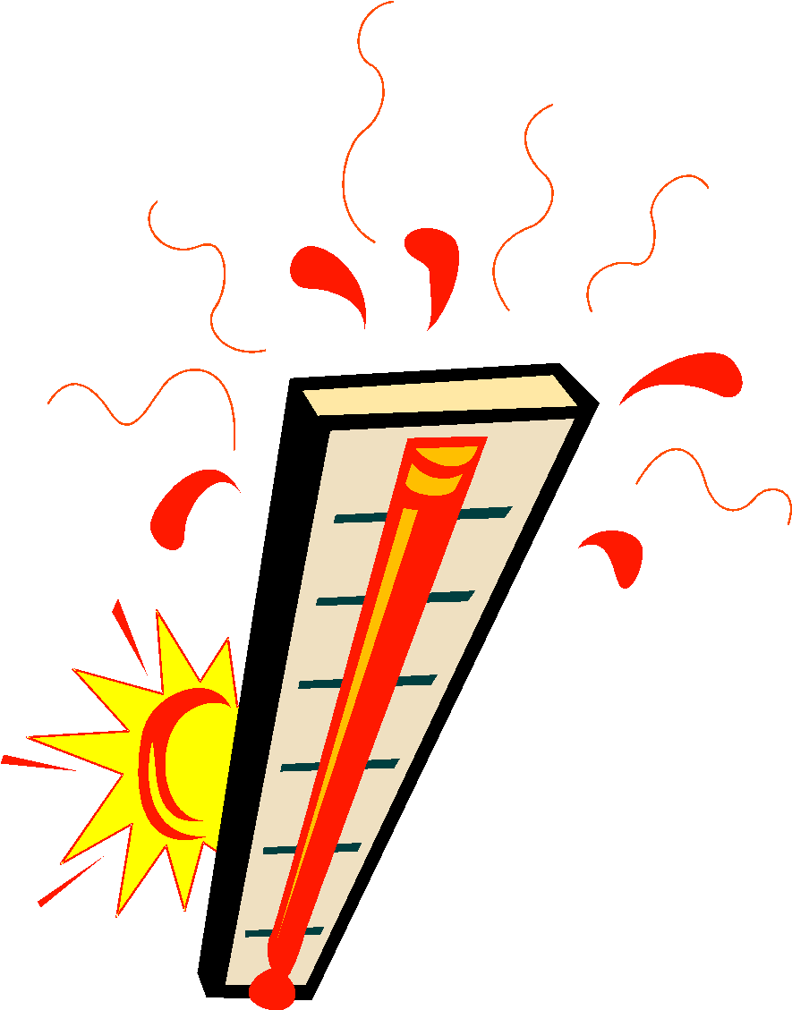
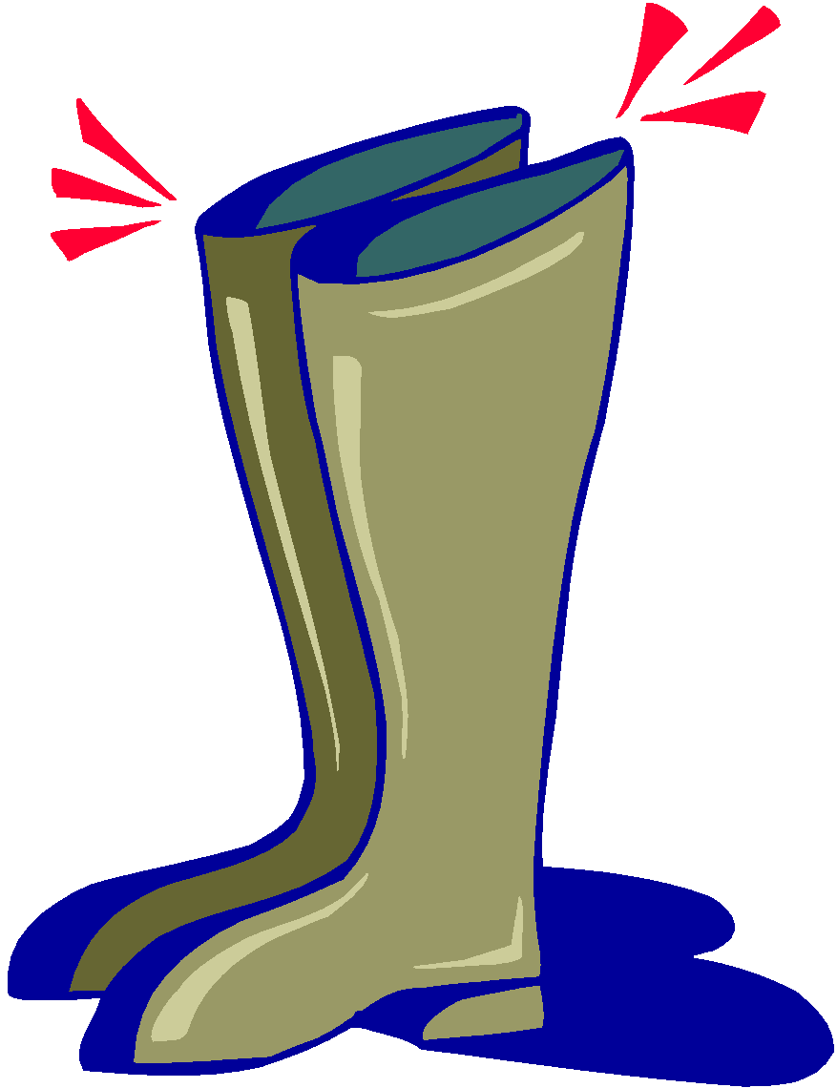
Say the name of the items below.
raincoat
umbrella
thermometer
boots

