Slide 1
Where do you stand? Animal Rights

Slide 2
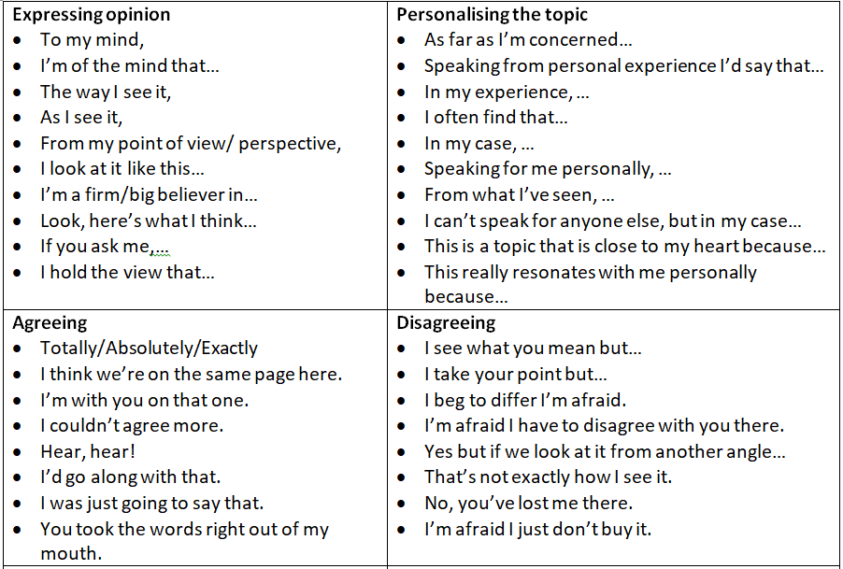
Zoos have a positive impact on society.

Slide 3
Big game hunting should be allowed the money from hunting licences should go towards conservation.

Slide 4
Humans shouldn’t step in to save endangered species; nature should be allowed to take its course.

Slide 5
I see no problem with testing cosmetics on animals.

Slide 6
I see no problem with testing medicines on animals.

Slide 7
People in the future will view the way we treat animals today as barbaric.

Slide 8
It’s not a square meal without some meat.

Slide 9
I could go vegetarian.

Slide 10
I could go vegan.

Slide 11
I could kill and butcher and animal for food.

Slide 12
I’m willing to cut down on meat for environmental reasons.

Slide 13
Eating animals like dogs and cats shouldn’t be viewed as strange; we eat pigs, sheep and cows.

Slide 14
I would be able to tell the difference between real and synthetic meat.

Slide 15
One day, all meat will be synthetic meat, grown in a laboratory.

Slide 16
Factory farming is necessary in order to feed the populations.

Slide 17
Eating meat is an important part of my culture.

Slide 18
Sports involving animals (hunting, horse riding, bullfighting, etc.) are an important part of my culture and must be protected.

