Slide 1
Where do you stand? Entertainment & Culture

Slide 2
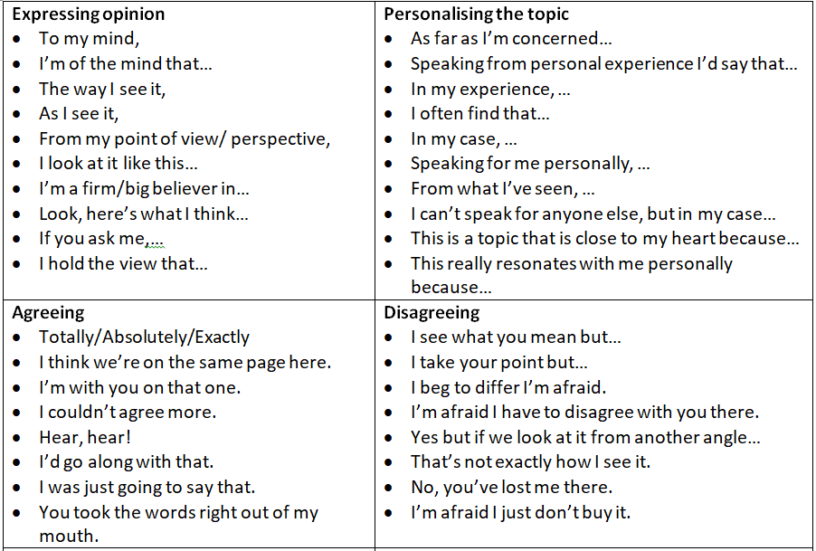
The book is always better than the film.

Slide 3
There are too many sequels and spin-off films these days. There aren’t many original stories.

Slide 4
The original version of a song is always the best.

Slide 5
Celebrities shouldn’t complain about being in the public eye. It’s part of the job.

Slide 6
Netflix will kill the cinema.

Slide 7
You shouldn’t watch films on your phone. It ruins the experience.

Slide 8
Watching a film at the cinema is always better than at home.

Slide 9
Violent films and videogames should be banned.

Slide 10
Music, art and drama should be compulsory subjects at school.

Slide 11
Social media companies should be responsible for the content that users post on their platforms.

Slide 12
Children shouldn’t play with “violent” toys like guns and weapons.

Slide 13
Something is always lost when a text is translated.

Slide 14
Physical books will disappear one day.

Slide 15
Governments should be allowed to censor some elements of the media including books and films.

Slide 16
The benefits of social media platforms outweigh the negative aspects.

Slide 17
Sports involving animals (hunting, horse riding, bullfighting, etc.) are an important part of my culture and must be protected.

Slide 18
Watching too much television makes you stupid.

