Slide 1


Slide 2
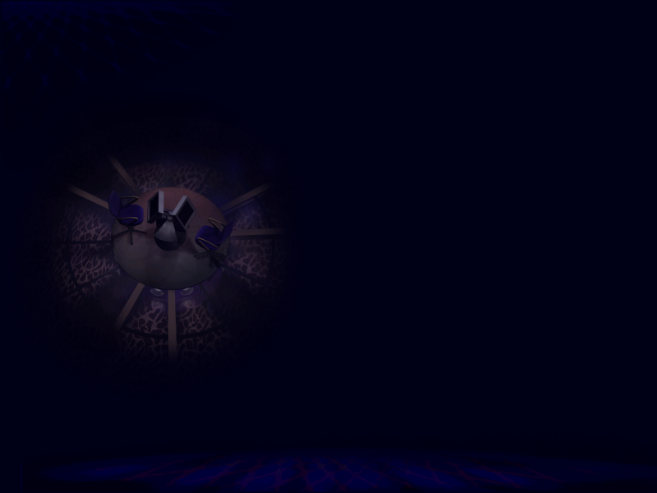
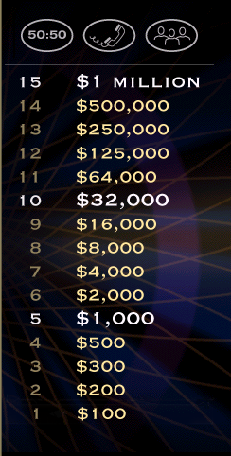

Slide 3
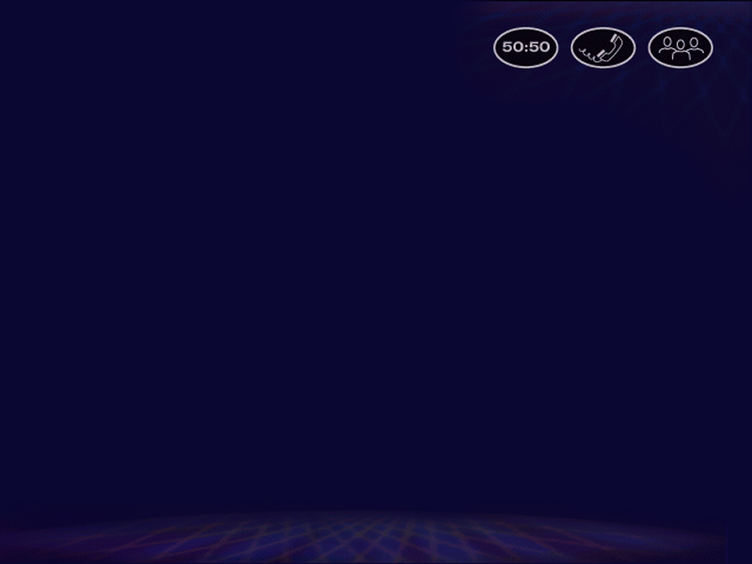
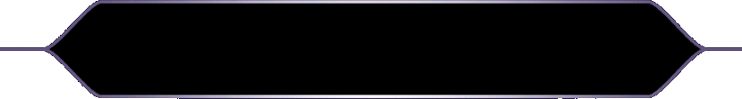



I _____ breakfast at 7:30am.
A.) do
B.) give
C.) correct answer
C.) have
D.) break
L
F

Slide 5
My Dad never _____ the washing up
in our house.
A.) does
A.) correct answer
B.) makes
C.) made
D.) done
L
F

Slide 7
If you have a headache, ____ an aspirin
and go to bed.
A.) eat
B.) correct answer
B.) take
C.) consume
D.) get
L
F

Slide 9
When I was in Paris, I ____ photos of
The Eiffel Tower.
A.) took
A.) correct answer
B.) made
C.) did
D.) got
L
F

Slide 11
My grandmother is very old so my Mum has
to ____ care of her.
A.) give
B.) make
C.) take
D.) show
C.) correct answer
L
F

Slide 13
We’re going to _____ a big party on
Saturday, it’s my birthday.
A.) do
B.) correct answer
B.) have
C.) make
D.) enjoy
L
F

Slide 15
My brother is always ______ TV when I
want to play video games.
A.) seeing
B.) looking
C.) eyeing
D.) watching
D.) correct answer
L
F

Slide 17
What are you doing this weekend?
I don’t know, it depends ____ the weather.
A.) of
B.) correct answer
B.) on
C.) for
D.) in
L
F

Slide 19
How often do you _____ sports?
A.) make
B.) participate
C.) correct answer
C.) do
D.) practice
L
F

Slide 21
He’s not having a good time at school.
The other students keep _____ fun of him.
A.) having
B.) laughing
C.) doing
D.) making
D.) correct answer
L
F

Slide 23
Julie is devastated because she has just
______ up with her boyfriend.
A.) gone
B.) smashed
C.) made
D.) broken
D.) correct answer
L
F

Slide 25
We should _____ advantage of the beautiful
weather and go for a bike ride.
A.) make
B.) correct answer
B.) take
C.) do
D.) get
L
F

Slide 27
In our school we ______ wear uniforms.
We can wear whatever we like.
A.) mustn’t
B.) could
C.) shouldn’t
D.) don’t have to
D.) correct answer
L
F

Slide 29
He _____ up as Dracula for Halloween.
A.) wore
B.) made
C.) dressed
D.) disguised
C.) correct answer
L
F

Slide 31
The teacher _____ him off for chewing
gum in class.
A.) correct answer
A.) told
B.) said
C.) punished
D.) shouted
L
F

Slide 32

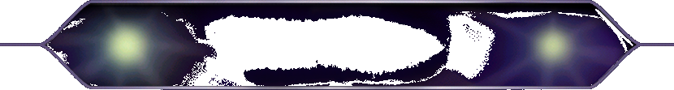
Congratulations!
Thank-you for playing…
Notes:
Correct

