Slide 1


Slide 2
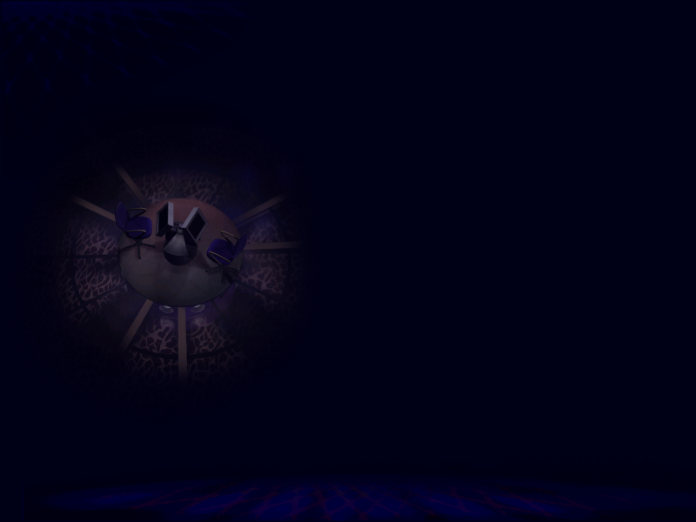
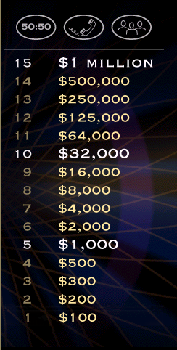

Slide 3




Do you fancy going ____ a drink this weekend?
A.) on
B.) correct answer
B.) for
C.) to
D.) out
L
F

Slide 5
I moved ____ of my parents house when
I was 18.
A.) correct answer
A.) out
B.) in
C.) under
D.) off
L
F

Slide 7

John has decided to put the meeting ____.
(postpone)
A.) over
B.) away
C.) off
D.) forward
C.) off
L
F

Slide 9
The fire alarm went ___ in the middle of the class and we
all had to leave.
A.) off
A.) correct answer
B.) away
C.) up
D.) on
L
F

Slide 11
He dropped ____ in the middle of the film and missed the end.
(fell asleep)
A.) in
B.) away
C.) correct answer
C.) off
D.) down
L
F

Slide 13
He found it very difficult to cope ____ the stress of
the new job.
A.) on
B.) correct answer
B.) with
C.) up
D.) across
L
F

Slide 15
He has just set ___ a new business with his brother.
(started)
A.) down
B.) on
C.) off
D.) correct answer
D.) up
L
F

Slide 17
I didn’t have any classes but I managed to ____ up a bit of
French just from day to day life.
A.) acquire
B.) correct answer
B.) pick
C.) learn
D.) collect
L
F

Slide 19
Did you hear? John’s little sister beat him at Fifa, everyone
is laughing about it, he’ll never ____ it down.
A.) get
B.) forget
C.) live
D.) put
C.) correct answer
L
F

Slide 21
I was cleaning the attic last week and I ____ across some old
photos of Mum and Dad, they’re so funny!
A.) found
B.) discovered
C.) looked
D.) came
D.) correct answer
L
F

Slide 23
I knew she was lying because she kept fiddling ____ her
bracelets while she was speaking.
A.) on
B.) around
C.) of
D.) correct answer
D.) with
L
F

Slide 25
You should always _____ your documents up on a pen drive
in case your computer crashes.
A.) store
B.) correct answer
B.) back
C.) save
D.) guard
L
F

Slide 27
He walks so fast! It’s impossible to ____ up with him!
(go at the same speed)
A.) maintain
B.) go
C.) speed
D.) keep
D.) correct answer
L
F

Slide 29
He’s been travelling for years but now he has decided to
_____ down and start a family.
A.) put
B.) sit
C.) settle
D.) rest
C.) correct answer
L
F

Slide 31
The girls are always ______ Jose Maria up,
they can be so annoying. (annoy)
A.) correct answer
A.) winding
B.) angering
C.) raging
D.) firing
L
F

Slide 32


Congratulations!
Thank-you for playing…
Notes:
Correct

