Slide 1

3
Copyright © 2005 – 2006 MES-English.com

Slide 2

Study

Slide 3
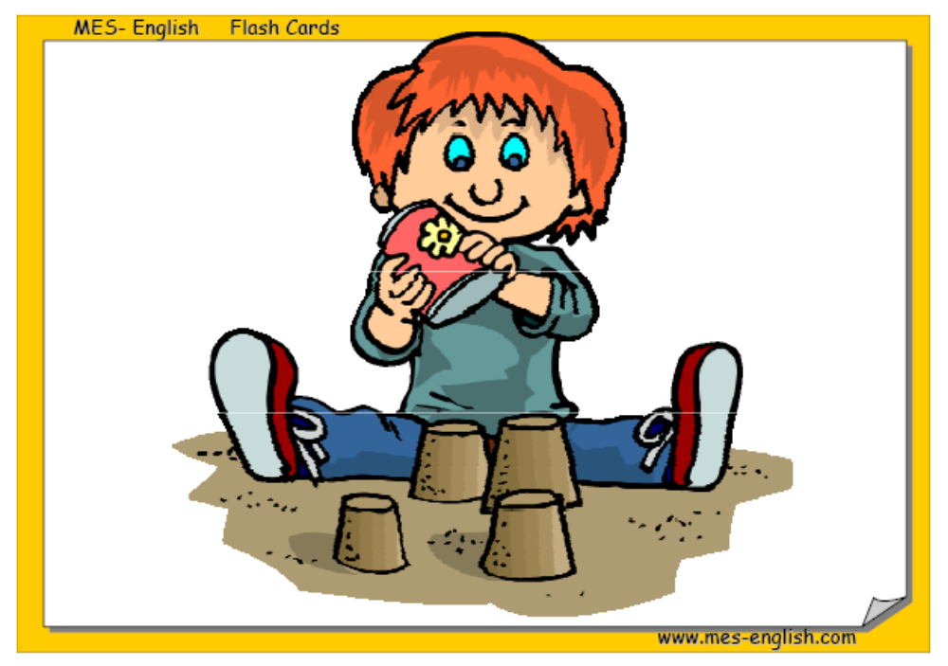
Make a sandcastle

Slide 4
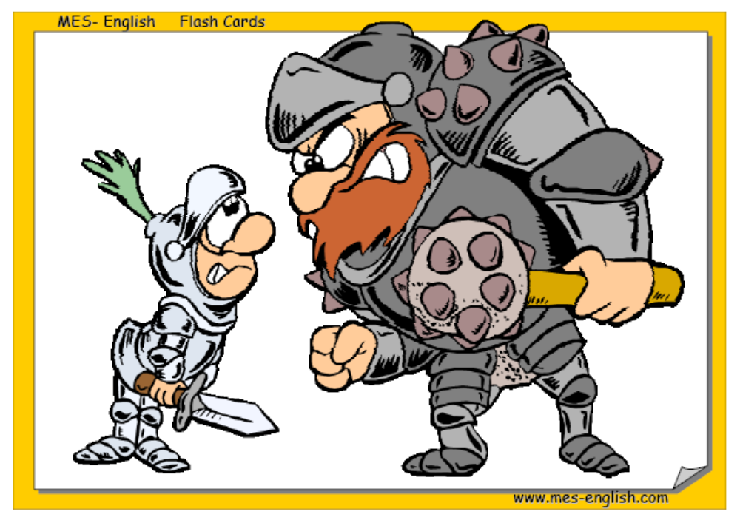
Fight

Slide 5
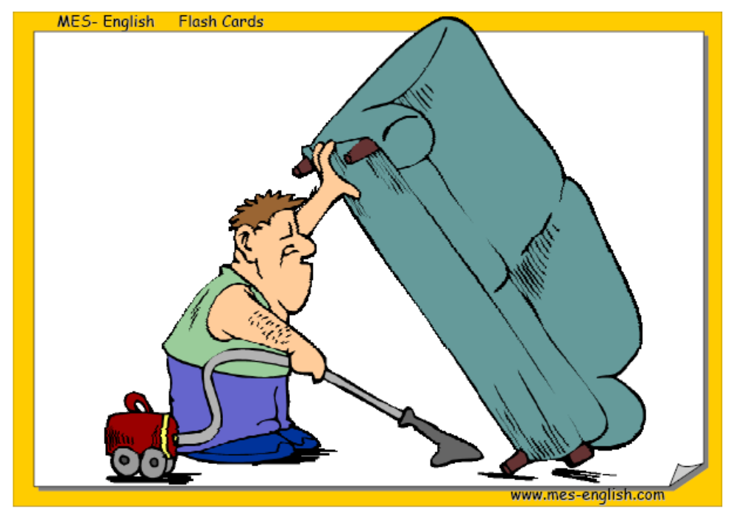
Clean

Slide 6
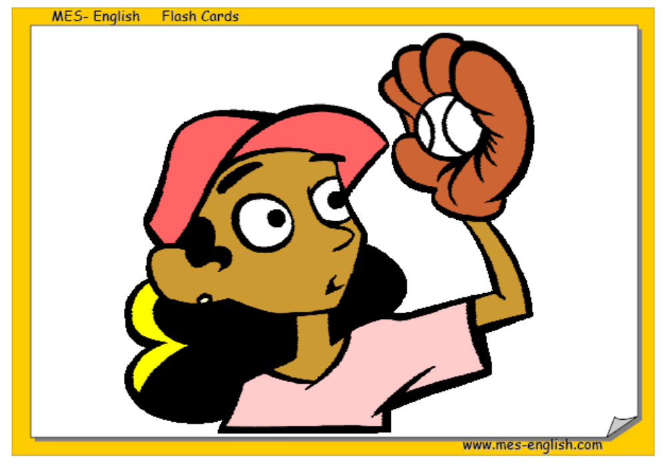
Catch

Slide 7
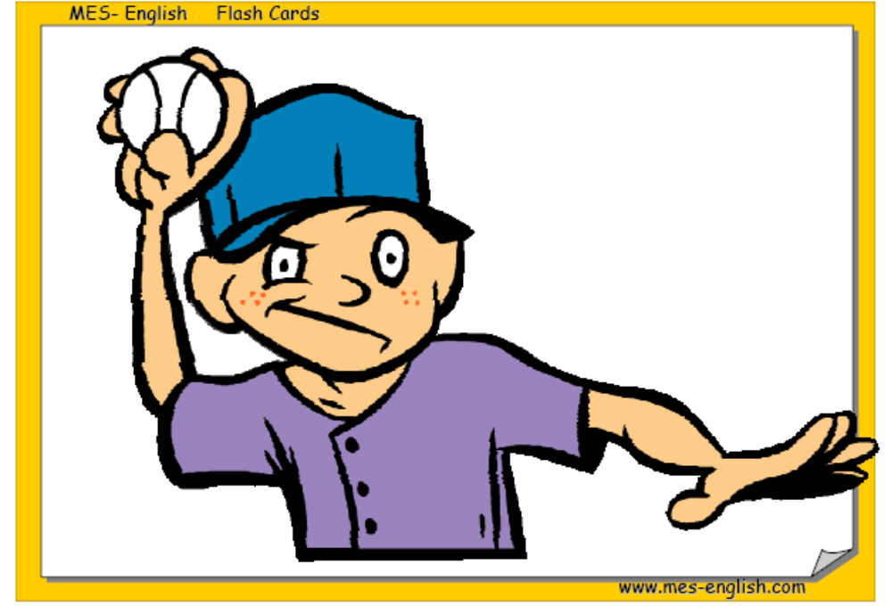
Throw

Slide 8
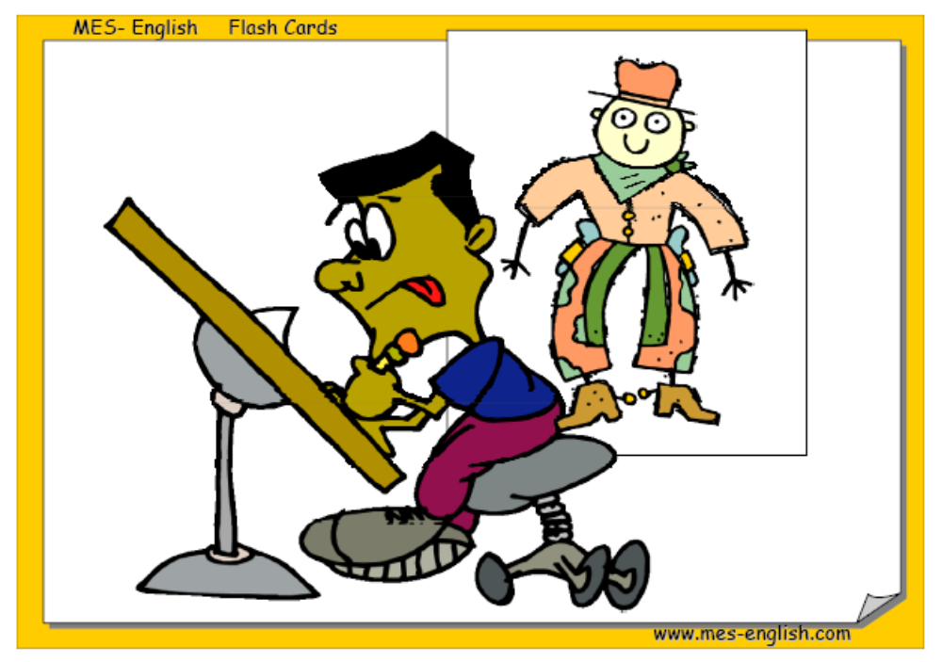
Draw

Slide 9
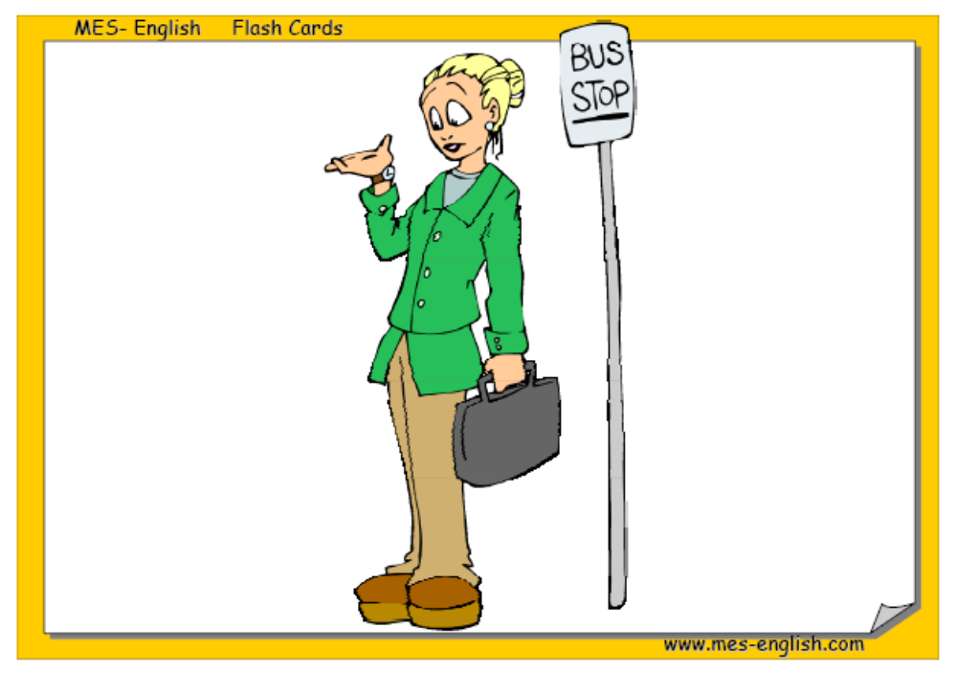
Wait

Slide 10
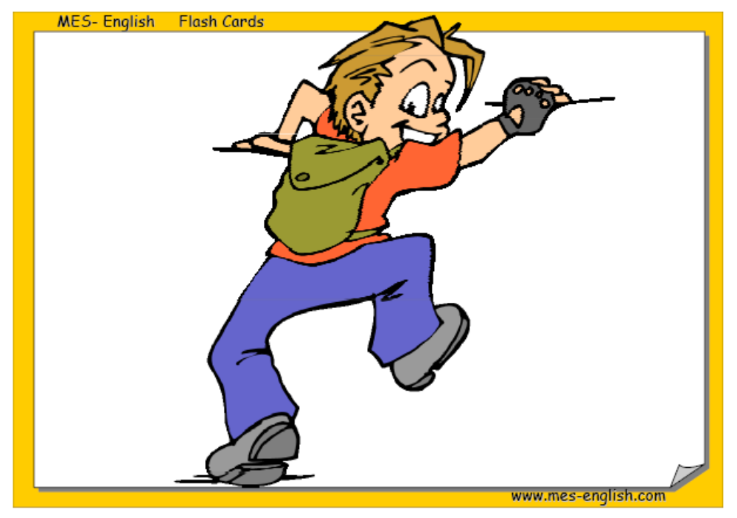
Climb

Slide 11

Play football

Slide 12
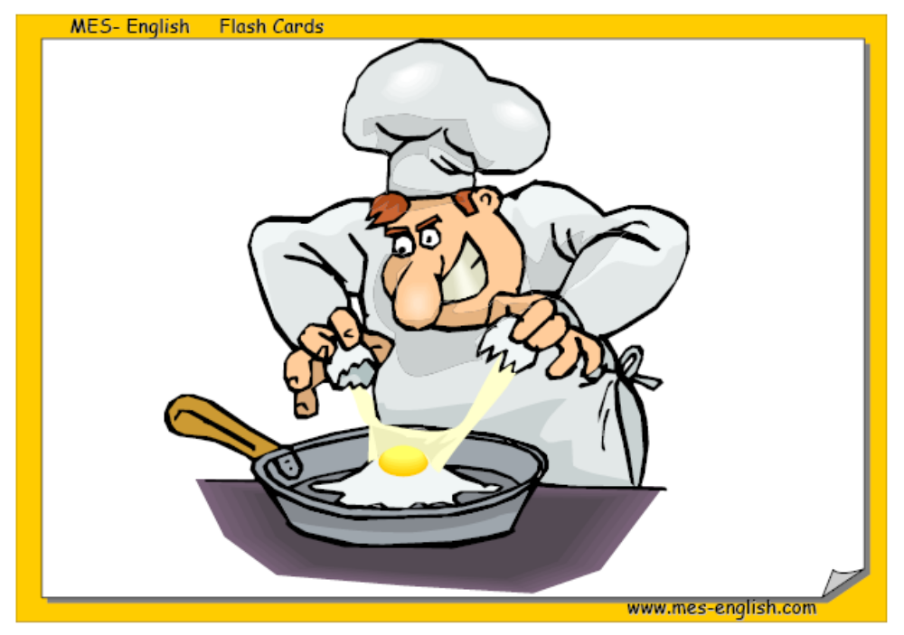
Cook

Slide 13
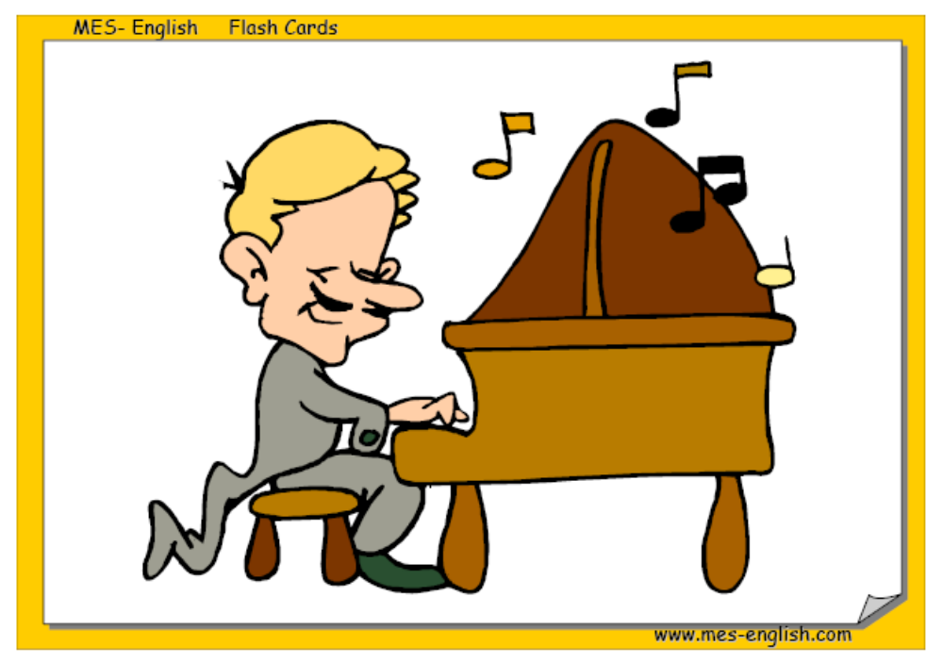
Play the piano

Slide 14

Use a computer

Slide 15
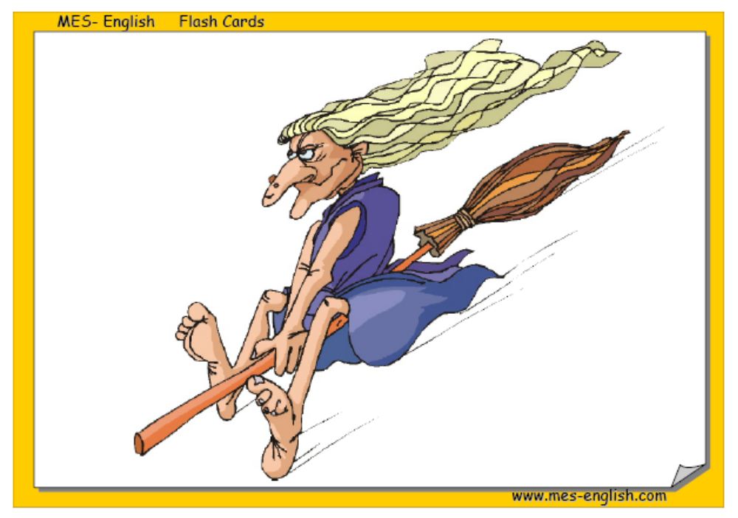
Fly

Slide 16
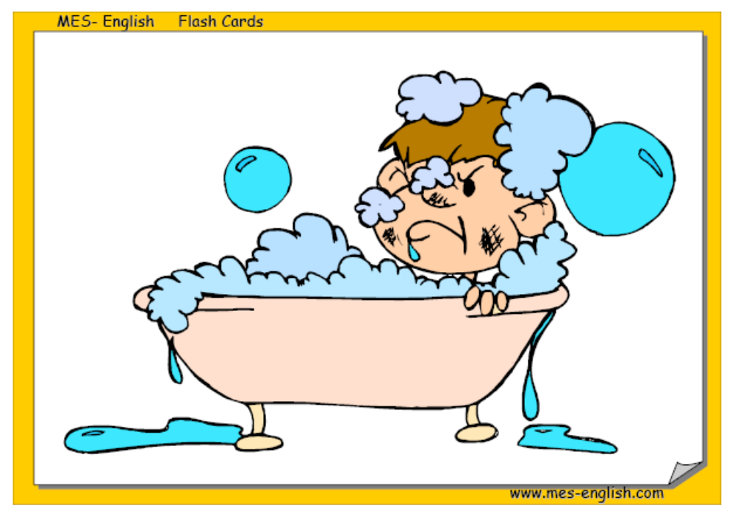
Take a bath

