Slide 1
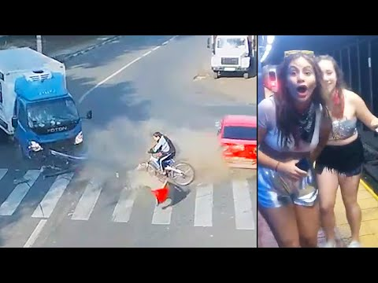
3RD CONDITIONAL PRACTICE
CLOSE CALLS

Slide 2
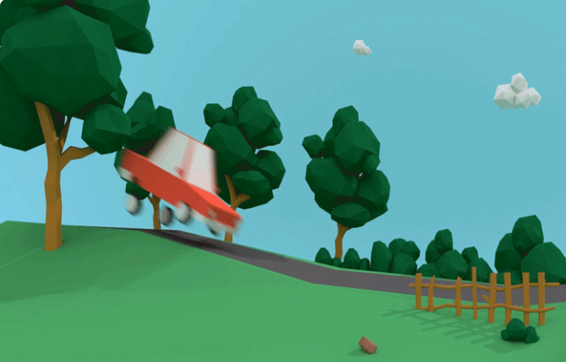
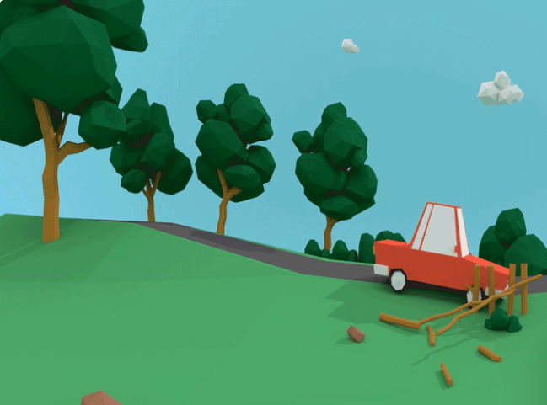
What conditionals could you use for the following scenario?
1st Conditional (slow down, fence)
3rd Conditional (so fast, crashed)
If the car doesn’t slow down it will hit the fence.
If he hadn’t been driving so fast he wouldn’t have crashed into the fence
2nd Conditional (fence, crash)
*Remember:
2nd conditional is about an unreal situation in the present or future that cannot happen.
3rd conditional is about an event in the past that didn’t happen
If the fence wasn’t there the car wouldn’t crash

Slide 3
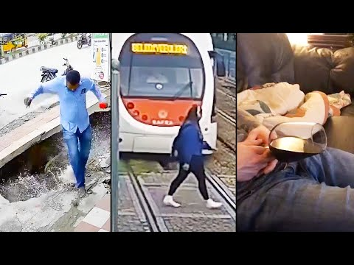
Write a 3rd Conditional for the following video clip:
Vocab help: Lift, leave, die
Examples:
-If he hadn´t left the lift, he would´ve died

Slide 4
Write a 3rd Conditional for the following video clip:
Vocab help: headphones, wear, train, hit
Example:
-If she hadn´t been wearing headphones, the train wouldn´t have hit her

Slide 5
Write a 3rd Conditional for the following video clip:
Vocab help: car, utility pole, further forward
Examples:
-If the car had been further forward the utility pole would have killed the man.

Slide 6
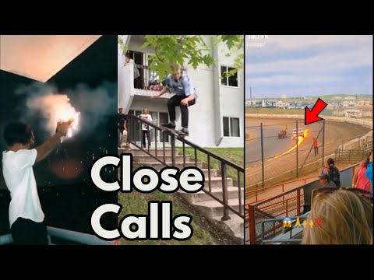
Write a 3rd Conditional for the following video clip:
Vocab help: Swing, wave, faster, hit
Examples:
-If she hadn’t run so fast she would’ve been hit by the wave
-She would’ve been hit by the wave if she hadn’t seen it

Slide 7
NOW YOU’RE GOING TO WRITE TWO MORE IN GROUPS OR PAIRS WITHOUT ANY HELP AND I’M GOING TO CORRECT THEM

Slide 8
Write a 3rd Conditional for the following video clip:
Vocab help: Slide, grab

Slide 9
Write a 3rd Conditional for the following video clip:
Vocab help: Open/pull his parachute, later, die

