Slide 1
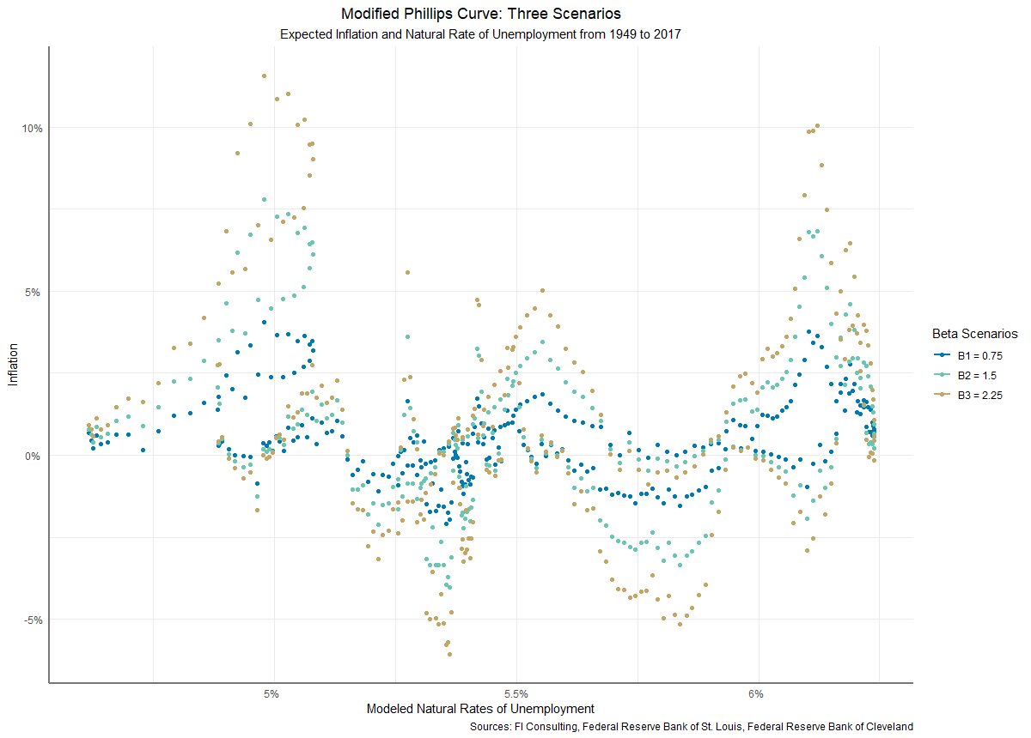


Presentation to the U.S. Department of Economics
The Phillips Curve
Evidence in the United States
1948 - 2017
August 27, 2019

Slide 2
Background
Research Questions
Does contemporary evidence suggest the Phillips curve holds for the United States?
Can modifications to Phillips’ original theory provide useful predictors for the United States’ macroeconomy?
Approach
Statistical and visual analyses are conducted on time series data from the Federal Reserve Board of Governors, Federal Reserve Boards of St. Louis and Cleveland, and the Bureau of Labor Statistics
Hypotheses are formed through data exploration and review of Federal Reserve publications on relevant economic theory

Slide 3
Key Theoretical Points
Phillips’ Original Theory
Later Theory and Proposed Adjustments
The inflation rate and the unemployment rate are negatively and nonlinearly correlated (Phillips 1958)
The relationship reflects supply and demand dynamics of labor markets
The relationship is not expected to hold following “a very rapid rise in import prices,” which is presumed to initiate wage-price spiral (Ibid.)
Phillips’ original paper concerns rate of change of money wage rates, but is extended to inflation, for which nominal wage rates are a proxy
Later economic theory has suggested the use of expected inflation rates as the causal link in labor force behavior (Phelps 1967, Minneapolis Fed 2001)
Exploratory analysis suggested testing of the U6 unemployment rate, as opposed to U3
The natural rate of unemployment was also tested, as a potentially insulated metric
Other analyses suggest the Phillips curve may hold for the United States in the short run but not the long run; all available time horizons will be tested

Slide 4
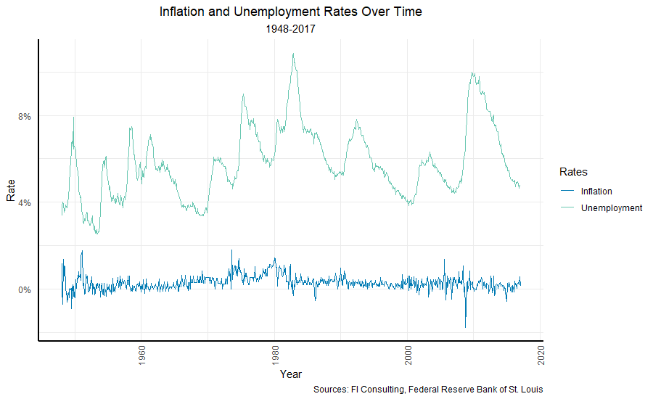
Underlying Calculations

Slide 5
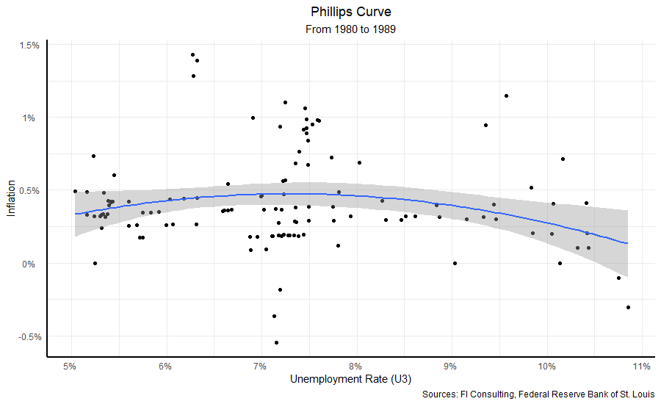
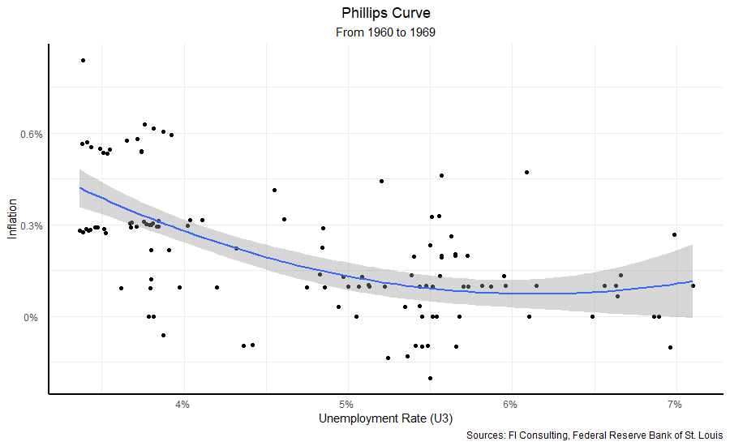
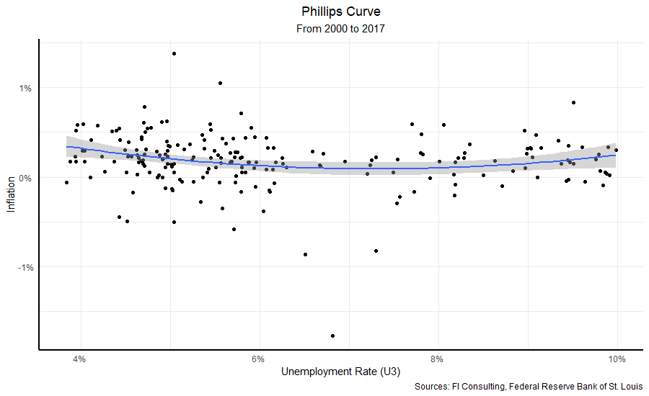
Analysis: Phillips Curves by Decade
Visual evidence for the standard Phillips curve centers around the 1960s
However, the correlation is rare across other tested time horizons, which ranged from 5 to 69 years

Slide 6
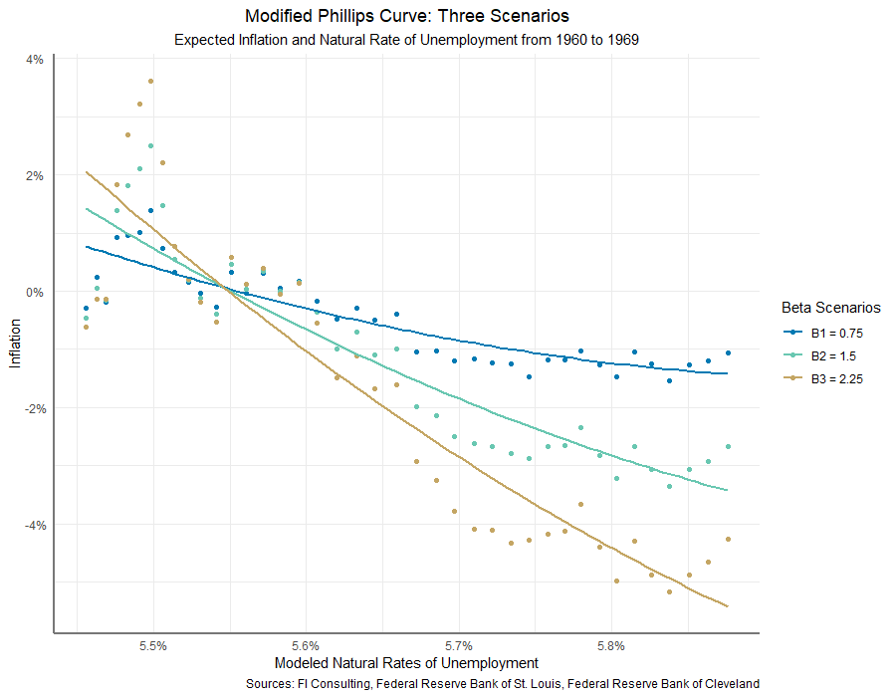
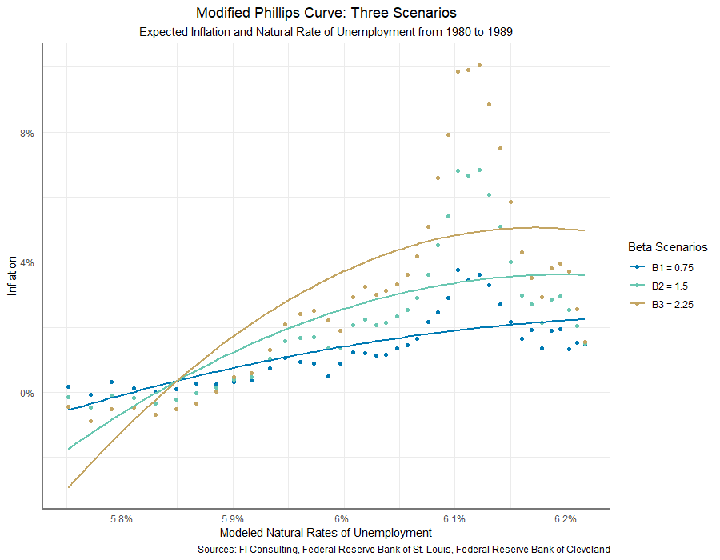
Modified Phillips Curves: Modeling Expected Inflation Scenarios
Varied expected inflation scenarios displayed significantly different results, but all in the same direction
Expected inflation was calculated as: $π_{e}= π+ β\left(U−U_{n}\right)$, where $β$ is a response parameter (shown as B)

Slide 7
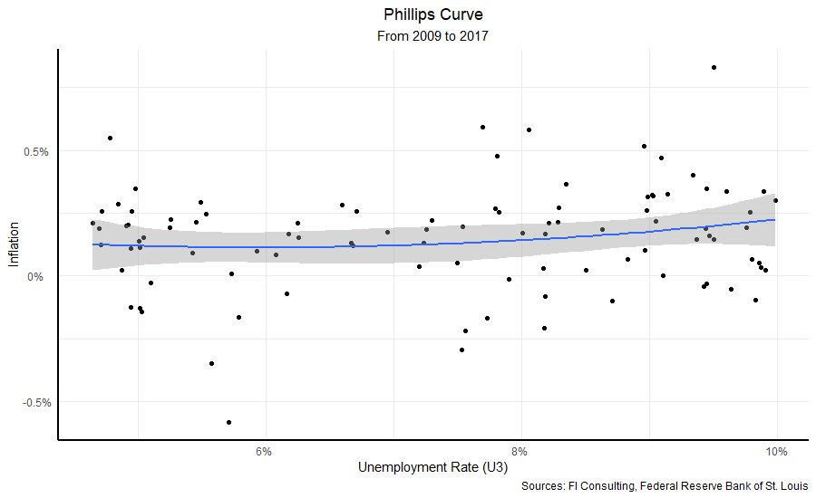
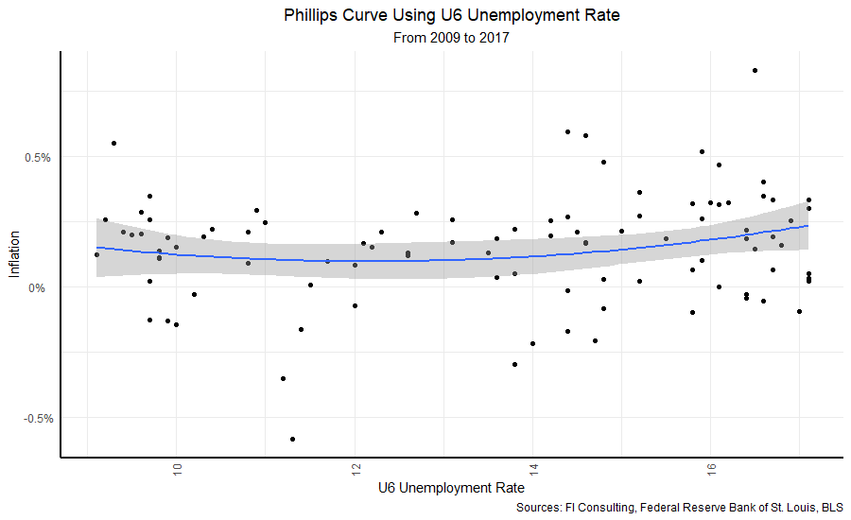
Comparing U3 and U6 Unemployment Rates
The choice of U3 or U6 drove no significant change in the short run or the long run
U6 captures a larger part of the non-working population, but tracks well with U3 over time

Slide 8
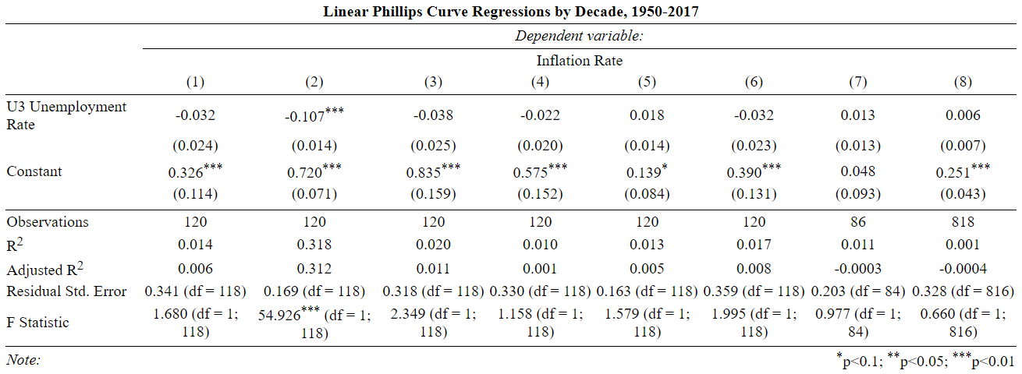
Linear Regression Models
Columns: (1) 1950s (2) 1960s (3) 1970s (4) 1980s (5) 1990s (6) 2000s (7) 2010-2017 (8) 1950-2017

Slide 9
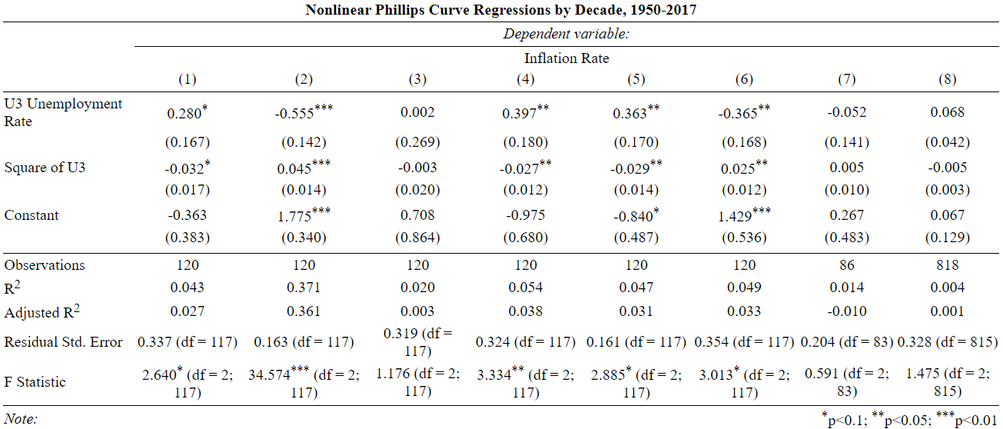
Nonlinear Regression Models
Columns: (1) 1950s (2) 1960s (3) 1970s (4) 1980s (5) 1990s (6) 2000s (7) 2010-2017 (8) 1950-2017

Slide 10
Modeling Conclusions
The 1960s display significant, but singular, evidence for the Phillips curve
Linear models were employed first to test for negative relationships. Only the 1960s displayed statistically significant results for the linear model, supporting the visual analysis. They were negative, as the Phillips curve suggests.
Quadratic models yield more significant results – but include positive trends
Phillips’ insight into the UK’s macroeconomy was of a nonlinear (namely, quadratic) and negative relationship between inflation and unemployment. This analysis suggests that the quadratic model does perform better than the linear model, but for positive as well as negative relationships, contradicting the theory.
The original theory is implausible given the present evidence
Notably, Phillips’ theory allows that a major rise in import prices may temporarily suspend the relationship. However, for the theory to hold, such rises must have been ongoing for most of the last 70 years.

Slide 11
Summary of Visual and Statistical Analysis
The Phillips curve does not appear to be a persistent feature in the United States
Testing across various time horizons displayed similar results for both model types: select periods could be identified which matched the Phillips curve prediction, but the majority failed. The analysis suggests that the Phillips curve is, at the least, not a general feature of the United States’ macroeconomy.
The hypothesized indicators also failed as useful predictors
The modified version of the theory, using various expected interest rate scenarios and accounting for natural unemployment rates, performed similarly to the base analysis, with low evidence.
If unemployment and inflation have an enduring relationship, it is sufficiently confounded to be of little verifiable predictive value in the United States today.

Slide 12
Relation to Existing Research
The findings accord with existing research that, since at least the 1980s, “inflation in the United States has been hard to predict using any method” (Minneapolis Fed 2001).
Indicators tested elsewhere have also failed to yield persistent evidence of the Phillips curve, including commodity prices, money supply, output gaps, and myriad forms of interest rate (Cecchetti, Chu, and Steindel 2000), though work on indicators continues (Mahedy and Shapiro 2017, Stock and Watson 2018, Ball and Mazumder 2019).
The Federal Reserve Bank of San Francisco, studying output gaps instead of inflation, reported modest empirical evidence for Phillips curves "intuition" from 1961 to 2018, but report that by 2003 Q1 rolling regression results become statistically insignificant.

Slide 13


Thank you.
Cory Combs
ccombs3j@hu.edu
202.855.4958

Slide 14
Data
Federal Reserve Bank of St. Louis, “Civilian Labor Force,” https://fred.stlouisfed.org/series/CLF16OV
Federal Reserve Bank of St. Louis, “Natural Rate of Unemployment”, https://fred.stlouisfed.org/series/NROU
Federal Reserve Bank of Cleveland, “Inflation Expectations,” https://www.clevelandfed.org/our-research/indicators-and-data/inflation-expectations.aspx
Bureau of Labor Statistics, “Labor Force Statistics from the Current Population Survey,” https://data.bls.gov/timeseries/LNS13327709
References
William Phillips, 1958, “The Relation Between Unemployment and the Rate of Change of Money Wage Rates in the United Kingdom, 1861-1957,” Economica
Andrew Atkeson and Lee E. Ohanian, 2001, “Are Phillips Curves Useful for Forecasting,” Federal Reserve Bank of Minneapolis Quarterly Review, https://www.minneapolisfed.org/research/qr/qr2511.pdf
John Roberts, 1995, “New Keynesian Economics and the Phillips Curve,” Journal of Money, Credit and Banking 27(4)
Charles Steindel, Stephen G. Cecchetti, and Rita Chu, 2000, “The Unreliability of Inflation Indicators,” Current Issues in Economics and Finance 6(4)
Tim Mahedy and Adam Shapiro, 2017, “What’s Down with Inflation,” Federal Reserve Board of San Francisco Economic Letters
James Stock and Mark Watson, 2018, “Identification and Estimation of Dynamic Causal Effects in Macroeconomics Using External Instruments,” National Bureau of Economic Research Working Paper No. 24216
Laurence Ball and Sandeep Mazumder, 2019, “A Phillips Curve with Anchored Expectations and Short‐Term Unemployment,” Journal of Money, Credit and Banking 51(1)

