Slide 1

FlexFeed
Lauren Bornfeld
Cory Knopp
Sasha Krutiy
Catherine Mangeym
Sebastian Lacki
Raymond Leo

Slide 2
Overview
FlexFeed allows users to centralize the social media feeds of organizations they are interested in.

Slide 3
Targeted Users
Investors
People who like things they enjoy

Slide 4
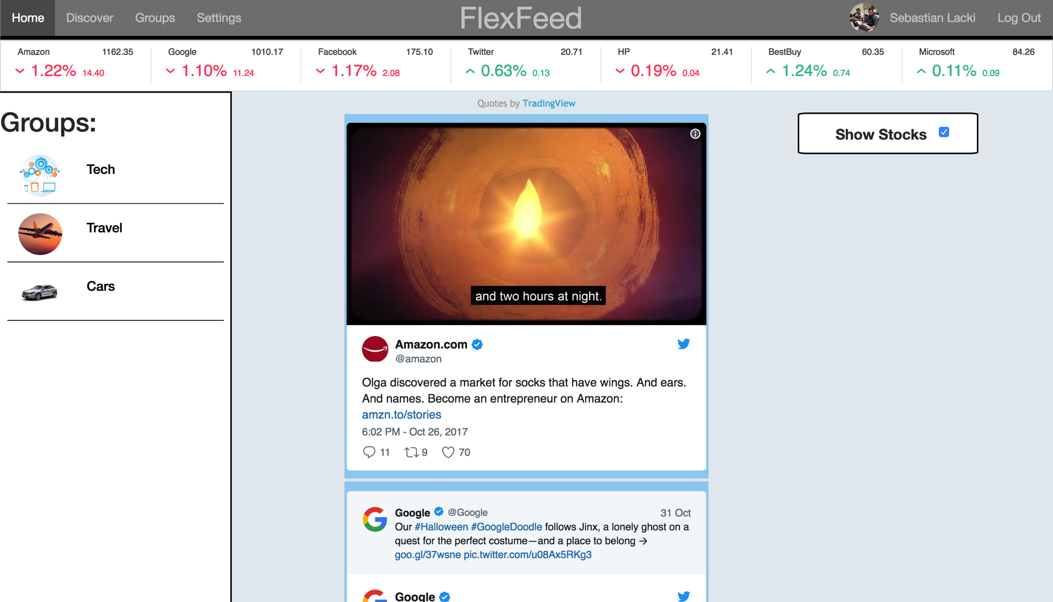
Home Page

Slide 5

Stock Bar
Dynamically updated!

Slide 6
Discover New Groups
Once we add more to the database we will put a screenshot of discovery here.

Slide 7
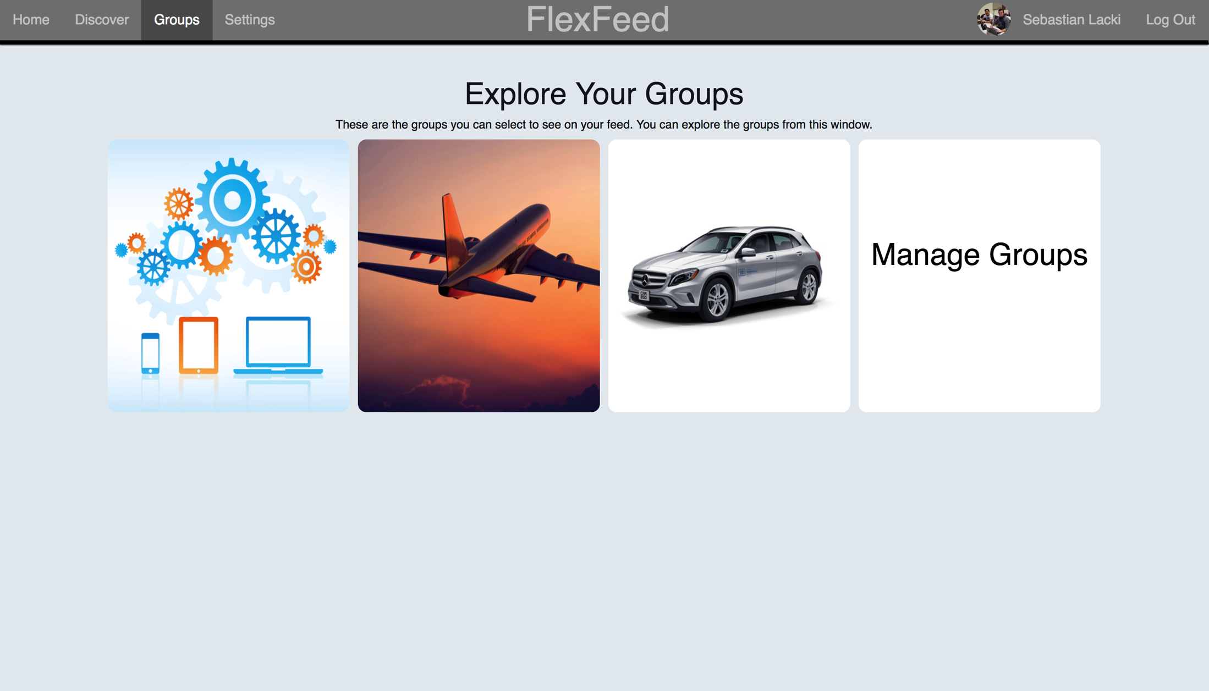
View and Manage your Groups

Slide 8
Edit groups
Once the edit groups page is fixed we will put a screenshot of that page here.

Slide 9
What was easy?
Taking the concepts from the Local Library tutorial applying them to our application

Slide 10
What was hard?
Team communication
GitHub

Slide 11
Future Improvements
Dynamically updated social media feeds for each member
Ability to view multiple/all groups at once
Ability to follow organizations without putting them in a group
Friends
More user friendly UI

Slide 12
Live demo…

