Slide 1
Meta Tags
By Cory Fugate

Slide 2
What are Meta Tags?
Meta tags are a snippet of informational code that has been located between your <HEAD> </HEAD> tags that are apart of your HTML document you've generated.
Their main purpose is to provide information to the browser, server, and/or to search engines.
There are quite a few different types of meta tags, some are more useful then others.
  http://www.webmarketingnow.com/tips/meta-tags-uncovered.html

Slide 3
Description Meta Tag
<meta name="description" content="Citrus fruit wholesaler.">
The Meta Description tag is used to provide a brief summary(15-25 words) of your webpage to search engines, and is often used in a search engines result page.
This tag can be very important, because often a compelling description of your webpage could be the reason it is selected out of a list of other webpages on a search engine’s result page.

Slide 4
Keyword Meta Tag
<meta name="keywords" content="oranges, lemons, limes">
The Meta Description tag is used to provide a list of relevant keywords to search engines to aid in the indexing process.
This tag is not as highly recommended or used as it once was.
  Not all search engines use these tags in indexing anymore
  Search engines will blacklist sites which abuse the tag, for example including keyword that aren’t relevant
  Competitors can view your keywords easily and use them for their own site

Slide 5
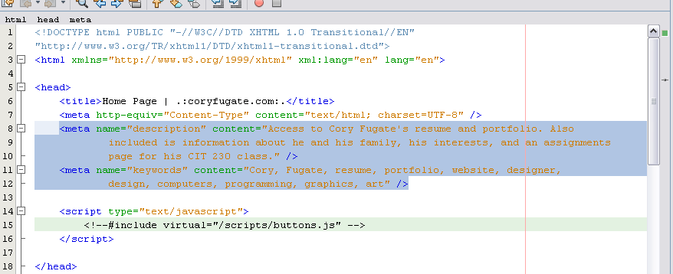
Implementing the Tags
These tags are very simple to implement, you just insert them within the <head></head> tags.

