Slide 1
Hang Seng China AH Premium Index
Cory Peshkin
21st May 2018
Professor Waugh
Data Bootcamp ECON.UB.0233

Slide 2
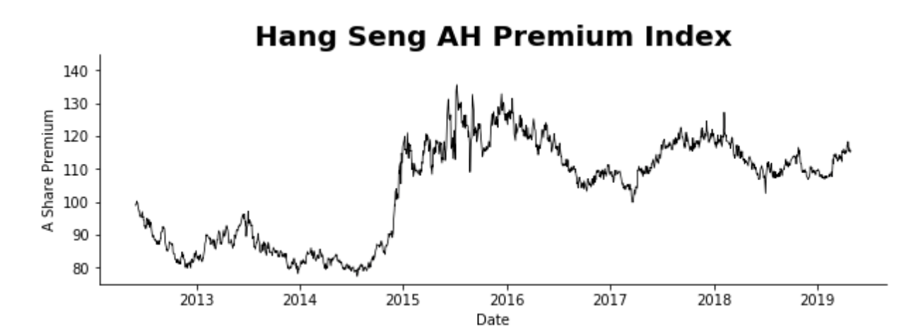
Clearly the AH Premium rose in late 2014
This index jump has led me to two questions:
1. Why did the index jump?
2. Did the source of the jump cause a systematic increase in premia?

Slide 3
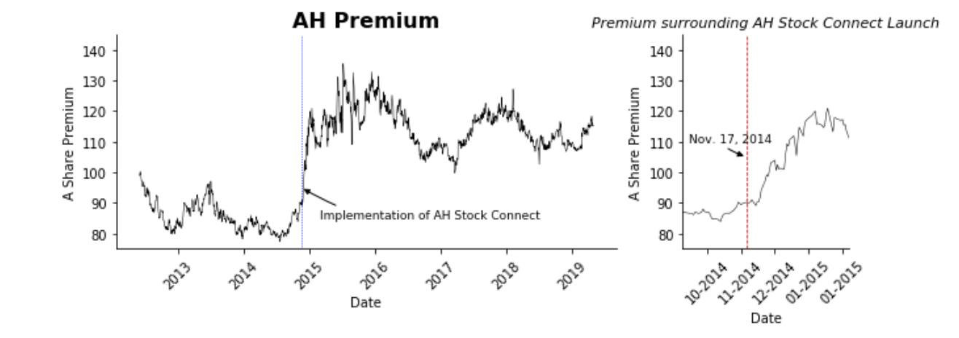
Evidently, it was the rollout of the Shanghai-Hong Kong AH Connect channels
This policy enable mainland investors to invest in Hong Kong, and visa versa.
Despite the fact that capital controls are likely to cause cross-market premiums, it does not indicate why the AH Premium is generally positive

Slide 4
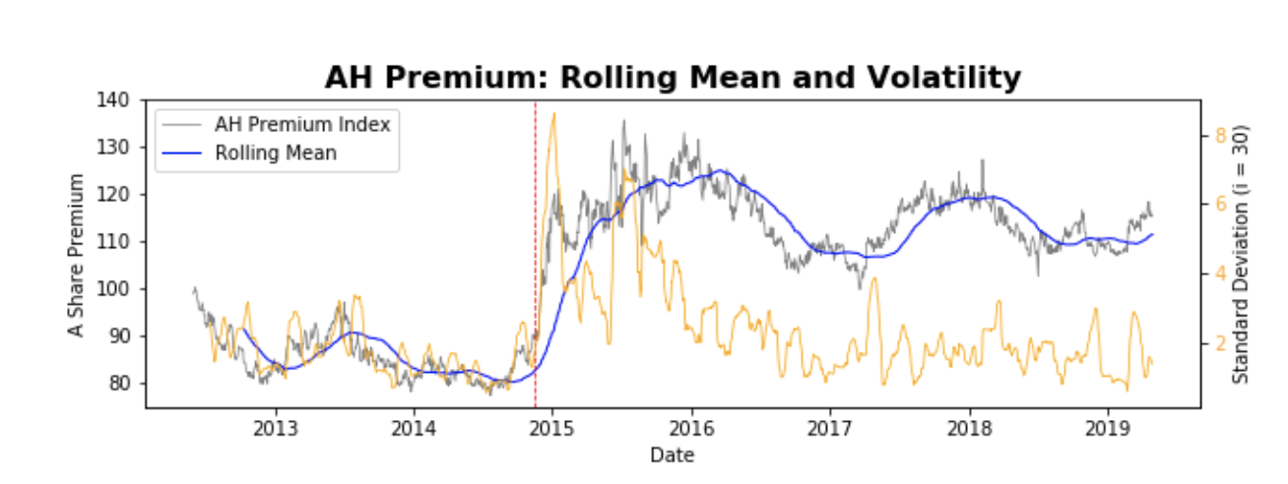
Did AH Connect systematically increase the AH Premium?
Evidently, the rollout of AH Connect led to a 8 standard deviation event (<0.001% likely to happen idiosyncratically)
Despite declining absolute volatility, the index’s volatility only grew more volatile after the AH Connect implementation.

Slide 5
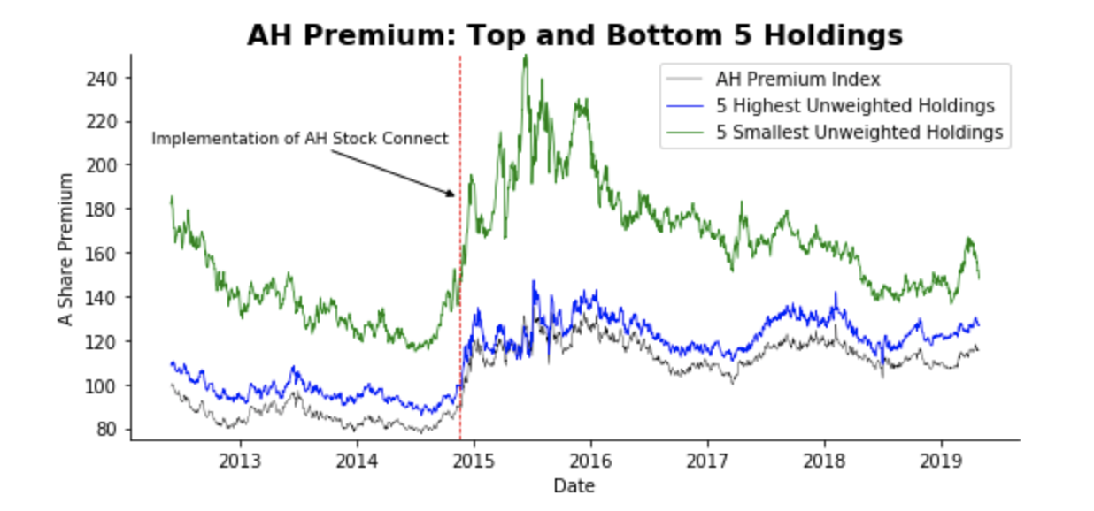
Evidence and Conclusion
The larger components of the index (20-40% of weight) have vastly lower premiums than their smaller components
This may be the result of higher cross-border demand for large-cap companies
Regardless of whether
or not AH Connect
promotes efficient
markets, it is clear that it
has enabled more volume
in A and H shares

