Slide 1
How long does it take to publish an RFC?
Aaron Falk

Slide 2
Background
The RFC Editor has been concerned over the delays in processing RFCs
We’ve spent some time analyzing the historical data on the queue
This presentation is a chance to inform the community what we’ve learned
The challenge with data is that it raises questions as it informs
  We don’t plan to do further analysis: these are just hints

Slide 3
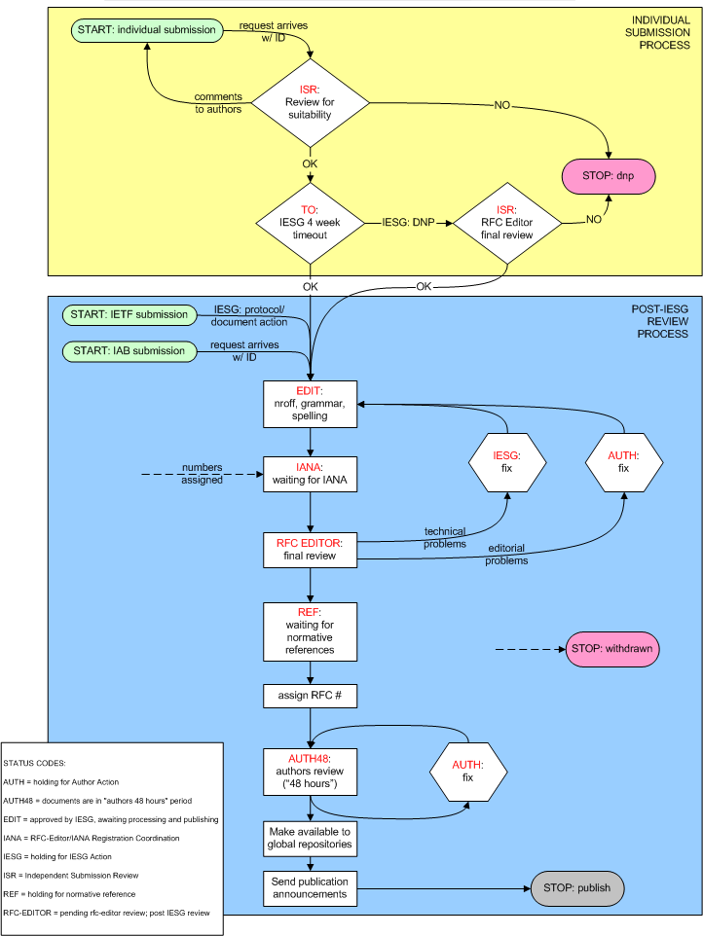
The RFC Editor Process
Flow and states are defined in this diagram
(this is online, link to follow…)

Slide 4
RFC Editor queue data from July 1999
Caution: the data is noisy and incomplete
  State names & definitions have evolved
Missing data in spring ’02
  This is unfortunate because the delays became quite long in this period
Values shown are medians
  Distributions have very long tails, means will be skewed by outliers

Slide 5
Measured Median Time to Publish an RFC
Simplest path through the graph:
  EDIT 7.1 wks
  RFC-EDIT 3.8
  AUTH48 1.6
  9.7 wks
For independent submission add:
  ISR 5.2 wks
  TO 5.8
  11.0 wks

Slide 6
Measured Median Time to Publish an RFC
But a given RFC *might* also enter one or more of the following penalty boxes:
  For AUTH add 1.2 wks
  For IANA actions add 3.5 wks
  For REF add 7.1 wks
  For IESG noodling add 9.4 wks

Slide 7
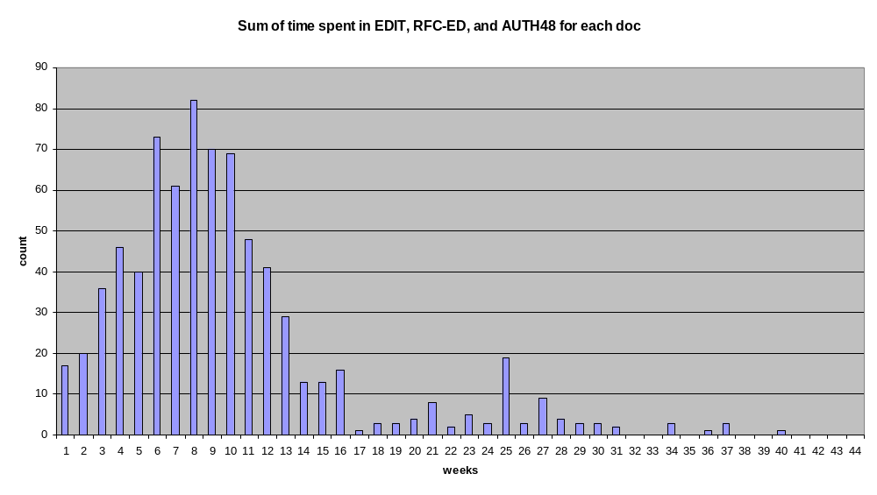
If the median is 2.5 months, why does it feel like it’s taking longer?
Distribution has a long tail

Slide 8
Why have some documents been delayed so long?
The RFC Editor is a small team
  Attention to quality requires time
  Staffing issues have enhanced visibility
Document arrivals are very bursty
“Authors 48 hours” is not

Slide 9
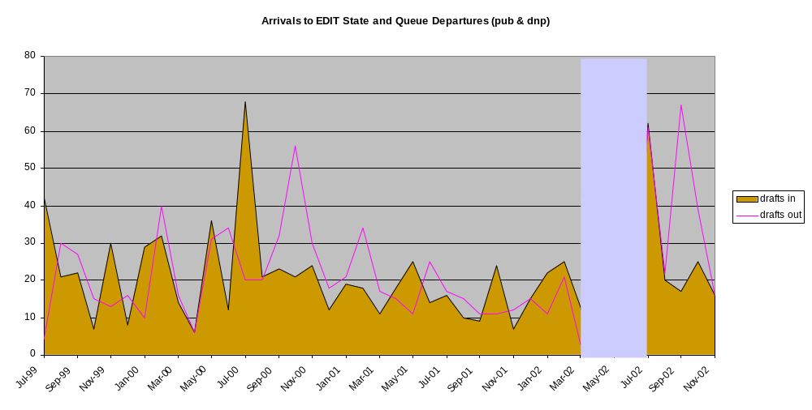
Queue arrival & departure rate per month
Note bursts in recent queue

Slide 10
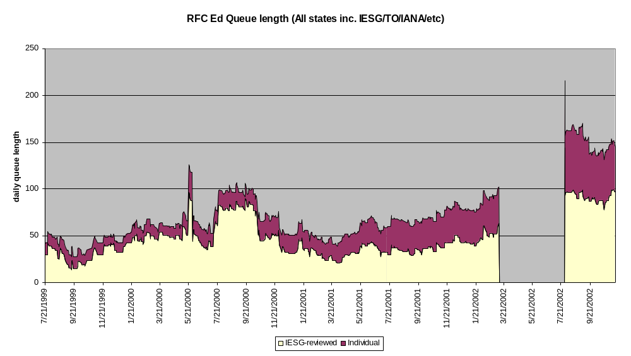
Queue Size

Slide 11
Things are getting better…
Have new management tools for tracking progress
  Helps ensure no docs slip through cracks (particularly important with IETF review of Individual Submissions)
  Bill Fenner’s web page checking IESG/RFC-Ed queue consistancy
Short term staffing issues are largely solved
  Increased editing capacity
Recent arrival burst has largely passed
  SIP, SNMPv3 docs
  But another may come along any time…

Slide 12
Challenges Remain
RFC Editor appears to be operating near capacity
Auth48 is a critical step in ensuring quality
  Again, at a cost of processing delays

Slide 13
What Can Authors Do?
Submit quality documents
  Clear, concise writing
Pay attention to formatting
  2223bis has editorial policies
Be responsive
  Need all authors for final approval

Slide 14
Links
RFC Editor Process flow available at
ftp://ftp.rfc-editor.org/in-notes/rfc-editor/rfc-editor-process.gif
RFC Editor Queue at http://www.rfc-editor.org/queue.html

