Slide 1
IETF Report – July 2003
57th IETF Meeting
Vienna, Austria
  Aaron Falk, Joyce Reynolds
  Bob Braden

Slide 2
Work in Progress
RFC 2223bis version –06 Now Available
  draft-rfc-editor-rfc2223bis-06.txt
Updating RFC Editor Charter
Limited distribution of XML index
IPv6 currently offline
Finalized the “DNP at this time” Policy
  http://www.rfc-editor.org/policy.html

Slide 3
FYI
Author Responsiveness:
In the month of June, the RFC Editor moved 25 documents into the Authors 48 hours period, and received author’s permission to publish only 7.
Please attempt to respond promptly to “authors 48 hours” notices.

Slide 4
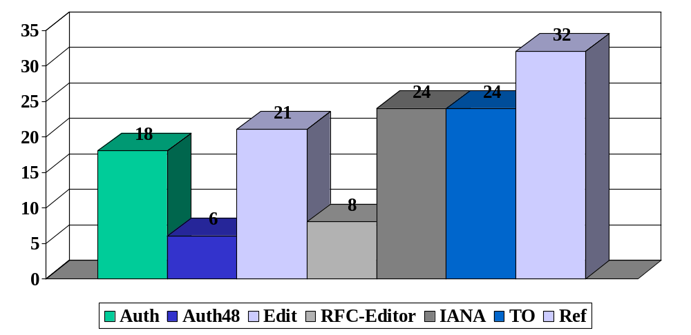
Current Queue Breakdown
As of June 30, 2003

Slide 5
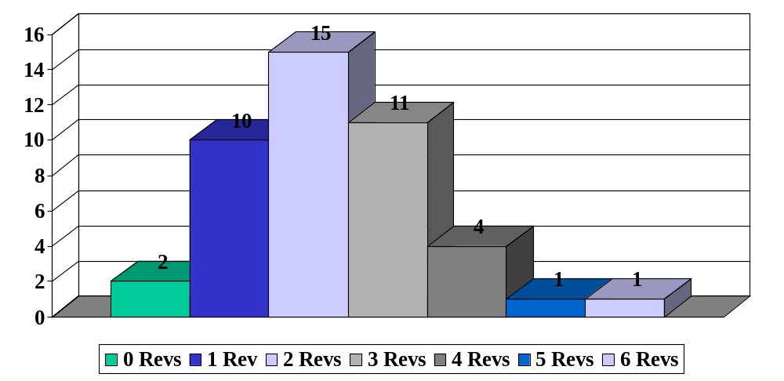
Pre-IESG Revisions of
Individual Submissions
As of June 30, 2003

Slide 6
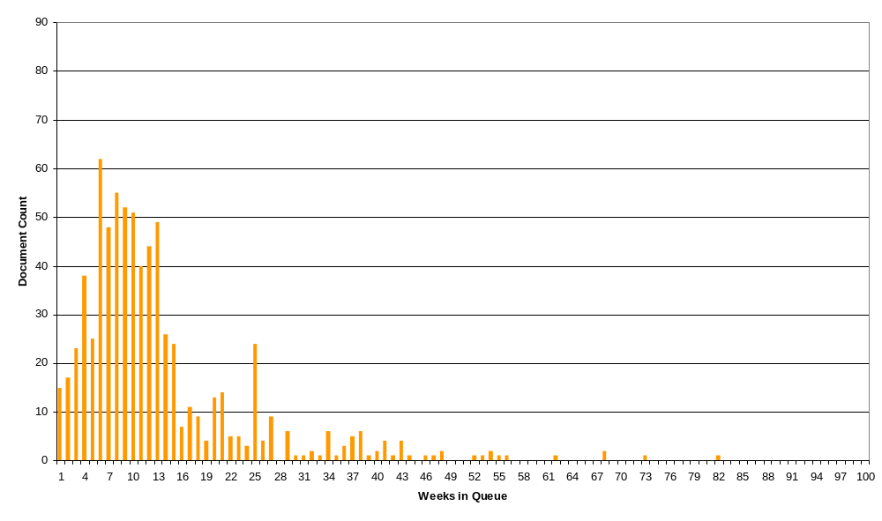
RFC Editor Queue Latency (through 11/2002)

Slide 7
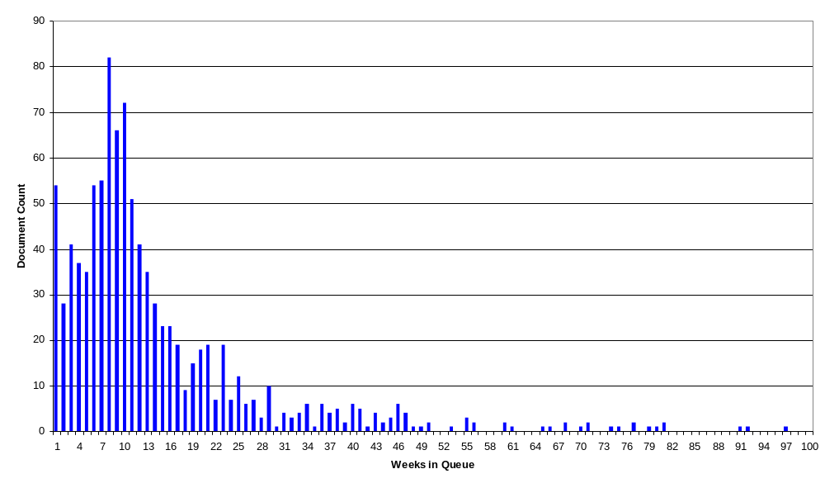
RFC Editor Queue Latency
(through 6/2003)

Slide 8
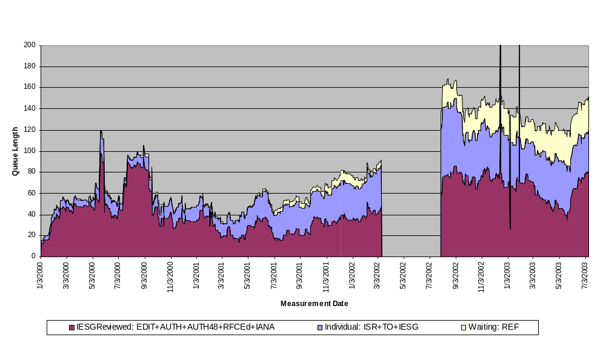
Daily Queue Breakdown
missing data

Slide 9
Thank You.
  This report can be found at:
  http://ftp.rfc-editor.org/in-notes/IETFreports

Slide 10
As of June 30, 2003
Monthly Stats
Totals Since Last IETF: March – June 2003
  Document Submissions Docs
  Individual Submissions: 31
  IESG Reviewed Submissions: 60
  Total Submissions: 91
  Queue Departures Docs Pages
  DNPs/Withdrawls: 7
  Total Published: 64 2036
RFC Editor Queue as of June 30, 2003
Status of Documents Docs Pages
  AUTH 18 89
  AUTH48 6 751
  EDIT 21 779
  IANA 24 867
  IESG 0 0
  ISR 14 321
  REF 32 1483
  RFC-EDITOR 8 242
  TO 24 467
  Total Drafts in Queue 147 4999

Slide 11
Throughput
March – June 2003
MONTH # Submitted # Published # Not Pub’d # in Queue
at month end
March 2003 19 23 0 109
April 2003 22 24 1 106
May 2003 21 10 0 117
June 2003 29 7 6 133
Total in Queue 91 64 7

Slide 12
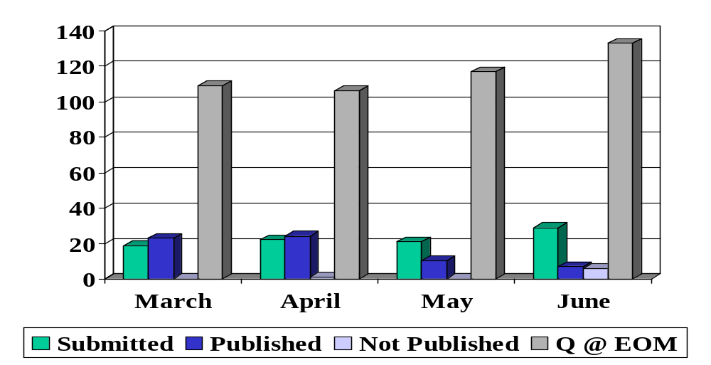
Throughput
March – June 2003

Slide 13
2003 ISR Details
As of June 30, 2003
0 Revisions: 2
1 doc in TO
1 doc IESG approved
We are awaiting new versions for all 10 doc
6 Sent to IESG
6 Awaiting new versions
2 DNP (rfc-ed decision)
1 DNP by IESG, but being re-reviewed by RFC Ed
7 Sent to IESG
4 Awaiting new versions
1 Sent to IESG
3 awaiting new versions
1 Moved into a WG
1 DNP by IESG, but being re-reviewed by RFC Ed
1 Revision: 10
2 Revisions: 15
3 Revisions: 11
4 Revisions: 4
5 Revisions: 1
6 Revisions: 1

